Slide 1
Logistic Regression – Supervised Classification
-LKM

Slide 2
Webinar Agenda :
Machine Learning Using Python
Session 1: Python Setup, Introduction to AI and Machine Learning, Basic Python Commands,
Exploratory Data Analysis.
Session 2: Supervised Learning and implementing algorithms Using Python
Session 3: Unsupervised Learning and implementing algorithms Using Python
Session 4: Natural Language Processing and basic implementation
Session 5: Deep Learning and implementation of basic algorithms using Python

Slide 3
Supervised Algorithms
Supervised algorithms are used to build two kind of models
Label is used to predict a continuous value.
e.g. predict the price of an apartment,
support ticket volume prediction
REGRESSION
Label is used to predict a discrete value.
e.g. predict whether an email is spam or not,
support ticket classification
CLASSIFICATION

Slide 4
Classification
Naïve Bayes
Decision Trees
Support Vector Machine
Logistic Regression

Slide 5
Logistic Regression

Slide 6
Logistic Regression
What is it?
Logistic Regression is a Machine Learning classification algorithm that is used to
predict the probability of a categorical dependent variable.
In logistic regression, the dependent variable is a binary variable that contains data coded as 1 (yes, success, etc.) or 0 (no, failure, etc.).
In other words, the logistic regression model predicts P(Y=1) as a function of X.

Slide 7
Logistic Regression Assumptions
Binary logistic regression requires the dependent variable to be binary.
For a binary regression, the factor level 1 of the dependent variable should represent the desired outcome.
Only the meaningful variables should be included.
The independent variables should be independent of each other. That is, the model should have little or no multicollinearity.
The independent variables are linearly related to the log odds.
Logistic regression requires quite large sample sizes.

Slide 8
Business applications of logistic regression
SPAM Mail detection
Credit Rating
Medical Diagnosis
Predictive Maintenance
Sentiment Analysis
News Feeds Topic categorization

Slide 9
Business applications of logistic regression
A leading telecom operator has a large customer base of which it knows a lot of information in terms of usage and demographics. The company is interested in knowing who amongst its customer base are likely to leave the network.
A large financial services organization is interested in understanding the risk profile of customers and would like identify potential defaulters well before the default happens.
A large credit card company is developing a marketing program and is interested in understanding who amongst the list of prospects are most likely to respond.

Slide 10
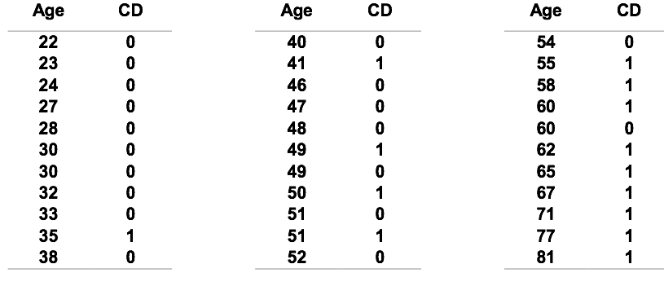
Example
Age and signs of coronary heart disease (CD) in women

Slide 11
How can we analyse these data?
Comparison of the mean age of diseased and non-diseased women
Labels
Non-diseased: < 38.6 years
Diseased: > 58.7 years
Linear regression?

Slide 12
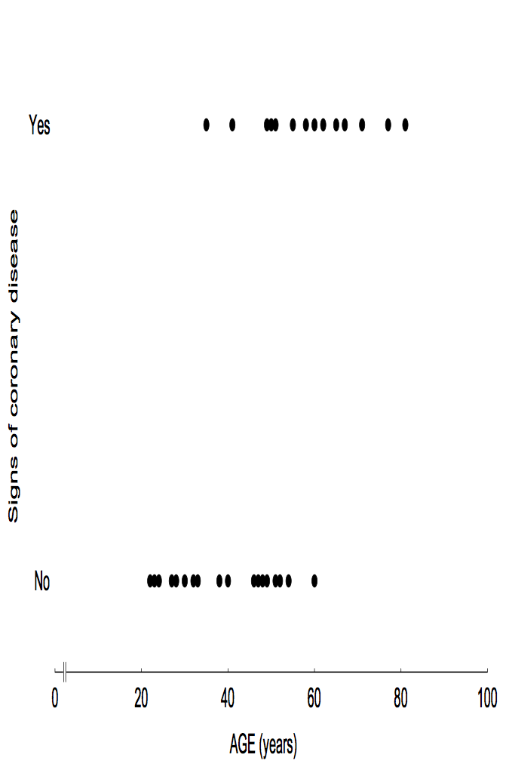
Dot-plot

Slide 13
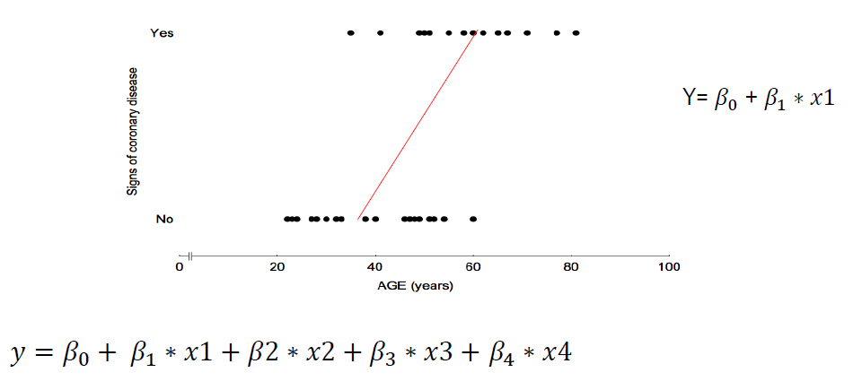
Dot -plot

Slide 14
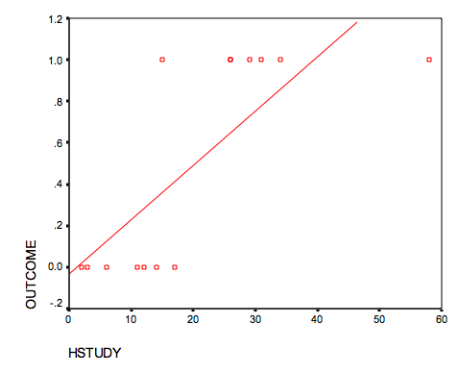
Why not Linear Regression?
Linear probability models (LPM) – what is wrong with them?
Let us do a scatter plot and insert the
regression line:
The probability of Outcome=1 can take values between 0 and 1
But we do not observe probabilities but the actual event happening
A straight line will predict values between negative and positive infinity, outside the [0,1] interval!
OUTCOME = 0.031861 + 0.026219 * HSTUDY
Notes:
As the dependent variable just takes value 1 or value 0, we have a bunch of observations aligned to value 0 and another bunch aligned to value 1. It can be seen that the observations which take value 1 for the variable ‘Outcome’ are associated with a larger number of study hours, while the observations taking value 0 are associated with a smaller number of study hours.
If the equation for this regression like was outcome = 0.031861 + 0.026219 * hrs_of_study, then what would the model predict if we studied 100 hours for the exam?
Regression?Linear Probability Models (LPM) – What is wrong with them?

Slide 15
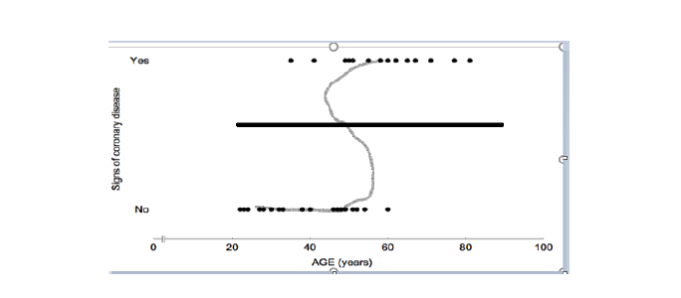
Dot-Plot

Slide 16
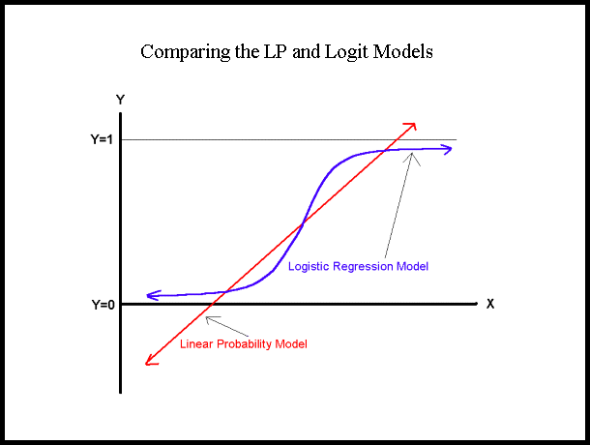
Comparison of Linear Regression with Logistic Regression

Slide 17
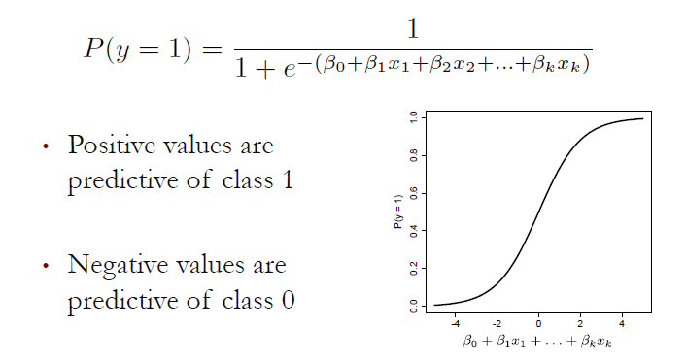
Logistic Function

Slide 18

Understanding the Logistic Function
The coefficients are selected to
Predict a high probability for a positive case
Predict a low probability for a negative case

Slide 19
Threshold Value
The outcome of a logistic regression model is a probability
Often, we want to make a binary prediction
We can do this using a threshold value t
If P(y = 1) ≥ t, then we predict the positive value
If P(y = 1) < t, then we predict the negative value
What value should we pick for t?

Slide 20
Threshold Value
Often selected based on which errors are “better”.
If t is Large, then we predict the positive rarely
If t is Small, then we predict negative rarely
With no preference between the errors, select t = 0.5
Predicts the more likely outcome.

Slide 21
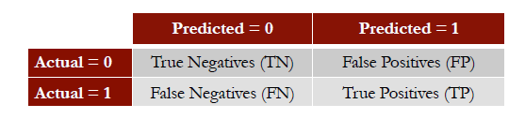
Selecting a Threshold Value
Compare actual outcomes to predicted outcomes using the CONFUSION MATRX.

Slide 22
Logistic Regression –Python Hands on
Python – Hands on

Slide 23
Nonstop Learning Bytes
https://techtime.accenture.com/document/roc-receiver-operating-characteristic-curves?dir=digital_playlist

Slide 24
Thank You

