Slide 1
Rents fell 17%, then climbed 48%. So what should your flat rent for this week?
We priced all 65,777 City of Sydney flats. Four in five estimates land within $100.
Team d4data | Microburbs Hackathon | 7 November 2026
Notes:
Rents fell seventeen percent, then climbed forty-eight. So what should your flat rent for this week? We built an estimator that prices all 65,777 City of Sydney flats, and four in five estimates land within a hundred dollars.

Slide 2
Rent is the biggest bill, and nobody knows if the number is fair
Tenants
Landlords
Agents
Is this asking rent in line with nearby flats?
Too high and the flat sits vacant. Too low and money is left behind.
Need a number they can defend, with and without parking.
Team d4data | Microburbs Hackathon 2026
Notes:
Rent is the biggest bill for most households. Tenants can't tell if an asking rent is fair. Landlords price too high and sit vacant, or too low and leave money behind. Agents need a number they can defend.

Slide 3
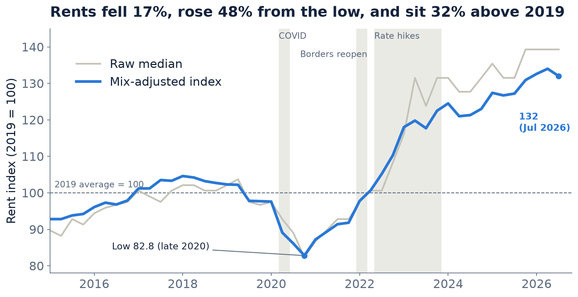
After the 2020 dip, rents rose 48% and now sit 32% above 2019
Adjusted for suburb, bedrooms, bathrooms, parking and type. Event dates approximate: timing, not proof of cause. Three-bedroom flats fell furthest, 28% from their peak.
Notes:
We studied 112,000 adverts. After adjusting for suburb, size and parking, rents ended 2020 seventeen percent below 2019, then jumped forty-eight percent, and now sit thirty-two percent above.

Slide 4
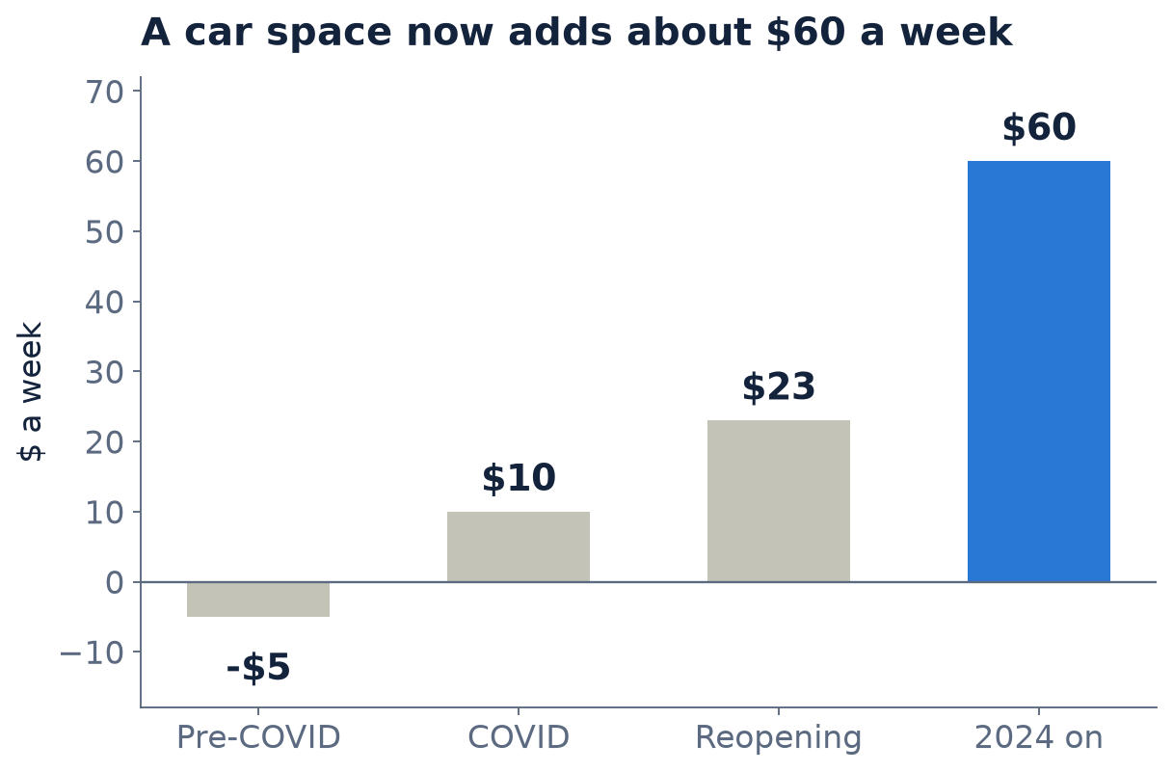
A car space is worth about $60 a week, and the market is cooling
Same-flat rent growth, per year
8-10%
2022 and 2023
2-5%
now
Matched on suburb, bedrooms, bathrooms and type. About $3,100 a year.
Notes:
A car space went from worth nothing to about sixty dollars a week. And the market is cooling: same-flat growth fell from eight to ten percent a year to two to five.

Slide 5
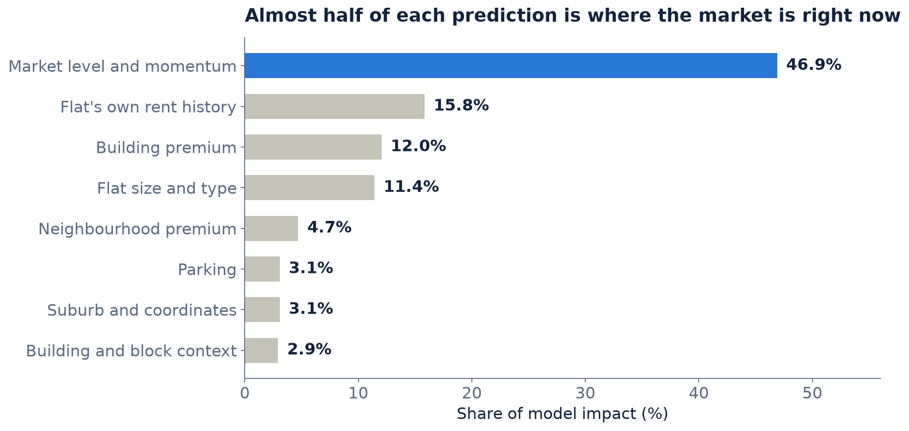
Almost half of each prediction comes from where the market is right now
LightGBM
Predicts log rent with an absolute-error loss, so a few $5,000-a-week outliers cannot drag it around.
Two predictions per flat
With and without a car space. Rent with parking is never below rent without.
Team d4data | Microburbs Hackathon 2026
Notes:
Our model is LightGBM, predicting log rent, so a few five-thousand-dollar outliers can't drag it around. Almost half of each prediction comes from where the market is right now for that suburb and bedroom count. Then it adjusts for the flat's own history, its building and parking.

Slide 6
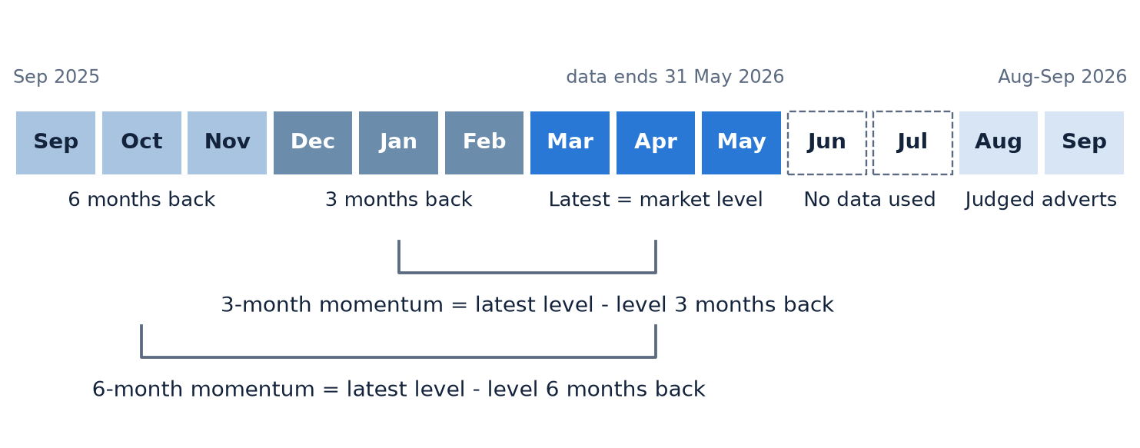
Momentum tells the model how fast the market was moving
Market level = average log rent of earlier adverts in a 3-month window, for the suburb and bedroom count.
Everything is lagged 3 months, because judged adverts fall months after our data ends.
Example: Surry Hills one-bedrooms rose +2.0% over 6 months.
Notes:
We add momentum: how much rents moved over the last three and six months, with a three-month lag, because the judged adverts fall months after our data ends.

Slide 7
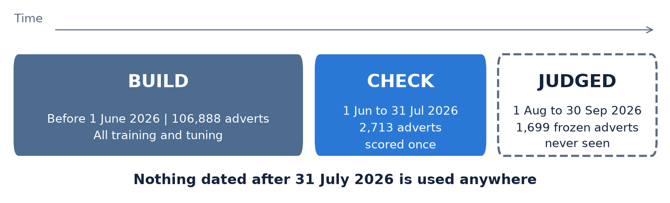
We split by date so the model never saw the answers
Settings were chosen using only the training period.
Check adverts never went into building or tuning the method.
We did not retrain on the check adverts.
Notes:
To avoid fooling ourselves, we split by date. We trained only on adverts before June, and scored once on June and July: twenty-seven hundred adverts the model never saw. Nothing after July thirty-first was used.

Slide 8
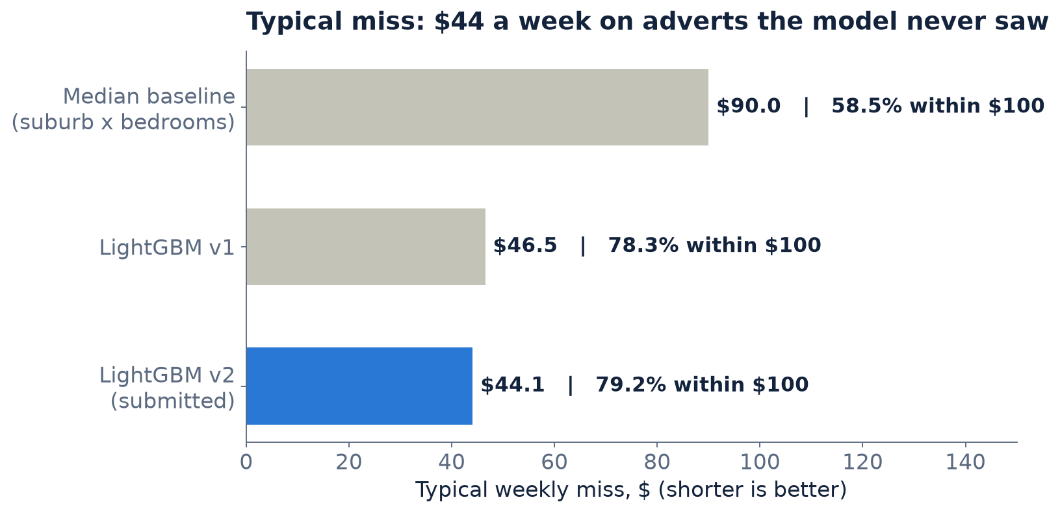
A typical miss of $44 a week, 79% within $100
$44
79.2%
0.888
typical weekly miss
of estimates within $100
R squared on the held-out check
Context, not a head-to-head
Organisers' baseline: $86 and 55.21% within $100, on their frozen August to September set. Our figures come from an earlier check: 2,713 adverts, 1 Jun to 31 Jul 2026.
Notes:
The result: a typical miss of forty-four dollars a week, seventy-nine percent within a hundred dollars, R-squared point eight eight eight. A simple suburb-and-bedroom median misses by ninety. The organisers' baseline missed by eighty-six on their own set, so that's context, not a head-to-head.

Slide 9
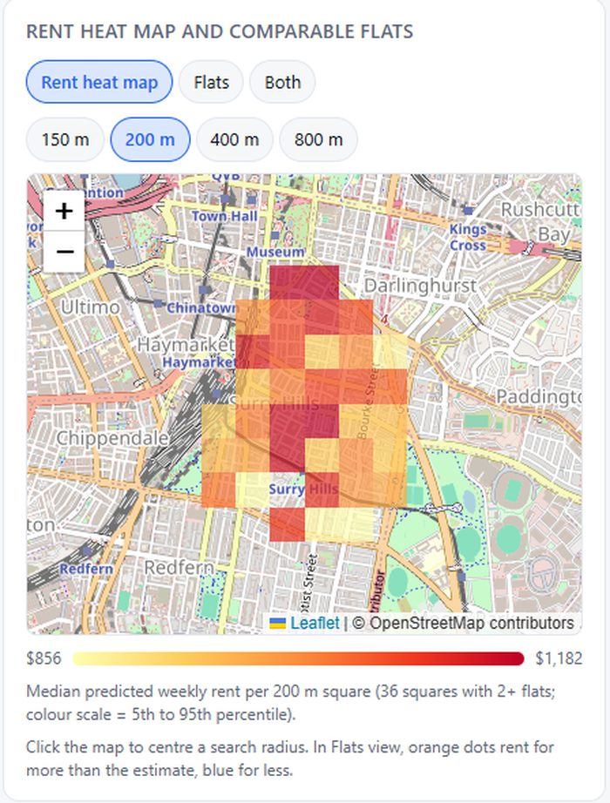
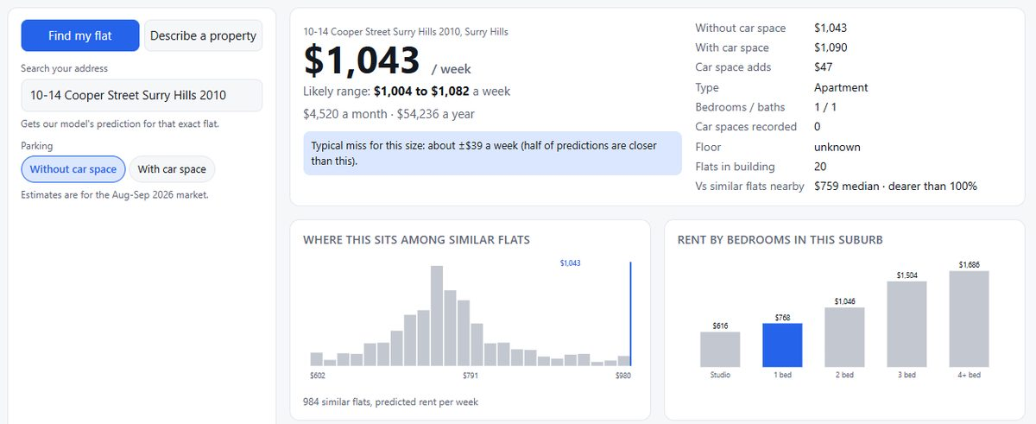
Try it: search your address, see the rent heat map
10-14 Cooper Street, Surry Hills: about $1,043 a week without a car space.
d4data-rent-estimator.vercel.app
Map data: OpenStreetMap contributors
Notes:
Here it is live. Search ten to fourteen Cooper Street: about a thousand and forty-three dollars a week, with a likely range. Switch to the heat map to see rent by square across the city.

Slide 10
Where we're least sure, and what we'd do next
Least sure
Next
The judged adverts fall 2 to 4 months after our data, so real error may be higher (a July-only test gave about $50).
Flats with no rent history miss by about $66 against $42.
Waterfront and luxury areas and 3-bedrooms are hardest.
Asking-rent estimates, not valuations.
Add June and July market-trend data.
Test floor area and building age.
Re-check on the hidden August to September adverts.
Team d4data | Microburbs Hackathon 2026
Notes:
The judged window is two to four months past our data, so the real miss may be larger.

Slide 11
Does the number feel right for your flat?
Open the live app: d4data-rent-estimator.vercel.app
Team d4data | Microburbs Hackathon 2026
Research for information only; not valuations or financial advice. Uses only information dated by 31 July 2026.
Notes:
Try your own address and tell us if the number feels right. We're team d4data.

