Slide 1
C – Programming Language?
Presentation on C Programming Language
By
Satish Tamrakar
www.satishtamrakar.com.np

Slide 2

INTRODUCTION
C is a general-purpose, high-level language that was originally developed by Dennis M. Ritchie to develop the UNIX Operating system at Bell Labs. C was originally first implemented on the DEC PED-11 Computer in 1972.
C has now become a widely used professional language for various reasons:
Easy to learn
Structured language
It produces efficient programs
It can handle low-level activities
It can be compiled on a variety of computer platforms.

Slide 3

Facts about C:
C was invented to write an operating system called UNIX.
C is a successor of B language which was introduced around the early 1970s.
The language was formalized in 1988 by the American National Standard Institute (ANSI).
The UNIX OS was totally written in C.
Today C is the most widely used and popular system programming language.
Most of the state – of – the – art software has been implemented using C.
Today’s most popular Linux OS and RDBMS MySQL have been written in C.

Slide 4

Why use C?
C was initially used for system development work, particularly the programs that make-up the operating system. Some examples of the use of C might be:
operating system
Language Compilers
Assemblers
Text Editors
Modern Programs
Databases
Languages Interpreters
Utilities
Print Spoolers
Network Drivers

Slide 5

Software Download
If you are or want to work on any programming language like C, C++, JAVA,
C#. Then, you need to have two software basically i.e Editor (where you type
the code) and another is Compiler (that check the errors where you type
your code)
Software that are avaible:
Codeblocks
Dev C++
Visual Studio Community Edition
Turbo C++
Steps to download codeblocks Software:
Search fo codeblocks download in google.com.
Goto www.codeblocks.org/downloads
Click on Binaries
Click on Codeblocks with mingw-setup
Download will starts and wait until downloading files completed
Install Software and run.

Slide 6

Our First Hello World Program in C
Open codeblocks software that you have installed
Create a folder where you gonna do C programs in your drive
In codeblocks softeare, goto file>new>empty file
Save in to your folder that you have created before
There should not be any spaces in your filesname for eg; 1.helloworld.c (.c should be the extension for C programming and .cpp for C++)
Start your first code

Slide 7
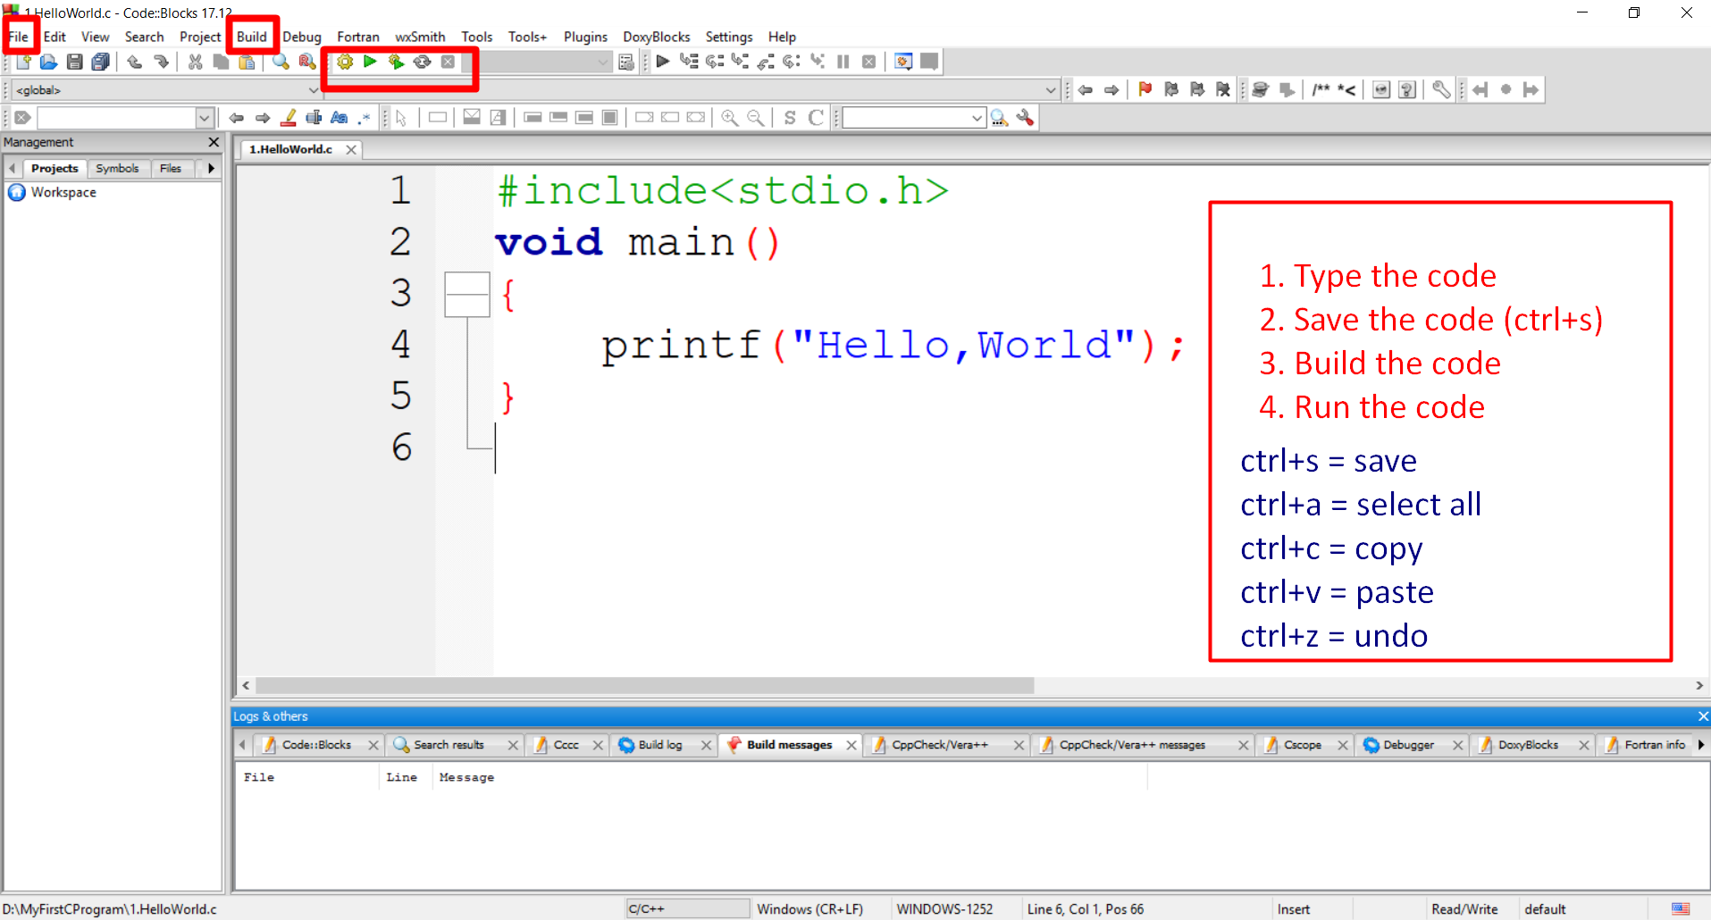
There are many header files
stdio.h → standard input output header file which have method called printf.
conio.h → console input output header file getch() read character from user
Math.h → math related function

Slide 8
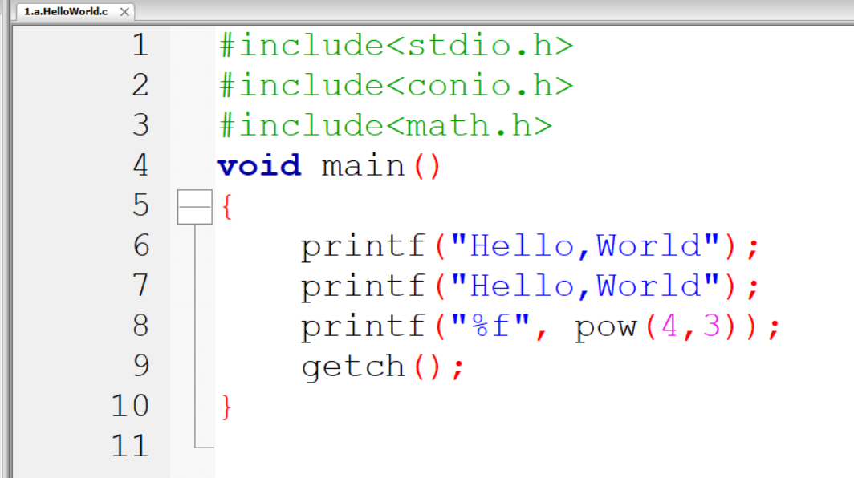
Another example with all header files.

Slide 9
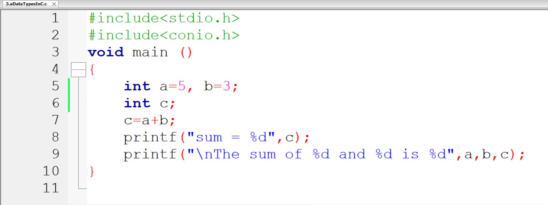
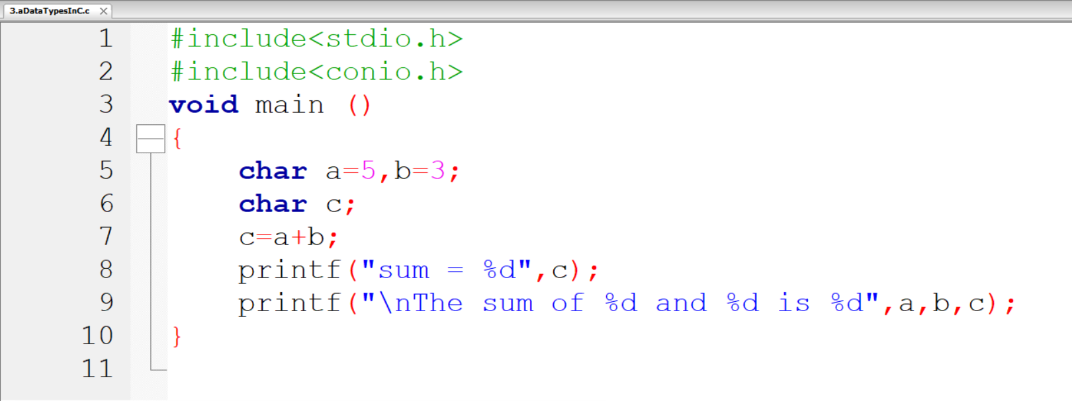
int (declare as integer) = data type
a, b, c = variable
5, 3 = value
\n = breaks the line
%d indicates for printing integer value

Slide 10
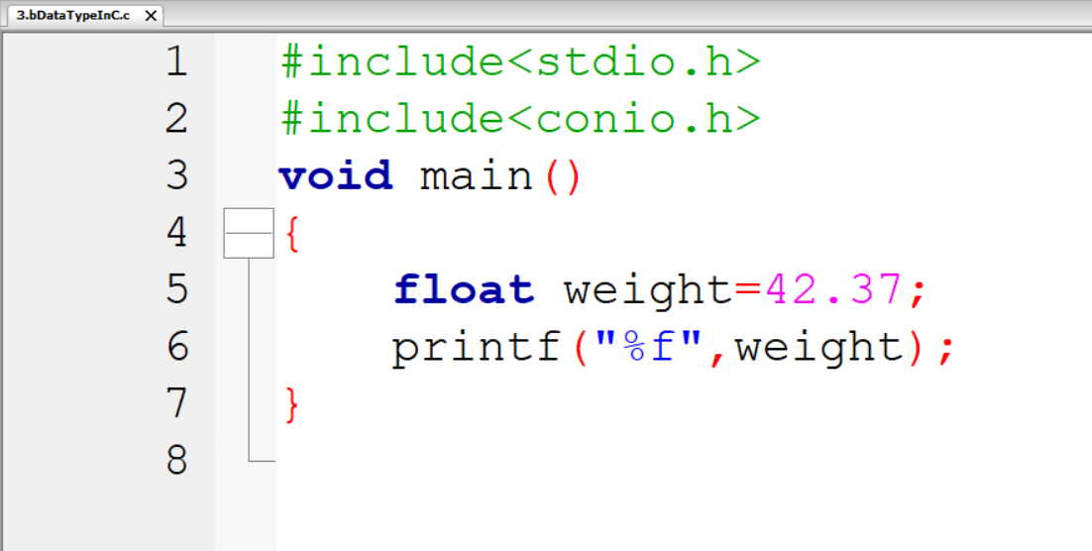
Printing Float Value
For integers we use %d and for
printing float value we use %f

Slide 11
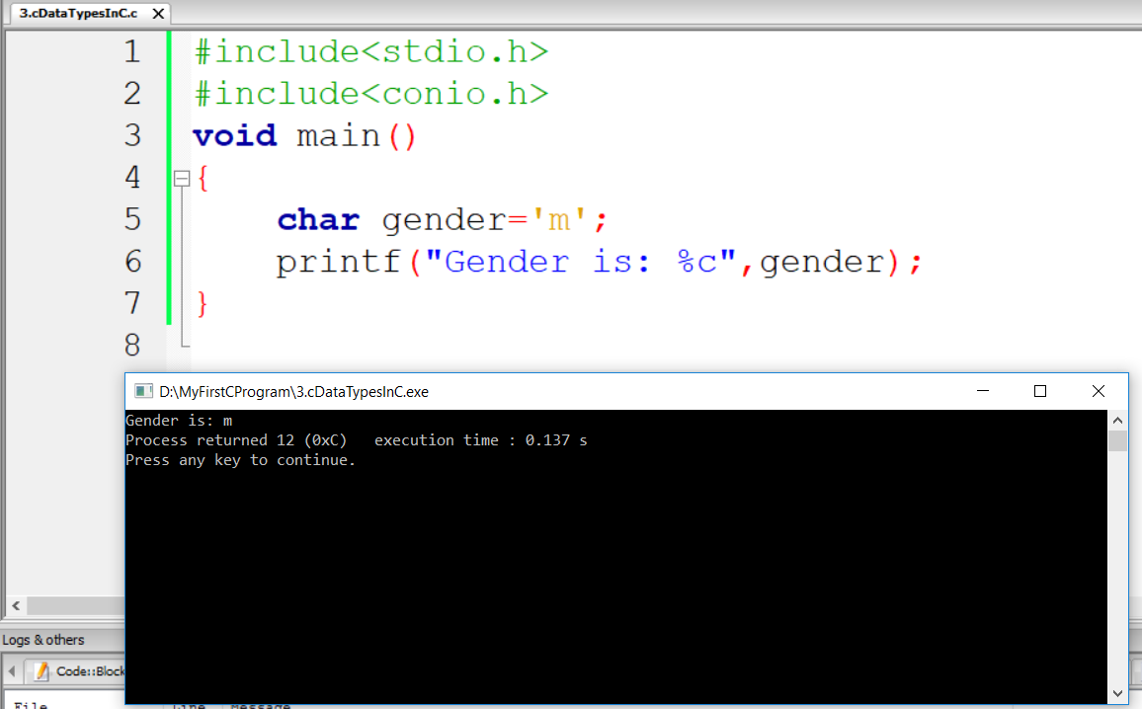
Need to use single quotation to
insert character (char)

Slide 12

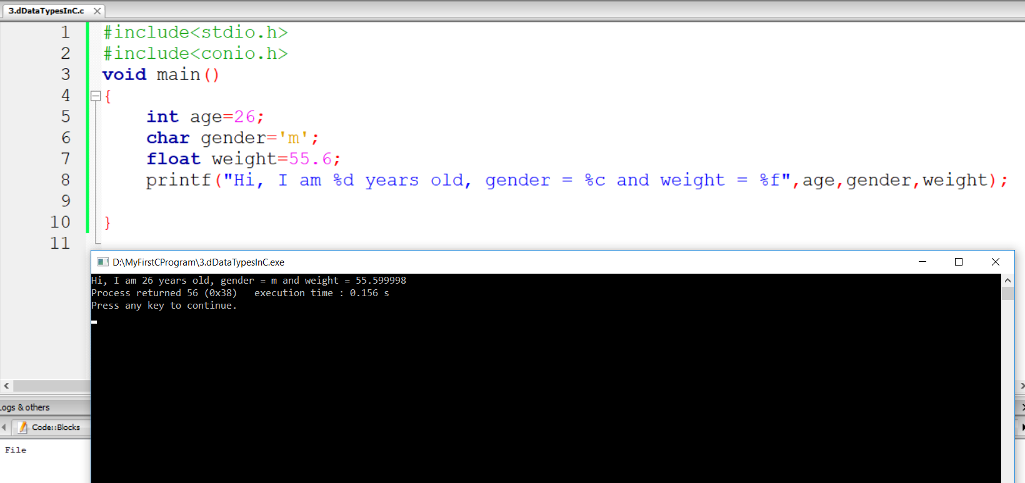
%d for integers
%c for character
%f for floating value

Slide 13
Data Types we have in C Language
unsigned int – can only store positive numbers
int – can store positive and negative numbers
unsigned long – bigger intergers that can store positive numbers which are bigger than integers
long – can store positive and negative integers which are bigger than integers
float – can store decimal values
double- can store decimal values and bigger than float
long double – this is more accurate than float and double
unsigned char – can store the values from 0 to 255
char- stores small integers from -128 to 127

Slide 14
These are format specifiers we use
Data Type | Scanf
char | %c
int | %d
float | %f
double | %lf
long int | %ld
string (or character array) | %s
unsigned int | %u

Slide 15
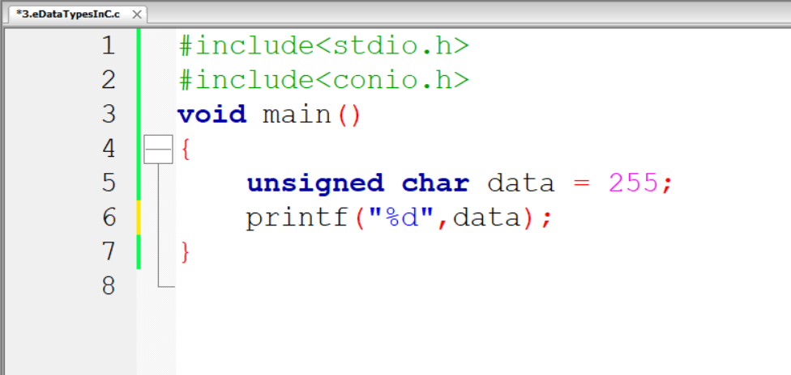
If your change data into 256. Then the output will be 0
because unsigned char can store the values from 0 to 255

Slide 16

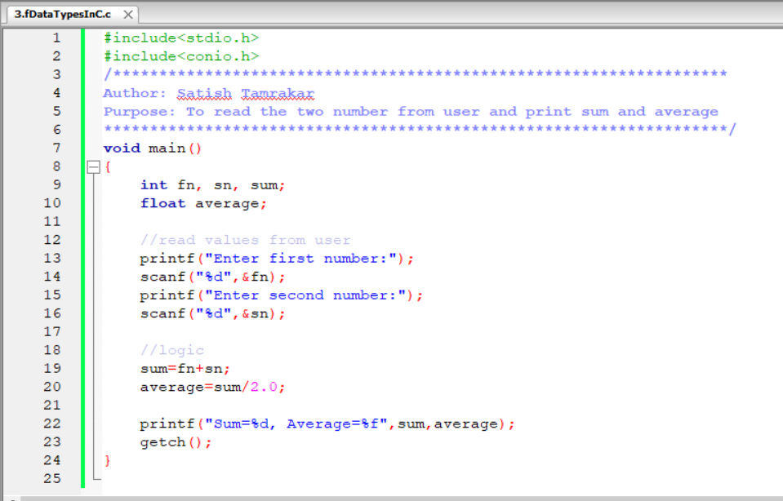
Printf and Scanf (read values from user)
We use scanf to get values from user
And use & in scanf

Slide 17
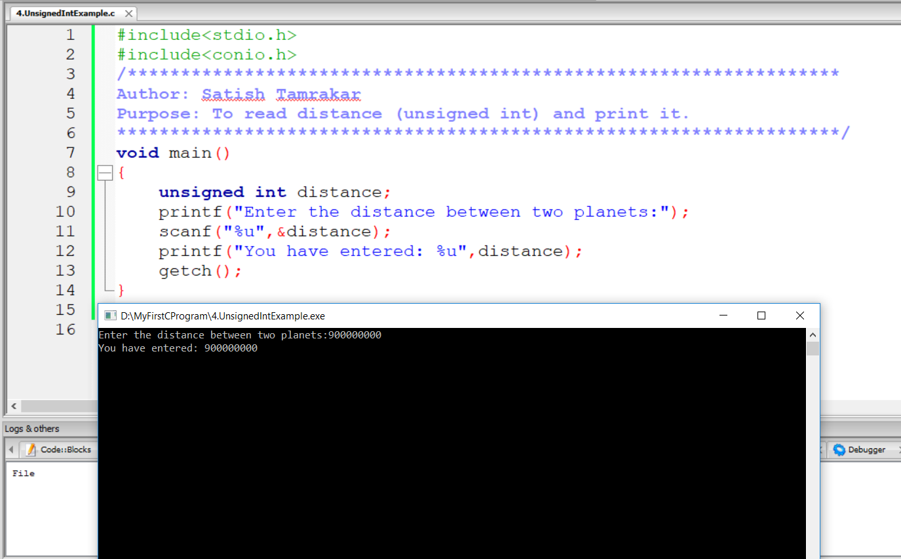

Slide 18
