Slide 1


Nearest Document Search
FR
FABRIKAM RESIDENCES
PRAXIS BUSINESS SCHOOL
Presented By:
Abhisikta Biswas (D18001)
Madan P (D18015)
Ruhi Ghosh (D18034)
Satish Vavilapalli (D18036)
Vinisha Maurya (D18042)

Slide 2
Contents
Problem Statement
Objective
Challenges
Data Description
Approach
Graphical User Interface
Future Scope
FR
FABRIKAM RESIDENCES

Slide 3
Problem Statement
Time is money! Reading the newspaper consumes a lot of time. Thus, how to manage time effectively so that we get updated on day to day news ?
Project overview visual!

Slide 4
Objective
The main purpose of this project is to come up with the news recommendation engine. This application helps us to find the most similar news based on any particular news. Also it helps to read a summary of the entire news, and generates the sentiment analysis with its frequently occurring word of a news.
Hence, saving a lot of human time!

Slide 5
Challenges
Most of the news websites do not allow us to scrape or copy documents. Main drawbacks were availability of data.
Segregating news into their original categories is another problem.
Since our data is small so KNN model worked. But in real time, when the dataset is large enough, KNN seems to fail, and we may not get optimum results.
In real time, when the dataset is large enough, we can face challenges while using Vader sentiment analysis as it works well when document size is small.

Slide 6

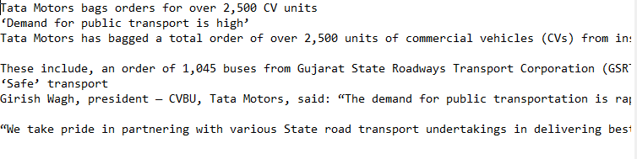
Data Description
We have 6 different category of news data.
Each category has news data in text format:

Slide 7
Approach
Natural Language Processing
Nearest Neighbour Search
Word Cloud
Text Summarization
Sentiment Analysis

Slide 8
Natural Language Processing
Pre-Processing of the text
Stop Words Removal
Words like the, a, is, etc. gives no much importance to a text while processing. Thus removing of these stop words helps in building the relevant sparse matrix.
Removing of punctuations
Punctuations adds no value to the text. Thus it is advisable to remove the punctuation

Slide 9
Natural Language Processing
Pre-Processing of the text
Removal of Digits
To build a model with text data it is always advisable to remove the digits from the corpus.
Tokenization
It is a process of breaking a stream of text up into words, phrases, symbols, or other meaningful elements called tokens.
Example: “NLP is awesome”
The tokens of this sentence will be “NLP”, “is”, “awesome”.

Slide 10
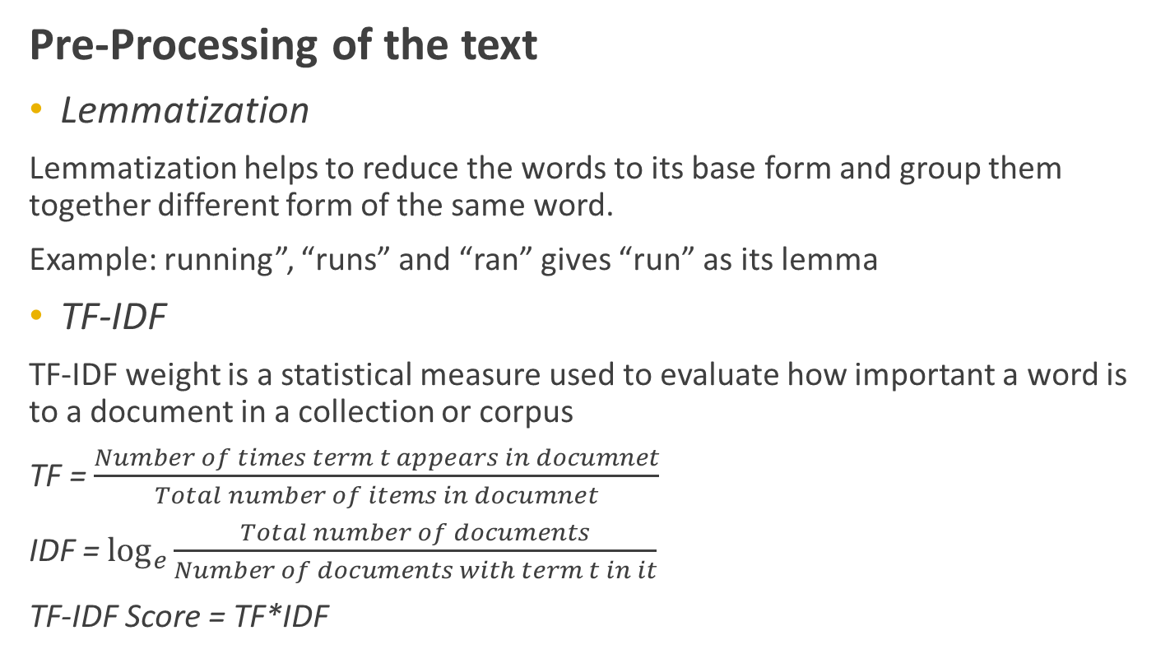
Natural Language Processing
Pre-Processing of the text
Lemmatization
Lemmatization helps to reduce the words to its base form and group them together different form of the same word.
Example: running”, “runs” and “ran” gives “run” as its lemma
TF-IDF
TF-IDF weight is a statistical measure used to evaluate how important a word is to a document in a collection or corpus
TF = $\frac{Number of times term t appears in documnet}{Total number of items in documnet}$
IDF = $\log_{e}{\frac{Total number of documents}{Number of documents with term t in it}}$
TF-IDF Score = TF*IDF

Slide 11
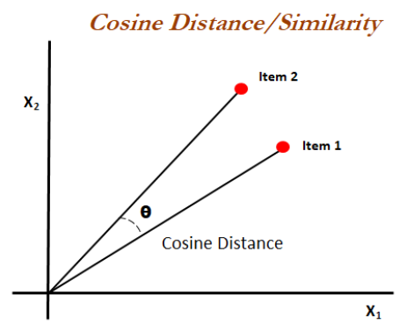
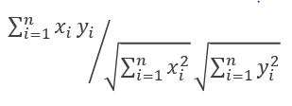
Nearest Neighbour Search
We have used KNN model to fetch the 3 nearest neighbouring news article based on one particular news.
Distance metric used: Cosine Similarity
Formula:

Slide 12
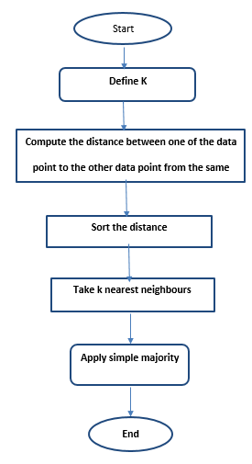
KNN Algorithm

Slide 13
KNN
Advantage:
Robust in nature
Ease to interpret output
Can be applied to data of any distribution
Simple and intuitive
Disadvantage:
Need to determine the value of k is tricky
Choosing the correct distance metric is sometimes a challenge
Computational cost is high
Performance of the algorithm depends on the number of dimensions used.

Slide 14
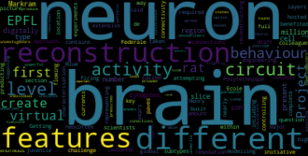
Word Cloud
Word Cloud are a way of displaying how important words are in a corpus or text. It identifies the word which frequently arrives in the text by giving that particular word a greater space to occupy in the image.

Slide 15
Text Summarization
It is a process of extracting words and word phrases from the original text to create a summary.
We have used Extractive approach with LexRank algorithm for text summarization.
Extractive summarization picks up sentences directly from the original document depending on their importance
LexRank is an unsupervised graph based approach. LexRank uses IDF-modified Cosine as the similarity measure between two sentences. This similarity is used as weight of the graph edge between two sentences.

Slide 16
Sentiment Analysis
Sentiment analysis is also known as opinion mining.
Sentiment analysis is a type of data mining that measures the inclination of people’s opinions through natural language processing (NLP), computational linguistics and text analysis, which are used to extract and analyze subjective information from the Web - mostly social media and similar sources.
Sentiment analysis is used to track the following:
Brand reception and popularity
New product perception and anticipation
Company reputation
Flame/rant detection

Slide 17
VADER Sentiment Analysis
VADER (Valence Aware Dictionary for sentiment Reasoning) is a model used for text sentiment analysis that is sensitive to both polarity (positive/negative) and intensity (strength) of emotion.
VADER text sentiment analysis uses a human-centric approach, combining qualitative analysis and empirical validation by using human raters and the wisdom of the crowd.

Slide 18
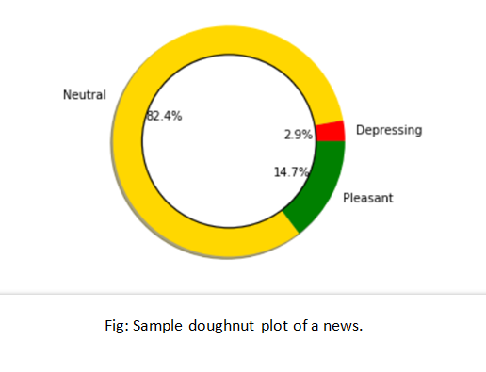
How Does VADER works?
It returns a sentiment score in the range -1 to 1, from most negative to most positive.
For our interest we have generated a doughnut plot using output the VADER text sentiment analysis.
This doughnut plot explains
That a particular news is
82 % neutral, 3 % depressing
And 14% pleasant.
This can be obtained even
before reading the
News article!

Slide 19
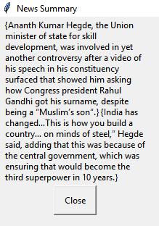
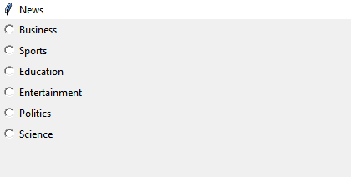
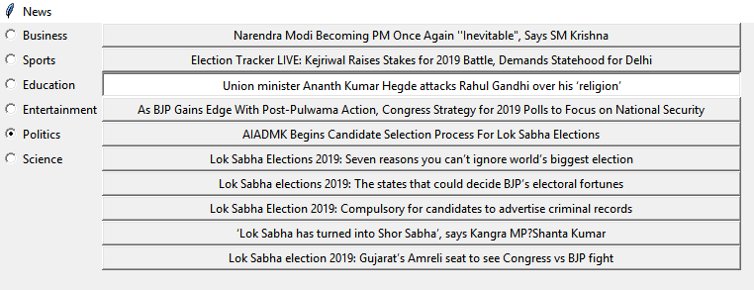
Graphical User Interface
Page 4: Summary of any particular News
Page 1: News Categories
Page 2: Different News in a particular categories
We have used tkinter python to build the UI

Slide 20
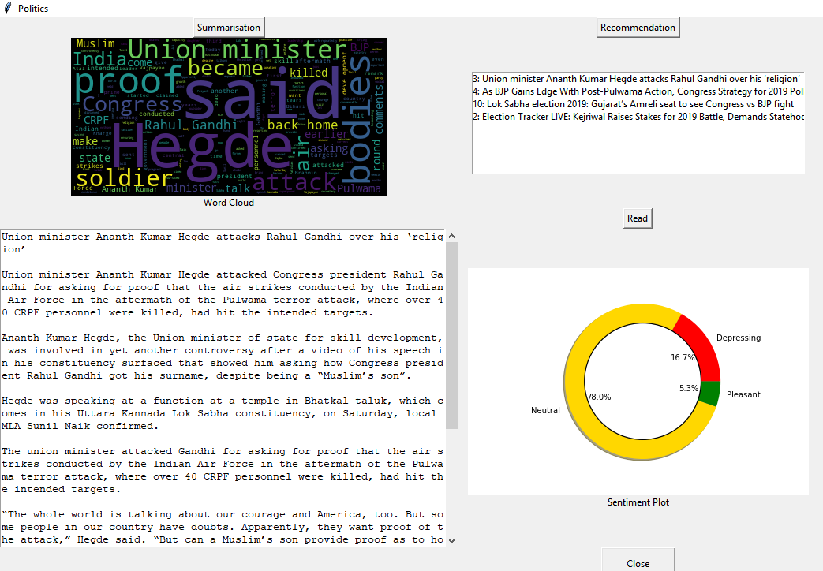
UI Page:

Slide 21
Future Work
We have created the basic skeleton of out application, this can further be modified by including images, color themes etc.
To make it more real time, everyday scrapping of news data needs to be done.
When the data is enormously large, other similarity search models like LDA, KDTree, LSH, K means clustering etc. could be used.
This application can be hosted on cloud as well, which will ensure efficient flow of data.

Slide 22


Thank You.

