Slide 1
Cloud Tech and vEPC over RIFT openstack using RIFT MANO
07/26/2017 Presented by: Satish Verma

Slide 2
Agenda
Current Network overview( Telco/Enterprise)
Major Challenges with current Network deployments
What is the solution?
Major Cloud Computing components
NFV and MANO framework
Openstack components
LTE core components- Overview
vEPC deployment lifecycle using Tacker(MANO)
Deployed vEPC components overview and information flow details

Slide 3
Data Center(Telco/Enterprise) at a glance
Delhi Data Center(DC)
Each DC contains 4-5 equipment layers (Racks)
OSS/BSS Layer
Mumbai DC
Telecom Application Layer
Database Application Layer
Chennai DC
IP Network interface
Bangalore DC
Physical network interface
Pan India (X Telecom)
Each of there layers have customized hardware for each application
Each layer have typically 100-200 hardware based on Telco’s size
It takes lot of time and human effort to configure each hardware and software

Slide 4
Problems with existing Telecom Infrastructure
Huge amount of Capex and Opex required
E.g Airtel India & SA ( Capex= $2,400 Mn, Opex: 43.3 % of revenue (FY,16)
Run time scaling is far than impossible
Quick deployment of new services is not possible
Difficult to manage geographically separated DATA centers
Major Network upgrade due to technology changes is too costly and time consuming
More human power is required to manage multiple data centers
Difficult to change the hardware for new service deployment
Many more…………

Slide 5

What is the solution? Need for Virtualization evolved
What about making software independent of hardware? Software virtualization over standard hardware
What about single machine hosting multiple OS? Hypervisor
What about putting Data center in cloud accessible remotely?
NFV and SDN
What about managing multiple devices remotely
Orchestration

Slide 6




Cloud computing Framework
Software as a service(SaaS)
Services and built in functionality
SalesForce CRM
, LotusLive, Gmail, Facebook etc.
Developments tools
Google App Engine
Platform as a service
(PaaS)
Basic middleware
(database services , application server )
Virtualized resources
Virtualized images
Compute
Networking
Image Metadata
Openstack based private/public clouds
Infrastructure as a Service
(IaaS)
Storage
Image
Software kernel (OS. VM Manager)
Hardware

Slide 7
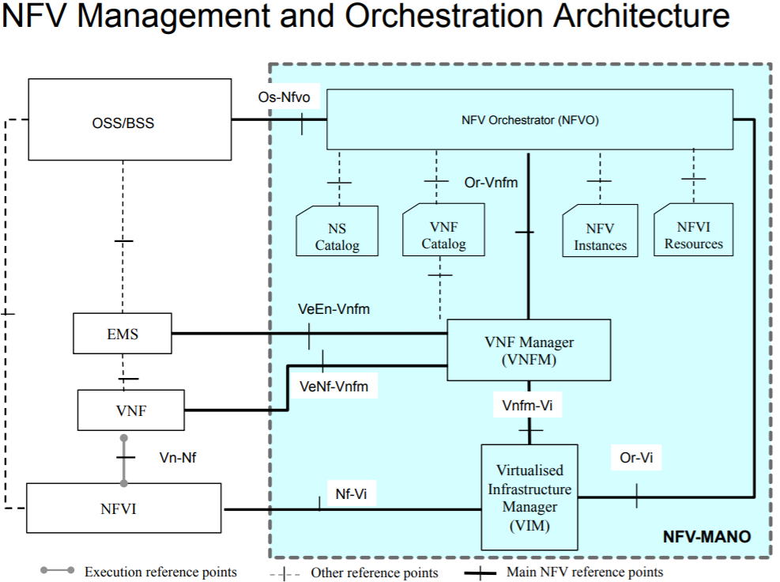
NFV Specifications NFV Specifications
NFV Use cases (GS NFV 001)
NFV Architectural Framework (GS NFV 002)
Terminology for Main Concepts in NFV (GS NFV 003)
NFV Virtualization Requirements (GS NFV 004)
NFV Proof of Concepts Framework (GS NFV-PER 002)
Openstack variants
Openstack (base version)
Mirantis Openstack
HP Helion Openstack
Huawei FusionSphere
RIFT Openstack
Lot many others…..
MANO variants
Tacker
Open-O
Open MANO(OSM)
RIFT MANO
Lot many others…..

Slide 8
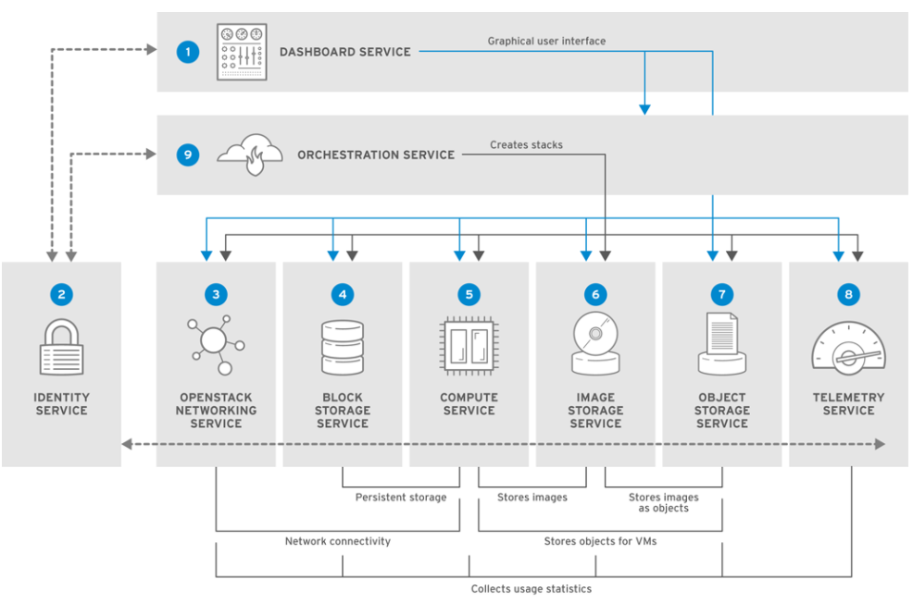
Openstack components
 | Service | Description | Location
 | Dashboard | horizon | Web browser-based dashboard that you use to manage OpenStack services.
 | Identity | keystone | Centralized service for authentication and authorization of OpenStack services and for managing users, projects, and roles.
 | OpenStack Networking | neutron | Provides connectivity between the interfaces of OpenStack services.
 | Block Storage | cinder | Manages persistent block storage volumes for virtual machines.
 | Compute | nova | Manages and provisions virtual machines running on hypervisor nodes.
 | Image | glance | Registry service that you use to store resources such as virtual machine images and volume snapshots.
 | Object Storage | swift | Allows users to store and retrieve files and arbitrary data.
 | Telemetry | ceilometer | Provides measurements of cloud resources.
 | Orchestration | heat | Template-based orchestration engine that supports automatic creation of resource stacks.

Slide 9
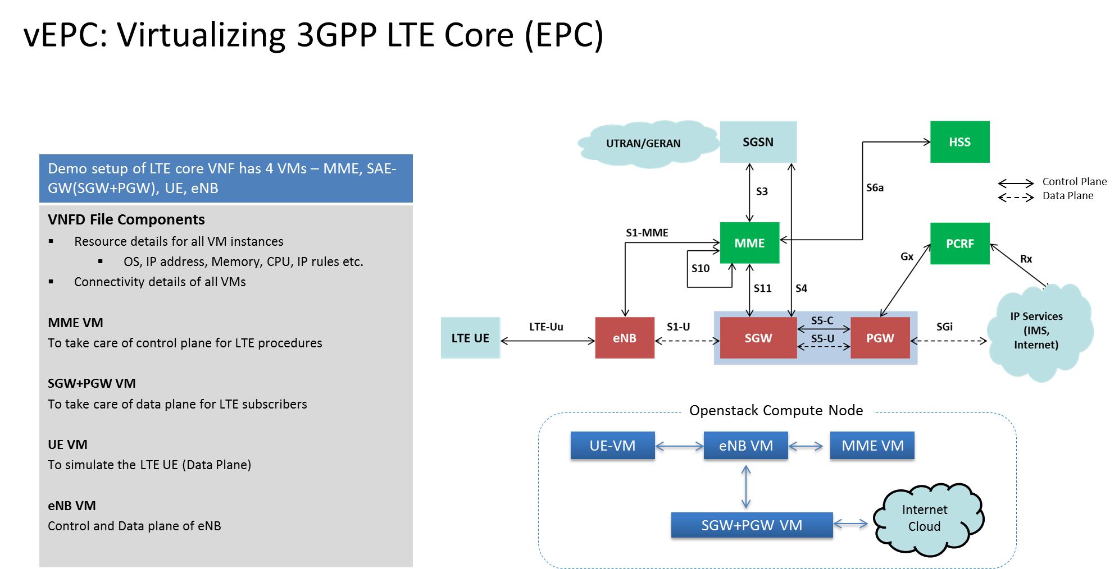

Slide 10
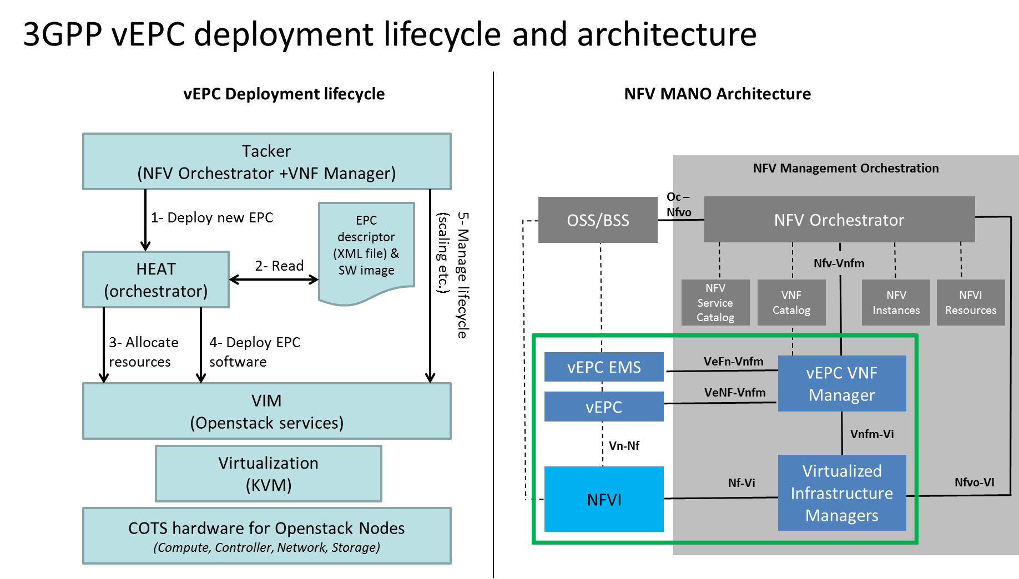

Slide 11
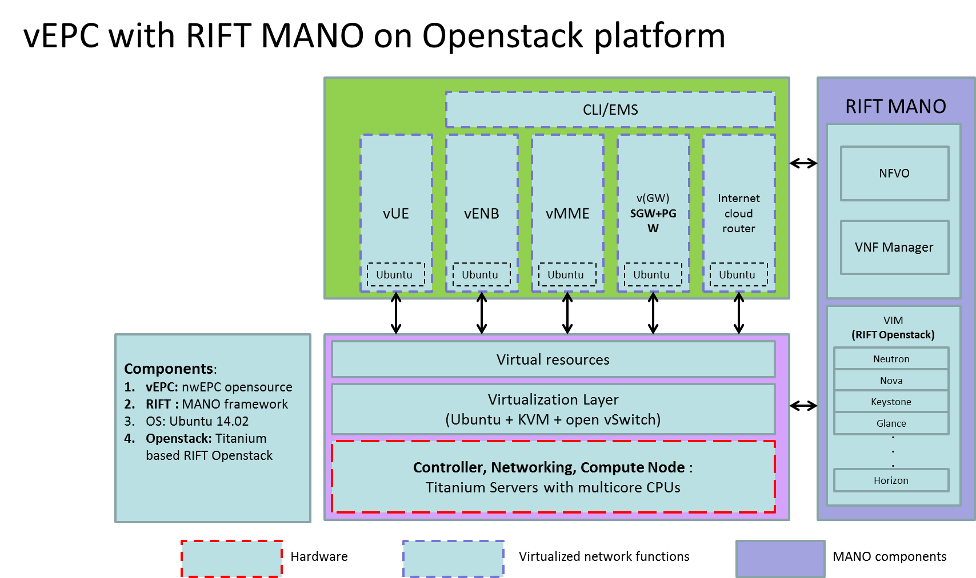

Slide 12
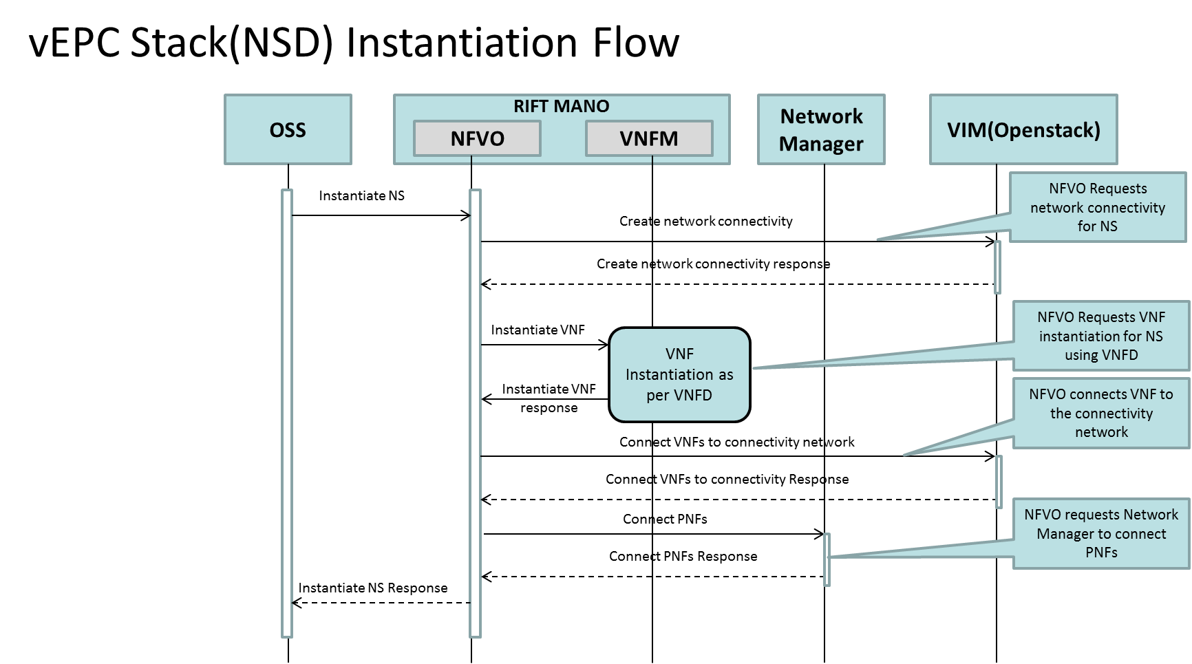

Slide 13
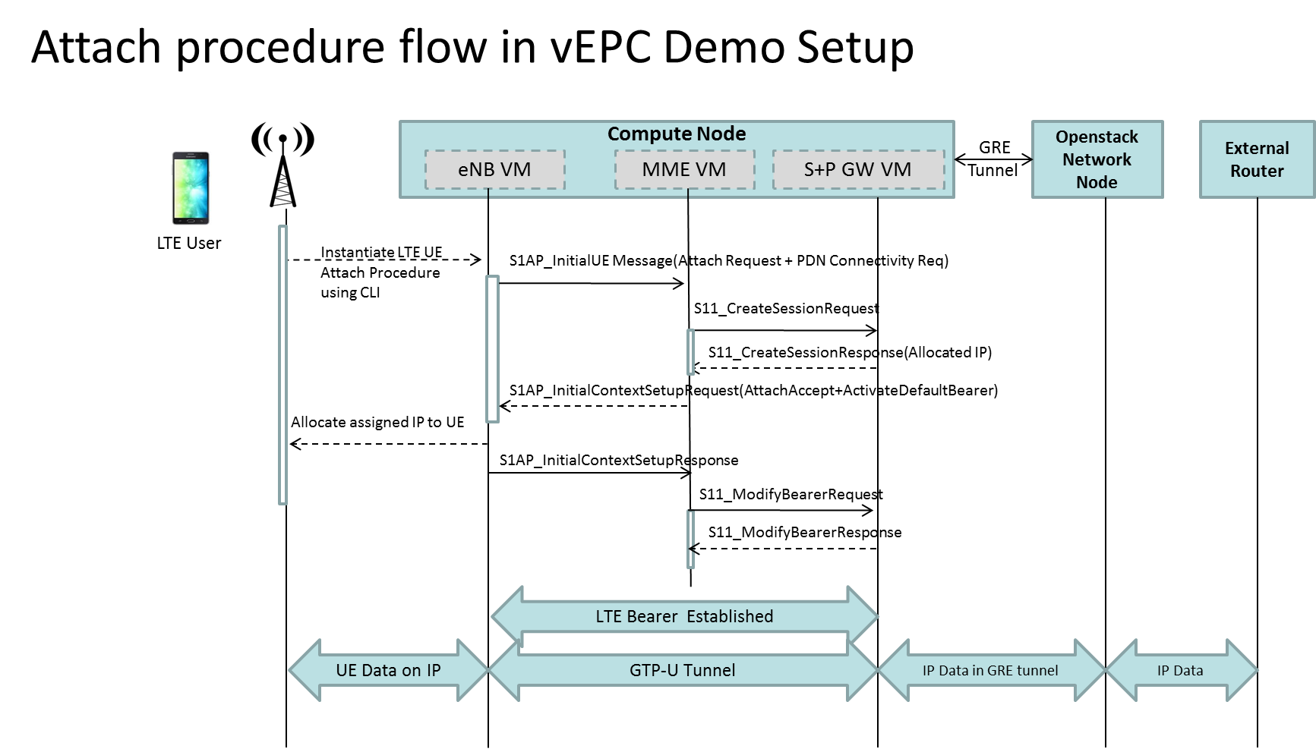

Slide 14
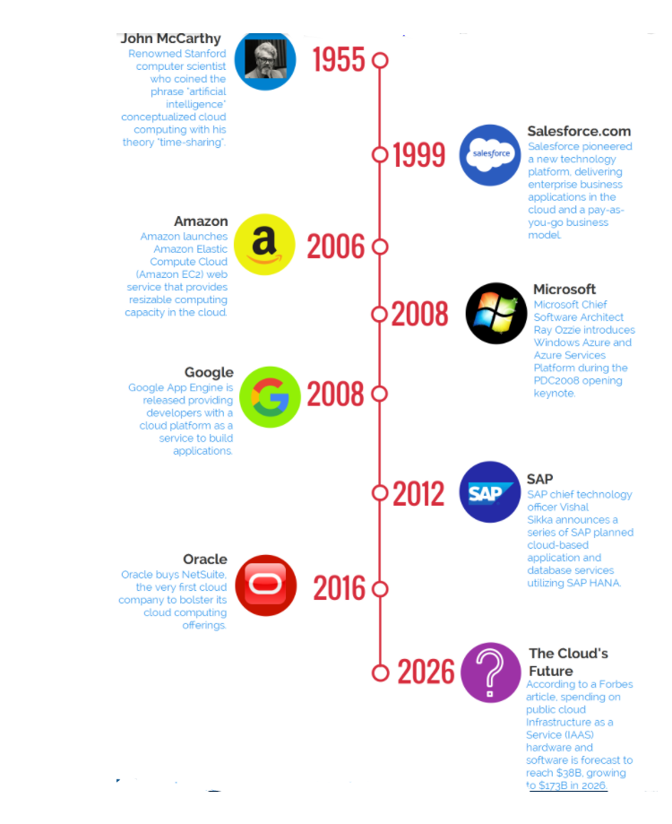
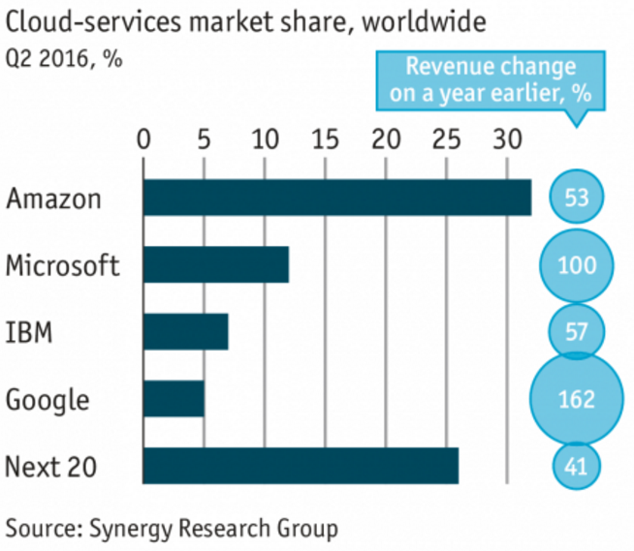
Historical events of Cloud Computing

Slide 15
Thanks

