Slide 1
Final Project Clickpath Analytics
Satish Vittalam

Slide 2
Problem Statement
Ecommerce retailers and other companies who have an online presence are trying gather more details about the customers browsing or online shopping patterns, the products they buy, the products they may be interested in the future and also provide a better shopping experience. They perform Basket Analysis, Path optimization and even try to analyze the next product to buy. To achieve this, companies have to process massive amounts of data sets in terms of web server logs which is also referred to as Clickpath or Clickstream data. This information is captured by Webserver as customer navigates around the website.

Slide 3
Technology Overview
Azure HDInsight offers a cost-effective way to process massive amounts of data. Hadoops framework and its ecosystem helps to analyze this information easier, get better insights about the customer and help improve the effectiveness of the shopping. We use the tools and technologies provided to process large datasets of log files, get the required information from the logs and combine them with user profile and products data (these could be available from the OLTP application) to perform the required analytics. Hadoop offers multiple analytics tools for these big datasets. We will load, refine and visualize the log data.

Slide 4
Approach
WebLogs + Products + User Profile
Preprocess Data
Process in Hadoop Clusters
Final load into Hive tables
Visualize in Zeppelin and PowerBI

Slide 5
Data Set
Data set obtained at : https://s3.amazonaws.com/hw-sandbox/tutorial8/RefineDemoData.zip
The following datasets are primarily used for this project:
Webserver log data
Product information data
User Profile data

Slide 6
Sample Data Set –Raw log file
Visit Timestamp
IP Address
1331799426 2012-03-15 01:17:06 2860005755985467733 4611687631188657821 FAS-2.8-AS3 N 0 99.122.210.248 1 0 10 http://www.acme.com/SH55126545/VD55170364 {7AAB8415-E803-3C5D-7100-E362D7F67CA7} U en-us,en;q=0.5 516 575 1366 Y N Y 2 0 304 sbcglobal.net 15/2/2012 4:16:0 4 240 45 41 10002,00011,10020,00007 Mozilla/5.0 (Windows; U; Windows NT 6.1; en-US; rv:1.9.2) Gecko/20100115 Firefox/3.6 48 0 2 3 0 homestead usa 528 fl 0 0 0 0 0 WPLG 0 120 WPLG 0
URL
User Profile ID
Location Details
Ref: https://hortonworks.com/blog/how-to-capitalize-on-clickstream-data-with-hadoop/

Slide 7
Sample Data Set –Raw log file
Sample Data for Products:
url category
http://www.acme.com/ books
http://www.acme.com/SH55126545/VD55149415 movies
http://www.acme.com/SH55126545/VD55163347 games
http://www.acme.com/SH55126545/VD55165149 electronics
Sample data for Users:
SWID BIRTH_DT GENDER_CD
0001BDD9-EABF-4D0D-81BD-D9EABFCD0D7D 8-Apr-84 F
00071AA7-86D2-4EB9-871A-A786D27EB9BA 7-Feb-88 F
00071B7D-31AF-4D85-871B-7D31AFFD852E 22-Oct-64 F
0007967E-F188-4598-9C7C-E64390482CFB 1-Jun-66 M

Slide 8
Process Overview
Created a HortonWorks Cluster available on Azure and configure it for SSH
Pre-process the Web logs sample data that is obtained
Create a SQL database in Azure
Move the sample data into Hadoop File system
Use Pig latin script to combine the web server logs into one.
Use Sqoop to move the data from traditional RDBMS (OLTP system) to Hive
Create custom Hive tables that will store the final data that is created for visualization.
Use Zepplin and Power BI for Analytics and visualization

Slide 9
Benefits
These are the potential benefits of Clickpath Analysis:
What is the most efficient path for a site visitor to research a product, and then buy it?
What products do visitors tend to buy together, and what are they most likely to buy in the future?
Where should I spend resources on fixing or enhancing the user experience on my website?

Slide 10
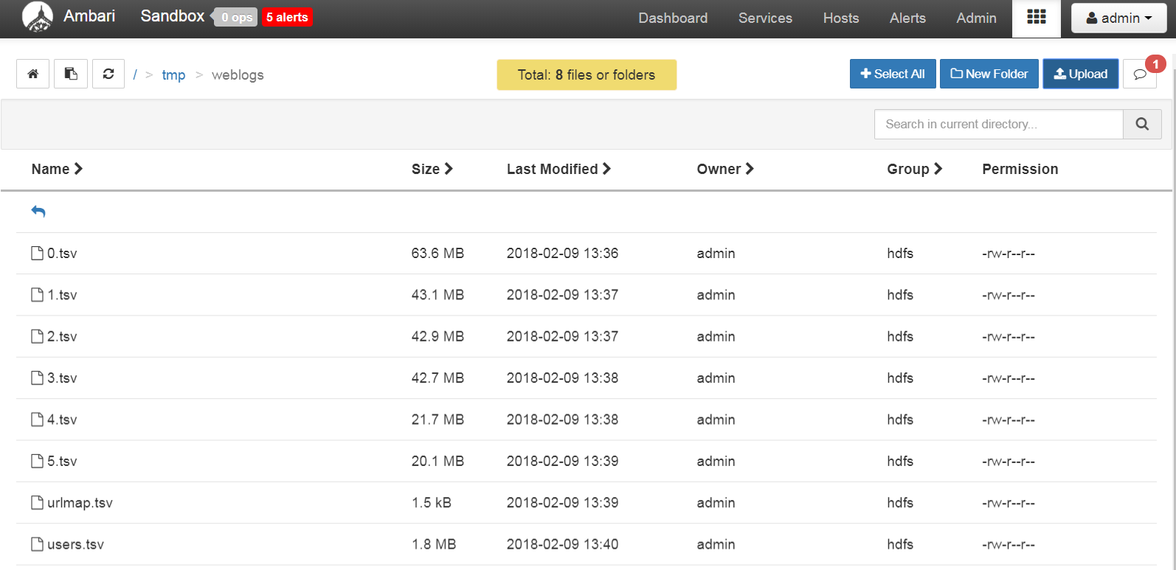
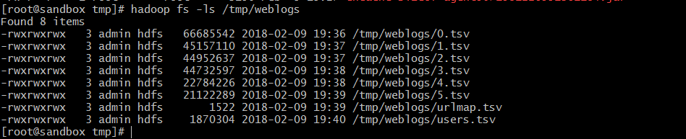
Input Files uploaded

Slide 11
Using Scoop to import into Hive from RDBMS
sqoop import --connect "jdbc:sqlserver://svsqlserver.database.windows.net:1433;databaseName=svsqldemodb" \
--username svittalam -P --table product \
--target-dir /tmp/urlmap --fields-terminated-by "," \
--hive-import --create-hive-table --hive-table default.urlmap \
-m 1
sqoop import --connect "jdbc:sqlserver://svsqlserver.database.windows.net:1433;databaseName=svsqldemodb" \
--username svittalam -P --table user \
--target-dir /tmp/user --fields-terminated-by "," \
--hive-import --create-hive-table --hive-table default.user \
-m 1

Slide 12
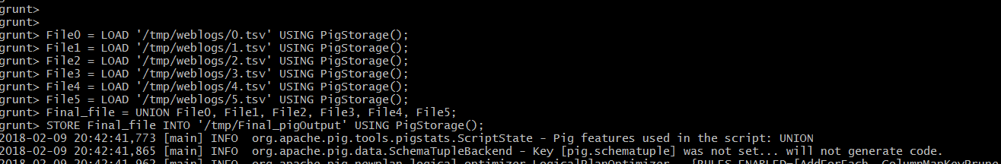
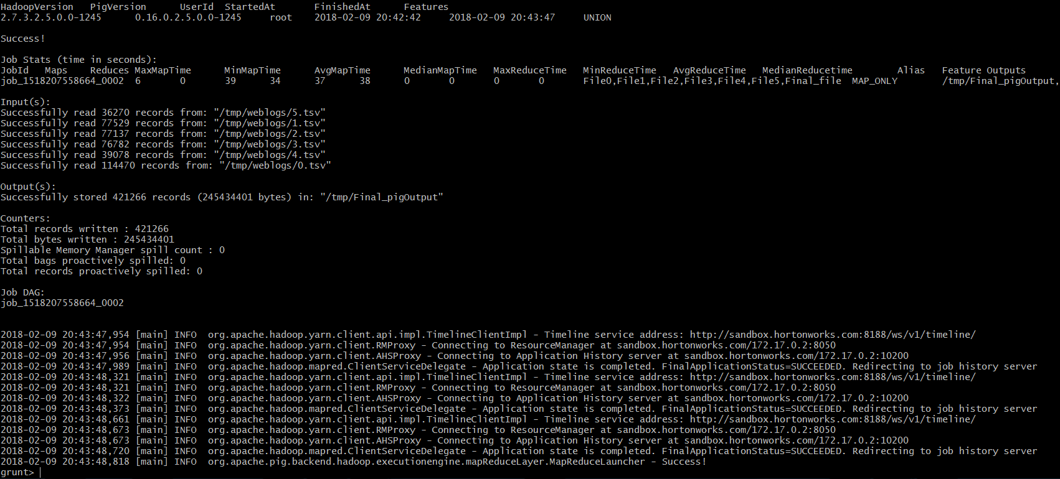
Using Pig Latin to merge datasets

Slide 13
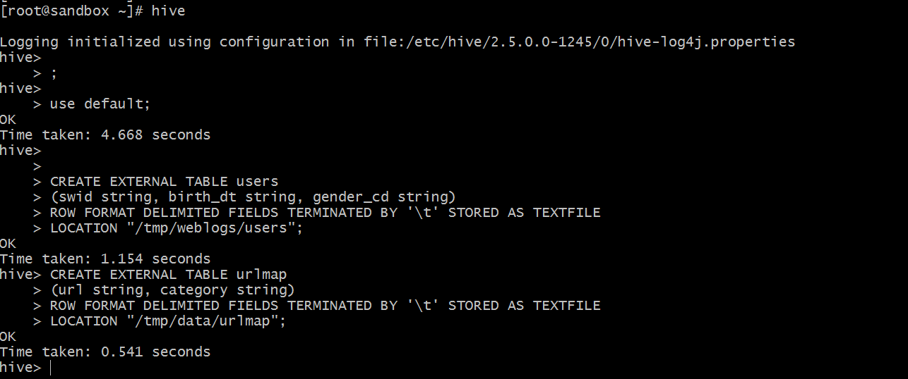
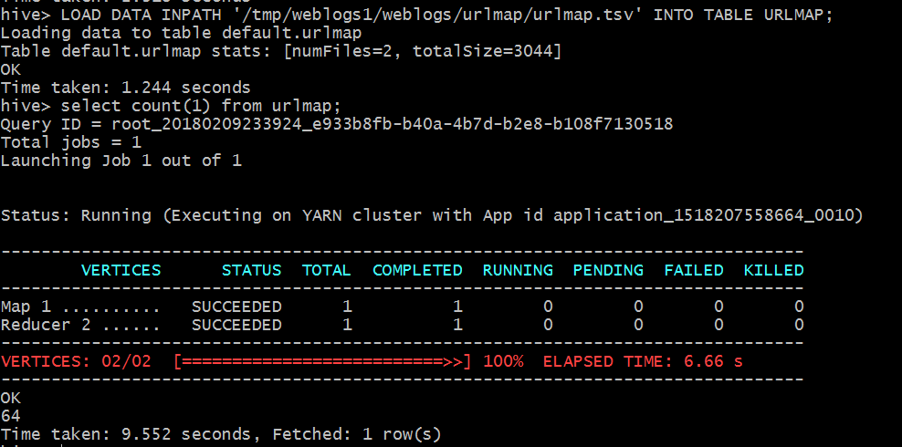
Creating tables in Hive and loading data

Slide 14
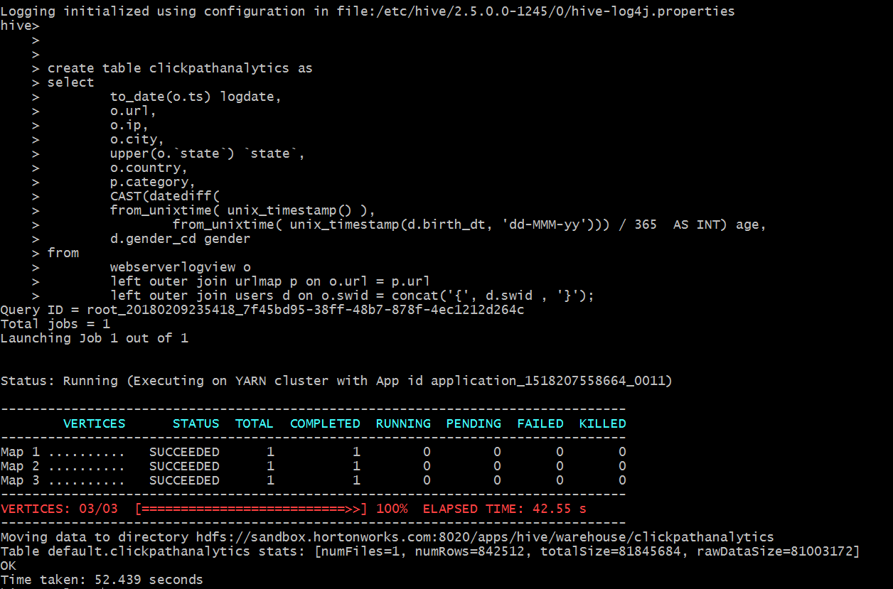
Creating dataset for analysis

Slide 15
Final dataset for analysis
logdate | url | ip | city | state | country | category | age | gender
3/15/2012 | http://www.acme.com/SH55126545/VD55170364 | 99.122.210.248 | homestead | FL | usa | home&garden
3/15/2012 | http://www.acme.com/SH55126545/VD55170364 | 99.122.210.248 | homestead | FL | usa | home&garden
3/15/2012 | http://www.acme.com/SH55126545/VD55177927 | 69.76.12.213 | coeur d alene | ID | usa | clothing | 36 | F
3/15/2012 | http://www.acme.com/SH55126545/VD55177927 | 69.76.12.213 | coeur d alene | ID | usa | clothing | 36 | F
3/15/2012 | http://www.acme.com/SH55126545/VD55166807 | 67.240.15.94 | queensbury | NY | usa | computers | 35 | M
3/15/2012 | http://www.acme.com/SH55126545/VD55166807 | 67.240.15.94 | queensbury | NY | usa | computers | 35 | M
3/15/2012 | http://www.acme.com/SH55126545/VD55149415 | 67.240.15.94 | queensbury | NY | usa | movies | 35 | M
3/15/2012 | http://www.acme.com/SH55126545/VD55149415 | 67.240.15.94 | queensbury | NY | usa | movies | 35 | M
3/15/2012 | http://www.acme.com/SH55126545/VD55179433 | 98.234.107.75 | sunnyvale | CA | usa | shoes | 22 | M
3/15/2012 | http://www.acme.com/SH55126545/VD55179433 | 98.234.107.75 | sunnyvale | CA | usa | shoes | 22 | M
3/15/2012 | http://www.acme.com/SH55126545/VD55179433 | 75.85.165.38 | san diego | CA | usa | shoes | 28 | F
3/15/2012 | http://www.acme.com/SH55126545/VD55179433 | 75.85.165.38 | san diego | CA | usa | shoes | 28 | F
3/15/2012 | http://www.acme.com/SH55126545/VD55166807 | 71.53.206.175 | charlottesville | VA | usa | computers | 26 | F
3/15/2012 | http://www.acme.com/SH55126545/VD55166807 | 71.53.206.175 | charlottesville | VA | usa | computers | 26 | F
3/15/2012 | http://www.acme.com/SH55126545/VD55179433 | 97.96.62.161 | parrish | FL | usa | shoes | 45 | F
3/15/2012 | http://www.acme.com/SH55126545/VD55179433 | 97.96.62.161 | parrish | FL | usa | shoes | 45 | F
3/15/2012 | http://www.acme.com/SH55126545/VD55170364 | 129.119.158.240 | dallas | TX | usa | home&garden | 28 | F
3/15/2012 | http://www.acme.com/SH55126545/VD55170364 | 129.119.158.240 | dallas | TX | usa | home&garden | 28 | F

Slide 16
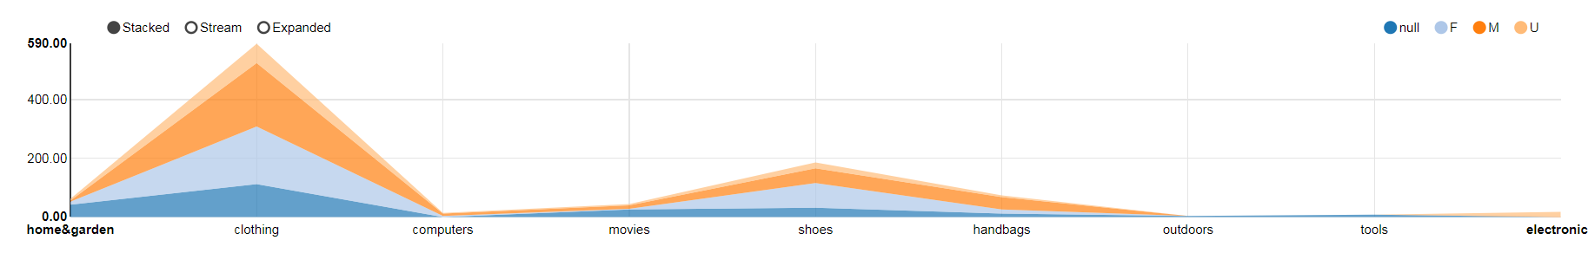
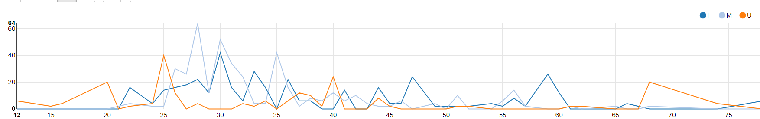
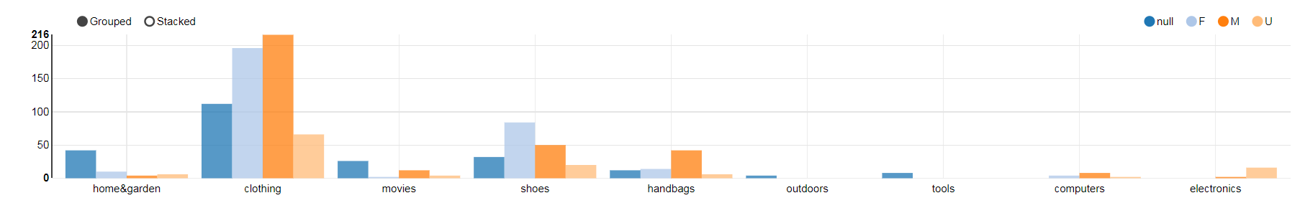
Visualization in Zepplin

Slide 17
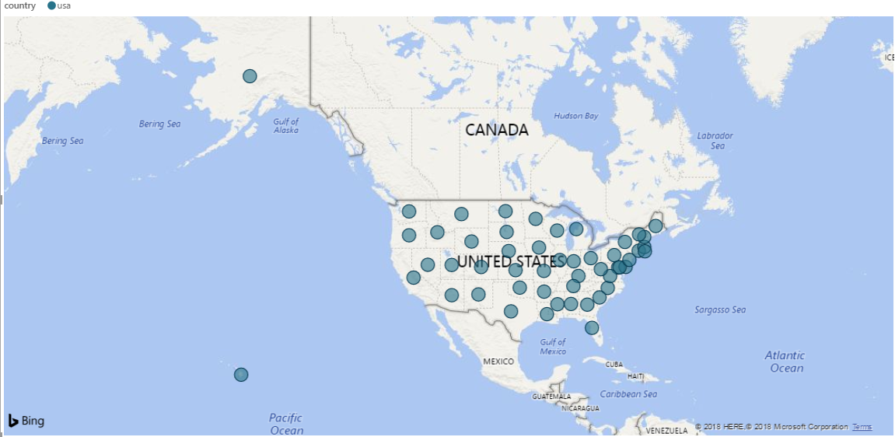
Visualization in PowerBI

Slide 18
Lessons Learned
When I used the HDInsight cluster and logged into the Ambari UI, I could not see all the utilities. For eg., I could not find the link for Zepplin.

Slide 19
YouTube URLs, GitHub URL, Last Page
Two minute (short):
15 minutes (long):
GitHub Repository with all artifacts:
https://hortonworks.com/tutorial/getting-started-with-apache-zeppelin/
https://community.hortonworks.com/content/repo/56765/zeppelin-notebook-for-analysing-web-server-logs.html

