Slide 1
AWS Final Project
Presented by –
Jaybrata Karmakar
Mauricio Gutierrez Lopez
Sathish Kumar Saminathan

Slide 2
Introduction
As a part of this final project the main objective is to explore and implement highly scalable fault tolerant and Highly Available Infra setup with Continuous Integration and Continuous Deployment (CI/CD) pipeline using AWS native services.
It will focuses on the technical architecture, our implementation journey, and the lessons learned.
What We Will Cover today:
Architecture Deep Dive: A walkthrough of our CI/CD pipeline, detailing the integration of services like CodePipeline, CodeBuild, EKS, and ECS for our "Events API" and "Events Website" applications.
Live Demonstration: A showcase of the pipeline in action, from a code commit to automated deployment with features like Blue//Green Deployment
Challenges & Learnings: An honest look at the technical hurdles encountered, limitations within the tooling, and key takeaways from this pilot project.
Setting Expectations:
This is a technical demonstration, not a business use case analysis. Our primary focus was on the feasibility and mechanics of the AWS CI/CD stack and high availability.
We will discuss the rationale behind our technology choices (e.g., why AWS Code-Pipeline over Jenkins).
The project serves as a pilot to gather feedback and understand the capabilities and constraints of the selected tools.

Slide 3




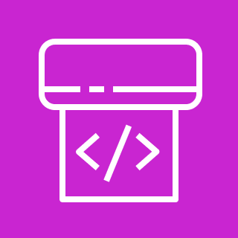


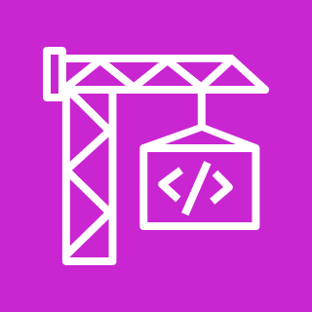
Architecture - Continuous Integration
Infra setup code with Application code can be found on - https://github.com/satissssss/AWSFinalProject
Git push
Third-party Git repository
Git webhook/AWS Codestarconnections
This architecture creates an automated pipeline that takes your source code and turns it into a ready-to-deploy Docker container image.
AWS CodePipeline:
This is the orchestrator of your release process. It watches your source code repository (like GitHub, Bitbucket, or AWS CodeCommit). When it detects a change, like a git push, it automatically kicks off the entire workflow of CI.
AWS CodeBuild:
CodePipeline triggers a CodeBuild project. CodeBuild is a fully managed build service. In this step, it performs tasks defined in a buildspec.yml file, which typically includes:
Compiling your code.
Running unit tests.
Building a Docker image from your application's Dockerfile.
Amazon Elastic Container Registry (ECR):
Once CodeBuild successfully builds the Docker image, it pushes the new image to your private ECR repository. ECR is a secure and scalable Docker image registry, storing your container images so they can be pulled for deployment.
From ECR, Jenkins pull image and deploy into EKS with required version of your application. EKS is created through Cloudformation template in Jenkins
AWS Cloud
Us-East-1
Virtual private cloud (VPC)
Continuous Integration
AWS CodePipeline
Amazon Elastic Container Registry (Amazon ECR)
AWS CodeBuild

Slide 4




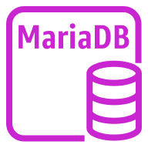

Architecting final project application
Git push
Third-party Git repository
Git webhook/AWS Codestarconnections
AWS Cloud
Us-East-1
Virtual private cloud (VPC)
Availability Zone
Availability Zone
EKS
Amazon Elastic Container Registry (Amazon ECR)
AWS CodePipeline
Continuous Integration
Frontend
Jenkins
Continuous Deployment
MariaDB Database

Slide 5
THANK YOU

