Slide 1
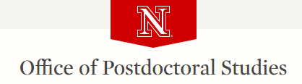
R for Research
Data Analysis using R
Day1: Basic R
Baburao Kamble
University of Nebraska-Lincoln

Slide 2
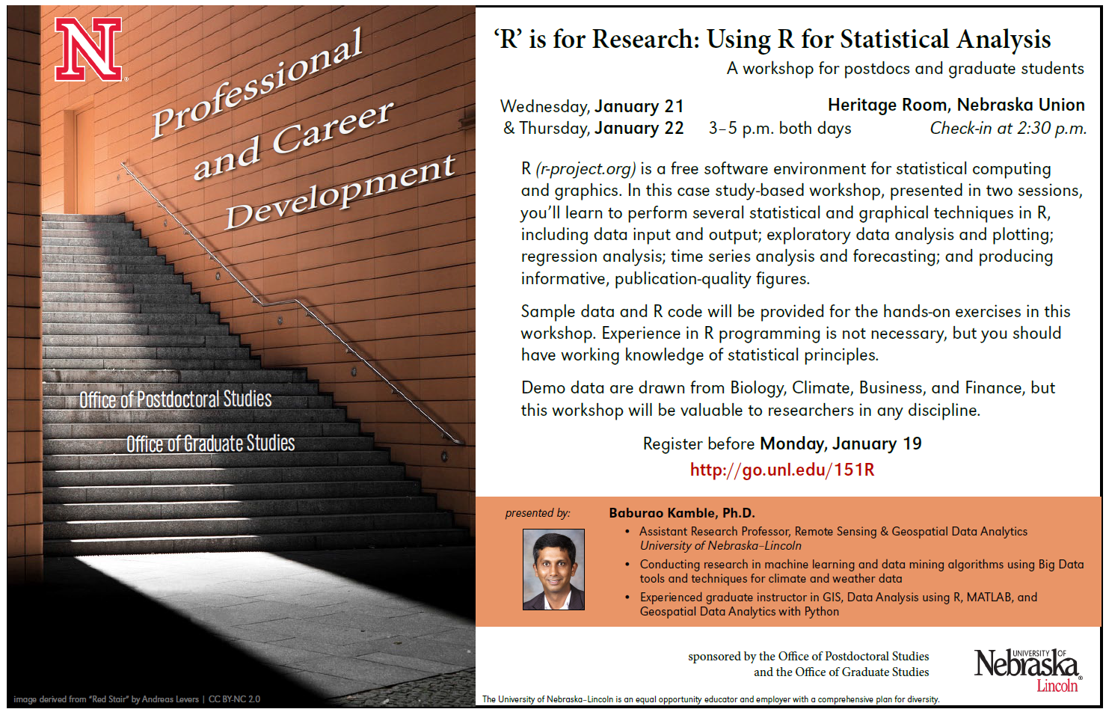

Slide 3
Agenda R
Introduction
Installation
Data Types
Data Import/Export
Data Preprocessing
Data Exploration
Handling missing data
Data Visualization
Basic Plots and annotation
Advanced Plotting (ggplot and lattice)
Workshop Material: http://snr.unl.edu/bkamble/r-pac/

Slide 4
What is R
R is a free programming environment for statistical computing and graphics.
R is
programming language
environment for data manipulation,
Calculation & graphical display.
includes conditionals, loops, user-defined recursive functions and input and output facilities.
R is similar to the award-winning S system, which was developed at Bell Laboratories.

Slide 5
Why R?
Open source and open development.
Design and deployment of portable, extensible, and scalable software.
Interoperability with other languages: C, XML.
Variety of statistical and numerical methods.
High quality visualization and graphics tools.
Effective, extensible user interface.
Innovative tools for producing documentation and training materials: vignettes.
Supports the creation, testing, and distribution of software and data modules: packages.
A grad student’s 2 cents http://thetarzan.wordpress.com/2011/07/15/why-use-r-a-grad-students-2-cents/ Why biologists should use R http://labstats.net/articles/why_r.html

Slide 6
Installing, Running, and Interacting with R
How to get R:
http://www.r-project.org/
Google: “R”
Windows, Linux, Mac OS X, source

Slide 7
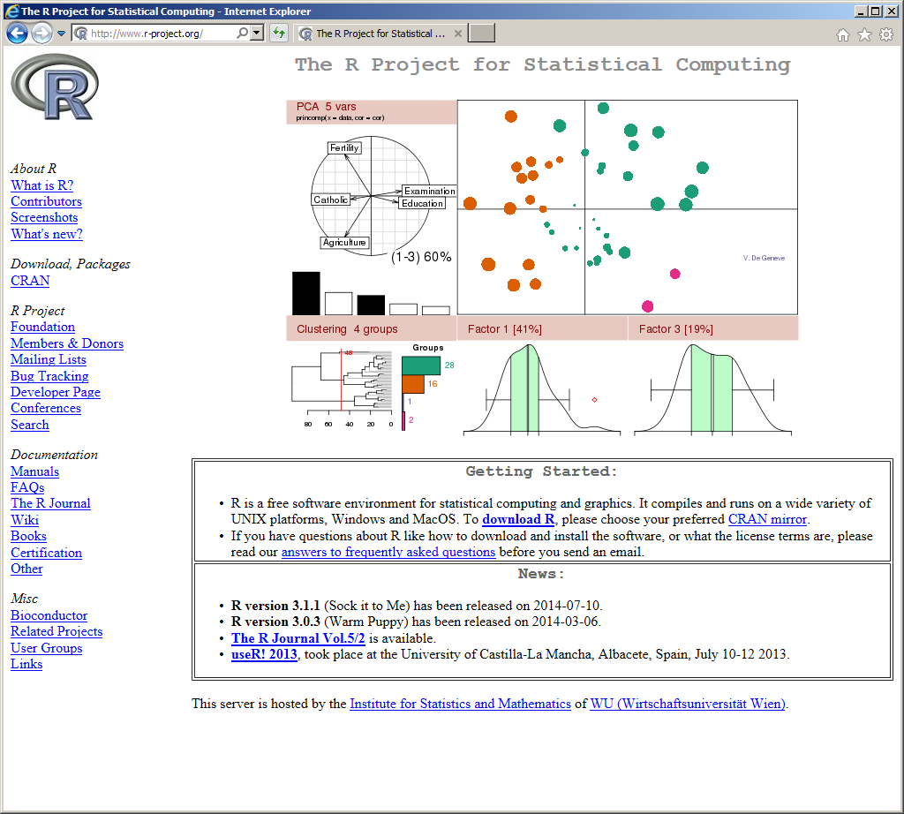
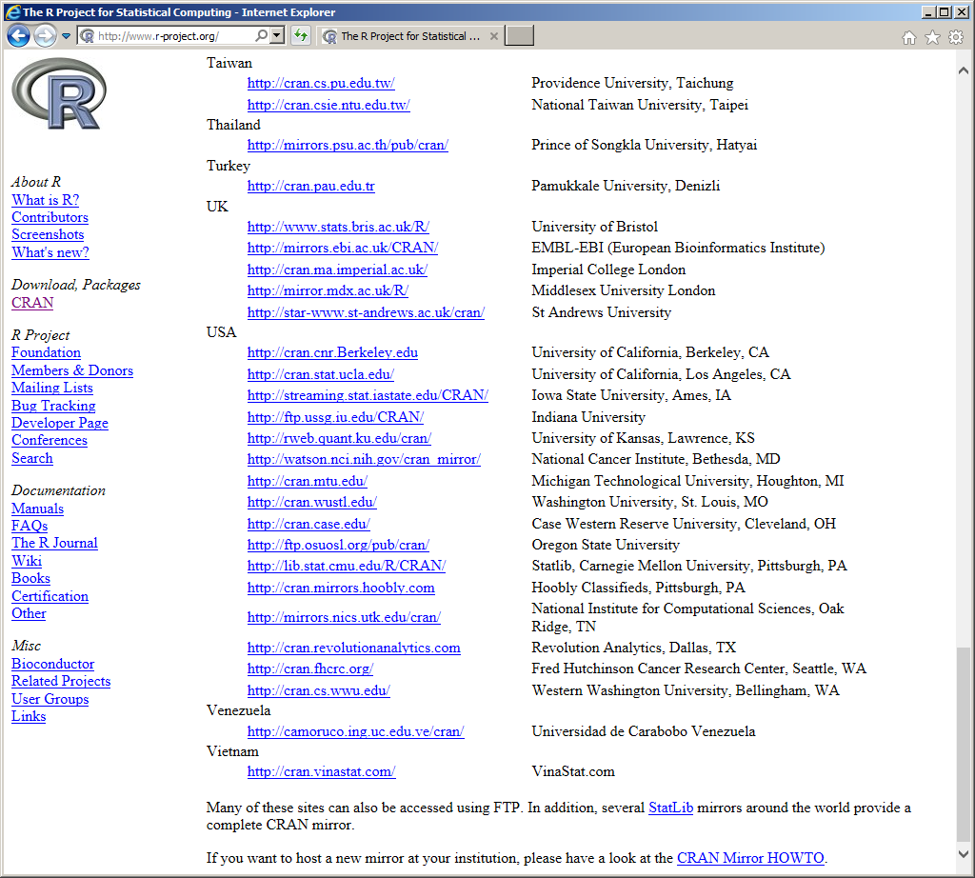
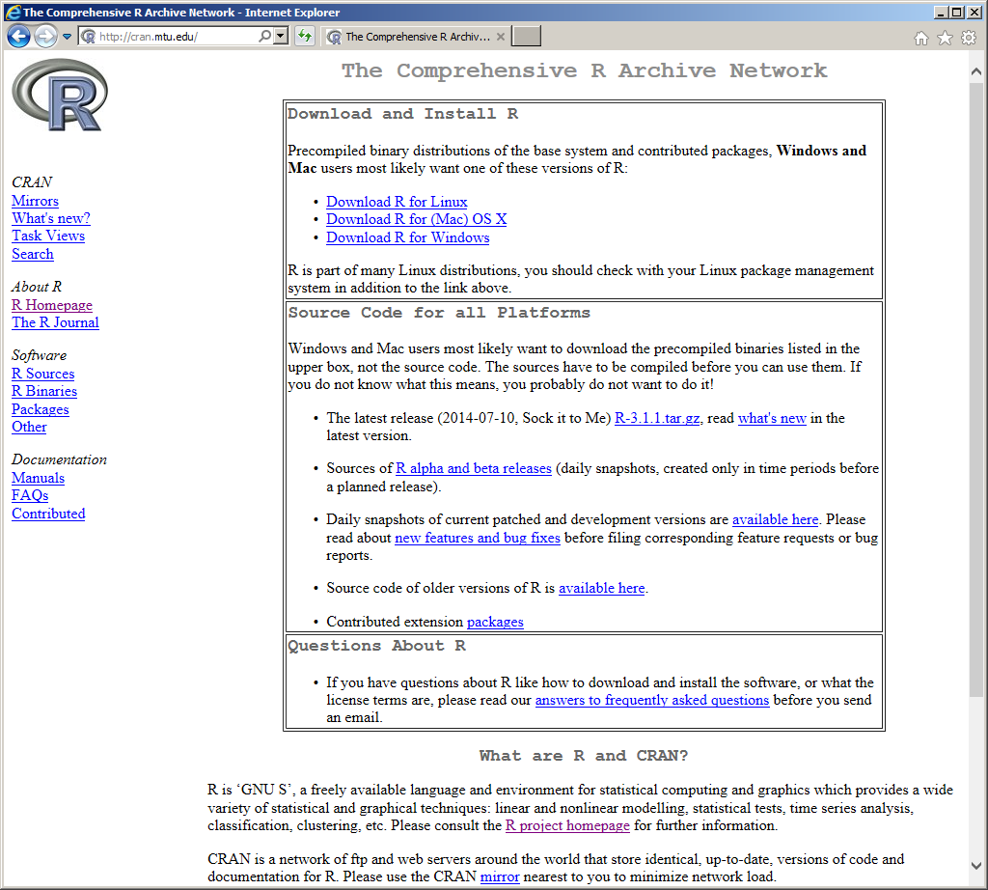
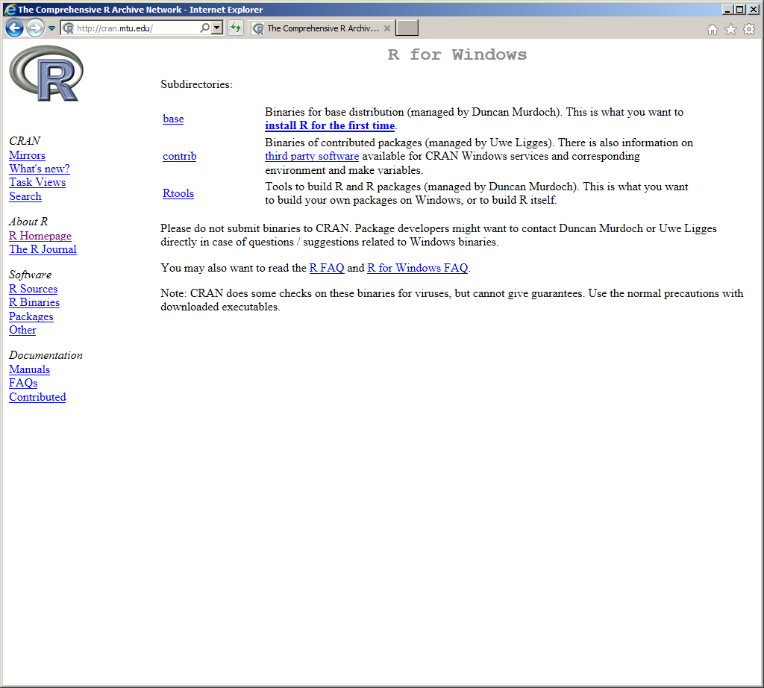
The R Project Statistical Computing (R-CRAN) http://cran.r-project.org/

Slide 8
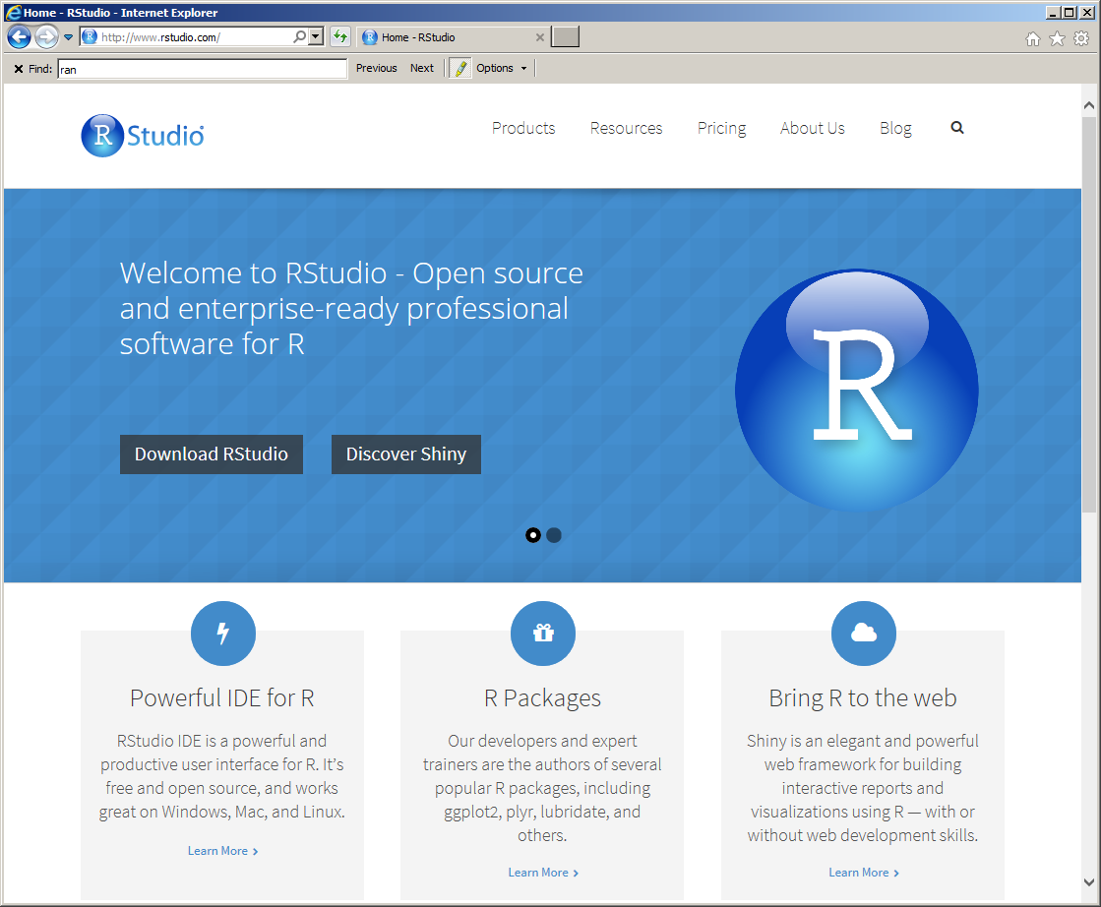
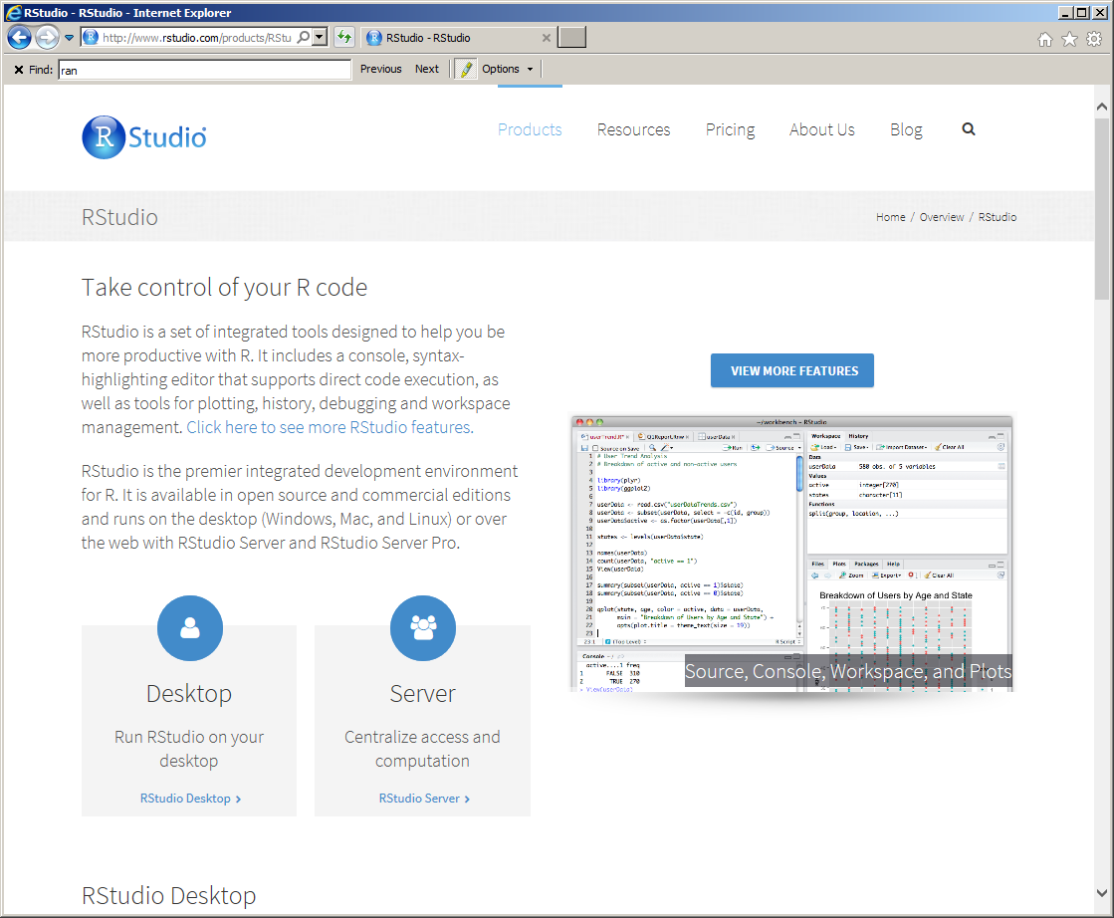
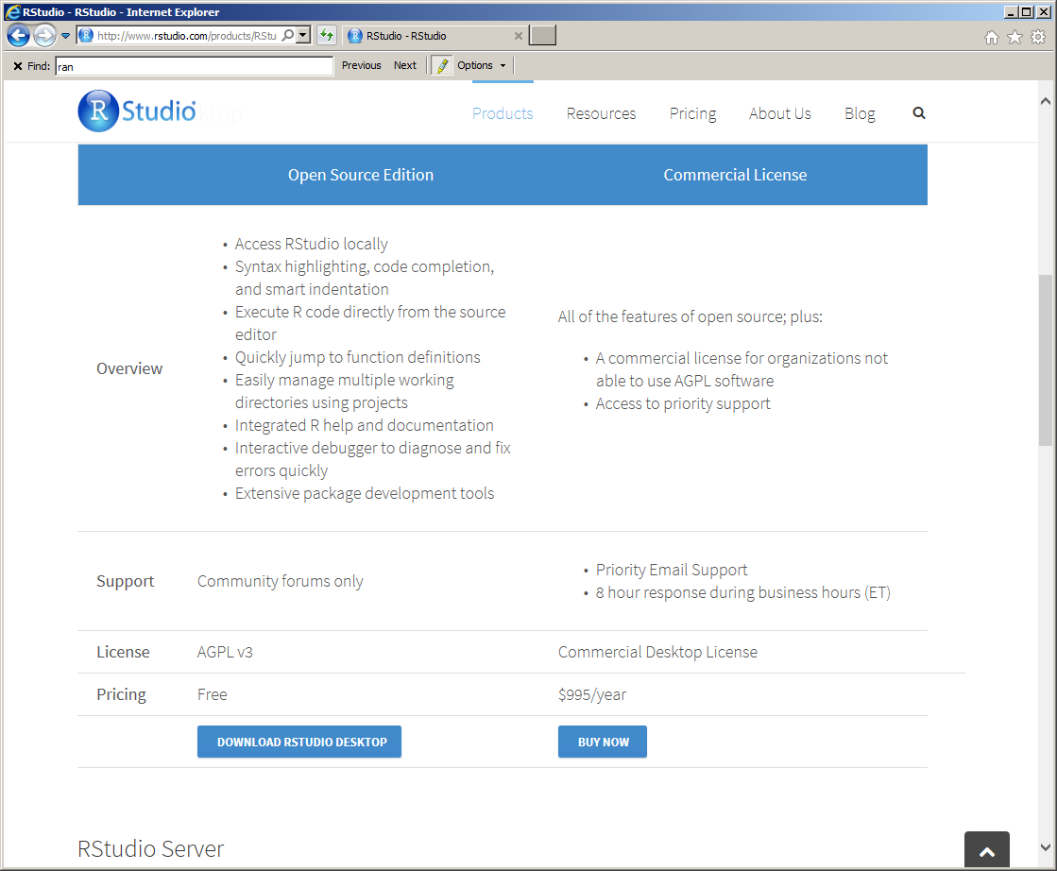
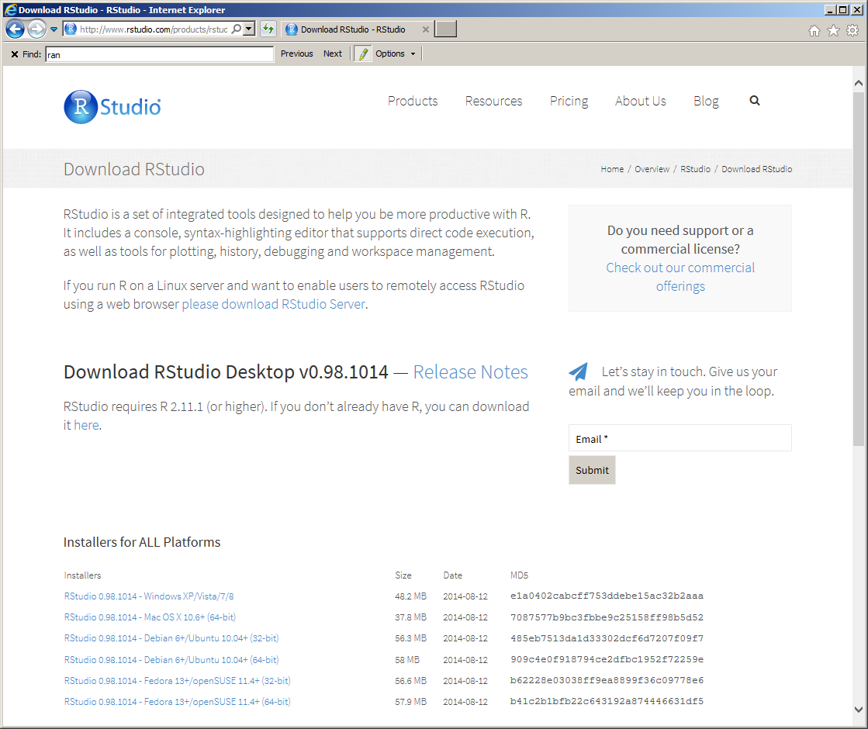
The R Studio http://www.rstudio.com/

Slide 9
Data Analysis
Data Basic
Import Data
Prepare, explore, and clean data
Statistical Analysis and Modeling
Export Data (Graph/Chart/Tables)
Day 1
Day 2

Slide 10
Data Structure and Data Types
Vectors
Matrices
Arrays
Data Frames
Lists
Factors
Numeric
Integer
Complex
Logical
Character
DataTypes.R
DataTypes.R

Slide 11
Data Types
Vector is a sequence of data elements of the same basic type
Matrix is a rectangular array of data arranged in rows and columns.
Arrays are similar to matrices but can have more than two dimensions.
Data frame is more general than a matrix, in that different columns can have different modes of data (numeric, character, factor, etc.).
Lists are ordered collection of objects (components).
Factor is a vector whose elements can take on one of a specific set of values.
DataTypes.R

Slide 12
Data Import
Data Import
Read (write) variety of data
Text: *.csv, *.tsv, *.txt
Excel: *.xls, *.xlsx
Images: *.tiff
Shapefile: *.shp
DataIO.R

Slide 13
Data Preprocessing
Subset data from the vector and data frame
Merge two vectors or data frames
Aggregation of data (mean, mode,…..,etc)
Reshape the data frame
Sorting data in ascending and descending
DataPreprocessing.R
DataProcessing_Example.R

Slide 14
Data Exploration
Check the dimensionality of the object
dim(x)
Variable names or column names
Names(DataFrameA)
Structure and Attributes
str(DataFrameA)
Get the first and last 5 rows (head and tail)
head(DataFrameA); tail(DataFrameA)
Summary
summary(DataFrameA)
Frequency
Table(DataFrameA$State)
Pair plot
pairs(DataFrameA)
DataExploration.R

Slide 15
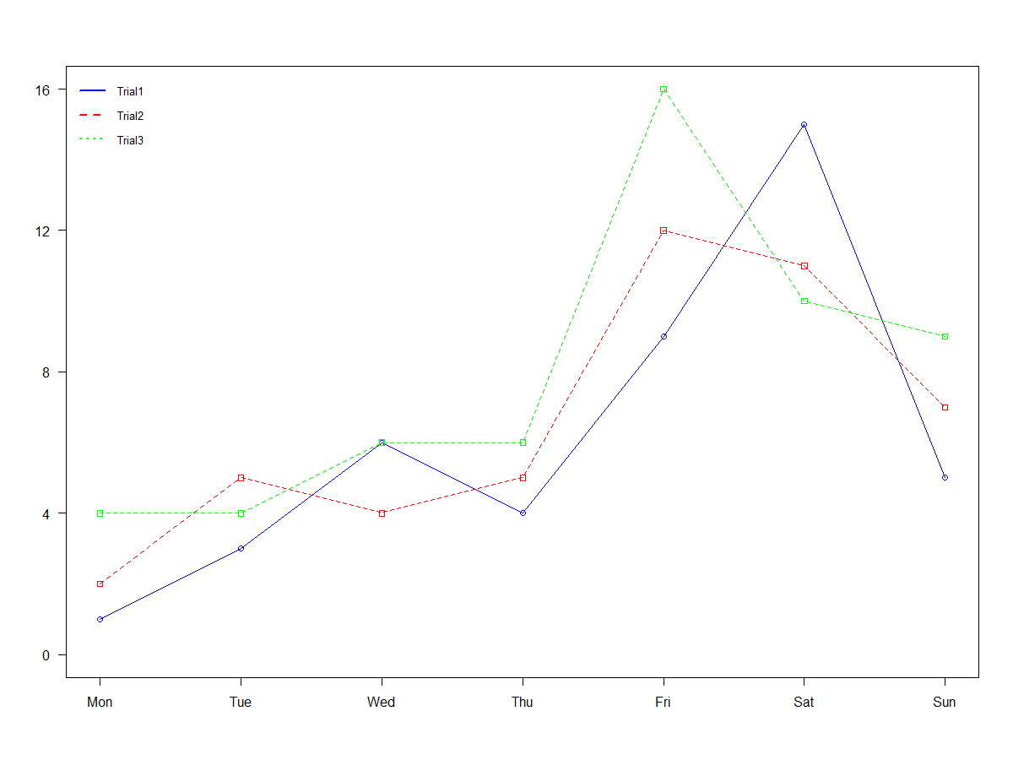
Data Visualization Basic Plot
Creating a Graph
Customization of graphs (fonts, colors, axes, titles) through graphic options.
Saving Graphs
DataVisulization1.R

Slide 16
Data Visualization Advanced Plotting
Time series plot and Two Y axis
Publication Quality Graphics
There is more called ggplot and lattice
DataVisulization2.R

Slide 17
Statistical Analysis
Advanced visualization (ggplot, lattice, spatial)
Descriptive Statistics
Regression Analysis
Time Series Data Analysis
Seasonal
ARIMA Modeling
Forecasting/Prediction

Slide 18

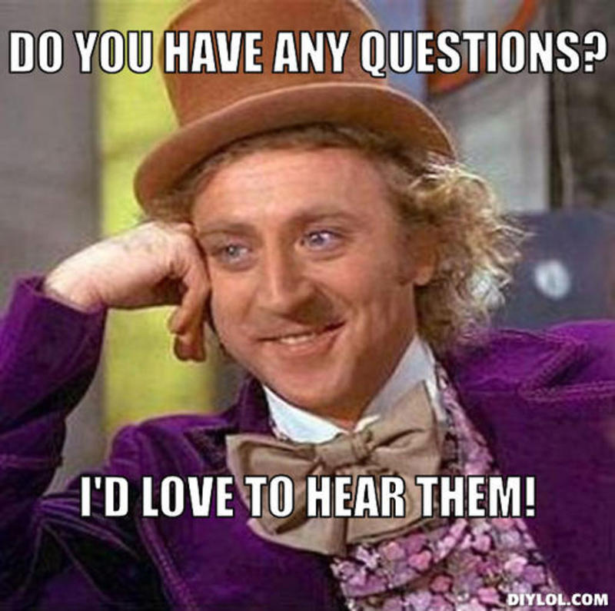
Back Page

