Slide 1
NRES-498/898
Data Analysis Using R
Baburao Kamble (Ph.D)
University of Nebraska-Lincoln

Slide 2
About me
Education
B.Tech (Agril Engineering): Konkan Agril University, India
M.Engg(Remote Sensing and GIS): Asian Institute of Technology, Thailand
Ph.D. (Civil Eng and Computer Science) University of Nebraska-Lincoln
Experience:
Postdoc: College of Engineering, UNL- May 2012 – December 2013
Research Assistant Professor : School of Natural Resources, UNL - January 2013

Slide 3
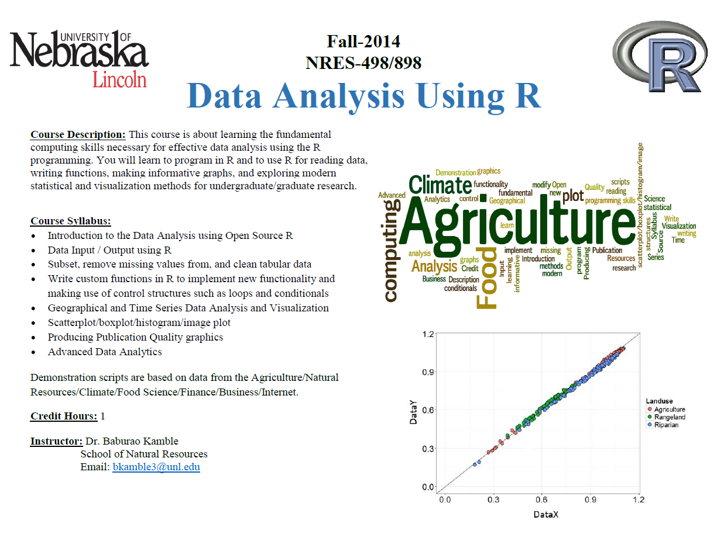

Slide 4
Schedule
Week | Topic
Week1 | Syllabus, Introduction to R
Week2 | Data Types and Data Manipulation in R
Week3 | Data Input/Output, Subset, remove missing values from, and clean tabular data
Week4 | Function, Control Structures, and Loops in R
Week5 | Chart/Plots in R
Week6 | Regression Analysis using R
Week7 | Probability Distributions using R
Week8 | Time Series Data Analysis
Week9 | Geospatial Data Analysis Using R
Week10 | Data Mining -1: Social Network Data
Week11 | Data Mining -2: Clustering, Classification and Prediction using R
Week12 | Advanced Data Visualization using R
Week13 | Project Presentations
Week14 | Project Presentations

Slide 5
Useful Books on Data Analysis using R
Standard texts
Chambers (2008). Software for Data Analysis, Springer. (your textbook)
Chambers (1998). Programming with Data, Springer.
Venables & Ripley (2002). Modern Applied Statistics with S, Springer.
Venables & Ripley (2000). S Programming, Springer.
Pinheiro & Bates (2000). Mixed-Effects Models in S and S-PLUS, Springer.
Murrell (2005). R Graphics, Chapman & Hall/CRC Press.
Other resources
Springer has a series of books called Use R!.
A longer list of books is at http://www.r-project.org/doc/bib/R-books.html

Slide 6
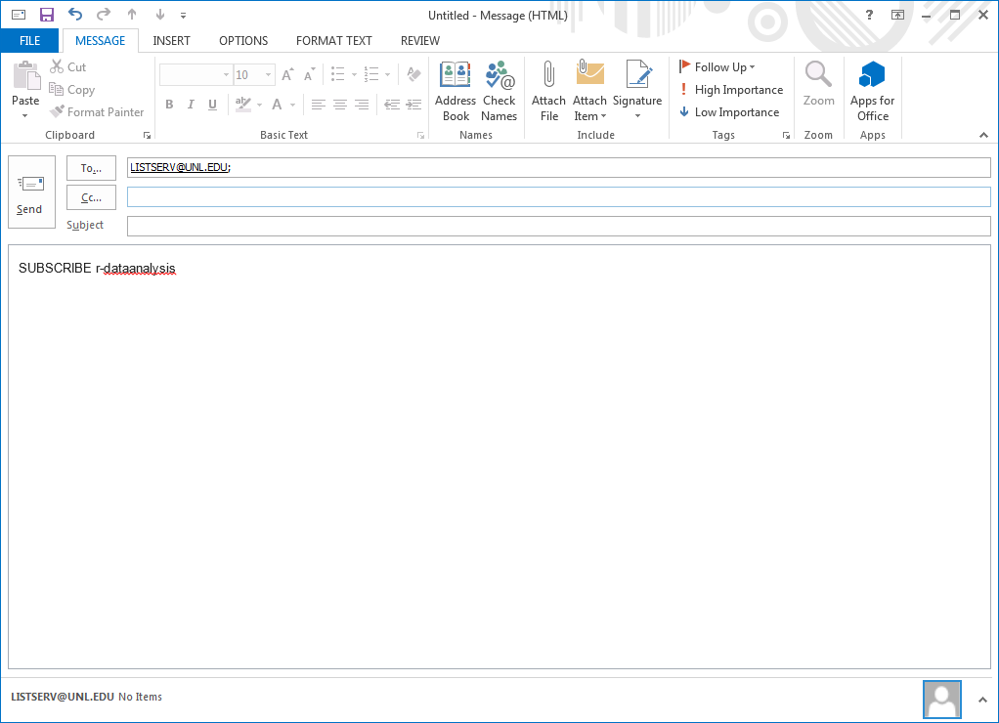
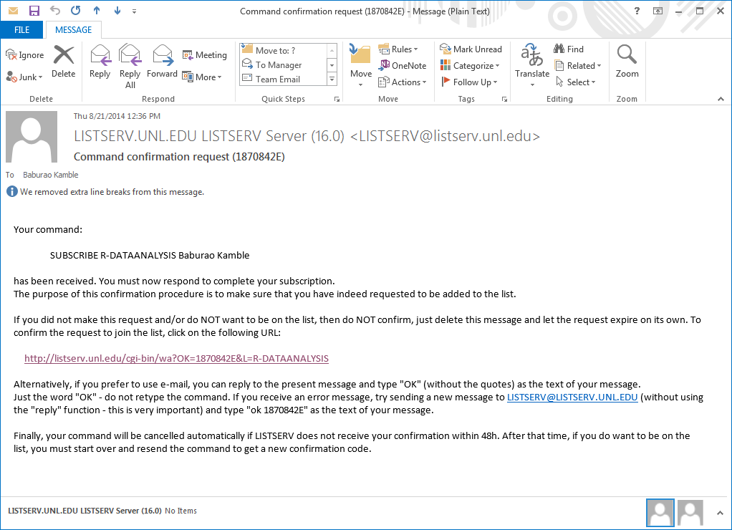
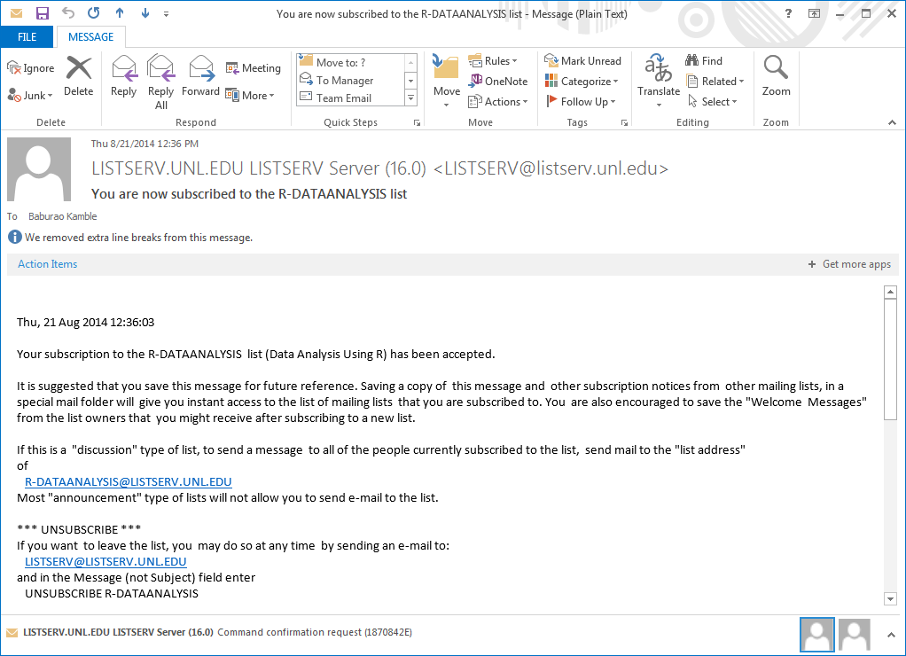
Listserv
http://listserv.unl.edu/cgi-bin/wa?A0=R-DATAANALYSIS

Slide 7

Outline
What is
Why use
How to obtain and install
Interface and Workspace of

Slide 8
What is R
R is a free programming environment for statistical computing and graphics.
R is
programming language
environment for data manipulation,
Calculation & graphical display.
includes conditionals, loops, user-defined recursive functions and input and output facilities.
R is similar to the award-winning S system, which was developed at Bell Laboratories.

Slide 9
What R is Not
a statistics software package
menu-driven
quick to learn
a program with a complex graphical interface

Slide 10
Why R?
Open source and open development.
Design and deployment of portable, extensible, and scalable software.
Interoperability with other languages: C, XML.
Variety of statistical and numerical methods.
High quality visualization and graphics tools.
Effective, extensible user interface.
Innovative tools for producing documentation and training materials: vignettes.
Supports the creation, testing, and distribution of software and data modules: packages.

Slide 11
A grad student’s 2 cents http://thetarzan.wordpress.com/2011/07/15/why-use-r-a-grad-students-2-cents/ Why biologists should use R http://labstats.net/articles/why_r.html
Why R?

Slide 12
Why R?
data handling and storage: numeric, textual
matrix algebra
hash tables and regular expressions
high-level data analytic and statistical functions
classes (“OO”)
graphics
programming language: loops, branching, subroutines
is not a database, but connects to DBMSs
has no graphical user interfaces, but connects to Java, TclTk
language interpreter can be very slow, but allows to call own C/C++ code
no spreadsheet view of data, but connects to Excel/MsOffice
no professional / commercial support

Slide 13
Installing, Running, and Interacting with R
How to get R:
http://www.r-project.org/
Google: “R”
Windows, Linux, Mac OS X, source

Slide 14
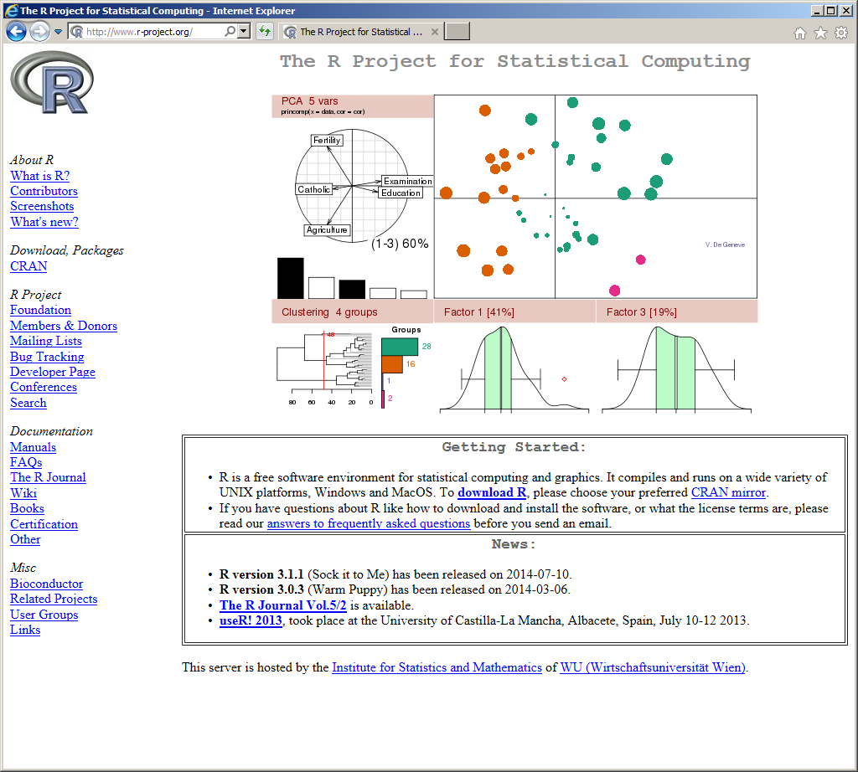
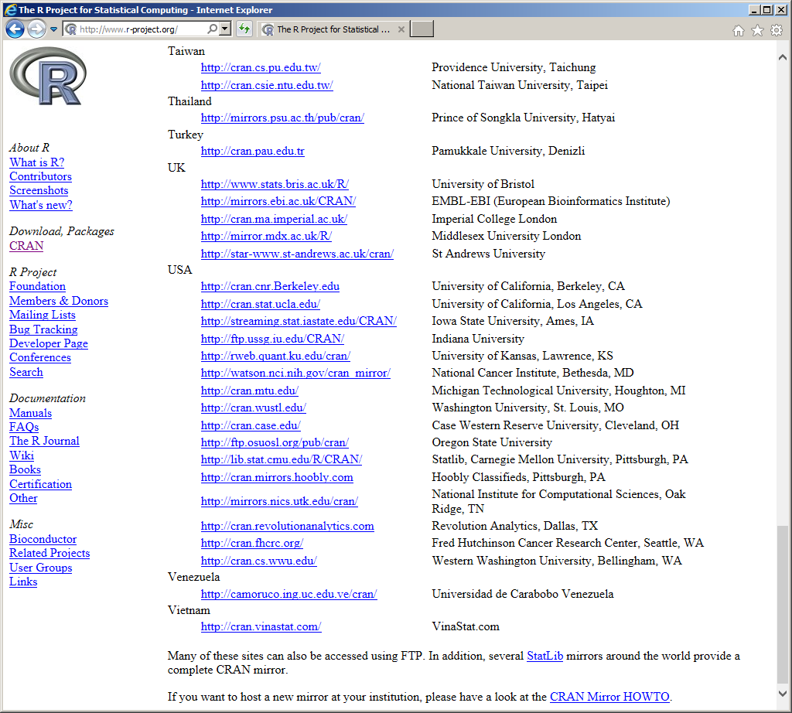
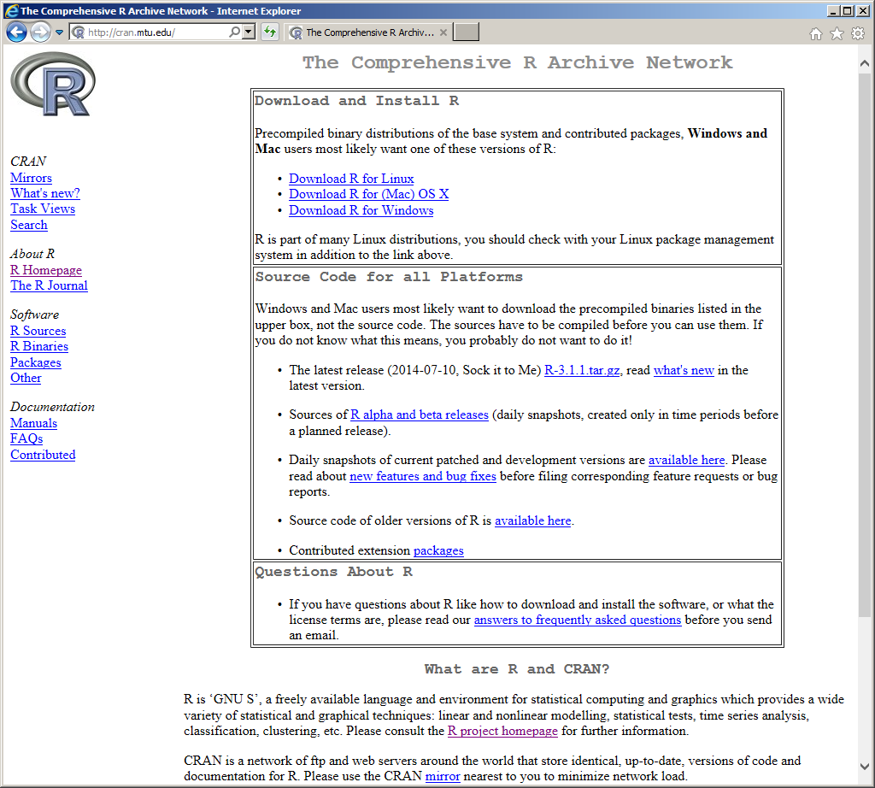
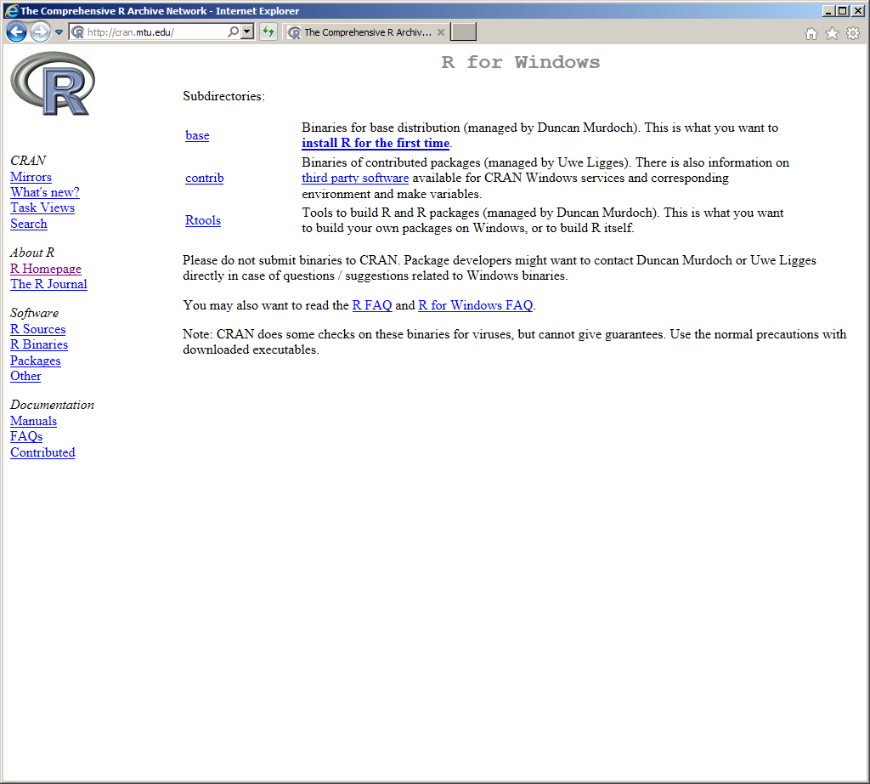
The R Project Statistical Computing (R-CRAN) http://cran.r-project.org/

Slide 15
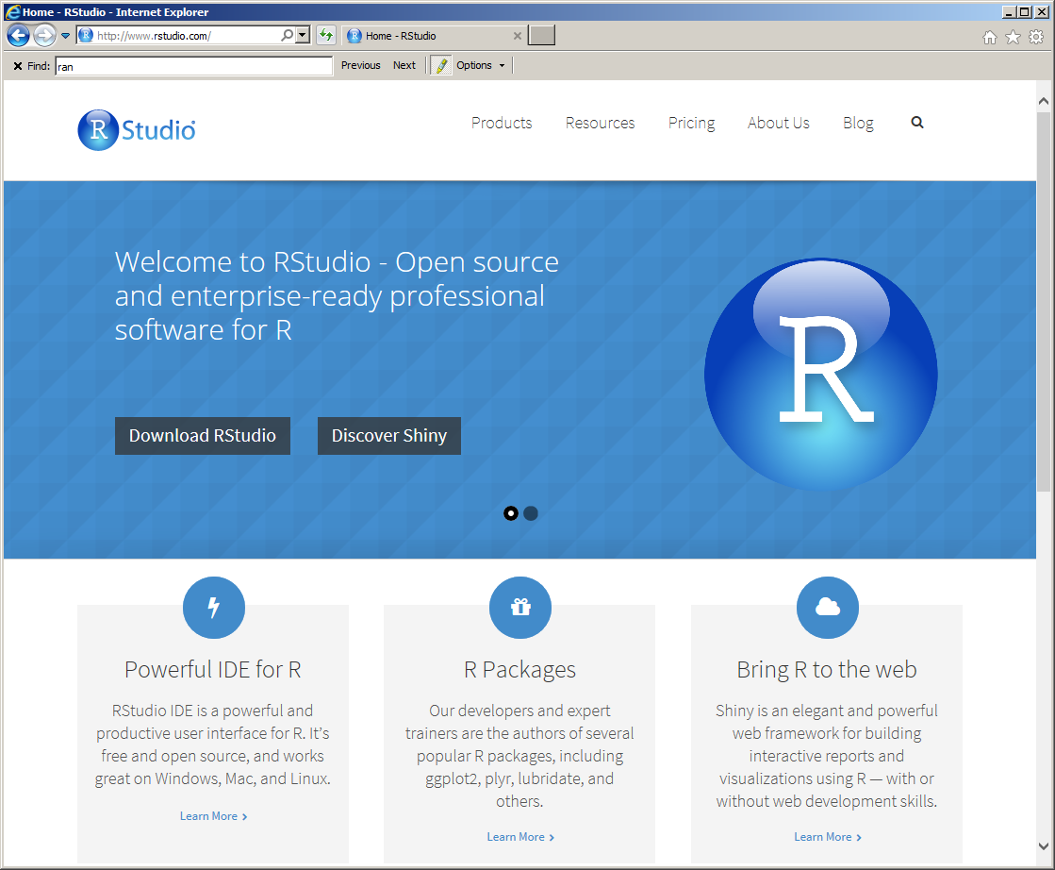
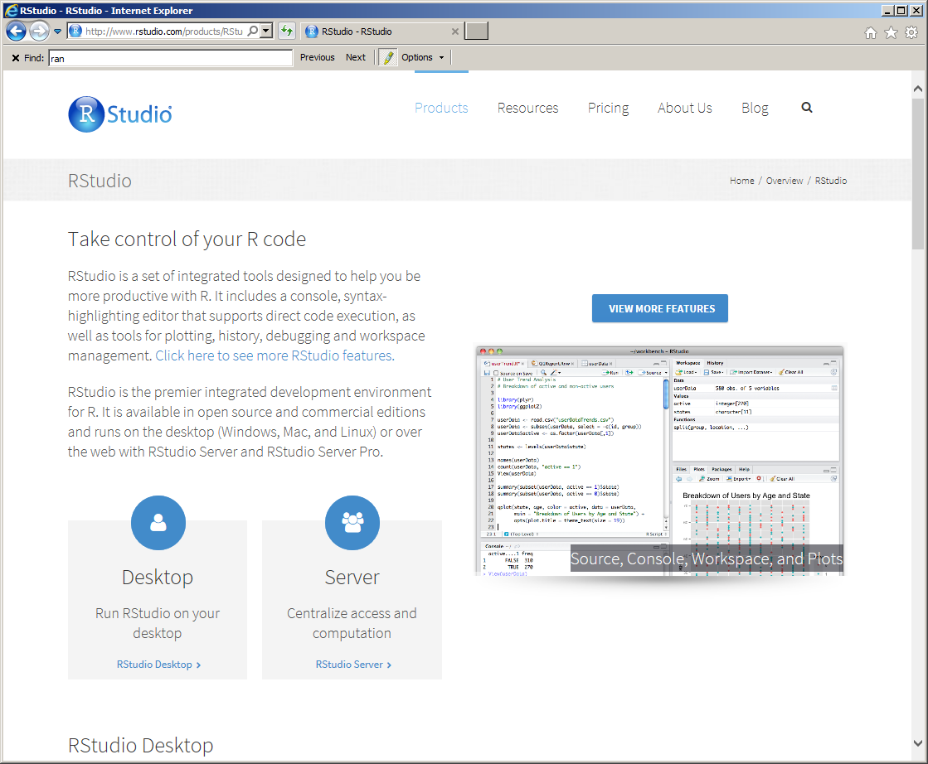
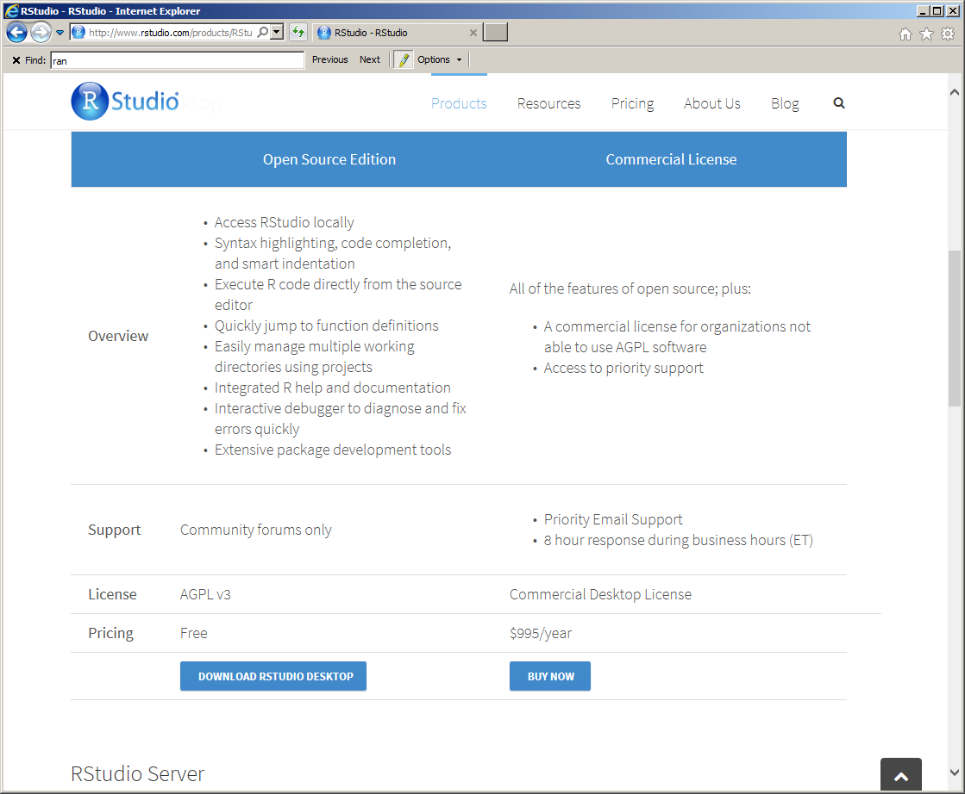
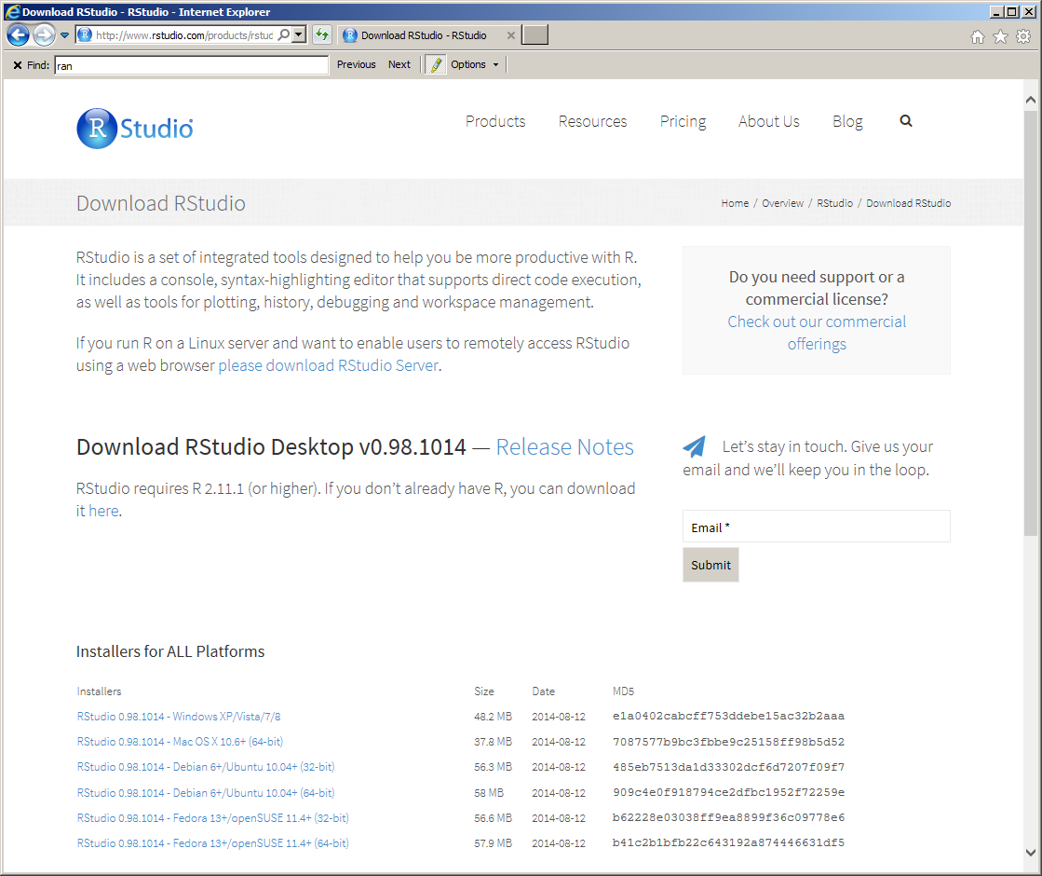
The R Studio http://www.rstudio.com/

Slide 16
Getting Started
Assignment
To assign a value to a variable use “<-” or “=”
Arithmetic Operators
Logical Operators
Operator | Description
+ | addition
- | subtraction
* | multiplication
/ | division
^ or ** | exponentiation
x %% y | modulus (x mod y) 5%%2 is 1
x %/% y | integer division 5%/%2 is 2
Operator | Description
< | less than
<= | less than or equal to
> | greater than
>= | greater than or equal to
== | exactly equal to
!= | not equal to
!x | Not x
x | y | x OR y
x & y | x AND y
isTRUE(x) | test if X is TRUE

Slide 17
Script
## Entering data: # Math: 1 + 1 1 + 1 * 7 (1 + 1) * 7 # Variables: x <- 1 y = 2 3 -> z x y z (x + y) * z## Entering data:
# Math:
1 + 1
1 + 1 * 7
(1 + 1) * 7
# Variables:
x <- 1
y = 2
3 -> z
x
y
z
(x + y) * z

