Slide 1
Data Analysis Using R
Week5: Charts/Plots in R
Baburao Kamble (Ph.D)
University of Nebraska-Lincoln

Slide 2
Steps in Typical Data Analysis for Research
Data Collection
Import Data
Prepare, explore, and clean data
Statistical Analysis and Modeling
Export Data (Graph/Chart/Tables)
Getting a feel for the data using plots, then analyzing the data with correlations and linear regression.

Slide 3
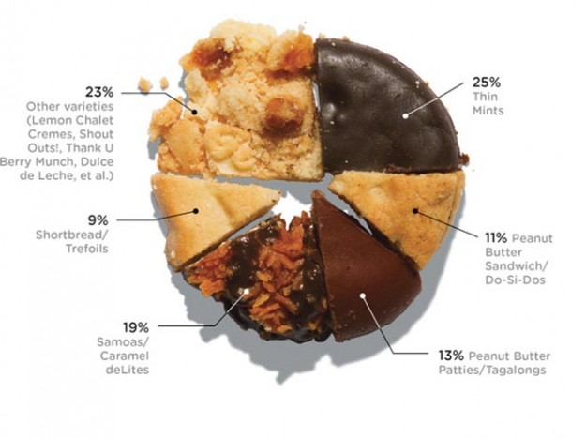

Slide 4
R graphics – Nice and Simple
R has powerful graphics facilities for the production of publication-quality diagrams and plots.
Can produce traditional plots as well as grid graphics.
Great reference: Murrell P., R Graphics

Slide 5
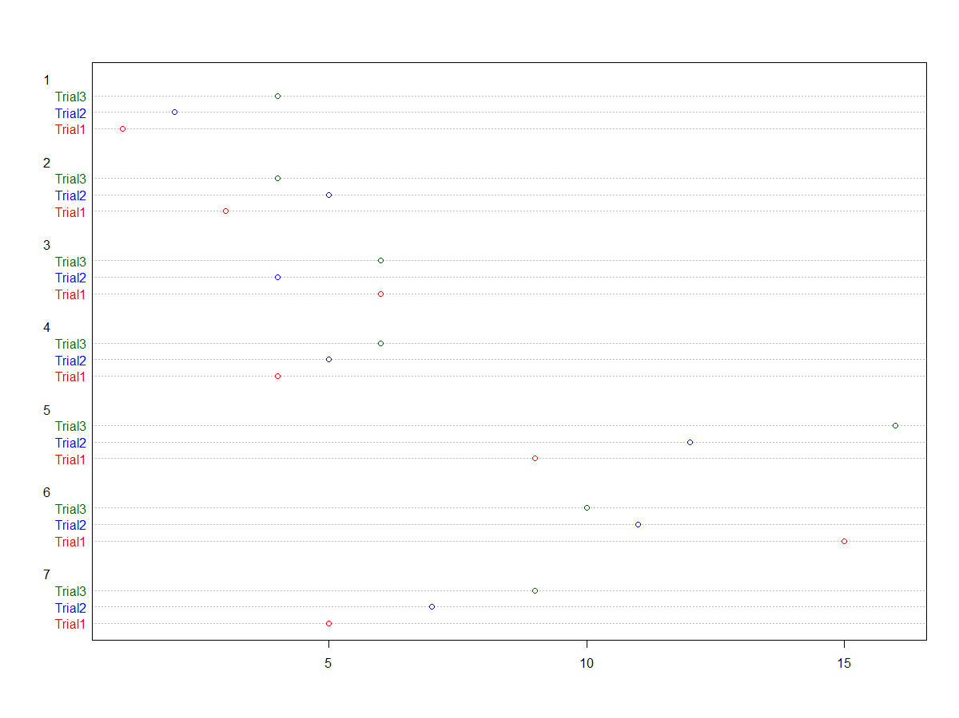
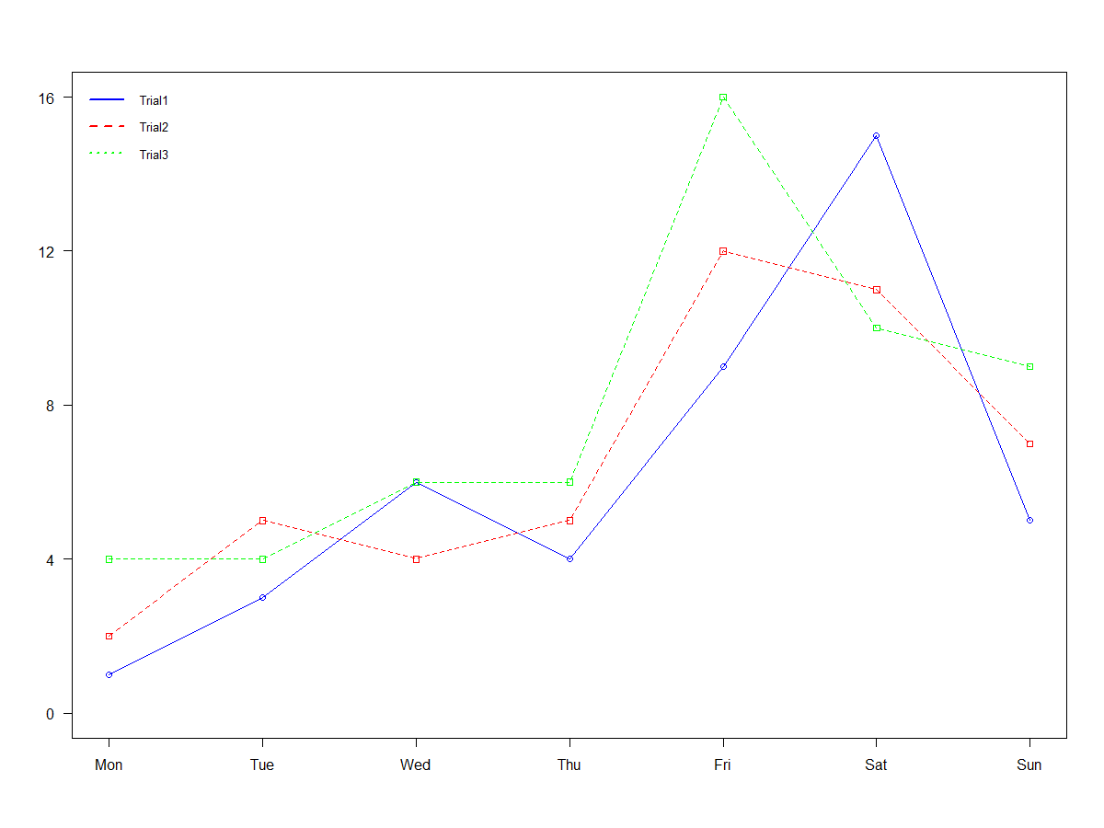
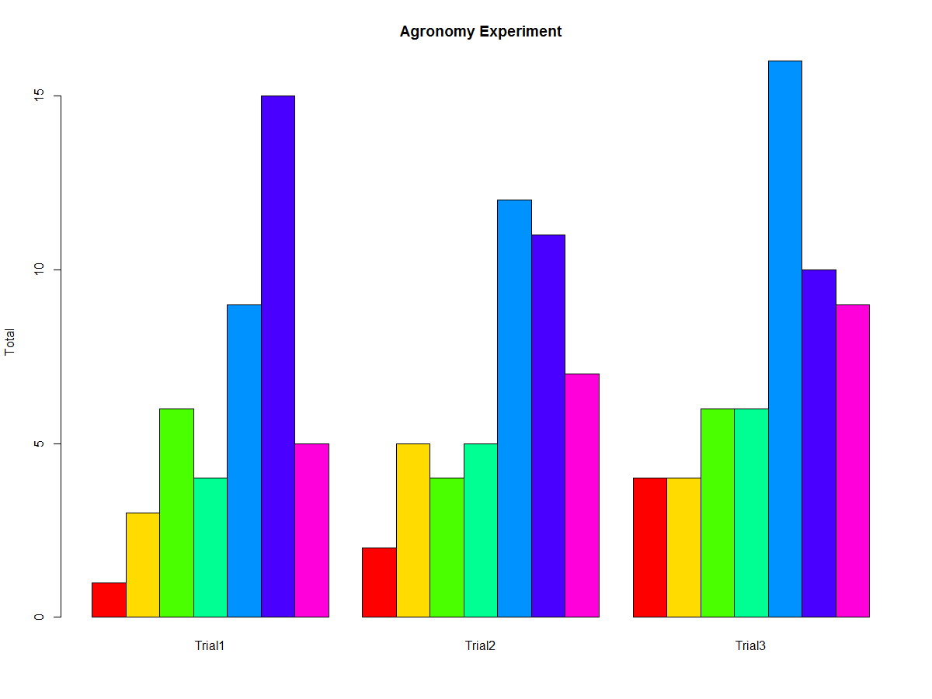

Slide 6
Topics for today
Line Charts
Bar Charts
Histograms
Pie Charts
Dotcharts
legend, xlab, ylab, main, xlim, ylim, pch, lty, lwd.
Save Graphs in different graphics formats (png/jpeg/pdf)
Notes:
AUD – alcohol abuse and alcohol dependence

Slide 7
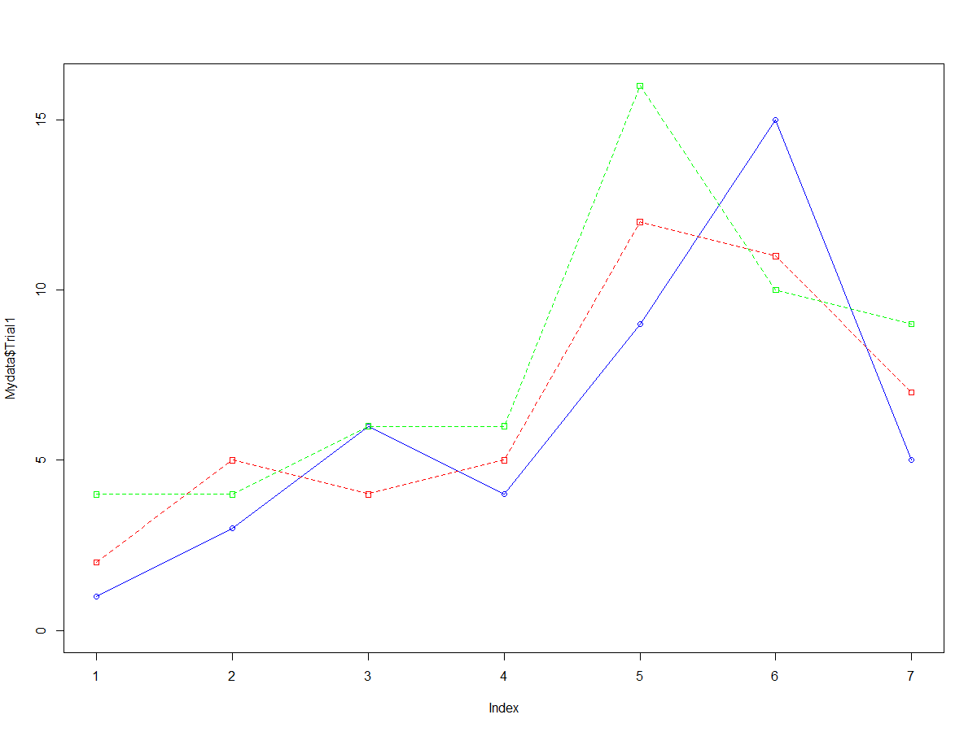
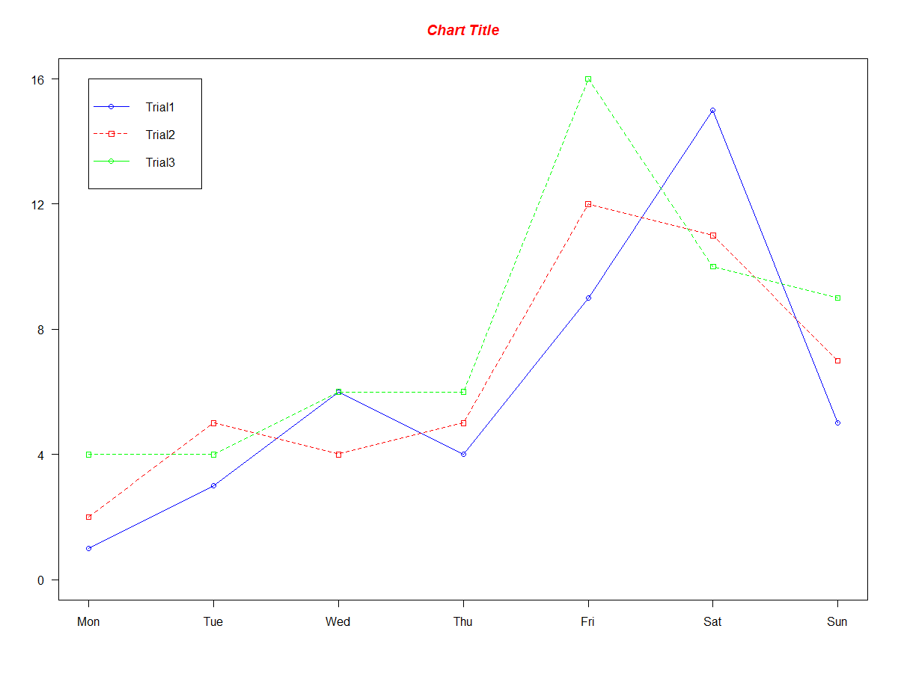
Chart– Before and After
Notes:
CBI – combined behavioral interventions
7

Slide 8
R code
Data available in R; for a full description: help(Puromycin).
We will start with the basic command plot() and tackle each parameter.
Generate multiple graphs in the same window using: par(mfrow).
For a better understanding use help().

Slide 9
Change Graphical Parameters using par()
A list of graphical parameters that define the default behavior of all plot functions.
Just like other R objects, par elements are similarly modifiable, with slightly different syntax.
  e.g. par(“bg”=“lightcyan”)
  This would change the background color of all subsequent plots to light cyan
When par elements are modified directly (as above, this changes all subsequent plotting behavior.
Notes:
9

Slide 10
Par examples modifiable from within plotting functions
bg – plot background color
lty – line type (e.g. dot, dash, solid)
lwd – line width
col – color
cex – text size inside plot
xlab, ylab – axes labels
main – title
pch – plotting symbol
… and many more (learn as you need them)
Notes:
10

Slide 11
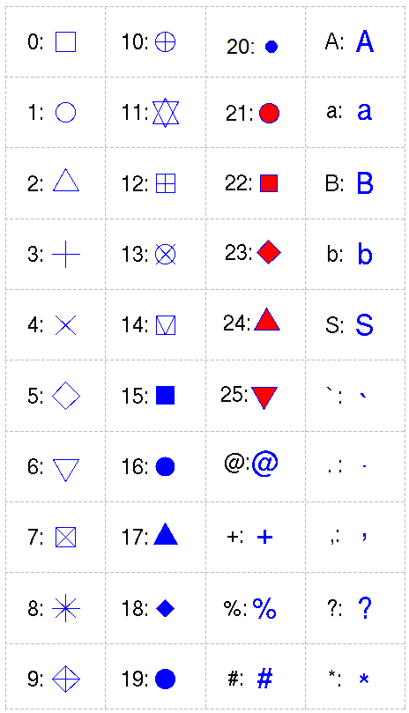
Plotting symbols for pch
option | description
cex | number indicating the amount by which plotting text and symbols should be scaled relative to the default. 1=default, 1.5 is 50% larger, 0.5 is 50% smaller, etc.
cex.axis | magnification of axis annotation relative to cex
cex.lab | magnification of x and y labels relative to cex
cex.main | magnification of titles relative to cex
cex.sub | magnification of subtitles relative to cex
Notes:
11

Slide 12
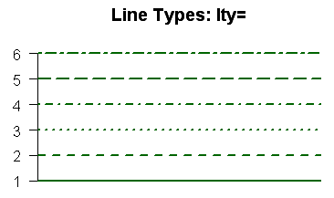
Plotting line: lty(line type)
option | description
lty | line type. see the chart below.
lwd | line width relative to the default (default=1). 2 is twice as wide.
Notes:
12

Slide 13
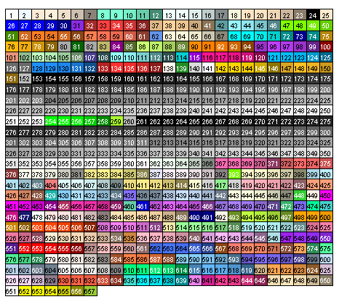
Color: col
option | description
col | Default plotting color. Some functions (e.g. lines) accept a vector of values that are recycled.
col.axis | color for axis annotation
col.lab | color for x and y labels
col.main | color for titles
col.sub | color for subtitles
fg | plot foreground color (axes, boxes - also sets col= to same)
bg | plot background color
Notes:
13

Slide 14
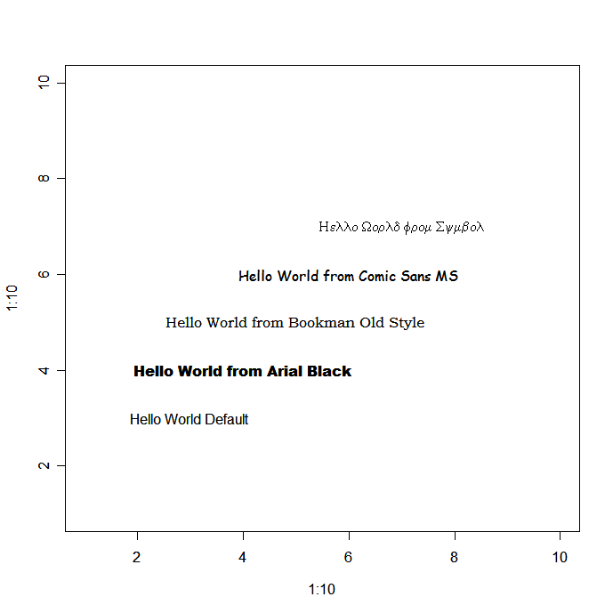
option | description
font | Integer specifying font to use for text. 1=plain, 2=bold, 3=italic, 4=bold italic, 5=symbol
font.axis | font for axis annotation
font.lab | font for x and y labels
font.main | font for titles
font.sub | font for subtitles
ps | font point size (roughly 1/72 inch) text size=ps*cex
family | font family for drawing text. Standard values are "serif", "sans", "mono", "symbol". Mapping is device dependent.

Slide 15
Save the output
Specify destination of graphics output or simply right click and copy
Could be files
  Not Scalable
    JPG # not recommended, introduces blurry artifacts
    around the lines
    BMP
    PNG
  Scalable:
    Postscript # preferred in LaTex
    Pdf # great for posters

Slide 16
How to Create Publication-Quality Figures
A step-by-step guide
http://cellbio.emory.edu/bnanes/figures/#13

Slide 17
Advanced Plotting
There are 4 plotting systems.
There is standard, grid, lattice, and ggplot2.
The latter two are higher level systems built on the former two. Each has advantages and disadvantages.

Slide 18
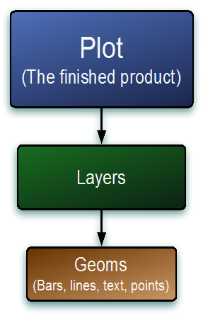
ggplot2
ggplot2
plyr
reshape
rggobi
profr
http://ggplot2.org/

Slide 19
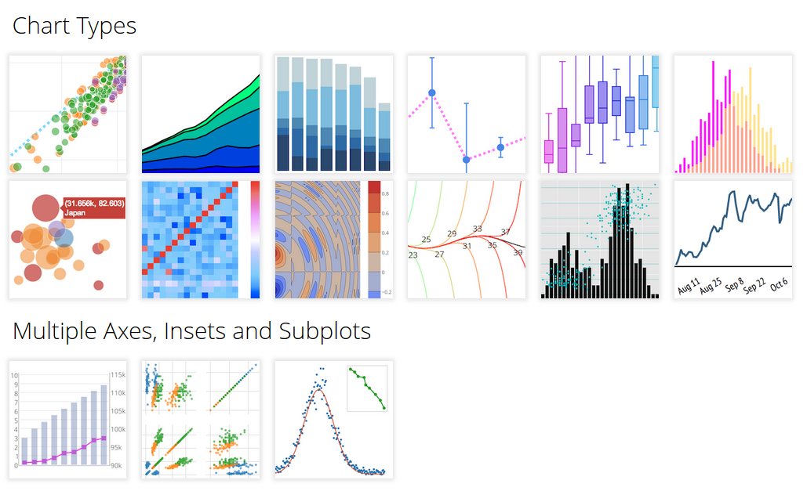

Slide 20
Questions ?

