Slide 1
Data Analysis Using R
Week6: Advanced Visualization in R
Baburao Kamble (Ph.D)
University of Nebraska-Lincoln

Slide 2
Steps in Typical Data Analysis for Research
Data Collection
Import Data
Prepare, explore, and clean data
Statistical Analysis and Modeling
Export Data (Graph/Chart/Tables)
Getting a feel for the data using plots, then analyzing the data with correlations and linear regression.

Slide 3

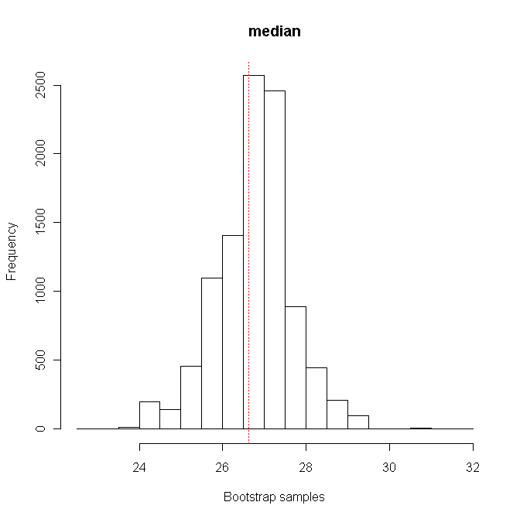
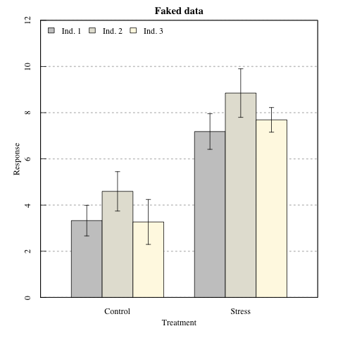
R Package –barpot, simpleboot
barplot()
hist()
image()
plot()
pairs()
persp()
piechart()
polygon()

Slide 4
Agenda
Pie Chart with % (PieChart.R)
Publication quality graphics (PublicationGraphics.R)
2Y Axis Plot (2YAxis.R)
Advanced Chart with ggplot2 and lattice
(AdvancedGraphics.R)
ggplot_timescale.R
Latticedemo.R

Slide 5
Data Visualization
To present R graphics users with enough information to make an informed choice as to which graphics package best meets their needs
Advanced Graphics R packages :ggplot2 and lattice

Slide 6
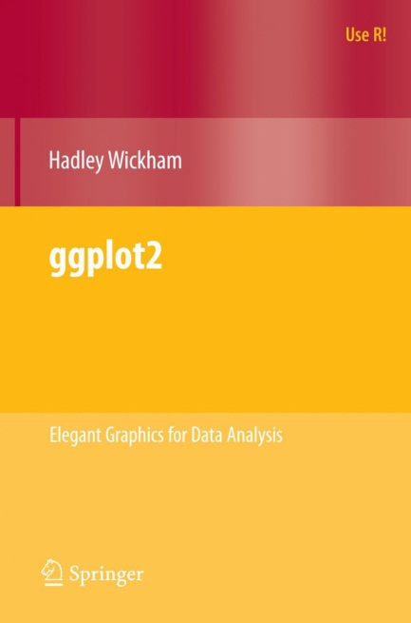
ggplot2 Graphics
Graphical package created by Hadley Wickham

Slide 7
ggplot2
Plotting system for R
Flexible, accessible, visualization of data
install.packages("ggplot2")
Developed by Hadley Wickham
Grammar of graphics: formal structured perspective on describing data graphics
Data properties: typically numerical or categorical values
Visual properties: x and y positions of points, colors of lines, heights of bars
Benefits compared to other R packages
Structure of the data can remain the same while making very different types of plots
Standard format for generating plots
Once you have your code you can reuse reuse reuse

Slide 8
Using ggplot2
Two primary ways of creating a plot:
Create a “quick plot” using qplot
Create plot at a more detail level using ggplot

Slide 9
qplot
qplot(x, y, data=, color=, shape=, size=, alpha=, geom=, method=, formula=, facets=, xlim=, ylim= xlab=, ylab=, main=, sub=)
option | description
alpha | Alpha transparency for overlapping elements expressed as a fraction between 0 (complete transparency) and 1 (complete opacity)
color, shape, size, fill | Associates the levels of variable with symbol color, shape, or size. For line plots, color associates levels of a variable with line color. For density and box plots, fill associates fill colors with a variable. Legends are drawn automatically.
data | Specifies a data frame
facets | Creates a trellis graph by specifying conditioning variables. Its value is expressed asrowvar ~ colvar. To create trellis graphs based on a single conditioning variable, userowvar~. or .~colvar)
geom | Specifies the geometric objects that define the graph type. The geom option is expressed as a character vector with one or more entries. geom values include "point", "smooth", "boxplot", "line", "histogram", "density", "bar", and "jitter".
main, sub | Character vectors specifying the title and subtitle
method, formula | If geom="smooth", a loess fit line and confidence limits are added by default. When the number of observations is greater than 1,000, a more efficient smoothing algorithm is employed. Methods include "lm" for regression, "gam" for generalized additive models, and "rlm" for robust regression. The formula parameter gives the form of the fit. For example, to add simple linear regression lines, you'd specify geom="smooth", method="lm", formula=y~x. Changing the formula to y~poly(x,2) would produce a quadratic fit. Note that the formula uses the letters x and y, not the names of the variables. For method="gam", be sure to load the mgcv package. For method="rml", load the MASS package.
x, y | Specifies the variables placed on the horizontal and vertical axis. For univariate plots (for example, histograms), omit y
xlab, ylab | Character vectors specifying horizontal and vertical axis labels
xlim,ylim | Two-element numeric vectors giving the minimum and maximum values for the horizontal and vertical axes, respectively

Slide 10
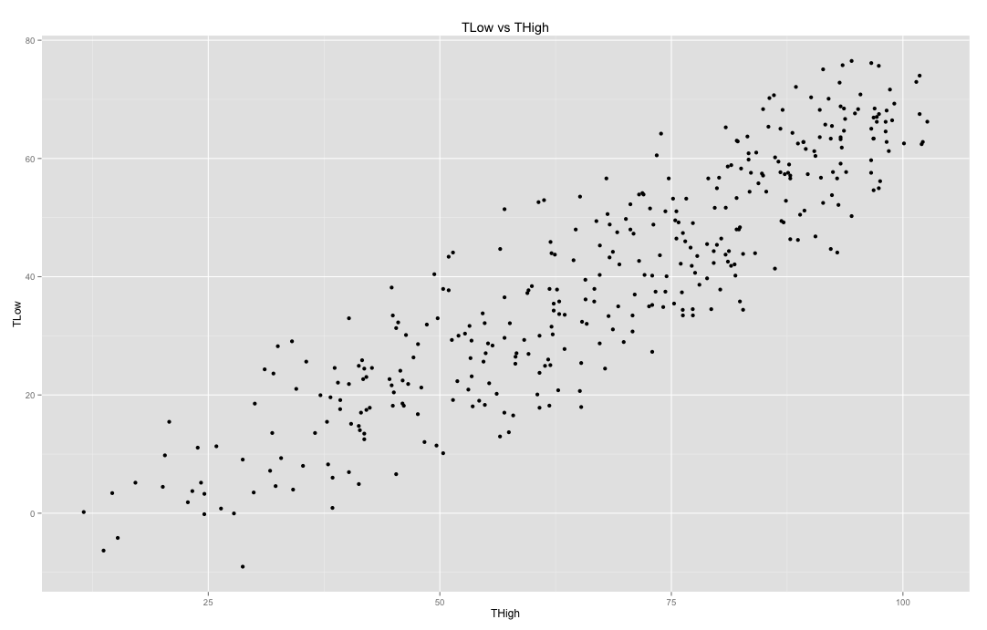
A Simple Scatter Plot using qplot
require(ggplot2)
qplot(THigh,TLow,data=weatherdata, main="TLow vs THigh")

Slide 11
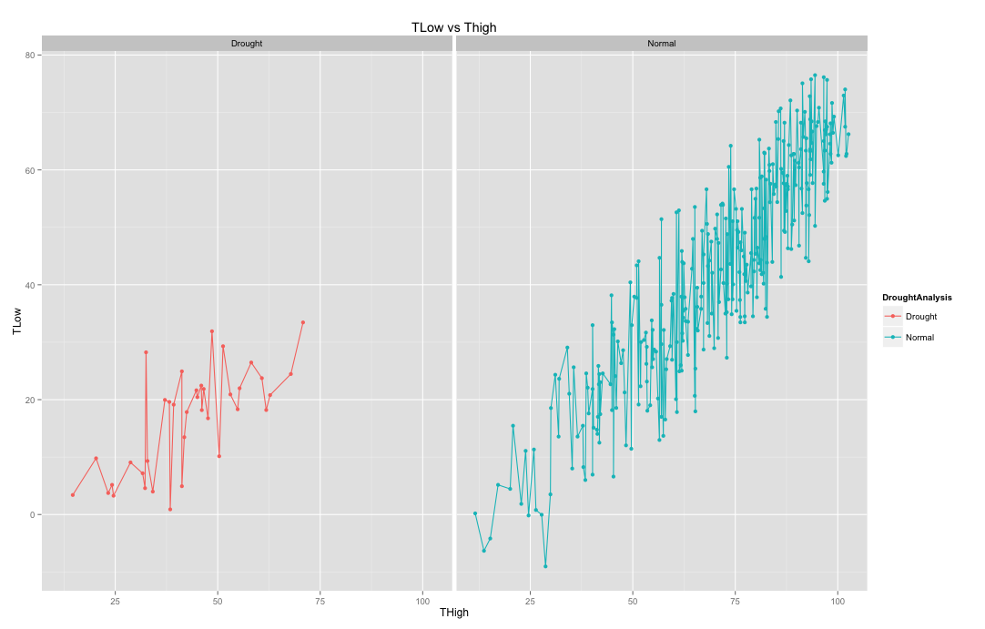
Panelling using qplot
qplot(THigh,TLow,data=weatherdata,
facets=~DroughtAnalysis, geom=c("point", "line"),main="TLow vs Thigh",color=DroughtAnalysis)

Slide 12

Styling
Styling appears in many places in ggplot2
The graphics shown so far have already been “styled” to some degree
In-built themes control general page styling:
Plot styling is controlled by scale layers…

Slide 13
ggplot2:Terminologies
Data: what we want to visualize
Geoms: geometric objects drawn to represent the data
Aesthetics (aes): visual properties of geoms such as defining X, defining Y, line color, point shapes, etc.
Mappings: mapping from data values to aesthetics
Scales: control mapping from data space to aesthetic space
Guides: show viewer how to map visual properties back to data space: tick marks and labels, etc

Slide 14

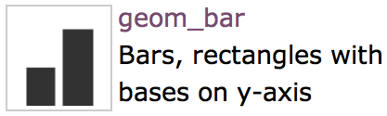
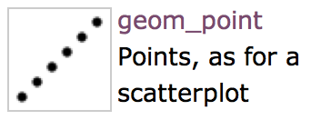
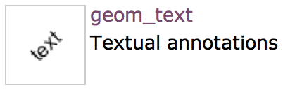
3. Geometric Object
A geom can only display certain aesthetics
A plot must have at least one geom; there is no upper limit

Slide 15
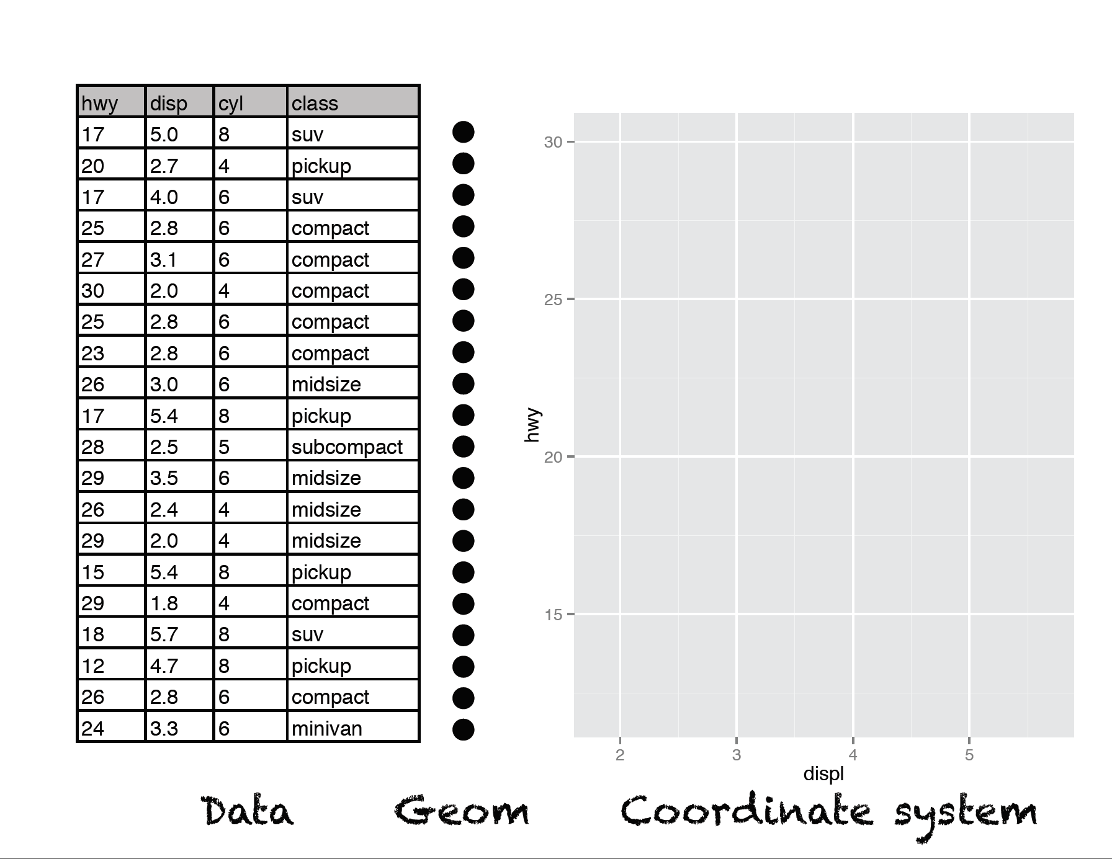

Slide 16
Example
The data.frame to plot
Aesthetic Mappings
ggplot(data=weather, aes(x=Tmin, y=Tmax))
+ geom_point()
What geom to use in plotting
ggplot2 graphics work with layers

Slide 17
ggplot2 Example 1: Scatter Plot
Ggplot2 example 1
ggplot(data, aes (x=Tmean, y=ET))
But we need to add geometric objects such as points, so we need to add:
ggplot(weatherdata, aes (x=Tmean, y=ET)) + geom_point( )
We can add group to the color of the points, by adding specifying aesthetics for that particular geom
ggplot(weatherdata, aes (x=Tmean, y=ET)) + geom_point(aes(color=Drought))

Slide 18
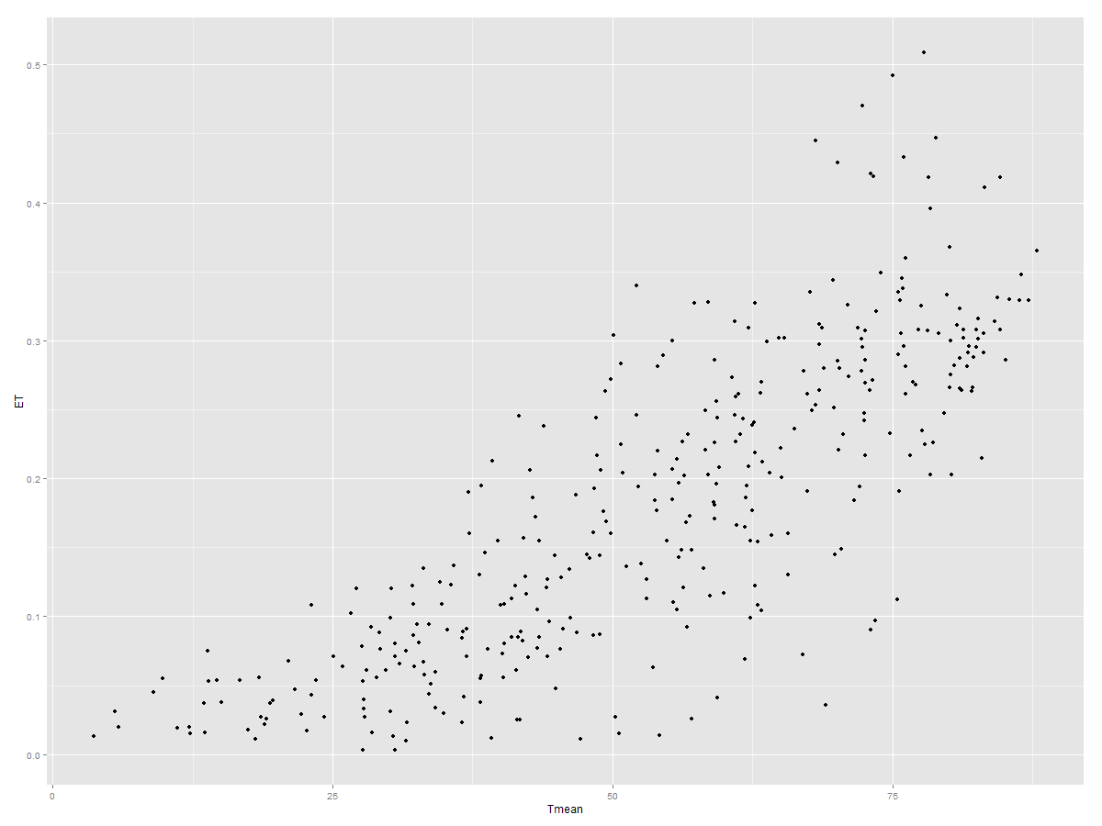
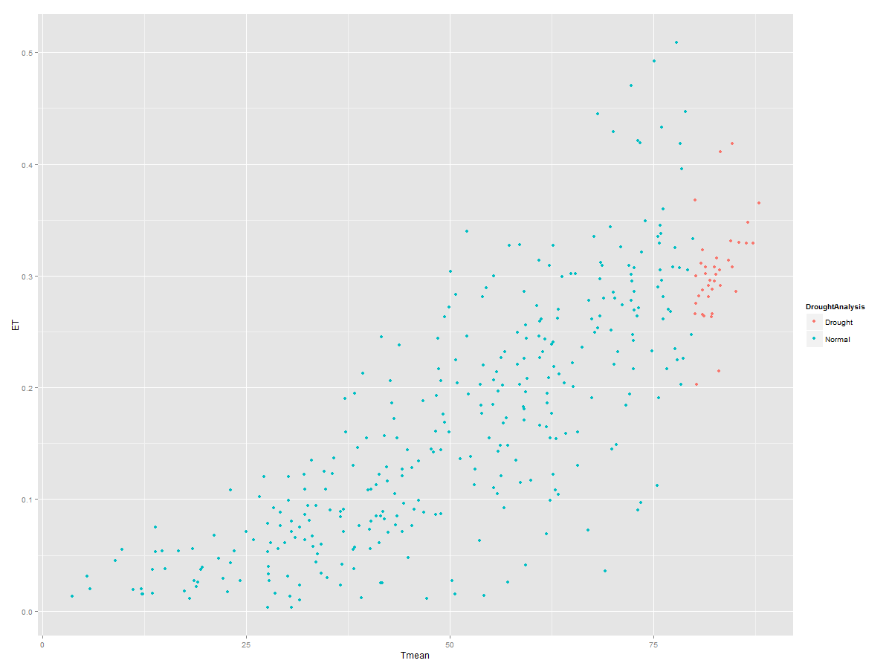
ggplot2 Example 1: Scatter Plot
Ggplot2 example 1
We can add group to the color of the points, by adding specifying aesthetics for that particular geom

Slide 19
ggplot2 Example : Scatter Plot
Ggplot2 example
How about changing the axes?
Command:
ggplot(dat, aes (x=PC1, y=PC2)) + geom_point( )
Modify the scale:
ggplot(dat, aes (x=PC1, y=PC2)) + geom_point( ) + geom_point( )+ scale_x_continuous (limits = c(0,8))

Slide 20
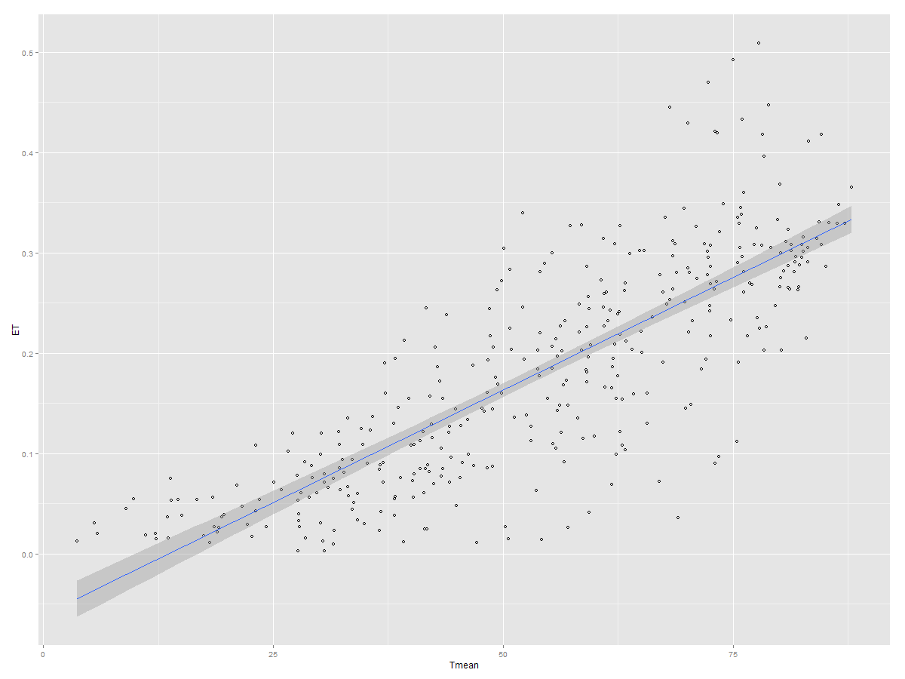
ggplot2 Example : Scatter Plot
Ggplot2 example 1
Change points
q1<-ggplot(weatherdata, aes (x=Tmean, y=ET,color=DroughtAnalysis))+ geom_point(shape=2) + scale_colour_hue(l=50)
# Use a slightly darker palette than normal

Slide 21
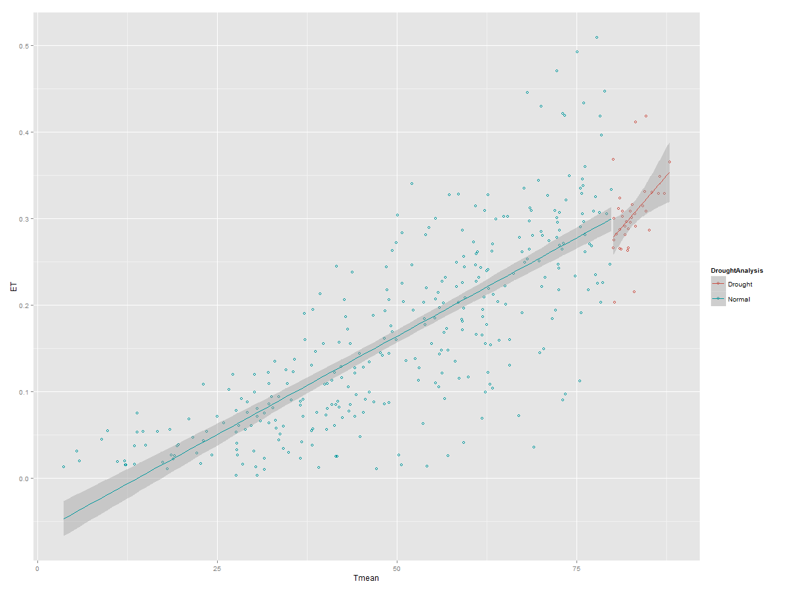
ggplot2 Example : Scatter Plot
Add regression lines
ggplot(weatherdata, aes(x=Tmean, y=ET)) + geom_point(shape=1) + scale_colour_hue(l=50) + geom_smooth(method = lm, se=TRUE)
#Add linear regression lines but don’t add shaded confidence region
ggplot(weatherdata, aes(x=Tmean, y=ET,color=DroughtAnalysis)) + geom_point(shape=1) + scale_colour_hue(l=50) + geom_smooth(method = lm, se=FALSE)

Slide 22
ggplot2 Example 2: Histograms
Histogram
ggplot(weatherdata, aes(x=Tmean)) + geom_histogram(binwidth=10, colour="red", fill="white") Histogram adding the mean
ggplot(weatherdata, aes(x=Tmean)) + geom_histogram(binwidth=10, colour="black", fill="white") +geom_vline(aes(xintercept=mean(Tmean, na.rm=T)),color="red", linetype="dashed", size=1)
Tip: you can use “bin width” to adjust bin size (wider bins, more items in each bin)

Slide 23
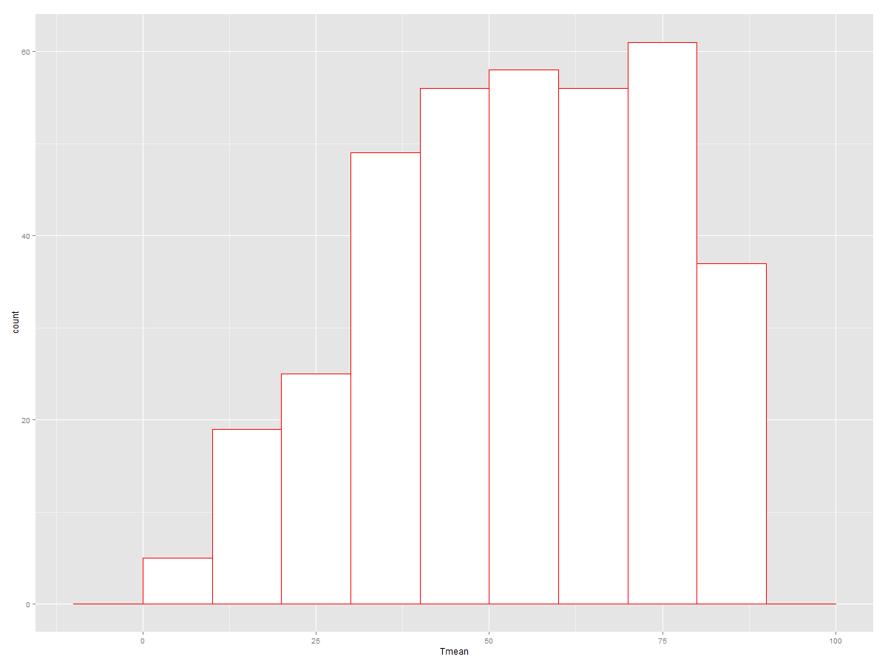
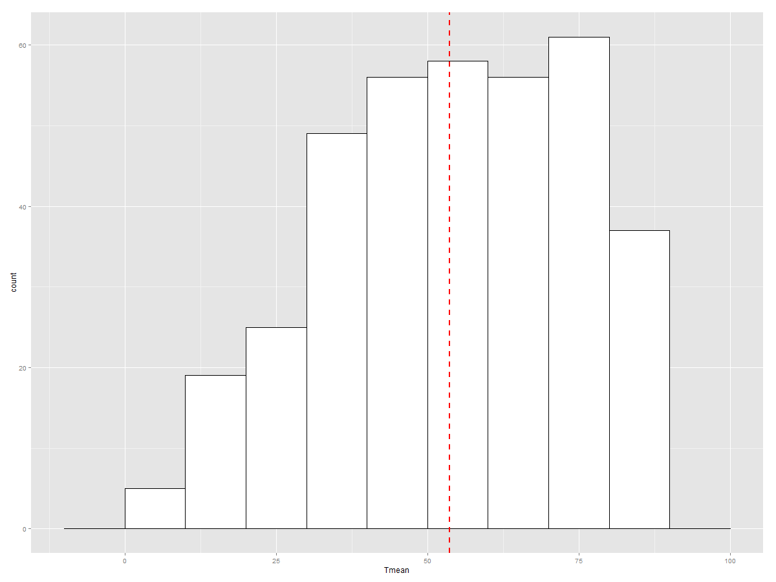
ggplot2 Example : Histogram and Density Graphs
ggplot(weatherdata, aes(x=Tmean)) + geom_histogram(binwidth=10, colour="red", fill="white")
ggplot(weatherdata, aes(x=Tmean)) + geom_histogram(binwidth=10, colour="black", fill="white") +geom_vline(aes(xintercept=mean(Tmean, na.rm=T)),color="red", linetype="dashed", size=1)

Slide 24
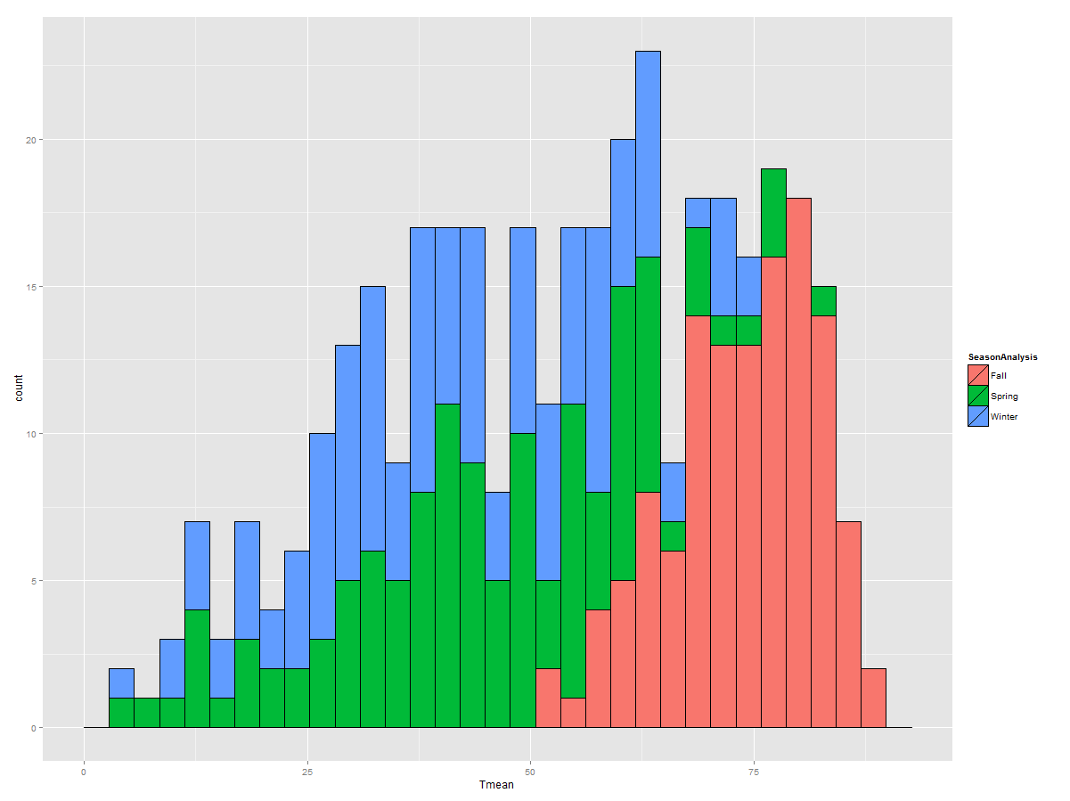
ggplot2 Example : Bar Graph
No outline
ggplot(data=weatherdata, aes(x=Tmean, fill=SeasonAnalysis)) + geom_bar()
Add outline, but slashes appear in legend
ggplot(data=weatherdata, aes(x=Tmean, fill=SeasonAnalysis)) + geom_bar(colour="black")
then graph the bars again with outline, but with a blank legend.
ggplot(data=weatherdata, aes(x=Tmean, fill=SeasonAnalysis)) + geom_bar() + geom_bar(colour="black", show_guide=FALSE)

Slide 25
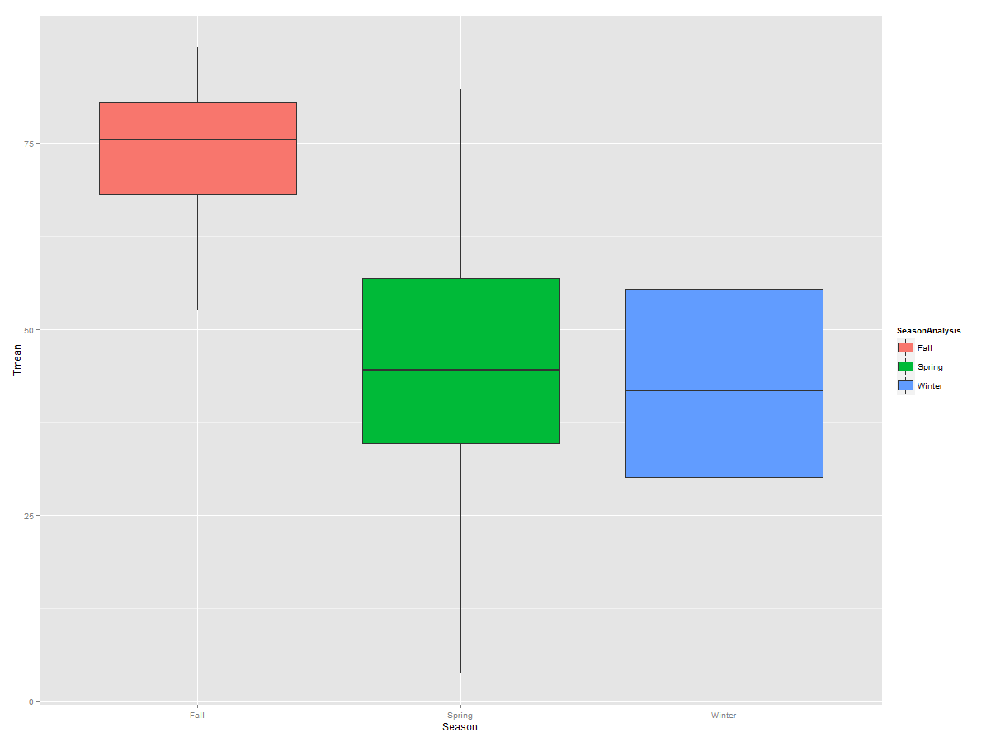
ggplot2 Example : Creating Boxplots
When comparing the distributions of groups of data, boxplots are a great approach instead of bar charts
ggplot(weatherdata, aes(x=SeasonAnalysis, y=Tmean, fill=SeasonAnalysis)) +
geom_boxplot() +xlab("Season")+ylab("Tmean")

Slide 26
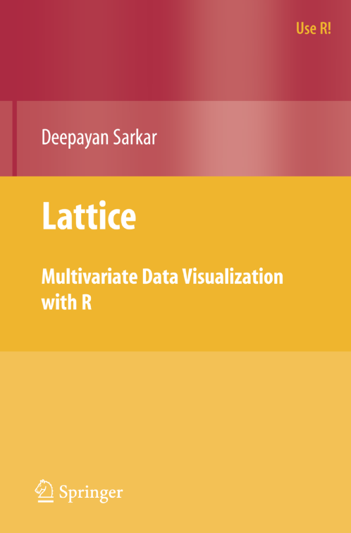
Overview of Lattice Graphics
One of the graphic systems of R
An implementation of the S+ “Trellis” Graphics
Written by Deepayan Sarkar, Fred Hutchinson Cancer Research Center

Slide 27
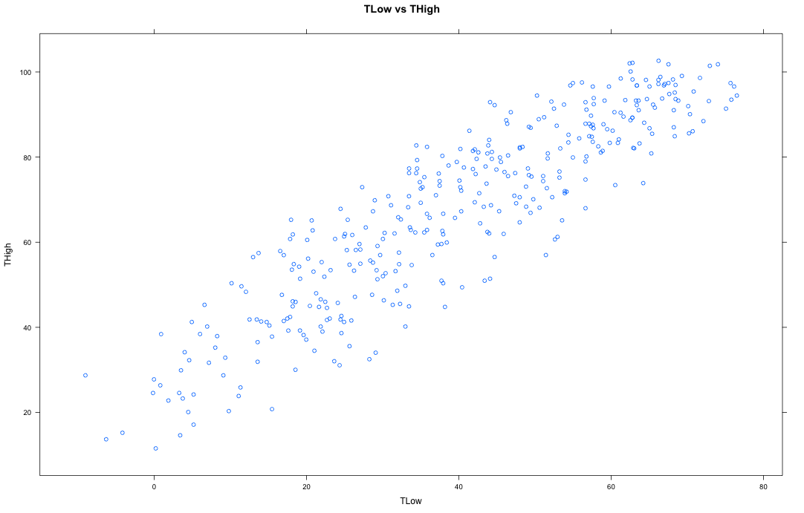
A Simple Scatter Plot
require(lattice)
xyplot(THigh~TLow,data=weatherdata, main="TLow vs THigh")

Slide 28
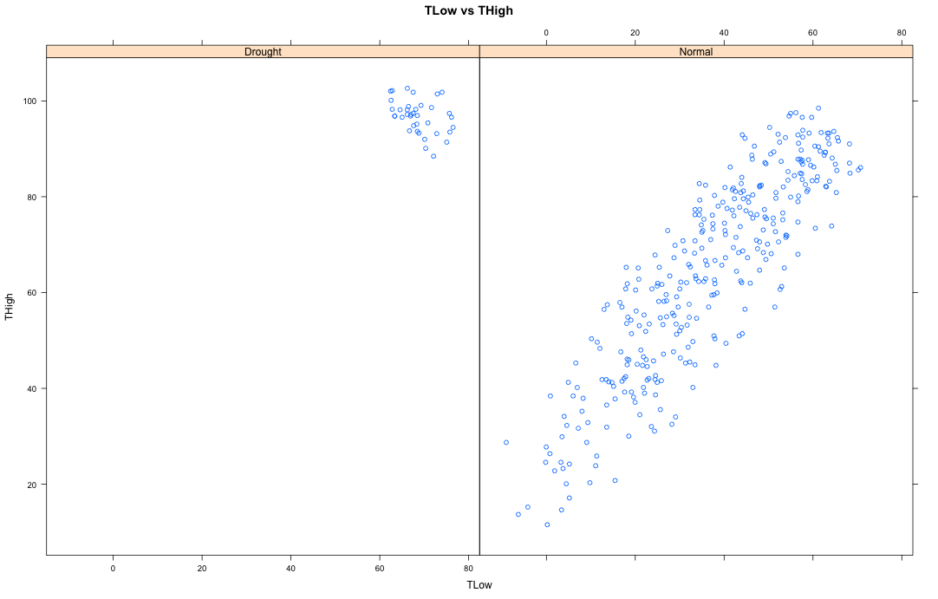
Paneling
xyplot(THigh~TLow |DroughtAnalysis, data=weatherdata, main="TLow vs THigh")

Slide 29
Styling
xyplot(THigh~TLow |DroughtAnalysis, data=weatherdata, main="TLow vs THigh")

Slide 30
Quick Summary of Lattice
Very effective for grouping and panelling
Big plus for fine level group control
However:
Default styling could be better
Can get a little fiddly for bespoke graphics
Notes:
Not sure whether to add to this or remove it and deal with it later?

Slide 31
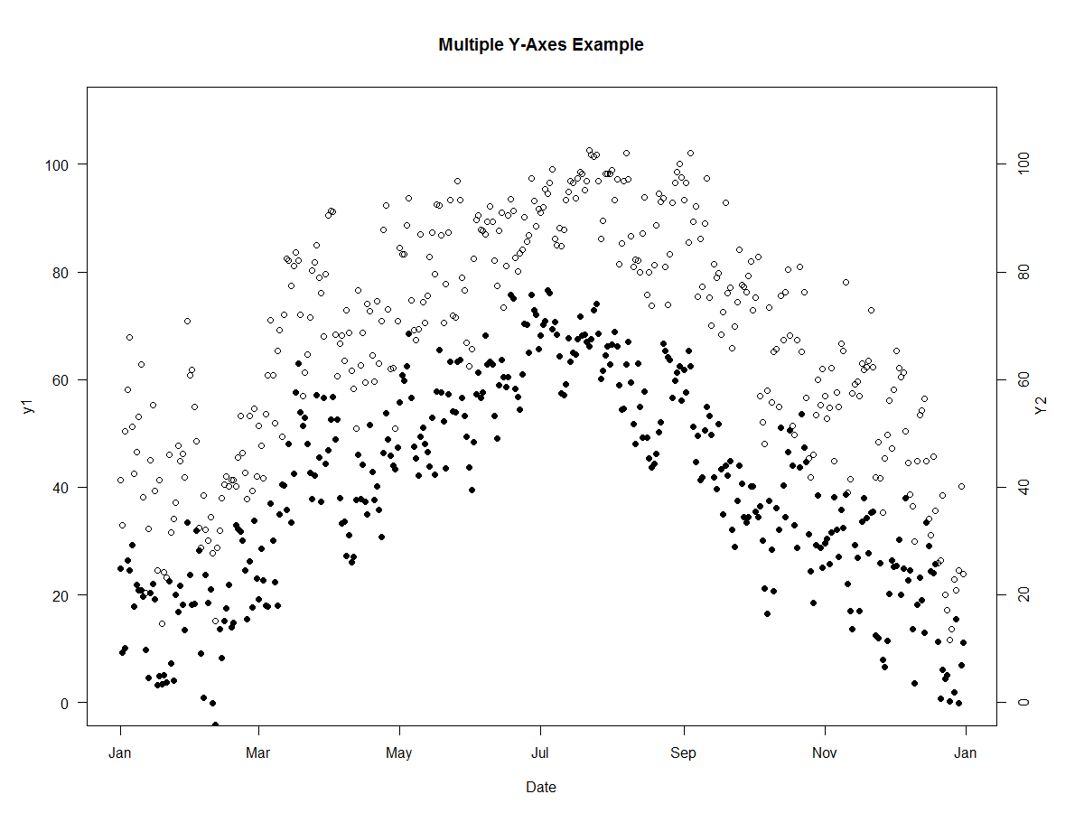
Two Y-Axis Plot
R makes it easy to combine multiple plots into one overall graph, using either the par( ) or layout( ) function.

Slide 32
Questions ?

