Slide 1
Data Analysis Using R
Week7: Regression Analysis
Baburao Kamble (Ph.D)
University of Nebraska-Lincoln

Slide 2
Steps in Typical Data Analysis for Research
Data Collection
Import Data
Prepare, explore, and clean data
Statistical Analysis and Modeling
Export Data (Graph/Chart/Tables)
Getting a feel for the data using plots, then analyzing the data with correlations and linear regression.

Slide 3
Regression Analysis
In statistics, regression analysis is a statistical process for estimating the relationships among variables.

Slide 4
Types of Regression Techniques
Linear Regression: This is a simple and easy to use method that models the relationship between a dependent variable y and one or more explanatory variables denoted as X.
Least Squares Method: The method of least squares is used to analyze and solve over determined systems
Non-Linear Regression: The non-linear regression analysis uses the method of successive approximations. Here, the data are modeled by a function, which is a non-linear combination of model parameters and depends on one or more explanatory variables.

Slide 5
Selecting the Regression Technique and Models
Importance of the different variables, their relationships, coefficient signs and their effect by conducting thorough research.
To determine the goodness of fit of the model, you need coefficients of determination, measure the standard error of estimate, significance of regression parameters and confidence intervals.Better fits lead to more precision in the results.
Remember, simple models produce more accurate results; so while the problem might be complex, it’s not always necessary to adopt a complex model. Start with simple models by breaking down the problem and add complexity only when required.
Tread cautiously while inferring causal relationships; always remember the mantra- ‘correlation does not imply causation’.

Slide 6
Linear Regression Analysis
Regression analysis is fundamental and forms a major part of statistical analysis!
Regression is a statistical technique to determine the linear relationship between two or more variables.
Regression is primarily used for prediction and causal inference.

Slide 7
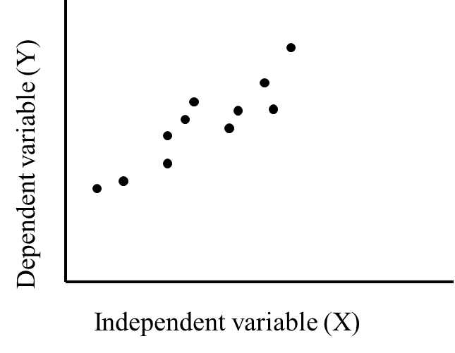

Linear Regression Analysis
Regression analysis is used to predict the value of one variable (the dependent variable) on the basis of other variables (the independent variables).
Dependent variable: denoted Y
Independent variables: denoted X₁, X₂, …, X_{k}
If we have only one independent variable then model will look like
which is referred to as simple linear regression. We would be interested in estimating β₀ and β₁ from the data we collect.

Slide 8
The equation of a line
The equation of a line
Mathematicians use
Y = mX + c
Statisticians use
y = β₀ + β₁ x
β₁ is the slope of the line
β₀ is the intercept (the value of y when x=0)
To calculate the coefficients use
β₁ = (y₂-y₁)/(x₂-x₁)
β₀ = y- β₁ x

Slide 9
Linear regression analysis: Methodology
The regression model:
The values of β₀ and β₁ are unknown and will be estimated in a reasonable manner from the data
The estimated regression line is
(using "hats" to denote the estimates)
For each data point x_{i} we have
(called the predicted value)
The difference between the true and predicted value is the residual

Slide 10
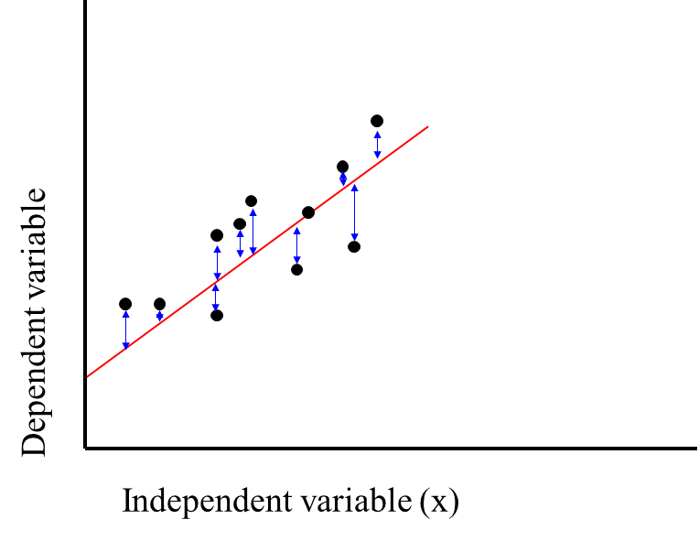
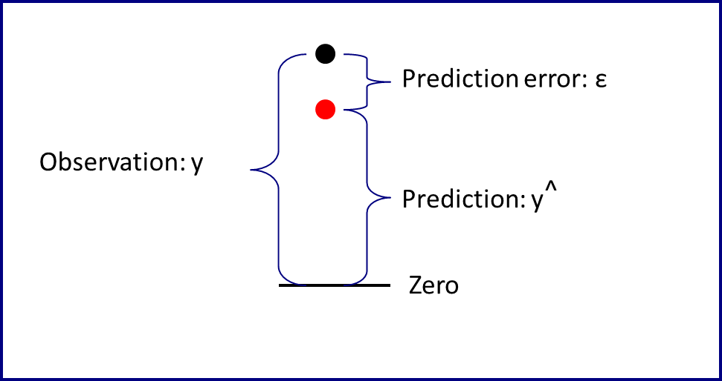
Linear regression analysis
Regression

Slide 11
Correlation Analysis
Calculates the strength and direction of a linear relationship between two interval variables
e.g. is there a relationship between age and income?
Measured using the Pearson correlation coefficient (r)
Data must be normally distributed (check with a histogram)

Slide 12
Correlation Analysis
If the correlation coefficient is close to +1 that means you have a strong positive relationship.
If the correlation coefficient is close to -1 that means you have a strong negative relationship.
If the correlation coefficient is close to 0 that means you have no correlation.
Alternatively:
+/- 0.10 to 0.29 = weak
+/- 0.30 to 0.49 = medium
+/- 0.50 to 1.00 - strong

Slide 13
Correlation Analysis
No relationship
Negative relationship
Positive
Relationship
No
Relationship
Negative
Relationship
Positive relationship

Slide 14
Example: linear regression with R
lm(formula, data, subset, weights, na.action, method = "qr", model = TRUE, x = FALSE, y = FALSE, qr = TRUE, singular.ok = TRUE, contrasts = NULL, offset, ...)
#Fit the simple linear regression model and save the results in fit
fit<-lm(formula = Y~X)
plot(X,Y)
abline(fit)

Slide 15
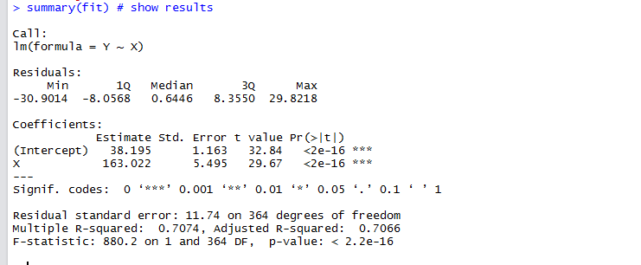
Interpreting the output
No. | Name
1 | Formula
2 | Residuals
3 | Estimated Coefficient
4 | Standard Error of #3
5 | t-value of #3
6 | Variable p-value
7 | Significance Stars
8 | Significance Legend
9 | Residual Std Error / Degrees of Freedom
11 | R-squared
11 | F-statistic & p-value
1
2
3
4
5
6
7
8
9
10
11

Slide 16
Interpreting the output
No. | Name | Description
1 | Model | Regression model formula
2 | Residuals | The residuals are the difference between the actual values of the variable you're predicting and predicted values from your regression
3 | Estimated Coefficient | The estimated coefficient is the value of slope calculated by the regression.
4 | Standard Error of #3 | Measure of the variability in the estimate for the coefficient.
5 | t-value of #3 | Score that measures whether or not the coefficient for this variable is meaningful for the model. t-value is used to calculate p-value and the significance levels.
6 | Variable p-value | Probability the variable is NOT relevant. This number to be as small as possible
7 | Significance Stars | The stars are shorthand for significance levels, with the number of asterisks displayed according to the p-value computed. *** for high significance and * for low significance.
8 | Significance Legend | The more punctuation there is next to your variables, the better. Blank=bad, Dots=pretty good, Stars=good, More Stars=very good
9 | Residual Std Error / Degrees of Freedom | Residual Std Error / Degrees of Freedom. The Degrees of Freedom is the difference between the number of observations included in your training sample and the number of variables used in your model (intercept counts as a variable).
11 | R-squared | Metric for evaluating the goodness of fit of your model.
11 | F-statistic & p-value | Performs an F-test on the model. This takes the parameters of our model (in our case we only have 1) and compares it to a model that has fewer parameters. The DF, or degrees of freedom, pertains to how many variables are in the model. In our case there is one variable so there is one degree of freedom.

Slide 17
Prediction for new values
One primary use of regression analysis is to make predictions for the response value for new values of the predictor.
We can use a regression line to get the predicted value for a new value of x.
It is a little chunk to use the predict function!
For example, to get a prediction for Temp 80 and 90
We need a data frame with column names matching the predictor variable, which can be done with the data.frame function with name=values.
Can you get the same answer with estimated coefficients?
predict(fit, data.frame(X=c(80,90)))

Slide 18
Terms in linear regression.
Residual: The difference between the predicted value (based on the regression equation) and the actual, observed value.
Outlier: In linear regression, an outlier is an observation with large residual.
Leverage: An observation with an extreme value on a predictor variable is a point with high leverage. Leverage is a measure of how far an independent variable deviates from its mean. High leverage points can have a great amount of effect on the estimate of regression coefficients.
Influence: An observation is said to be influential if removing the observation substantially changes the estimate of the regression coefficients. Influence can be thought of as the product of leverage and outlierness.
Cook's distance (or Cook's D): A measure that combines the information of leverage and residual of the observation.

Slide 19
Checking the validity of the linear model
plot(fit)
Residuals vs. fitted: Look for spread around the line y = 0 and no obvious trend.
Normal Q-Q plot(Quantile-Quantile): The residuals are normal if this graph falls close to a straight line.
Scale-Location plot shows the square root of the standardized residuals. The tallest points, are the largest residuals.
Cook's distance plot identifies points which have a lot of influence in the regression line.
Residuals vs. leverages plot shows observations with potentially high influence
Cook's distances vs. leverage/(1-leverage)

Slide 20
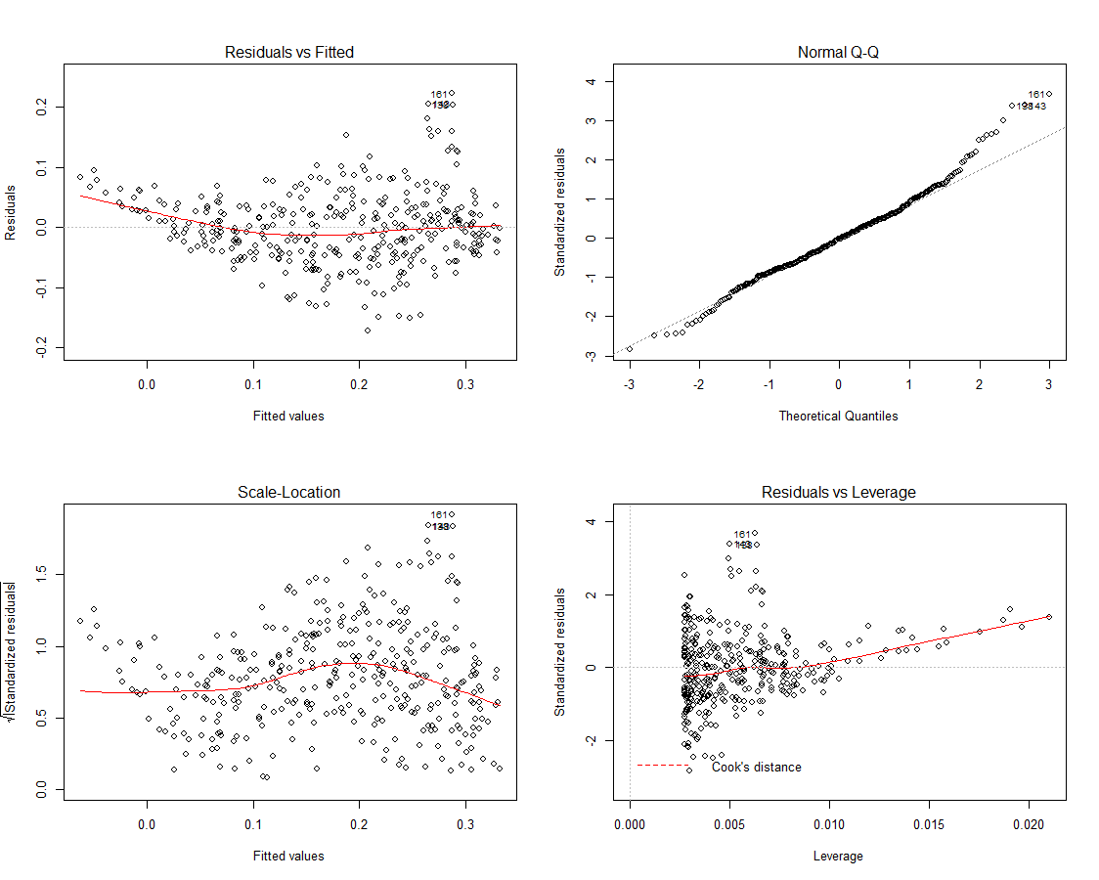

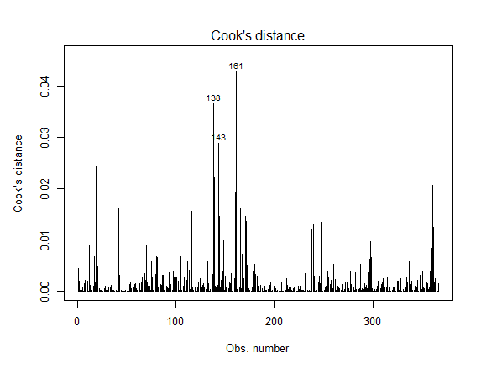

Slide 21
Multivariate data
Multivariate data consists of multiple data vectors considered as a whole.
There are many advantages to combining them into a single data object. This makes it easier to save our work, is convenient for many functions, and is much more organized.
Multivariate data can be summarized and viewed in ways that are similar to those for bivariate and univariate data.
As there are many more possible relationships, we can look at all the variables simultaneously or hold some variables constant while we look at others.

Slide 22
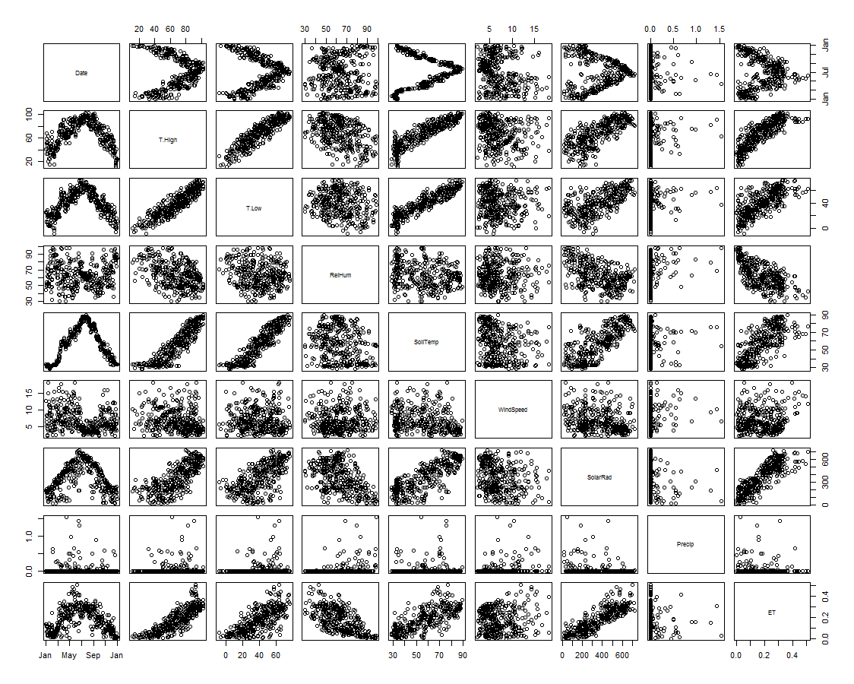
Scatterplot matrix
R has a built-in function for creating scatterplots of all possible pairs of variables.
This scatterplot matrix can be made with the pairs() function
pairs (weatherdata)

Slide 23
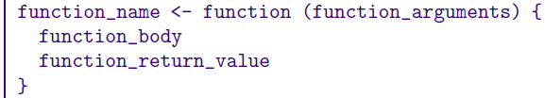
Functions in R
Easy to create your own functions in R
As tasks become complex, it is a good idea to organize code into functions that perform defined tasks
In R, it is good practice to give default values to function arguments
Template for function:

Slide 24
Next Week
Advanced Regression
ANOVA and Linear Regression
Probability

Slide 25
Questions ?

