Slide 1
Time Series Analysis & Prediction
Baburao Kamble

Slide 2
Quantitative Forecasting Methods
Quantitative
Forecasting
Time Series
Causal
Models
Models
Moving
Exponential
Trend
Model
Regression
Average
Smoothing
Notes:
15

Slide 3
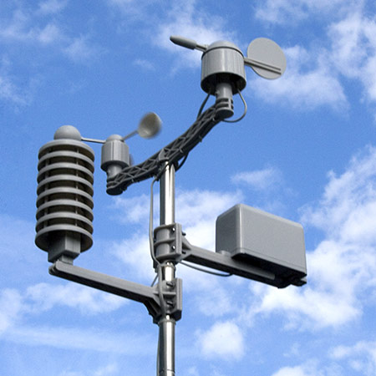
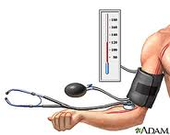

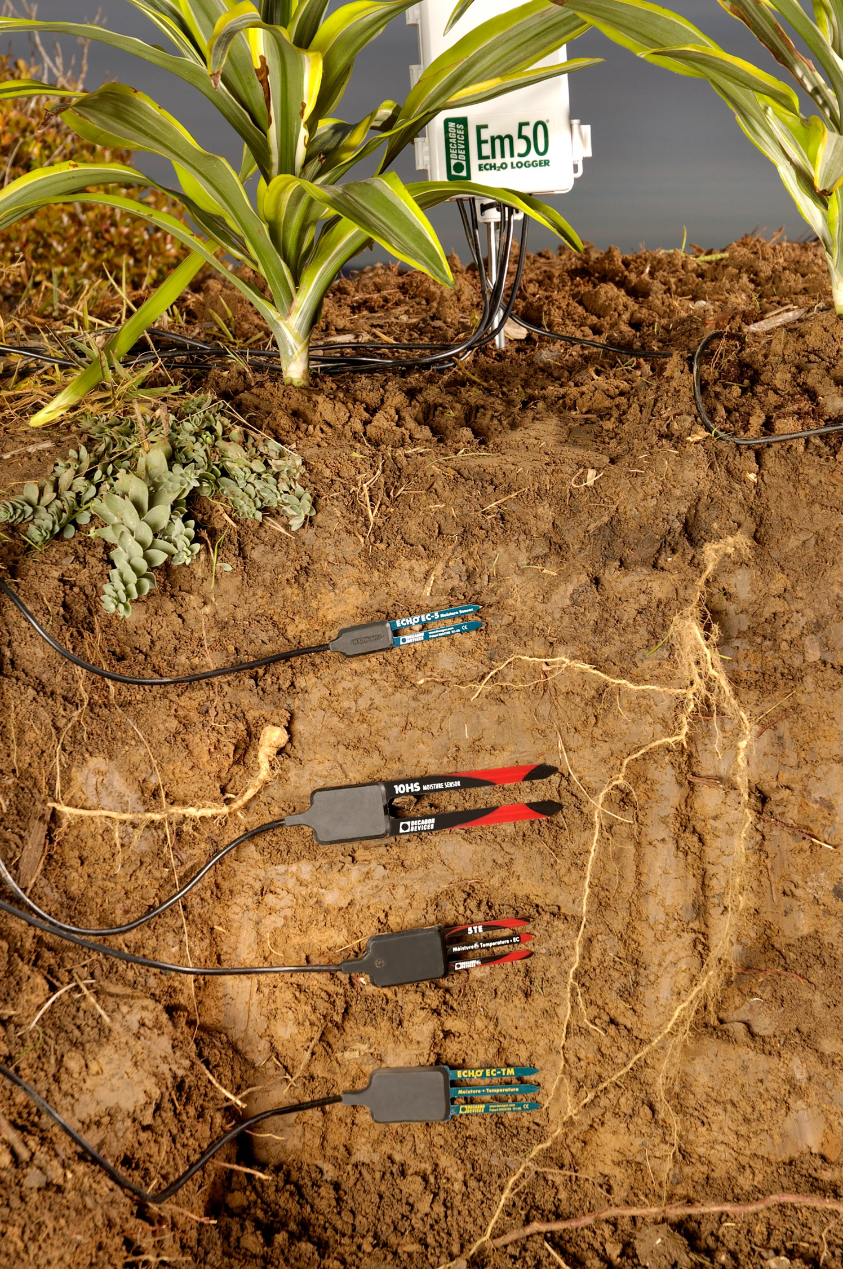
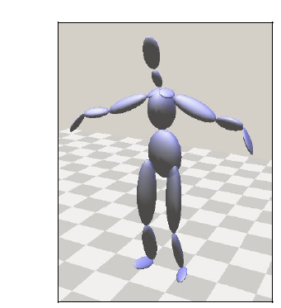
Time Series Examples
Definition: A sequence of measurements over time
Biology
Meteorology
Finance
Social science
Epidemiology
Medicine
Speech
Geophysics
Seismology
Robotics

Slide 4
What is Time Series Analysis?
Time series analysis is a process of using statistical techniques to model and explain a time-dependent series of data points.
In other words, we are studying data that is dependent on random variables (or vectors) as appose to studying the dependence of one variable on another.
We use time series models to help us generate future observations based on what we have seen.

Slide 5
Components of a Time Series
Trend – long term upward or downward movement
Seasonality – the pattern that occurs every year
Cycles – the pattern that occurs over a period of years
Random variations – caused by chance and unusual events

Slide 6
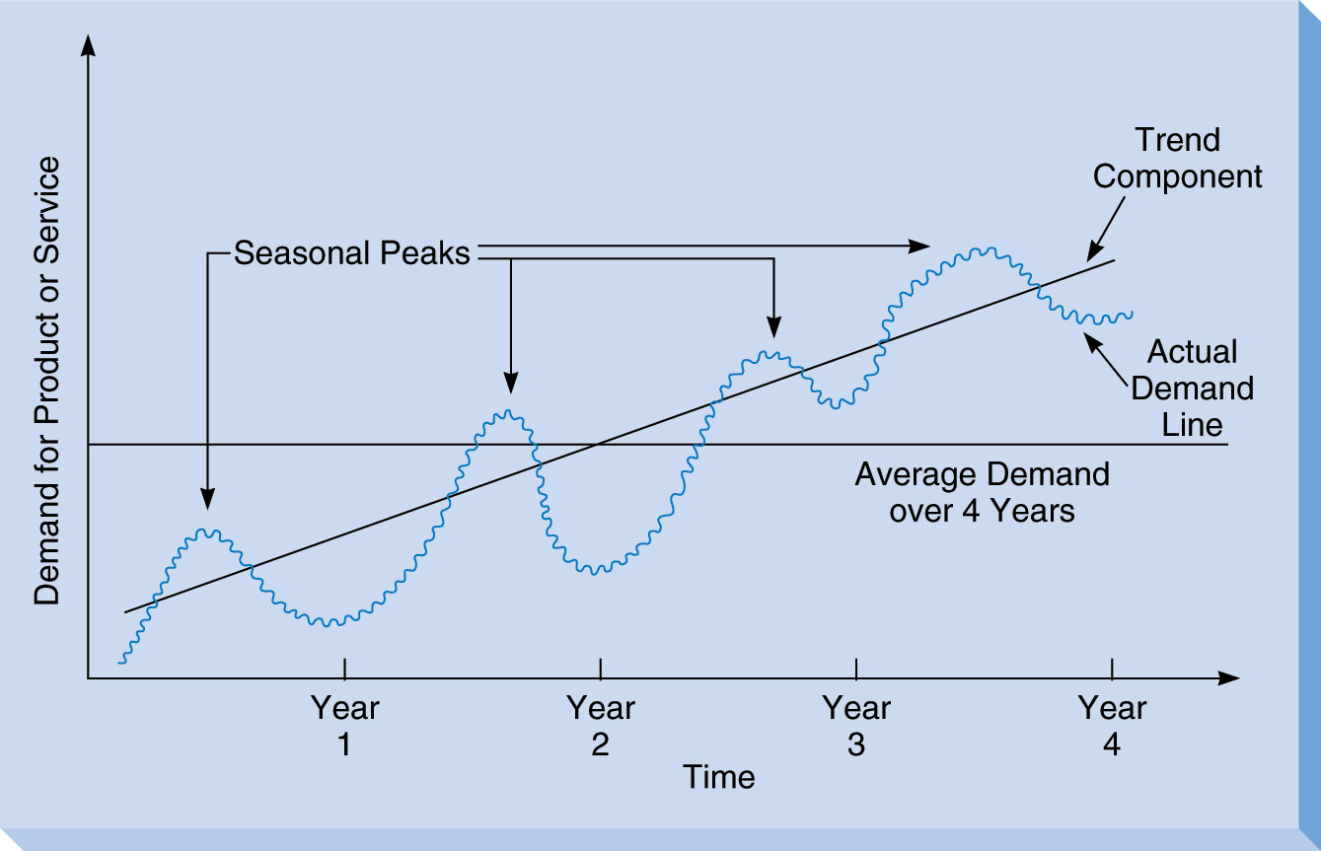
Time Series Components

Slide 7
Why? Time Series Analysis
Gain a better understanding of the data
Predict future values
Optimally control systems
Monitor processes
Derive computer simulations
Prepare countermeasures in cases of unexpected events
Improve output, quality and/or performance of a system

Slide 8
Objective
The main objective of time series analysis
Conversation – Convert data based on time
Visualizing – Looking at the data with plots, graphs and other plotters.
Filtering – Used in preprocessing to smooth things out.
Prediction – Applying the Stochastic Models.

Slide 9
Data Conversion
Subset data by date range
Convert daily data based on time parameters (e.g. daily to weekly)
Demo1.R

Slide 10
Data Visualizing
Looking at the data with plots, graphs and other plotters for numerical trend, and change over the time.
Demo1.R

Slide 11
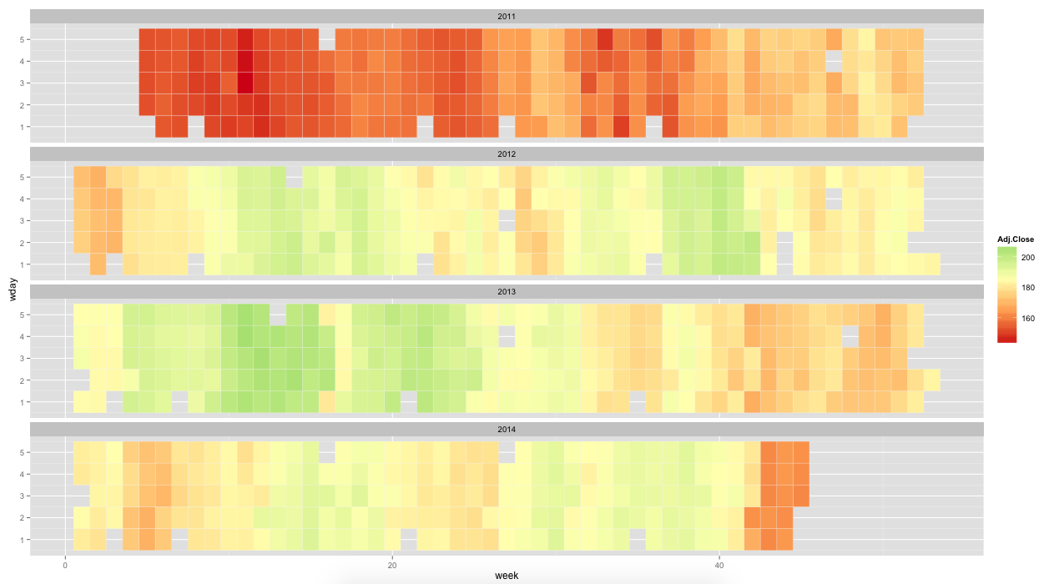


WHY?
HOW?
Demo_StockMarket.R
HeatMap.R
http://www.forbes.com/sites/gurufocus/2013/01/08/why-warren-buffett-keeps-buying-ibm/
http://www.marketwatch.com/story/warren-buffett-losing-over-1-billion-on-ibm-2014-10-20

Slide 12
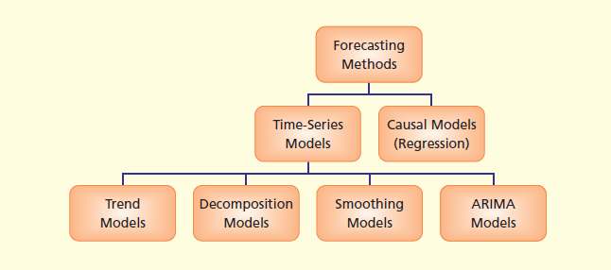
Simple Component Analysis
Exponential Smoothing
ARIMA–Models

Slide 13
Seasonal and Trend decomposition using Loess
STL is a very versatile and robust method for decomposing time series.
STL is an acronym for “Seasonal and Trend decomposition using Loess”, while Loess is a method for estimating nonlinear relationships.
The STL method was developed by Cleveland et al. (1990)
Demo3_Trend.R

Slide 14
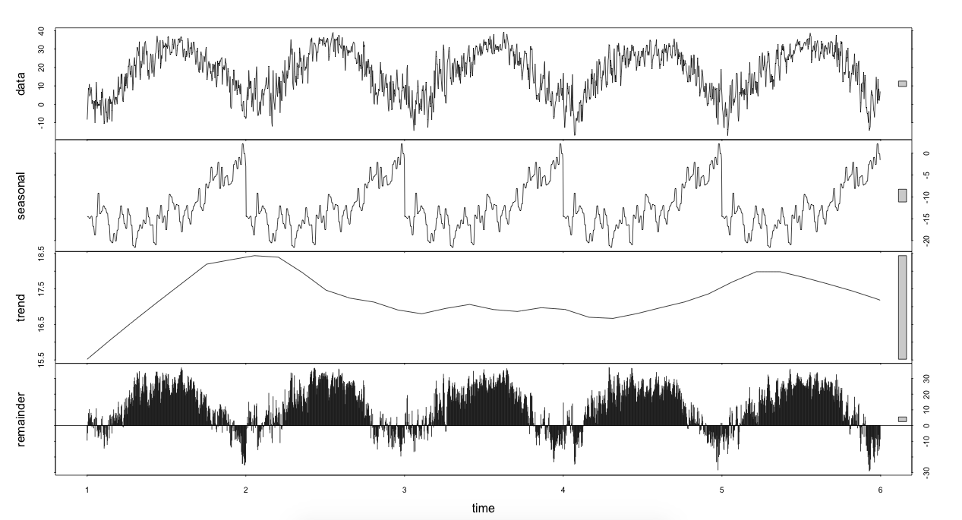
Exponential smoothing
The four graphs are the original data, seasonal component, trend component and the remainder and this shows the periodic seasonal pattern extracted from the temperature data for the Mead Weather station and the trend that moves around between 15.5 and 18.5 degrees Celsius.
There is a bar at the right hand side of each graph to allow a relative comparison of the magnitudes of each component. For this data the change in trend is less than the variation doing to the monthly variation.

Slide 15
Smoothing
A Moving Average Can Smooth Data That Remains Volatile after Seasonal Adjustment
Smoothing techniques reduce the volatility in a data series, which allows researchers/analysts to identify important trends in the data.
Smoothing Methods
Moving average
Kernel Smoothing
Spine
Smoothing.R

Slide 16
ARMA Model and ARIMA
ARMA/ARIMA
These models are the most basic time series model and can be fit with many major statistical packages.
This the tool for understanding and perhaps, predicting future values.
The disadvantage is that it is often not very descriptive of the underlying processes, the parameters are difficult to interpret.

Slide 17
ARIMA Models and Forecasting
If we can describe the way the points in the series are related to each other (the autocorrelations), then we can describe the series using the relationships that we’ve found
AutoRegressive Integrated Moving Average Models (ARIMA) are mathematical models of the autocorrelation in a time series
One way to describe time series

Slide 18
Non-Seasonal ARIMA
A nonseasonal ARIMA model is classified as an "ARIMA(p,d,q)" model, where:
p is the number of autoregressive terms,
d is the number of nonseasonal differences, and
q is the number of lagged forecast errors in the prediction equation.

Slide 19
ARIMA-BlackBox
1
1
1
p
d
q
Forecasts
Time-Series Data
0
2
0
2
0
2
adjust the knobs until the residuals are “white noise” (uncorrelated)

Slide 20
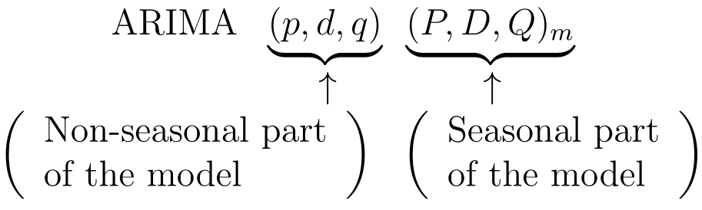
Seasonal ARIMA
m= number of periods per season

Slide 21
To fit and ARIMA model using a specific method type:
> arima(sunData[,”no”],order = c(2,0,0), method ="ML")
The output
Call:
arima(x = sunData[, "no"], order = c(2, 0, 0), method = "ML")
Coefficients:
ar1 ar2 intercept
1.4088 -0.7137 48.2095
s.e. 0.0704 0.0700 4.9557
sigma^2 estimated as 227.2: log likelihood = -414.46, aic = 836.91
“CSS-ML“ - minimize conditional sum-of-squares to find starting values then maximum likelihood (the default method)
“ML" - maximum likelihood
“CSS" - minimize conditional sum-of-squares

Slide 22
The autocorrelation function
The dependence structure of a stationary time series is characterized by the autocorrelation function.
The autocorrelation function is defined as the correlation between z_{t} and z_{t+k}; ρ_{k}=correlation(z_{t},z_{t+k}), k is called the time lag.
The autocorrelation function is estimated by the empirical autocorrelation function: r_{k}=c_{k}/c₀.

Slide 23
ARIMA modelling of a univariate time series.
arima(x, order = c(0, 0, 0),
seasonal = list(order = c(0, 0, 0), period = NA), xreg = NULL,
include.mean = TRUE,
transform.pars = TRUE,
fixed = NULL,
init = NULL,
method = c("CSS-ML", "ML", "CSS"),
n.cond,
optim.method = "BFGS",
optim.control = list(),
kappa = 1e6)
X : a univariate time series
Order : A specification of the non-seasonal part of the ARIMA model: the three components (p, d, q) are the AR order, the degree of differencing, and the MA order.
seasonal A specification of the seasonal part of the ARIMA model, plus the period (which defaults to frequency(x)). This should be a list with components order and period, but a specification of just a numeric vector of length 3 will be turned into a suitable list with the specification as the order.
xreg : Optionally, a vector or matrix of external regressors, which must have the same number of rows as x.

Slide 24
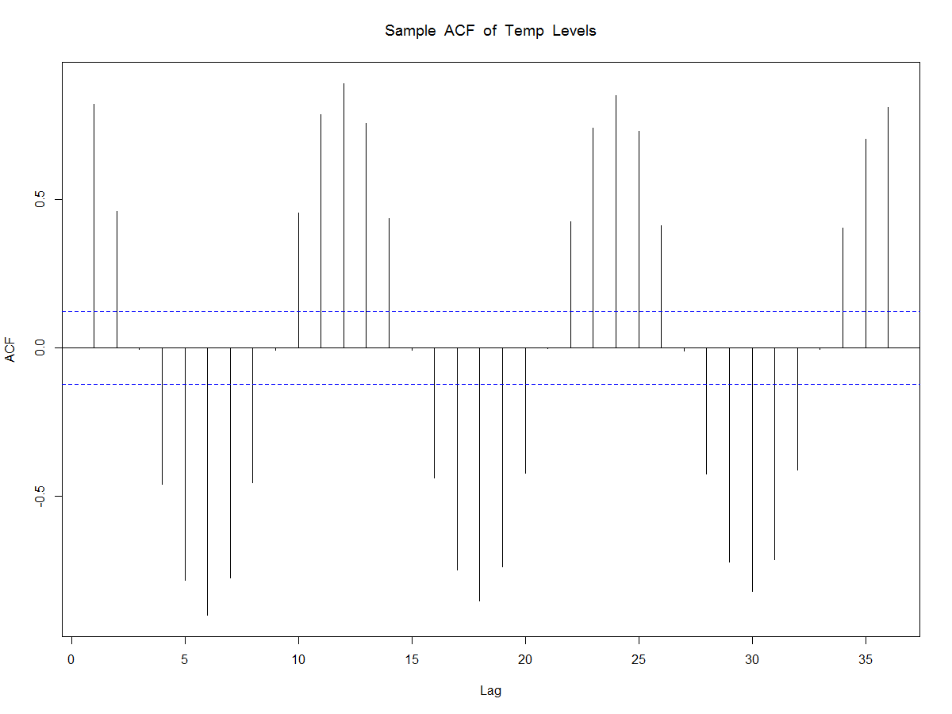
Tools for identifying ARIMA models: ACF and PACF plots
The autocorrelation function (ACF) plot shows the correlation of the series with itself at different lags
The partial autocorrelation function (PACF) plot shows the amount of autocorrelation at lag k that is not explained by lower-order autocorrelations

Slide 25
Seasonal Models
For ARIMA models, the serial dependence of the current observation to the previous observations was often strongest for the immediate past and followed a decaying pattern as we move further back in time.
For some systems, this dependence shows a repeating, cyclic behaviour.
This cyclic pattern or as more commonly called seasonal pattern can be effectively used to further improve the forecasting performance.
The ARIMA models are flexible enough to allow for modeling both seasonal and non-seasonal dependence.

Slide 26
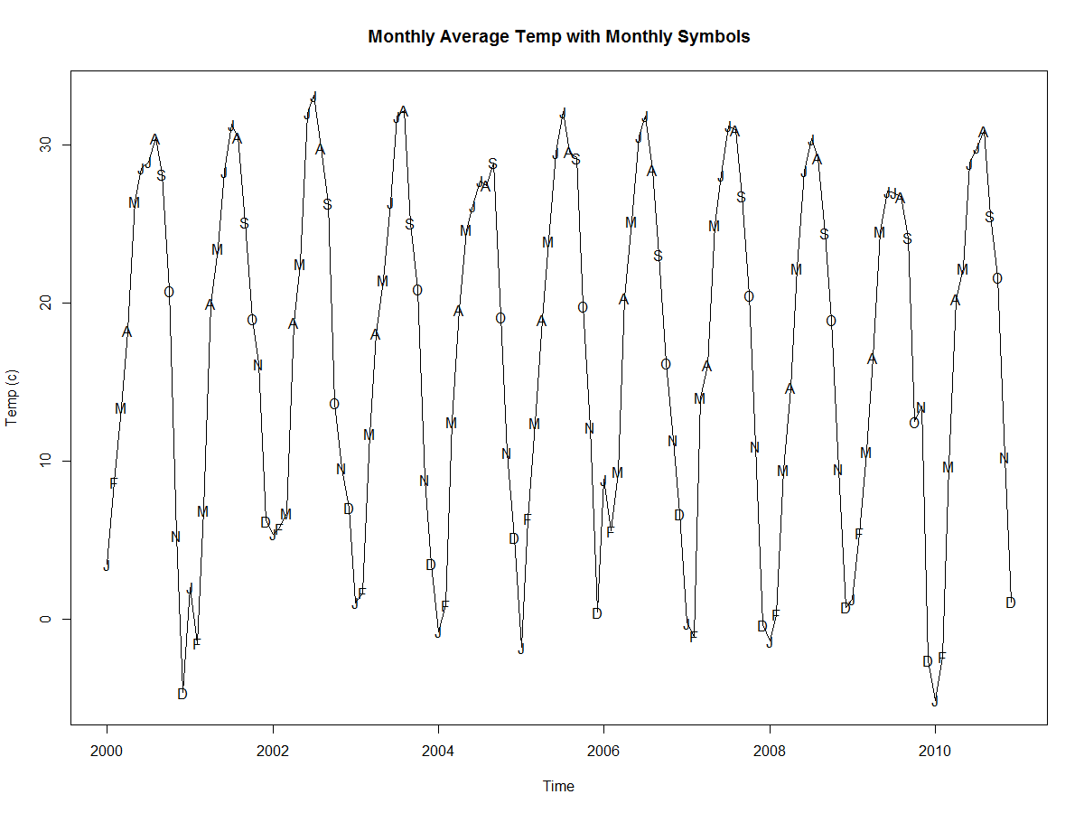
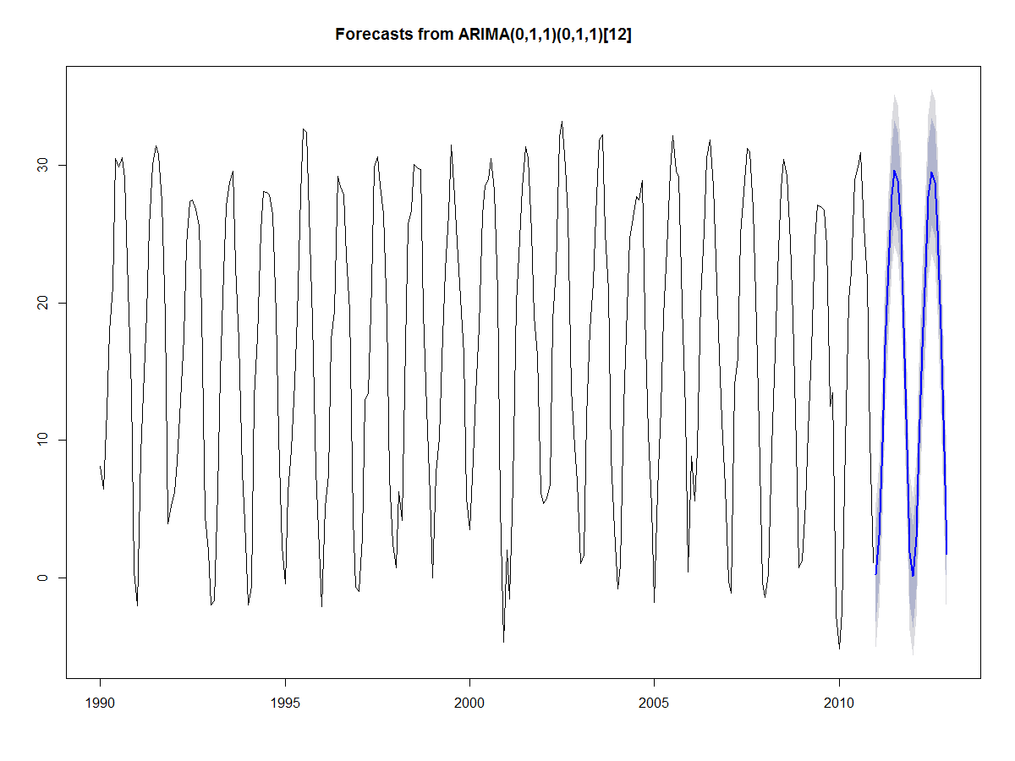
Temperature Prediction Using Seasonal ARIMA
ARIMA_DemoTemp.R

