Slide 1
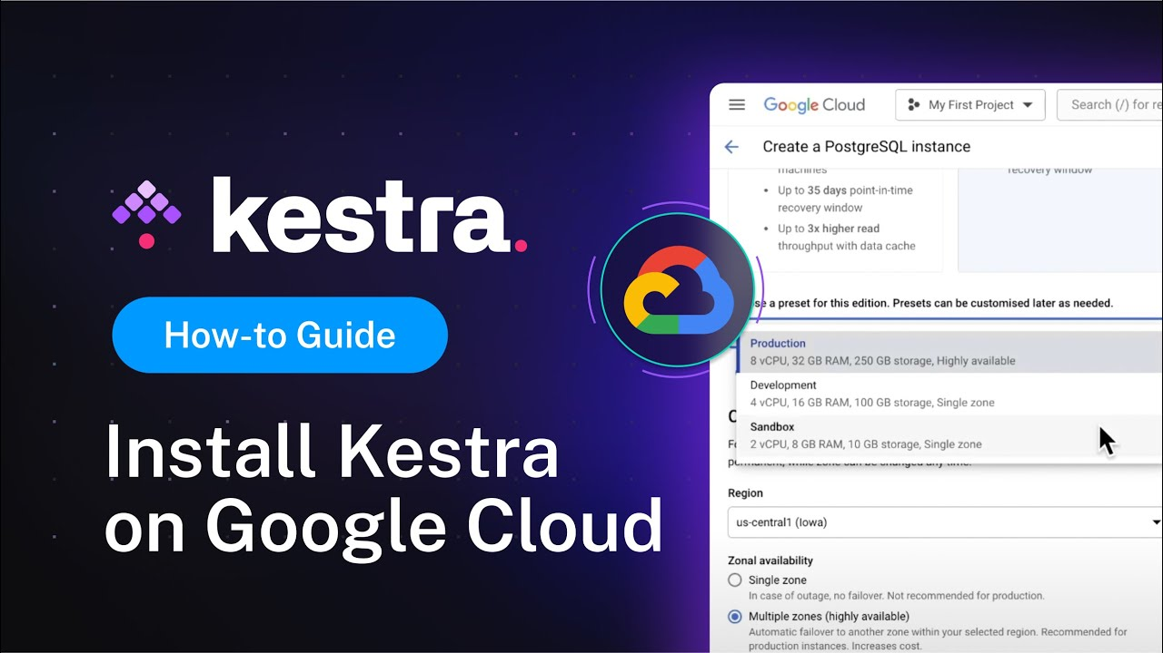

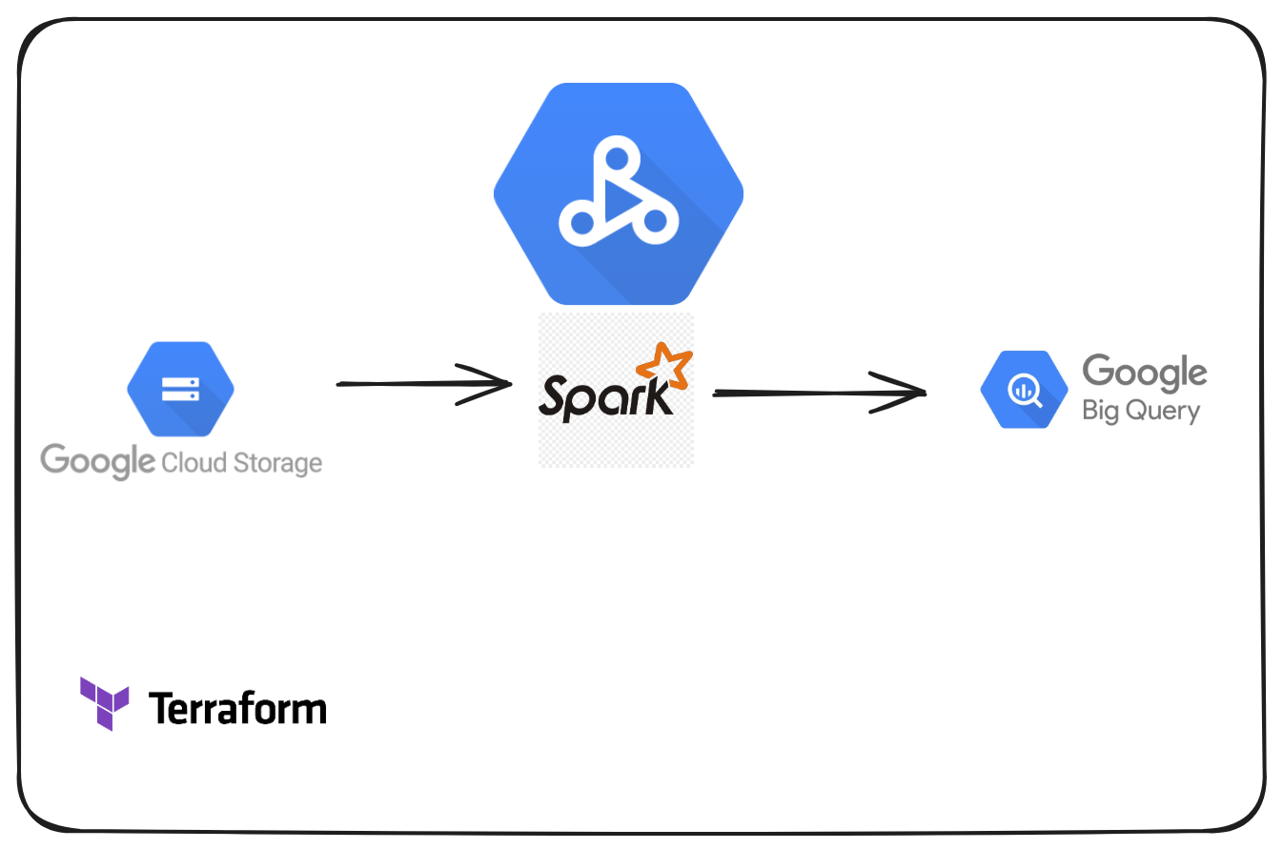

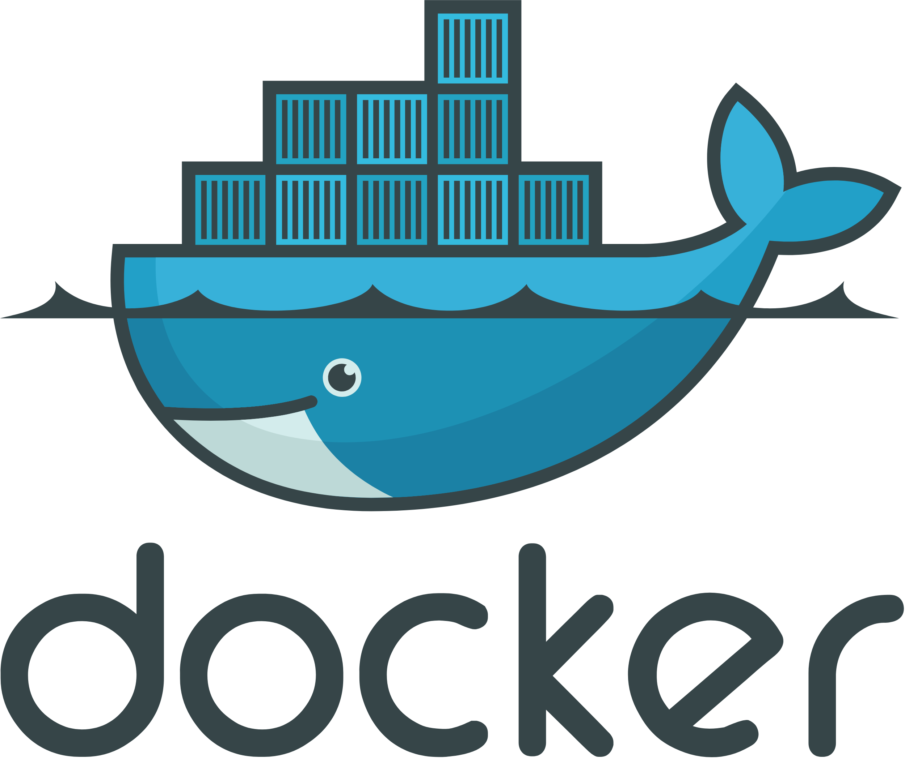
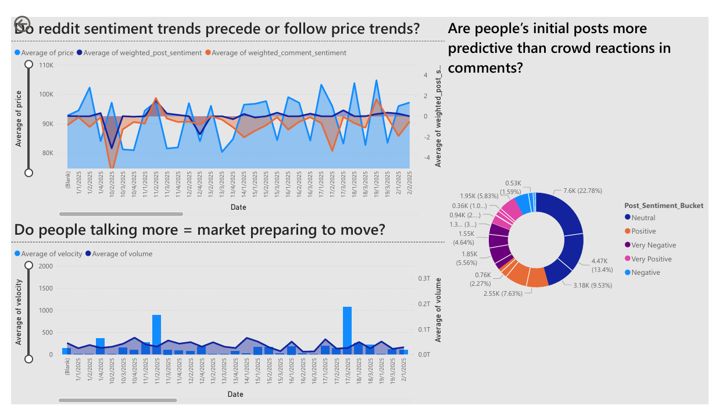

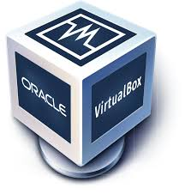

Kestra Orchestrator Container in GCP VM
4. Kestra container on GCP VM triggers data proc to perform transformation and loading of data to Bigquery through truncate-write mechanism.
1. Kestra container on GCP VM reverse tunnels into local machine SSH on port 9090 to trigger scrapper docker container on TCP (port 22)
5. Sentiment analysis carried out on posts and comments via PySpark and VADER libraries. Further transformation done on Dataproc cluster.
6. Data from Bigquery visualized on Power BI dashboard.
3. Loaded Data Ingested into GCS through DLT load tool
2. Data Scrapped from websites through python-selenium library
Docker in Oracle VirtualBox running scrapper container

