Slide 1
About Java
Java is a general-purpose computer programming language that is concurrent, class-based, object-oriented, and specifically designed to have as few implementation dependencies as possible. It is intended to let application developers "write once, run anywhere" (WORA), meaning that compiled Java code can run on all platforms that support Java without the need for recompilation. Java applications are typically compiled to bytecode that can run on any Java virtual machine (JVM) regardless of computer architecture. As of 2016, Java is one of the most popular programming languages in use, particularly for client-server web applications, with a reported 9 million developers. Java was originally developed by James Gosling at Sun Microsystems (which has since been acquired by Oracle Corporation) and released in 1995 as a core component of Sun Microsystems' Java platform. The language derives much of its syntax from C and C++, but it has fewer low-level facilities than either of them.

Slide 2
About Java Servlet and Java Server Page
Java Servlet
A Java servlet is a Java program that extends the capabilities of a server. Although servlets can respond to any types of requests, they most commonly implement applications hosted on Web servers.[1] Such Web servlets are the Java counterpart to other dynamic Web content technologies such as PHP and ASP.NET.
Java Server page
Java Server Pages (JSP) is a technology that helps software developers create dynamically generated web pages based on HTML, XML, or other document types. Released in 1999 by Sun Microsystems, JSP is similar to PHP, ASP and React's JSX, but it uses the Java programming language. To deploy and run JavaServer Pages, a compatible web server with a servlet container, such as Apache Tomcat or Jetty, is required.

Slide 3
About Web Development
Web development is a broad term for the work involved in developing a web site for the Internet (World Wide Web) or an intranet (a private network). Web development can range from developing the simplest static single page of plain text to the most complex web-based Internet applications, electronic businesses, and social network services. A more comprehensive list of tasks to which web development commonly refers, may include web engineering, web design, web content development, client liaison, client-side/server-side scripting, web server and network security configuration, and e-commerce development. Among web professionals, "web development" usually refers to the main non-design aspects of building web sites: writing markup and coding. Most recently Web development has come to mean the creation of content management systems or CMS. These CMS can be made from scratch, proprietary or open source. In broad terms the CMS acts as middleware between the database and the user through the browser. A principle benefit of a CMS is that it allows non-technical people to make changes to their web site without having technical knowledge.

Slide 4

About MVC Pattern
Model–view–controller (MVC) is a software architectural pattern for implementing user interfaces on computers. It divides a given application into three interconnected parts in order to separate internal representations of information from the ways that information is presented to and accepted from the user. The MVC design pattern decouples these major components allowing for efficient code reuse and parallel development.Traditionally used for desktop graphical user interfaces (GUIs), this architecture has become popular for designing web applications and even mobile, desktop and other clients.[3] Popular programming languages like Java, C#, Ruby, PHP and others have popular MVC frameworks that are currently being used in web application development straight out of the box.

Slide 5
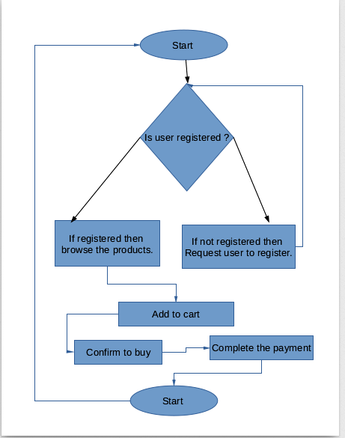
Flow Cycle For TakeHome

Slide 6
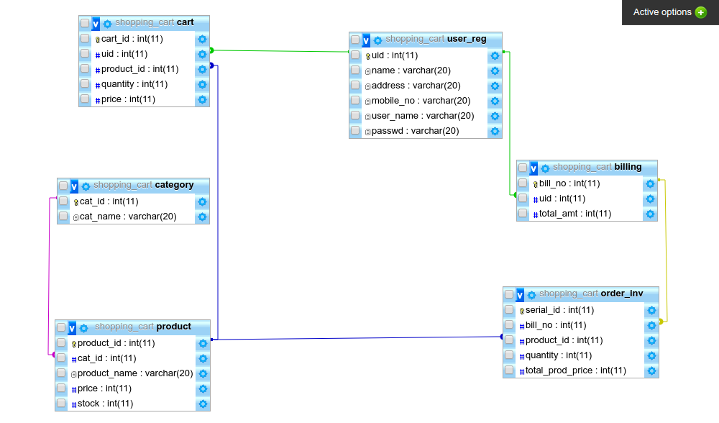
Database Designed for TakeHome

