Slide 1
https://www.cheaptubes.com/carbon-nanotubes-properties-and-applications/

Slide 2
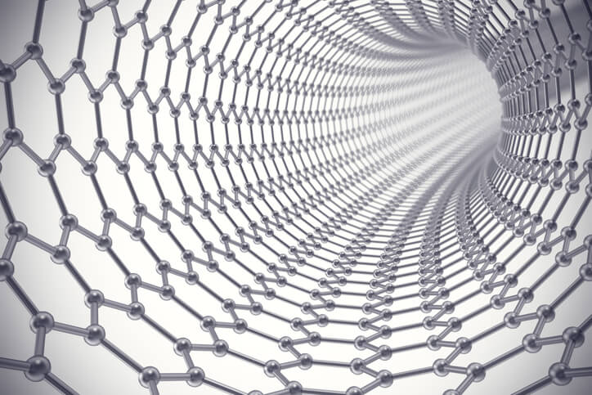
Carbon Nanotubes
Carbon nanotubes are tubes made of carbon with diameters typically measured in nanometers

Slide 3
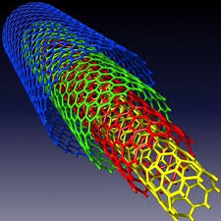
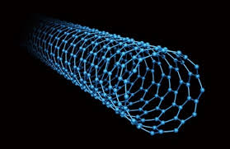
Types of Carbon Nanotubes
Multi Walled Carbon Nanotubes
Single Walled Carbon Nanotubes

Slide 4
Carbon Nanotubes Properties
Electrical Conductivity
can be highly conducting, and hence can be said to be metallic. Their conductivity has been shown to be a function of their chirality (degree of twist), as well as their diameter. CNTs can be either metallic or semi-conducting in their electrical behavior.
The resistivity of the SWNT ropes was in the order of 10^{–4} ohm-cm at 27°C. This means that SWNT ropes are the most conductive carbon fibers known. The current density that was possible to achieve was 10⁷ A/cm²
Strength And Elasticity
The carbon atoms of a single (graphene) sheet of graphite form a planar honeycomb lattice, in which each atom is connected via a strong chemical bond to three neighboring atoms. Because of these strong bonds, the basal-plane elastic modulus of graphite is one of the largest of any known material.
The current Young’s modulus value of SWNTs is about 1 TeraPascal, but this value has been disputed, and a value as high as 1.8 Tpa has been reported. Other values significantly higher than that have also been reported.

Slide 5
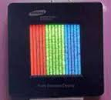
Thermal Conductivity And Expansion
University of Pennsylvania indicates that CNTs may be the best heat-conducting material man has ever known. Ultra-small SWNTs have even been shown to exhibit superconductivity below 20ºK.
The strong in-plane graphitic C-C bonds make them exceptionally strong and stiff against axial strains. The almost zero in-plane thermal expansion but large inter-plane expansion of SWNTs implies strong in-plane coupling and high flexibility against nonaxial strains.
Electron Emission
Field emission results from the tunneling of electrons from a metal tip into vacuum, under application of a strong electric field. The small diameter and high aspect ratio of CNTs is very favorable for field emission. Even for moderate voltages, a strong electric field develops at the free end of supported CNTs because of their sharpness.
High Aspect Ratio
CNTs have proven to be an excellent additive to impart electrical conductivity in plastics. Their high aspect ratio (about 1000:1) imparts electrical conductivity at lower loadings, compared to conventional additive materials such as carbon black, chopped carbon fiber, or stainless steel fiber.

Slide 6
Carbon Nanotubes Applications

Slide 7
Carbon Nanotubes Applications
Energy Storage
Molecular Electronics
Thermal Materials
Structural Materials
Electrical Emitters
Fabrics And Fibres
CNTs Air And Water Filtration
AND MORE!

Slide 8
Work yet to do

