Slide 1
ECO342A FINAL PAPER PRESENTATION
Enhancing the Accuracy of International Corn Trade Forecasts using Machine Learning Methods
Satmeet singh saluja (200890)

Slide 2
Introduction
The agricultural and food sectors are critical to human life, and their efficiency and agility are essential for global food security and economic growth.
In this study, machine learning techniques are applied to predict trade flows for corn, both at the aggregate and industry levels.
Agricultural products present unique challenges in terms of forecasting, including significant price volatility, trade protection, and constraints related to land and water resources.
Advanced machine learning models offer promising tools for predicting trade flows for specific agricultural commodities like corn, leveraging a range of data sources and analytical methods.
The objective of this research is to develop an effective machine learning model for forecasting trade flows for corn, which will provide valuable insights for policymakers, industry stakeholders, and other decision-makers in the agricultural sector.

Slide 3
Literature review
In the field of economics, machine learning approaches have been increasingly utilized to analyze economic trends and growth patterns. However, many existing studies are limited in their scope, and their models are not easily transferable to different geographical regions or commodities. For example, Feng et al. developed a neural networks model to study economic growth in Zhejiang, China, but the model's applicability to other Chinese provinces or countries is limited. Similarly, Falat et al. developed machine learning models to decipher economic trends but did not make any forecasts. This study aims to address these limitations by optimizing machine learning approaches to predict trade flows for specific commodities and countries. The results of this research will provide valuable insights for policymakers, industry stakeholders, and other decision-makers in the agricultural sector, helping them to make informed decisions and promote sustainable agricultural trade.
Milacic et al. developed a model for predicting GDP growth that incorporated agriculture, manufacturing, industry, and services. They utilized machine learning techniques, such as artificial neural networks and decision trees, to optimize accuracy. The model provides more nuanced insights into economic growth patterns and can inform policy decisions and investments. This represents an important contribution to economic forecasting.

Slide 4
Methodology and model
The term "machine learning" refers to a set of computational algorithms for extracting hidden insights from enormous volumes of data. Multiple machine learning algorithms are applied to a large data set of international trade (imports/exports) in this study. The distinction between ML and econometrics is that the former is concerned with regressions, classifiers, clusters, associations, and a variety of other actionable results, whilst the latter is focused with identifying casualties.
In recent years, decision trees and their extensions have grown highly popular. Because data is stratified or segmented into branches (splits) and leaves, they are referred to as trees (nodes). The number of predictors and cut-off values for predictors are used to stratify the data. If X comprises two column vectors, for example, stratification will be based on both constituents, either sequentially or randomly, for all conceivable cut-off values for each of these two predictors, such as X1<c1. Trees often utilize the mode or median of the outcome Y in the region to which the new X belongs to make predictions for new values of X.

Slide 5

The objective function for decision tree is:
Q = ${\sum_{i=1}^{N}{(Yi−\overline{Y})}}^{2}$ $,\overline{Y}$ = $\sum_{i=1}^{N}{Y}$
When splits are made on the basis of kth predictor,
Q(k,c) = $\sum_{i=X_{ik}≤c}{{\left(Y_{i}−{\overline{Y}}_{k,c,l}\right)}^{2}}+ \sum_{i=X_{ik}>c}{{\left(Y_{i}−{\overline{Y}}_{k,c,r}\right)}^{2}}$

Slide 6
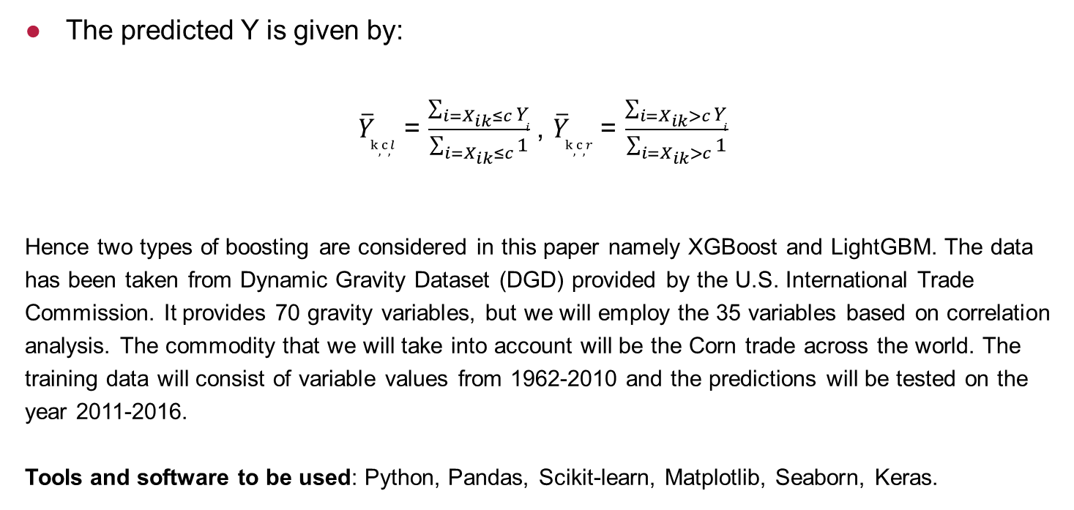
The predicted Y is given by:
${\overline{Y}}_{k,c,l}$ = $\frac{\sum_{i=X_{ik}≤c}{Y_{i}}}{\sum_{i=X_{ik}≤c}{1}}$ , ${\overline{Y}}_{k,c,r}$ = $\frac{\sum_{i=X_{ik}>c}{Y_{i}}}{\sum_{i=X_{ik}>c}{1}}$
Hence two types of boosting are considered in this paper namely XGBoost and LightGBM. The data has been taken from Dynamic Gravity Dataset (DGD) provided by the U.S. International Trade Commission. It provides 70 gravity variables, but we will employ the 35 variables based on correlation analysis. The commodity that we will take into account will be the Corn trade across the world. The training data will consist of variable values from 1962-2010 and the predictions will be tested on the year 2011-2016.
Tools and software to be used: Python, Pandas, Scikit-learn, Matplotlib, Seaborn, Keras.

Slide 7
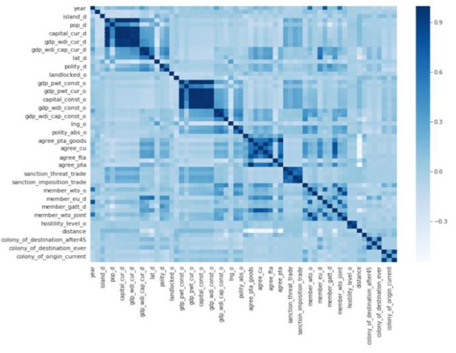

Slide 8
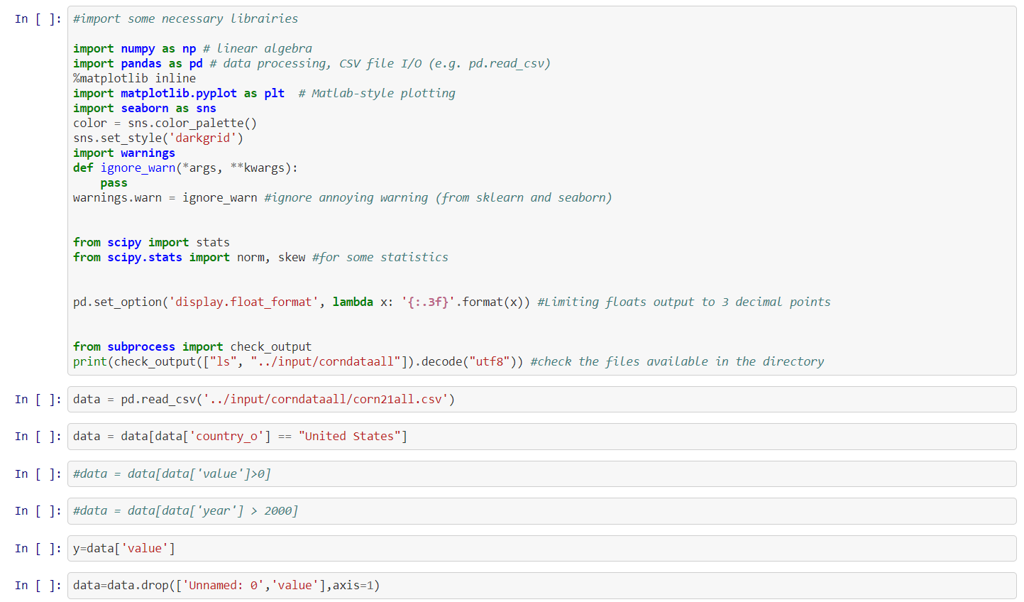
Python code

Slide 9
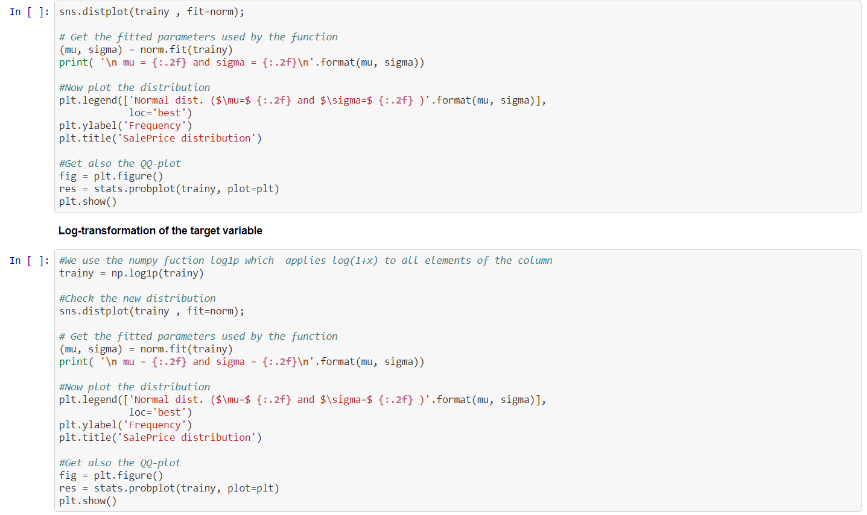

Slide 10
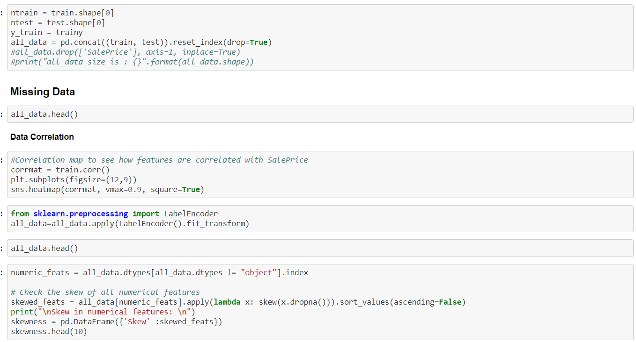

Slide 11
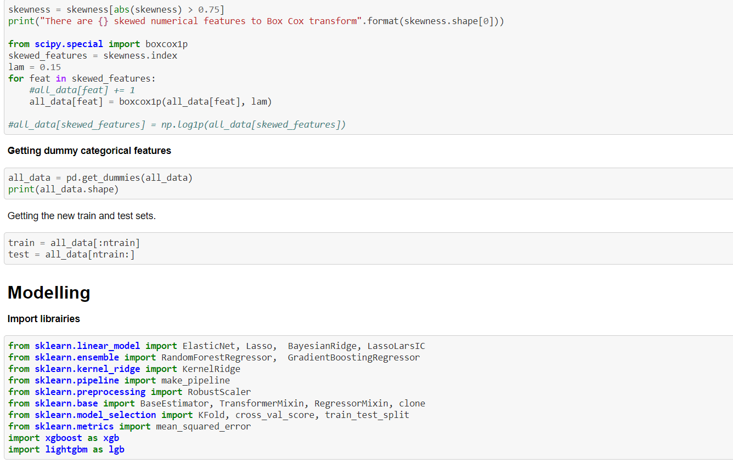

Slide 12
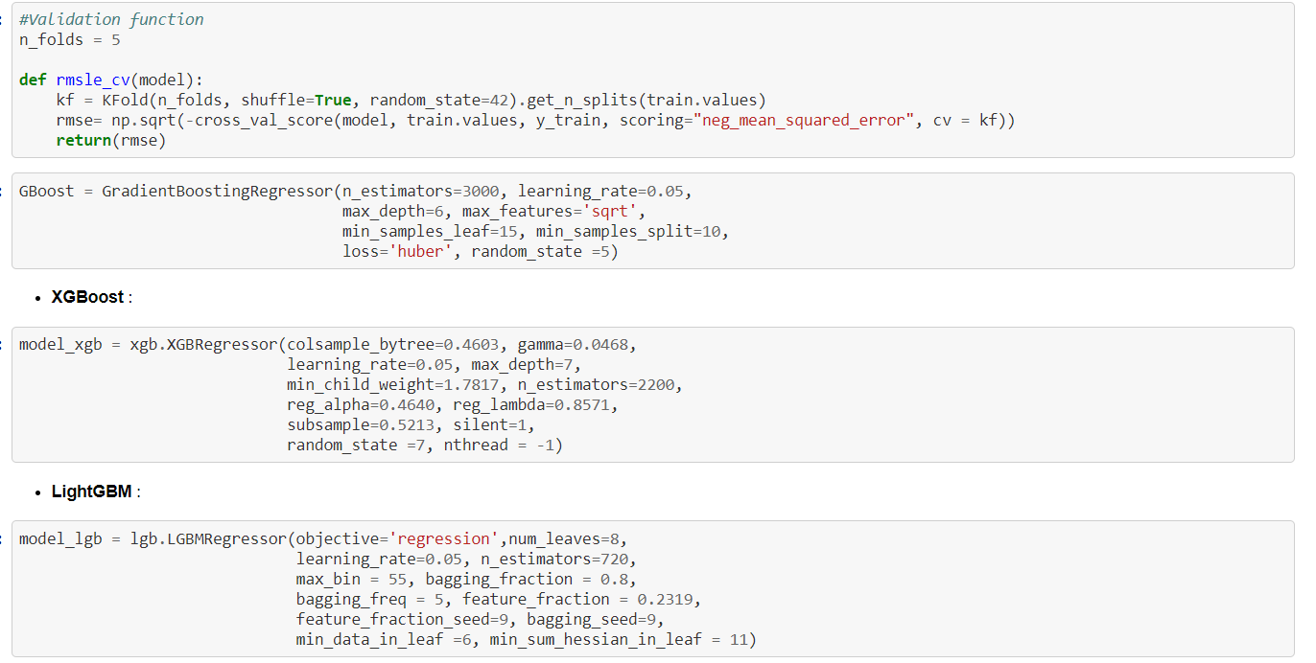

Slide 13
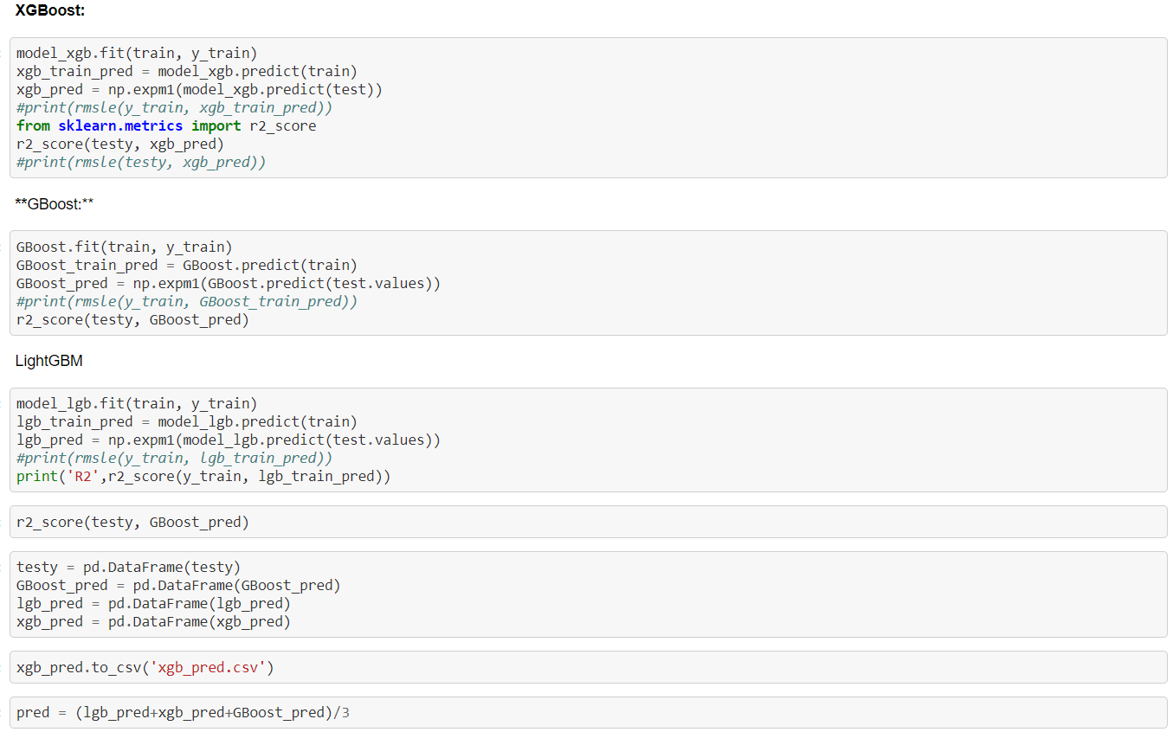

Slide 14
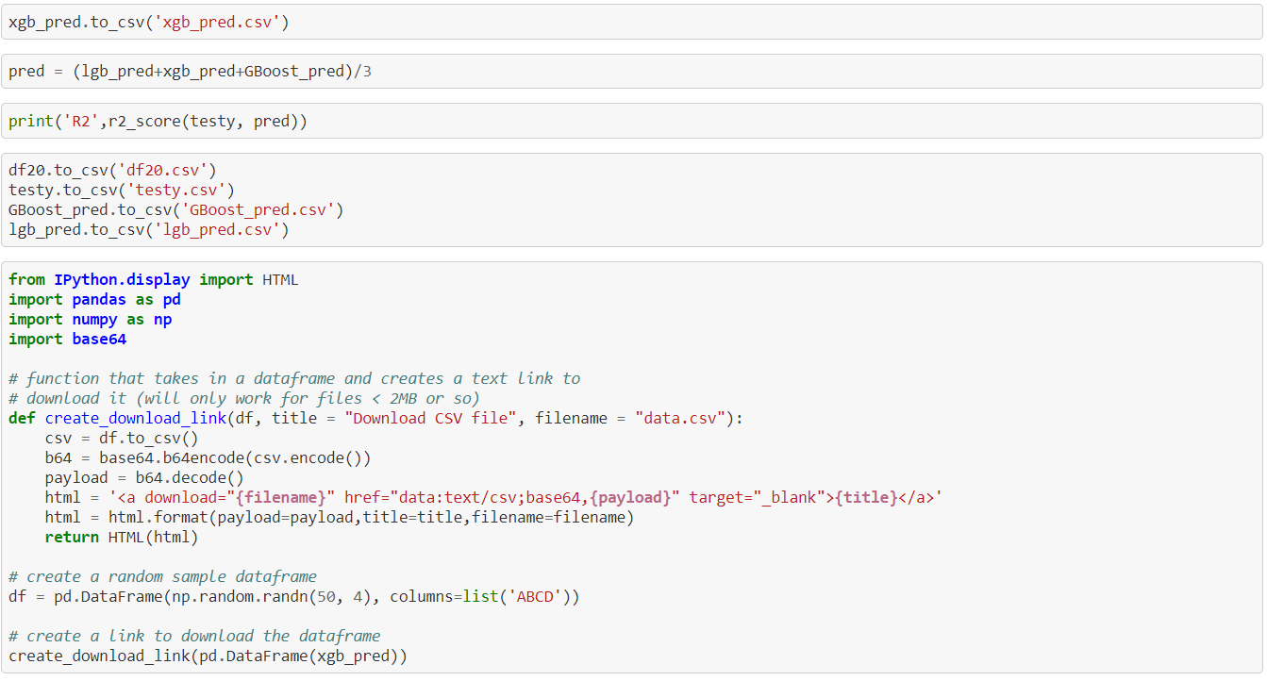

Slide 15
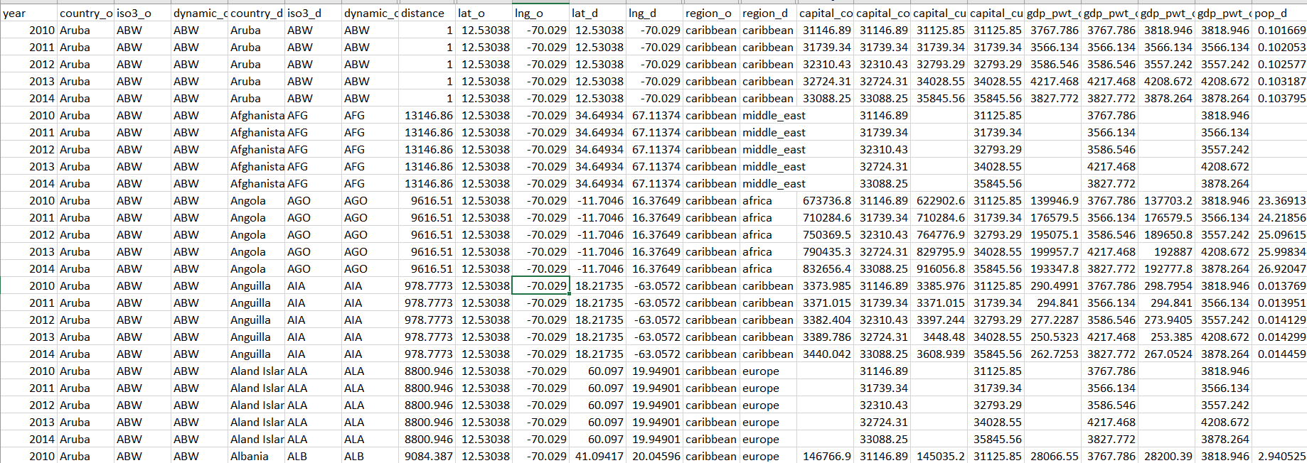
Sample dataset

Slide 16
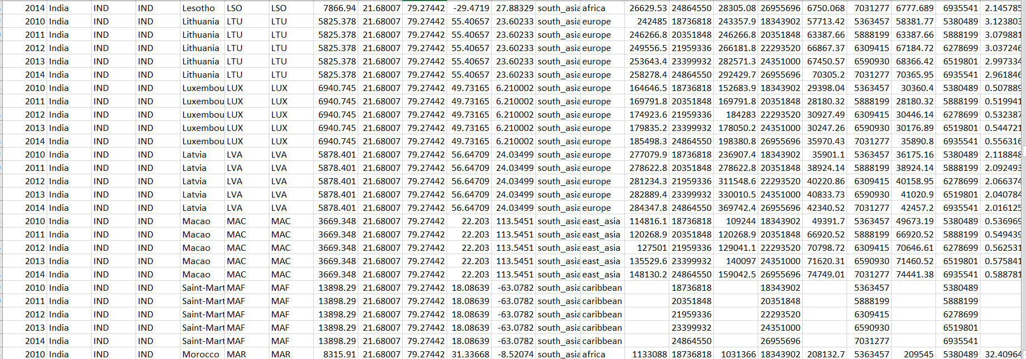

Slide 17
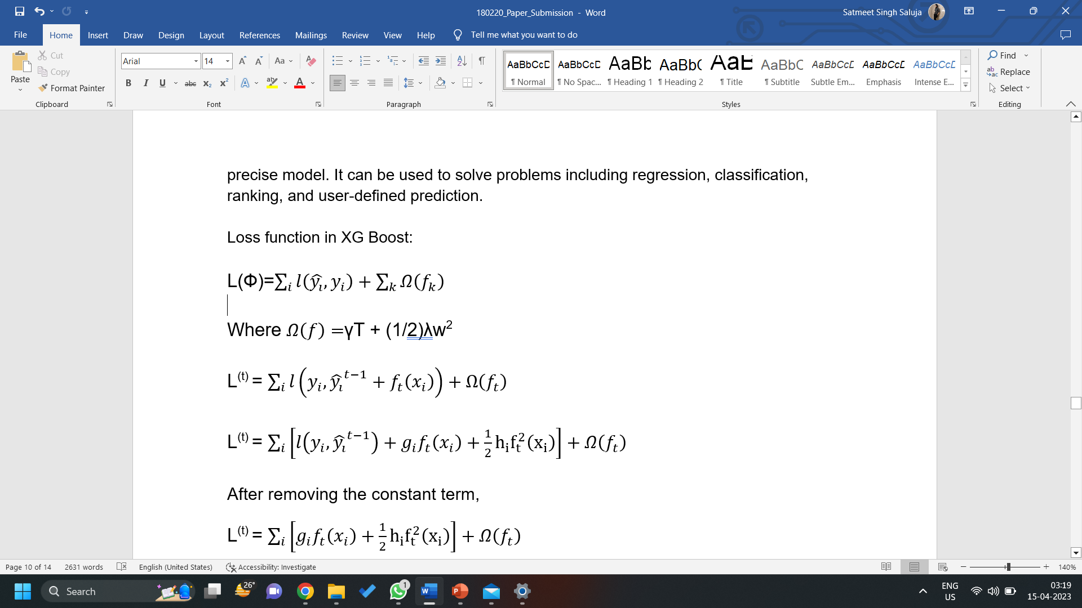
Xgboost model
Gradient Boosted decision trees are implemented in XGBoost. Decision trees are constructed sequentially in this approach. In XGBoost, weights are very significant. All of the independent variables are given weights, which are subsequently fed into the decision tree, which predicts outcomes. The weight of variables that the tree predicted incorrectly is increased, and the variables are then fed into the second decision tree. These various classifiers/predictors are then combined to create a more powerful and precise model. It can be used to solve problems including regression, classification, ranking, and user-defined prediction.

Slide 18
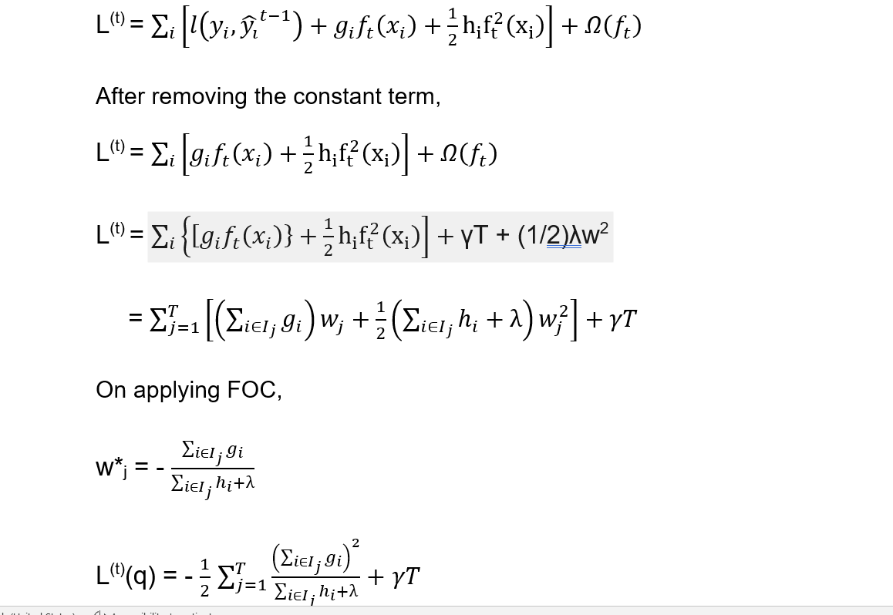

Slide 19
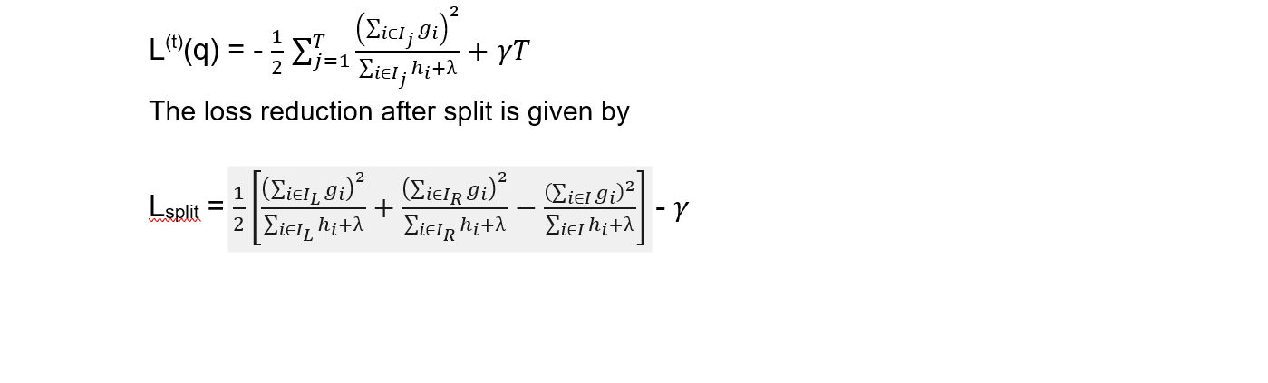
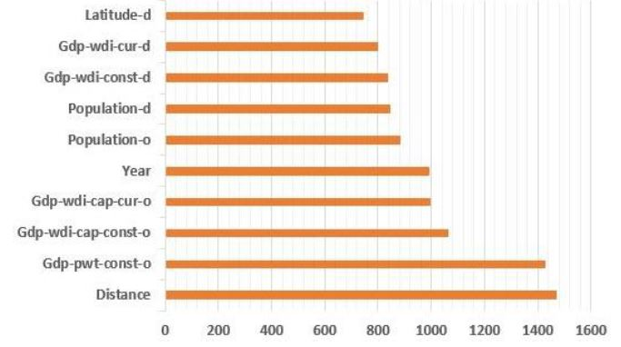
Relative Importance of Variables

Slide 20
lightbgm model
LightGBM scans all data instances to calculate the Gain from all possible Split points, which is evaluated in terms of the reduction in the total of squared errors. Rather than adjusting the weights for each erroneously predicted observation at each iteration, as other approaches such as GBoost do, LightGBM aims to match the new predictor to the prior predictor's errors.
LightGBM slits the tree leaf-wise, whereas XGBoost methods split the tree level-wise with the best fit. The leaf-wise approach can decrease more loss than the level-wise algorithm, resulting in more accurate predictions.

Slide 21
RESULTS AND CONCLUSION
When the models have a high-adjusted R-square and trade data spans a wide number of nations and years, supervised ML results demonstrate that the models fit well in the near to medium term (2011–2014), that is, forecasts closely match actuals. The addition of extra trees or boosting to change weak supervised learners into strong ones, on the other hand, causes predictive quality to plummet 3–4 years after the training data cut-off due to the high presence of zero trade values. The top 10 variables in terms of information gain (reduction in the total-sample sum of squared errors of the loss function attributable to a predictor) and relative importance show that the size of economies, distance between them, location of countries, and time are more important in explaining trade flows than other gravity variables. While these findings are in line with the literature on trade and gravity models, ML excels in variable selection, prediction, and economic importance. Furthermore, supervised machine learning models have made it possible to address time- and space-varying effects, such as the distance puzzle. While changing the training sample size is likely to generate various contributions by features, additional model criteria must be carefully examined to fully solve such puzzles.

Slide 22
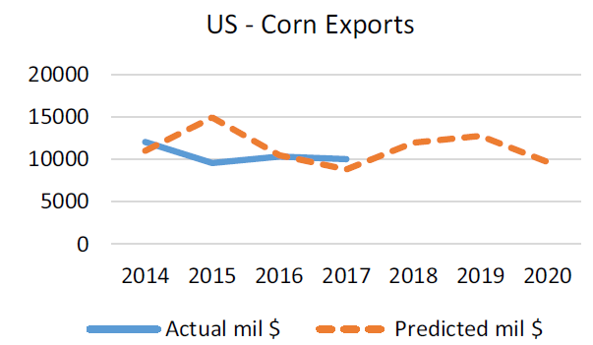
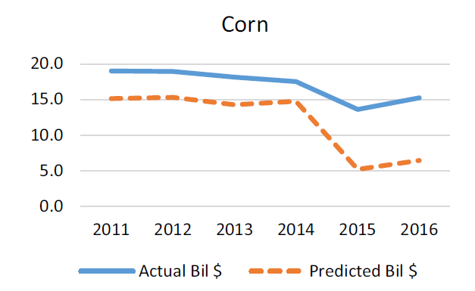
Commodity | Observations | LightGBM | XGBoost
Corn | Training—29,500 Test—10,583 | 0.880 | 0.924

Slide 23
RESULTS AND CONCLUSION
Predicting agricultural trade patterns is crucial for public and private sector decision-making, particularly in the current environment of trade conflicts involving tit-for-tat tariffs. Farmers, for example, are likely to assess prospective demand from other overseas sources before planting crops, particularly in significant exporters. Similarly, countries that set budgets for farm programmes require improved price and trade flow forecasts in order to analyse domestic production and consumption demands, as well as the tools used to attain those goals. The ML models allow for alternative and robust descriptions of complicated economic linkages by relying on data and deep learning. Furthermore, the ML models are cross-validated and may be used to simulate trade outcomes under various policy scenarios, including recent uncertainties. Modeling alternative policy scenarios can be aided by ML, much as it can be aided by computable general equilibrium models, which are useful in assessing the effects of trade policy changes. Changing training or testing data with prohibitive tariffs or trade prohibitions, for example, can produce predictions that can be compared to standard models.
Future work on additional industries, such as manufacturing, data/matrix completeness (a big issue when dealing with zeros in trade and tariffs), multi-variate response variables, and prescriptive ML techniques to compare with current causal models would considerably improve public and private decision making.

Slide 24
RESULTS AND CONCLUSION
Our findings demonstrated that there is high relevance of advanced machine learning model for predicting bilateral trade flow. Our Models- XGBoost and lightGBM improved the prediction quality and will lead to better and accurate results. This is noteworthy since our findings showed that utilizing basic time agnostic information, machine learning approaches are effective in predicting economic variables. Methods used in this paper allowed us the extractions of the best economic variables that would affect trade of specific commodities. We provide a superior alternative to current public-sector agriculture trade flow forecasting methodologies. We use data and deep learning from data to enable for alternative and robust definitions of complicated economic interactions, rather than complex behavioural models with assumptions answered by accessing information from a variety of research. In alternative policy situations, ML models can be used to simulate trade consequences. This research will be broadened to include other commodities and models, with a focus on those that provide policymakers with interpretable outcomes.

Slide 25
References
1. Batarseh, F.; and Yang, R. 2018. Federal Data Science: Transforming Government and Agricultural Policy us-ing Artificial Intelligence. Elsevier’s Academic Press. ISBN: 0128124431.
2. The White House. 2008. Open Data Initiative.
3. Gevel, J.; and Noussair, C. 2013. The Nexus between Artificial Intelligence and Economics. Springer Briefs in Economics. DOI: 10.1007/978-3-642-33648-5_1
4. Gunning, D. 2017. Explainable Artificial Intelligence. DARPA’s update on XAI.
5. National Bureau of Economic Research (NBER). https://www.nber.org/
6. Reddy, C.; Aggarwal, C. 2015. Healthcare Data Analyt-ics. Taylor and Francis Group CRC Press. ISBN: 1482232111.
7. Niemi, D.; Pea, R.; Saxberg, B.; Clark, R. 2018. Learn-ing Analytics in Education. Information Age Publish-ing. ISBN: 978-64113-369-2.
8. Bajari P, Nekipelov D, Ryan SP and Yang M (2015) Machine learning methods for demand estimation. American Economic Review 105(5), 481–485.
9. Ke G, Meng Q, Finley T, Wang T, Chen W, Ma W, Ye Q and Liu TY (2017) LightGBM: A Highly Efficient Gradient Boosting. In the 31st Conference on Neural Information Processing Systems, NIPS. Long Beach, CA, pp. 1–9.
10. Dynamic Gravity Dataset (DGD): https://www.usitc.gov/data/gravity/dgd.htm
11. International agricultural trade forecasting using machine learning , Munisamy Gopinath, Feras A. Batarseh and Sei Jeong.

