Slide 1
AI in Early Childhood Education
How to use
Date December 4th, 2025
Name: Reina Sato

Slide 2

Intro to AI in Early Childhood Education
AI helps young learners to provide students with experience to learn and interact with
Robots, Kits and teach coding skills
Enhance digital literacy skills, crucial thinking and problem solving.
Plays a significant role in preparing for the students to engage
Used for older kids but AI is used for younger ones

Slide 3
Benefits of AI in Early Childhood
Support teachers with administrative tasks
Personalize learning experiences
Assist diverse learners
Foster interaction in children
struggle in traditional social settings

Slide 4
Challenges of AI in Early Childhood
Privacy and data security
Digital dependency and social interaction
Bias and accessibility gaps
Content quality and ethical issues

Slide 5
Personalized learning experiences
Learning
Learning materials be aligned with student’s interests.
It can bring motivation and persistence
Creates your own education rather than the traditional school way
Limited social skills
A lot of biases assessment

Slide 6


Game based learning
Focuses literacy, problem solving, numeracy and different skills.
Engaging and explores children’s curiosity.
Games are such as puzzles, board games, manipulatives.
Date
School Name

Slide 7
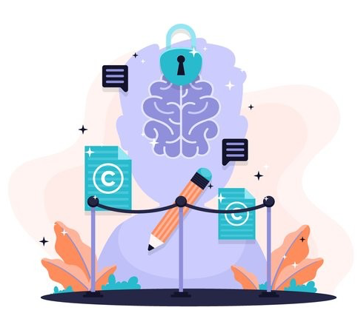


Different AI learning system
Speech recognition
Natural language processing
Adaptive learning system
Converts speech into text and help pronunciate and language development
Allows for verbal interactions with program, range from conversational bots to content generators
Personalized learning pathways on the need and process
Date
School Name

Slide 8
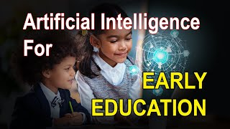

Slide 9
AI literacy in Early Childhood Education
Improves many aspects of child development like theory of mind, creative inquiry, emotional inquiry, and collaborative inquiry
It has become an essential literacy skill that is required for everyone
knowing and understand the basic use of AI and using AI applications is important for all citizens to become AI literates in today's digital world
Children needs to understand the the use of AI with powerful.
It should teach children to understand the basic functions of AI in their everyday lives
Tools were introduced such as Popbots and Zhorai.
Date
School Name

Slide 10
AI literacy in Early Childhood Education challenges
Challenges they might face:
Lack of teacher’s knowledge of AI Literacy
Lack of curriculum design and teaching guidelines
Quality of content
Undermining human connections
Lack of support and resources
Date
School Name

Slide 11
Supportive teacher’s administration
AI helps can manage their workload.
Teachers were burned out before AI existed.
Almost half (49%) of educators note that these administrative tasks are a leading cause of stress
Learning Intelligence Technology: can create many programs, such creating a curriculum, and can be reduce on workload.
Improving communication between families and educators
Date
School Name

Slide 12
AI can teach modern skills for their future
Students can learn how to be confident in their education
STEM and fieldwork
Bright future leaders who can teach AI modern education to others
Strengthen their knowledge of modern technology in this new era.
Date
School Name

Slide 13
Recap
The benefits and challenges of AI
Personalized learning experiences
Helps children and teacher’s learning and their classrooms while misinform their privacy.
Create unique curriculum based on children’s request weather through games, oral, or watching videos
AI literacy
Supportive teacher’s administration
AI literacy improves’ children’s knowledge while challenges face of lack of resources and help
Reduce teacher stress of workload, and create curriculum for the classroom
Helps succeed in their future
Know the modern technology skills for the career and teach others in this new era.
Date
School Name

Slide 14
Sources
https://direct.ewa.pub/proceedings/lnep/article/view/24154.html
https://www.instituteforchildsuccess.org/ai-early-childhood-education/#:~:text=Additionally%2C%20conversational%20AI%20applications%20can,childhood%20assessment%2C%20and%20administrative%20tasks.
S2666920X23000036
https://pmc.ncbi.nlm.nih.gov/articles/PMC11018941/
Picture
Picture
Picture

