Slide 1

Feature Engineering
and
Data Preparation

Slide 2
Feature Engineering
In the real world, not every data set is machine learning ready, we often need to perform data cleaning or try to produce more usable features.
In this section, we’ll work on the large linear regression data set to get it ready for a machine learning project.

Slide 3
Feature Engineering
What is feature engineering?
Is the process of using domain knowledge to extract features from raw data via data mining techniques.
But what does this actually entail?

Slide 4
Feature Engineering
Three general approaches:
Extracting Information
Combining Information
Transforming Information

Slide 5
Feature Engineering
Extracting Information
Imagine a dataset with visitor expenditure information for a bar.
We have a timestamp for each row:
1990-12-01 09:26:03
In its current format, its very difficult to pass into a machine learning algorithm.

Slide 6
Feature Engineering
Extracting Information
In its current format, its very difficult to pass into a machine learning algorithm.
There is no coefficient we can apply for a non-numeric data point:
1990-12-01 09:26:03
In general for most algorithms we need to make sure features are float or int.

Slide 7
Feature Engineering
Extracting Information
Instead we extract information
1990-12-01 09:26:03
Year: 1990
Month: 12
Weekday or Weekend (0/1)
Mon:1,Tues:2, … Sun:7

Slide 8
Feature Engineering
Extracting Information
More complex examples:
Text data for deed of house
Length of text
Number of times certain terms are mentioned

Slide 9
Feature Engineering
Combining Information
We’ve actually already done this with Polynomial Regression!
Recall advertising spend could have possible interaction terms to consider, so we could multiply them together.

Slide 10
Feature Engineering
Combining Information
Could also combine extracted information:
New Feature:
0 or 1 value indicating:
Both weekend and evening?

Slide 11
Feature Engineering
Transforming Information
Very common for string data
Most algorithms can not accept string data (can’t multiply a string such as “red” by a numeric coefficient)

Slide 12
Feature Engineering
Transforming Information
Often categorical data is presented as string data.
For example a large data set of social network users could have country of origin as a string feature (e.g. USA, UK, MEX, etc...)

Slide 13
Feature Engineering
Transforming Information
We can use two approaches here:
Integer Encoding
One-hot Encoding (Dummy Variables)

Slide 14
Feature Engineering
Integer Encoding
Directly convert categories into integers 1,2,3...N

Slide 15
Feature Engineering
Integer Encoding
Directly convert categories into integers 1,2,3...N
Country
USA
MEX
CAN
USA

Slide 16
Feature Engineering
Integer Encoding
Directly convert categories into integers 1,2,3...N
Country
USA
MEX
CAN
USA
Country
1
2
3
1

Slide 17
Feature Engineering
Integer Encoding
Possible issue is implied ordering and relationship (ordinal variable)
Country
USA
MEX
CAN
USA
Country
1
2
3
1

Slide 18
Feature Engineering
Integer Encoding
Here we see the implication MEX is twice the value of USA
Country
USA
MEX
CAN
USA
Country
1
2
3
1

Slide 19
Feature Engineering
Integer Encoding
Here we see the implication CAN is three times the value of USA
Country
USA
MEX
CAN
USA
Country
1
2
3
1

Slide 20
Feature Engineering
Integer Encoding
This may or may not make sense depending on the feature and domain
Country
USA
MEX
CAN
USA
Country
1
2
3
1

Slide 21
Feature Engineering
Integer Encoding
This may or may not make sense depending on the feature and domain
Spice Level
Mild
Hot
Fire
Mild
Spice Level
1
2
3
1

Slide 22
Feature Engineering
Integer Encoding
Always carefully consider the implication of integer encoding
Spice Level
Mild
Hot
Fire
Mild
Spice Level
1
2
3
1

Slide 23
Feature Engineering
Integer Encoding
Pros:
Very easy to do and understand.
Does not increase number of features.
Cons:
Implies ordered relationship between categories.

Slide 24
Feature Engineering
One Hot Encoding (Dummy Variables)
Convert each category into individual features that are either 0 or 1

Slide 25
Feature Engineering
One Hot Encoding (Dummy Variables)
Convert categories into individual features that are either 0 or 1
Country
USA
MEX
CAN
USA

Slide 26
Feature Engineering
One Hot Encoding (Dummy Variables)
Convert categories into individual features that are either 0 or 1
Country
USA
MEX
CAN
USA
USA | MEX | CAN
1 | 0 | 0
0 | 1 | 0
0 | 0 | 1
1 | 0 | 0

Slide 27
Feature Engineering
One Hot Encoding (Dummy Variables)
No ordered relationship is implied between categories.
Country
USA
MEX
CAN
USA
USA | MEX | CAN
1 | 0 | 0
0 | 1 | 0
0 | 0 | 1
1 | 0 | 0

Slide 28
Feature Engineering
One Hot Encoding (Dummy Variables)
However we greatly expanded our feature set, many more columns.
Country
USA
MEX
CAN
USA
USA | MEX | CAN
1 | 0 | 0
0 | 1 | 0
0 | 0 | 1
1 | 0 | 0

Slide 29
Feature Engineering
One Hot Encoding (Dummy Variables)
We can try to reduce this feature column expansion by creating higher level categories.
For example, regions or continents instead of countries.

Slide 30
Feature Engineering
One Hot Encoding (Dummy Variables)
Using pandas .map() or .apply() can achieve this.
May require a lot of tuning and domain experience to choose reasonable higher level categories or mappings.

Slide 31
Feature Engineering
One Hot Encoding (Dummy Variables)
Also must be aware of the “dummy variable trap”, mathematically known as multi-collinearity.
Converting to dummy variables can cause features to be duplicated.
Let’s consider the simplest possible example...

Slide 32
Feature Engineering
One Hot Encoding (Dummy Variables)
Consider a binary category (only two options):
Vertical Direction
UP
DOWN
UP
DOWN

Slide 33
Feature Engineering
One Hot Encoding (Dummy Variables)
Consider a binary category (only two options):
Vertical Direction
UP
DOWN
UP
DOWN
UP | DOWN
1 | 0
0 | 1
1 | 0
0 | 1

Slide 34
Feature Engineering
One Hot Encoding (Dummy Variables)
The new columns are duplicate information with inverted encoding.
Vertical Direction
UP
DOWN
UP
DOWN
UP | DOWN
1 | 0
0 | 1
1 | 0
0 | 1

Slide 35
Feature Engineering
One Hot Encoding (Dummy Variables)
Easily fixed by simply dropping last column.
Vertical Direction
UP
DOWN
UP
DOWN
UP
1
0
1
0

Slide 36
Feature Engineering
One Hot Encoding (Dummy Variables)
This can be extended to more than 2 categories:
Country
USA
MEX
CAN
USA
USA | MEX
1 | 0
0 | 1
0 | 0
1 | 0

Slide 37
Feature Engineering
One Hot Encoding (Dummy Variables)
Pros:
No ordering implied.
Cons:
Potential to create many more feature columns and coefficients.
Dummy variable trap consideration.
Not easy to add new categories.

Slide 38
Feature Engineering
Throughout this section of the course we’ll work on addressing the following issues:
Outliers in Data
Missing Data
Categorical Data
Not every issue here is strictly “feature engineering”, but could also be called “data cleaning”.

Slide 39
Feature Engineering
Keep in mind feature engineering in general will always be data and domain dependent.
There is no one size fits all solution!

Slide 40
Let’s get started!

Slide 41
Dealing with Outliers

Slide 42
Outliers
Often a data set will have a few points that are extreme outliers.
It’s often better to simply remove these few points from the data set in order to have a more generalized model.

Slide 43
Outliers
Outlier Considerations
Definition of an Outlier
Range and Limits
Percentage of Data
These are both very domain dependant!

Slide 44
Outliers
Outlier Considerations
Range and Limits
We need to decide what will constitute an outlier with some methodology:
InterQuartile Range
Standard Deviation
Visualized or Domain Limit Value

Slide 45
Outliers
Outlier Considerations
Percentage of Data
Keep in mind if a large percentage of your data is being labeled as an outlier, then you actually just have a wide distribution, not outliers!
Limit outliers to a few percentage points a most.

Slide 46
Outliers
Outlier Considerations
Utilize visualization plots to be able to see and identify outlier points.
Keep in mind, this will create caveats for your future model (e.g. Model not suitable for houses priced over $10 Million)

Slide 47
Outliers
Keep in mind, there is no 100% correct outlier methodology that will apply to every situation.
Let’s explore the Ames Data Set for outliers!

Slide 48
Dealing with
Missing Data
PART ONE: EVALUATING WHAT IS MISSING

Slide 49
Missing Data
Make sure you’ve viewed the “Missing Data” lecture in the pandas section before continuing with this series of lectures!
Many concepts and methods referred to here were explained in those lectures.

Slide 50
Missing Data
Working with the Ames data set, in Part One we will focus on evaluating just how much data is missing.

Slide 51
Dealing with
Missing Data
PART TWO: FILLING DATA FOR ROWS

Slide 52
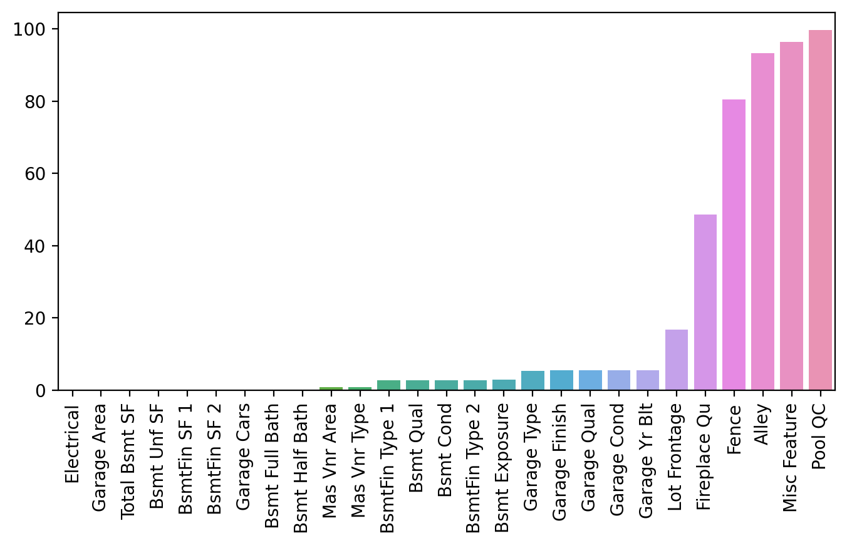
Missing Data
Recall we just calculated percentage of data missing per feature column:

Slide 53
Missing Data
Let’s first work on considering features that have a very small percent missing.

Slide 54
Missing Data
In the case of just a few rows missing the feature data, we’ll consider either dropping these few rows or filling in with a reasonable assumption based off domain knowledge.
Let’s jump to the notebook to explore our options!

Slide 55
Dealing with
Missing Data
PART THREE: FEATURE COLUMNS

Slide 56
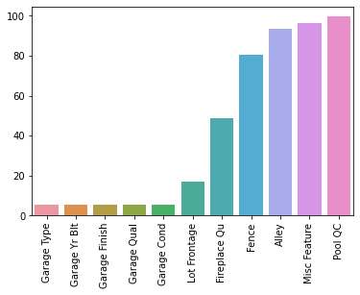
Missing Data
We are now dealing with missing data that goes beyond our 1% threshold.

Slide 57
Missing Data
In other words, more than 1% of rows are missing some of these feature values.

Slide 58
Missing Data
Two main approaches here:
Fill in the missing values
Drop the feature column
Let’s consider the pros and cons of each approach...

Slide 59
Missing Data
Dropping the feature column:
Very simple to do.
No longer need to worry about that feature in the future.
Potential to lose a feature with possible important signal.
Should consider drop feature approach when many rows are NaN.

Slide 60
Missing Data
Filling in the missing feature data:
Potentially changing ground truth in data.
Must decide on reasonable estimation to filled value.
Must apply transformation to all future data for predictions.

Slide 61
Missing Data
Filling in the missing feature data:
Simplest case:
Replace all NaN values with a reasonable assumption (e.g. zero if assumed NaN implied zero)
Harder cases:
Must use statistical methods based on other columns to fill in NaN values.

Slide 62
Missing Data
Filling in the missing feature data:
Statistical Estimation:
Dataset about people with some age data missing.
Could use current career/education status to fill in data (e.g. people currently in college fill in with 20 yrs)

Slide 63
Missing Data
Let’s explore both approaches!
Important note!
Realistically on the Ames data set, many NaN values are probably actually correctly “zero”. But we want to show the methodology for multiple approaches!

Slide 64
Dealing with
Categorical Data

Slide 65
Categorical Data
We’re going to jump straight to the transformation of the data, but make sure to have watched the section introduction lecture in full for a detailed discussion on dummy variables and one hot encoding!

