Slide 1

Boosting

Slide 2
Boosting
We’ve learned about single Decision Trees and have seeked to improve upon them with Random Forest models.
Let’s now explore another methodology of seeking to improve on the single decision tree, known as boosting.

Slide 3
Boosting
Section Overview:
Boosting and Meta-Learning
AdaBoost (Adaptive Boosting) Theory
Example of AdaBoost
Gradient Boosting Theory
Example of Gradient Boosting

Slide 4
Boosting
Related Reading:
ISLR: Section 8.2.3
Relevant Wikipedia Articles:
wikipedia.org/wiki/Boosting_(machine_learning)
wikipedia.org/wiki/AdaBoost

Slide 5
Let’s get started!

Slide 6
Boosting
Motivation and History

Slide 7
Boosting
The concept of boosting is not actually a machine learning algorithm, it is methodology applied to an existing machine learning algorithm, most commonly applied to the decision tree.
Let’s explore this idea of a meta-learning algorithm by reviewing a simple application and formula.

Slide 8
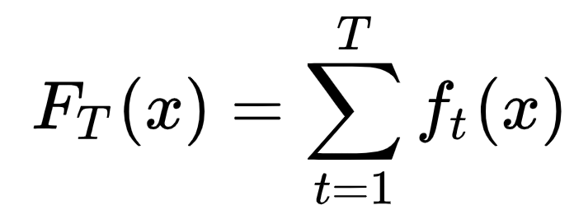
Boosting
Main formula for boosting:

Slide 9
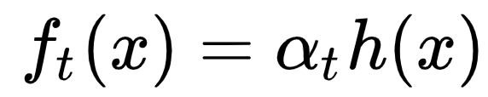
Boosting
Main formula for boosting:

Slide 10
Boosting
Main formula for boosting:
Implies that a combination of estimators with an applied coefficient could act as an effective ensemble estimator.

Slide 11
Boosting
Main formula for boosting:
Note h(x) can in theory be any machine learning algorithm (estimator/learner).

Slide 12
Boosting
Main formula for boosting:
Can an ensemble of weak learners (very simple models) be a strong learner when combined?

Slide 13
Boosting
Main formula for boosting:
For decision tree models, we can use simple trees in place of h(x) and combine them with the coefficients on each model.

Slide 14
Boosting
The idea of gradient boosting originated from Leo Breiman when he observed that boosting can be interpreted as an optimization algorithm on a cost function in publications in the late 1990s.
Later on Jerome H. Friedman and many others developed more explicit formulations of gradient boosting.

Slide 15
Boosting
Also in the late 1990s Yoav Freund and Robert Schapire developed the AdaBoost (Adaptive Boosting) algorithm, which also combines weak learners in an ensemble to create a stronger model.

Slide 16
Boosting
Let’s continue by focusing first on AdaBoost and building an understanding of how to combine weak learners to create a strong estimator.
We will also explore why Decision Trees are so well suited for boosting.

Slide 17
AdaBoost
Intuition and Theory

Slide 18
Boosting
AdaBoost (Adaptive Boosting) works by using an ensemble of weak learners and then combining them through the use of a weighted sum.
Adaboost adapts by using previously created weak learners in order to adjust misclassified instances for the next created weak learner.

Slide 19
Boosting
What is a weak learner?

Slide 20
Boosting
What is a weak learner?
A weak model is a model that is too simple to perform well on its own.

Slide 21
Boosting
What is a weak learner?
A weak model is a model that is too simple to perform well on its own.
The weakest decision tree possible would be a stump, one node and two leaves!

Slide 22
Boosting
Unlike a single decision tree which fits to all the data at once (fitting the data hard), AdaBoost aggregates multiple weak learners, allowing the overall ensemble model to learn slowly from the features.
Let’s first understand how this works from a data perspective!

Slide 23
Boosting
Imagine a classification task:
X₂
X₁

Slide 24
Boosting
What would a stump classification look like?
X₂
X₁

Slide 25
Boosting
What would a stump classification look like?
X
X₂
X₁

Slide 26
Boosting
What would a stump classification look like?
X₁
X₂
X₁

Slide 27
Boosting
What would a stump classification look like?
X₁
X₂
X₁

Slide 28
Boosting
What would a stump classification look like?
X₂
X₂
X₁

Slide 29
Boosting
What would a stump classification look like?
X₂
X₂
X₁

Slide 30
Boosting
How can we combine stumps? How to improve performance with an ensemble?

Slide 31
Boosting
AdaBoost Process:

Slide 32
Boosting
AdaBoost Process:
Main Formulas
Algorithmic Steps
Visual Walkthrough of Algorithm

Slide 33
Boosting
AdaBoost Process: Main Formulas

Slide 34
Boosting
AdaBoost Process:

Slide 35
Boosting
AdaBoost Process:

Slide 36
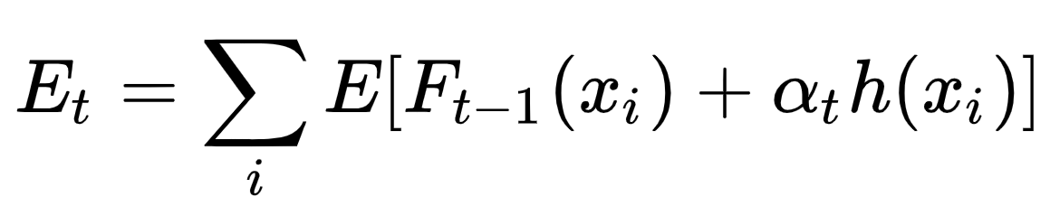
Boosting
AdaBoost Process:

Slide 37
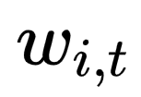
Boosting
AdaBoost Process:

Slide 38
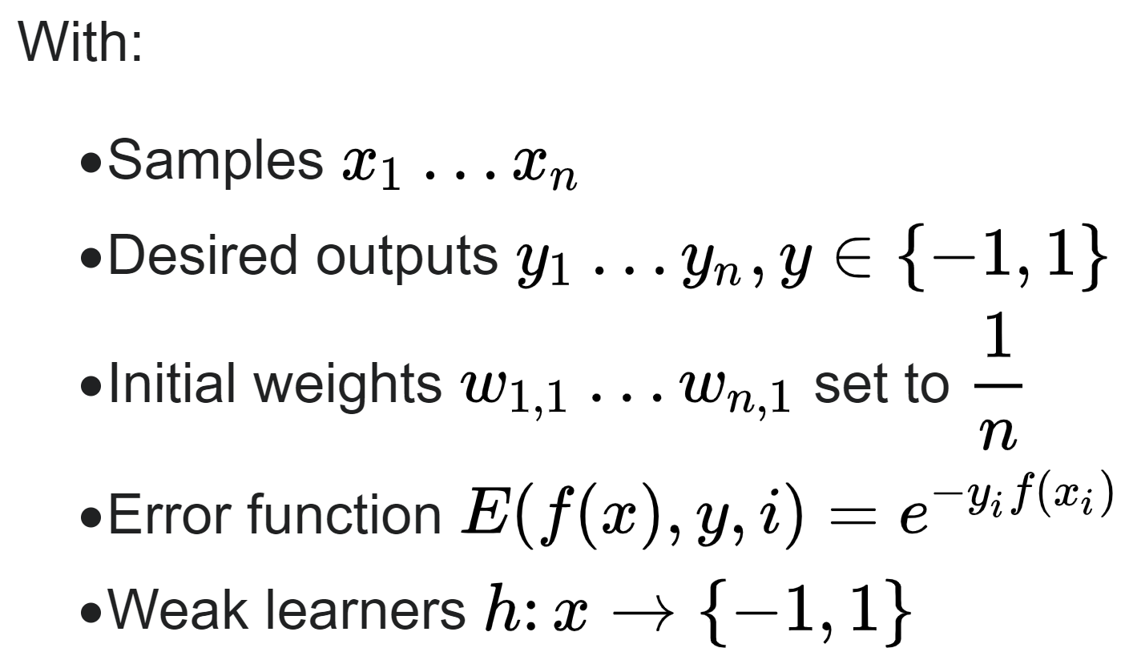
Boosting
AdaBoost Process: Algorithm Steps

Slide 39
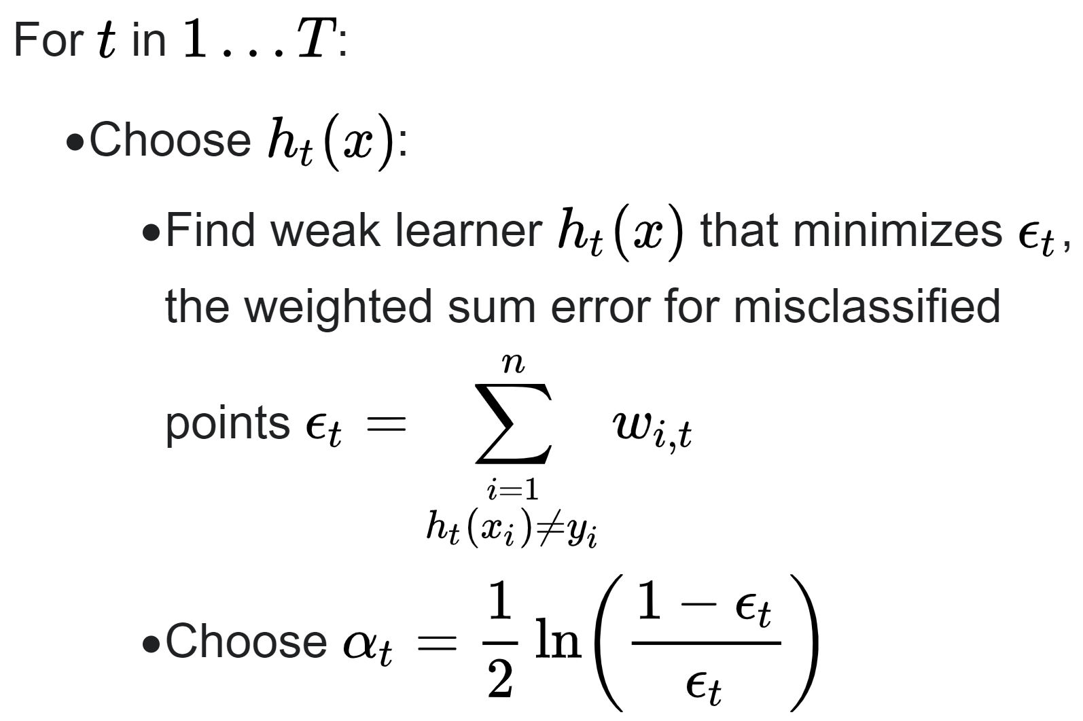
Boosting
AdaBoost Process:

Slide 40
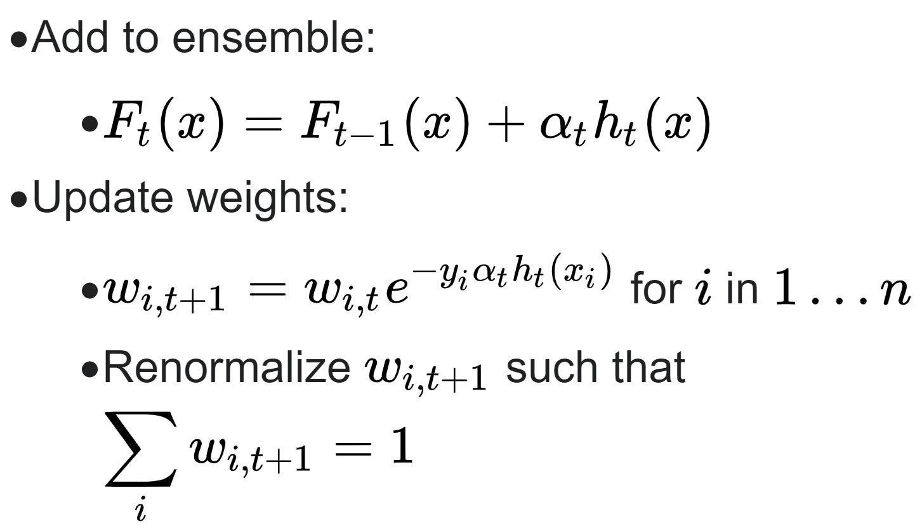
Boosting
AdaBoost Process:

Slide 41
Boosting
AdaBoost Process: Visual Walkthrough

Slide 42
Boosting
AdaBoost Process: Visual Walkthrough

Slide 43
Boosting
AdaBoost Process: Visual Walkthrough

Slide 44
Boosting
AdaBoost Process:
X₁

Slide 45
Boosting
AdaBoost Process:
X₁

Slide 46
Boosting
AdaBoost Process:
X₁

Slide 47
Boosting
AdaBoost Process:
α_{t}
X₁

Slide 48
Boosting
AdaBoost Process:
α_{t}
X₁

Slide 49
Boosting
AdaBoost Process:
α_{t}
X₁

Slide 50
Boosting
AdaBoost Process:
α_{t}
X₁
X₂

Slide 51
Boosting
AdaBoost Process:
α_{t}
X₁
X₂

Slide 52
Boosting
AdaBoost Process:
α_{t}
X₁
α_{t+1}
X₂

Slide 53
Boosting
AdaBoost Process:
α_{t}
X₁
α_{t+1}
X₂

Slide 54
Boosting
AdaBoost Process:
α_{t}
X₁
α_{t+1}
X₂

Slide 55
Boosting
AdaBoost Process:
α_{t}
X₁
α_{t+1}
X₂
X₁

Slide 56
Boosting
AdaBoost Process:
α_{t}
X₁
α_{t+1}
X₂
X₁

Slide 57
Boosting
AdaBoost Process:
α_{t}
X₁
α_{t+1}
X₂
α_{t+2}
X₁

Slide 58
Boosting
AdaBoost Process:
α_{t}
X₁
α_{t+1}
X₂
α_{t+2}
X₁

Slide 59
Boosting
AdaBoost Process:
α_{t}
X₁
α_{t+1}
X₂
α_{t+2}
X₁

Slide 60
Boosting
AdaBoost Process:
α_{t}
X₁
α_{t+1}
X₂
α_{t+2}
X₁

Slide 61
Boosting
AdaBoost Process:
α_{t}
X₁
α_{t+1}
X₂
α_{t+2}
X₁

Slide 62
Boosting
AdaBoost Process:
α_{t}
X₁
α_{t+1}
X₂
α_{t+2}
X₁

Slide 63
Boosting
AdaBoost Process:
α_{t}
X₁
α_{t+1}
X₂
α_{t+2}
X₁

Slide 64
Boosting
AdaBoost uses an ensemble of weak learners that learn slowly in series.
Certain weak learners have more “say” in the final output than others due to the multiplied alpha parameter.
Each subsequent t weak learner is built using a reweighted data set from the t-1 weak learner.

Slide 65
Boosting
Intuition of Adaptive Boosting:
Each stump essentially represents the strength of a feature to predict.
Building these stumps in series and adding in the alpha parameter allows us to intelligently combine the importance of each feature together.

Slide 66
Boosting
Notes on Adaptive Boosting:
Unlike Random Forest, it is possible to overfit with AdaBoost, however it takes many trees to do this.
Usually error has already stabilized way before enough trees are added to cause overfitting.

Slide 67
Boosting
Let’s move on to seeing AdaBoost in practice!

Slide 68
AdaBoost
Coding Walkthrough Part One: Data

Slide 69
Boosting
For this particular ML project, we will be walking through an example where a predictive model is not the main goal!
Let’s give you a brief overview of the data to fully understand the scope of the project.

Slide 70
Boosting
Mushroom Data
Variety of categorical features on mushrooms.
Can we use ML to accomplish two tasks:
Predict Poisonous vs. Edible.
Create cautionary guidelines for people picking mushrooms.

Slide 71
Boosting
Tree based methods have great capabilities to report feature importance.
Adaboost specifically has stumps focusing on one feature at a time, which could be useful in creating mushroom picking guidelines.
Let’s check out the data in a notebook!

Slide 72
AdaBoost
Coding Walkthrough Part Two: Model

Slide 73
Gradient Boosting
Theory and Intuition

Slide 74
Boosting
Gradient Boosting is a very similar idea to AdaBoost, where weak learners are created in series in order to produce a strong ensemble model.
Gradient Boosting makes use of the residual error for learning.

Slide 75
Boosting
Gradient Boosting vs. Adaboost:
Larger Trees allowed in Gradient Boosting.
Learning Rate coefficient same for all weak learners.
Gradual series learning is based on training on the residuals of the previous model.

Slide 76
Boosting
Gradient Boosting Regression Example
Area m² | Bedrooms | Bathrooms | Price
200 | 3 | 2 | $500,000
190 | 2 | 1 | $462,000
230 | 3 | 3 | $565,000

Slide 77
Boosting
Train a decision tree on data
Area m² | Bedrooms | Bathrooms | Price
200 | 3 | 2 | $500,000
190 | 2 | 1 | $462,000
230 | 3 | 3 | $565,000

Slide 78
Boosting
Note - not just a stump!
Area m² | Bedrooms | Bathrooms | Price
200 | 3 | 2 | $500,000
190 | 2 | 1 | $462,000
230 | 3 | 3 | $565,000

Slide 79
Boosting
Get predicted ŷ value
Area m² | Bedrooms | Bathrooms | Price
200 | 3 | 2 | $500,000
190 | 2 | 1 | $462,000
230 | 3 | 3 | $565,000

Slide 80
Boosting
Get predicted ŷ value
Area m² | Bedrooms | Bathrooms | y
200 | 3 | 2 | $500,000
190 | 2 | 1 | $462,000
230 | 3 | 3 | $565,000

Slide 81
Boosting
Get predicted ŷ value
y | ŷ
$500,000 | $509,000
$462,000 | $509,000
$565,000 | $509,000

Slide 82
Boosting
Calculate residual: e = y-ŷ
y | ŷ | e
$500,000 | $509,000 | -$9,000
$462,000 | $509,000 | -$47,000
$565,000 | $509,000 | $56,000

Slide 83
Boosting
Create new model to predict the error
y | ŷ | e
$500,000 | $509,000 | -$9,000
$462,000 | $509,000 | -$47,000
$565,000 | $509,000 | $56,000

Slide 84
Boosting
Create new model to predict the error
y | ŷ | e
$500,000 | $509,000 | -$9,000
$462,000 | $509,000 | -$47,000
$565,000 | $509,000 | $56,000

Slide 85
Boosting
Create new model to predict the error
y | ŷ | e | f1
$500,000 | $509,000 | -$9,000 | -$8,000
$462,000 | $509,000 | -$47,000 | -$50,000
$565,000 | $509,000 | $56,000 | $50,000

Slide 86
Boosting
Create new model to predict the error
y | ŷ | e | f1
$500,000 | $509,000 | -$9,000 | -$8,000
$462,000 | $509,000 | -$47,000 | -$50,000
$565,000 | $509,000 | $56,000 | $50,000
Area m² | Bedrooms | Bathrooms
200 | 3 | 2
190 | 2 | 1
230 | 3 | 3

Slide 87
Boosting
Create new model to predict the error
y | ŷ | e | f1
$500,000 | $509,000 | -$9,000 | -$8,000
$462,000 | $509,000 | -$47,000 | -$50,000
$565,000 | $509,000 | $56,000 | $50,000
Area m² | Bedrooms | Bathrooms
200 | 3 | 2
190 | 2 | 1
230 | 3 | 3

Slide 88
Boosting
Update prediction using error prediction
y | ŷ | e | f1
$500,000 | $509,000 | -$9,000 | -$8,000
$462,000 | $509,000 | -$47,000 | -$50,000
$565,000 | $509,000 | $56,000 | $50,000

Slide 89
Boosting
Update prediction using error prediction
y | ŷ | e | f1 | F1 = ŷ + f1
$500,000 | $509,000 | -$9,000 | -$8,000
$462,000 | $509,000 | -$47,000 | -$50,000
$565,000 | $509,000 | $56,000 | $50,000

Slide 90
Boosting
Update prediction using error prediction
y | ŷ | e | f1 | F1 = ŷ + f1
$500,000 | $509,000 | -$9,000 | -$8,000 | $501,000
$462,000 | $509,000 | -$47,000 | -$50,000 | $459,000
$565,000 | $509,000 | $56,000 | $50,000 | $559,000

Slide 91
Boosting
We can continue this process in series
y | ŷ | e | f1 | F1 = ŷ + f1
$500,000 | $509,000 | -$9,000 | -$8,000 | $501,000
$462,000 | $509,000 | -$47,000 | -$50,000 | $459,000
$565,000 | $509,000 | $56,000 | $50,000 | $559,000

Slide 92
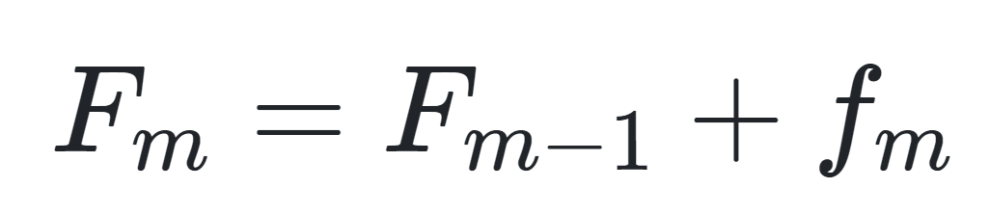
Boosting
Gradient Boosting Process

Slide 93
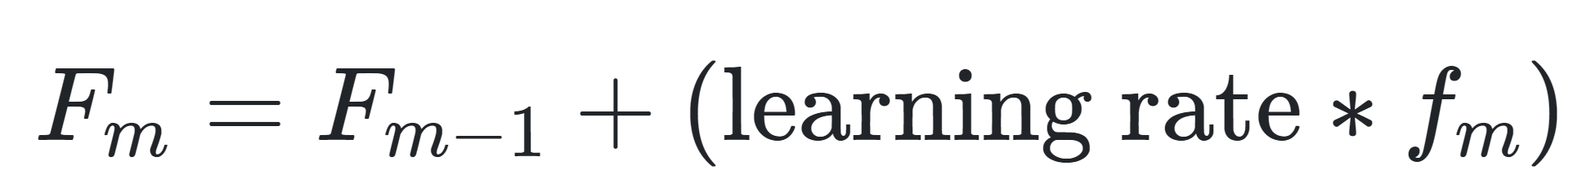
Boosting
Gradient Boosting Process

Slide 94
Boosting
Gradient Boosting Process
Create initial model: f₀
Train another model on error
e = y - f₀
Create new prediction
F₁ = f₀ + ηf₁
Repeat as needed
F_{m} = f_{m-1} + ηf_{m}

Slide 95
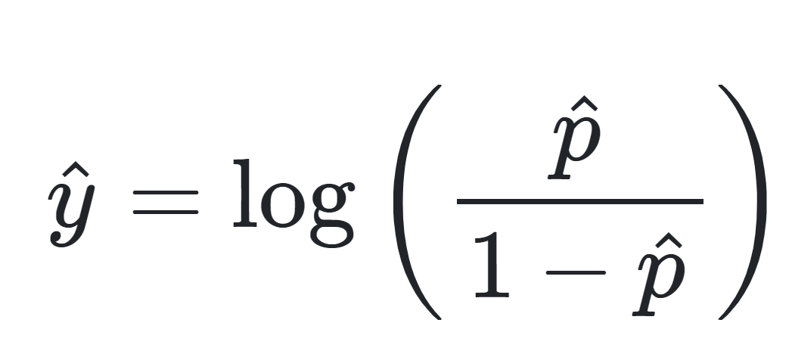
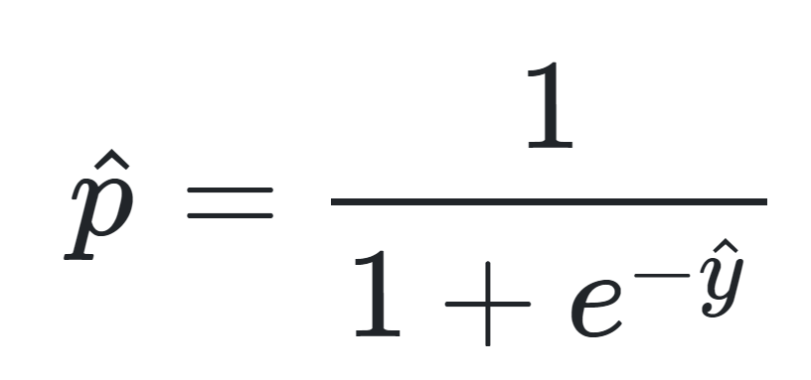
Boosting
Note, for classification we can use the logit as an error metric:

Slide 96
Boosting
Note, the learning rate is the same for each new model in the series, it is not unique to each subsequent model (unlike AdaBoost’s alpha coefficient).
Gradient Boosting is fairly robust to overfitting, allowing for the number of estimators to be set high be default (~100).

Slide 97
Boosting
Gradient Boosting Intuition
We optimize the series of trees by learning on the residuals, forcing subsequent trees to attempt to correct for the error in the previous trees.

Slide 98
Boosting
Gradient Boosting Intuition
The trade-off is training time.
A learning rate is between 0-1, which means a very low value would mean each subsequent tree has little “say”, meaning more trees need to be created, causing a longer computational training time.

Slide 99
Boosting
Let’s explore Gradient Boosting in practice in the next lecture!

Slide 100
Gradient Boosting
Coding Walkthrough Example

Slide 101
Supervised Learning
Project Exercise
Overview Lecture

Slide 102
Supervised Learning Project
We’ve learned a lot of Supervised Learning algorithms!
Let’s wrap up all these sections and the overview of tree methods with a supervised learning project.

Slide 103
Supervised Learning Project
For this project we will explore the churn of an internet and telephone provider, including:
Exploratory data analysis
Churn cohort analysis
Predictive machine learning

Slide 104
Supervised Learning Project
Three approaches to this project:

Slide 105
Supervised Learning Project
Three approaches to this project:
Load up the dataset and create a predictive model
Create any visualizations you find useful.
Use any supervised learning model you prefer.

Slide 106
Supervised Learning Project
Three approaches to this project:
Use the notebook as a guide and complete the tasks in the notebook.
Exploratory Data Analysis
Churn and Cohort Analysis
Predictive Tree-Based Models

Slide 107
Supervised Learning Project
Three approaches to this project:
Relax and treat this as a code along, go straight to the solutions notebook and video, following along to see where you would approach the data differently as we guide you.

Slide 108
Supervised Learning Project
Let’s jump to the exercise project notebook and check it out!

