Slide 1
Project 1
Aug 2018
Satoshi Iriyama

Slide 2
Satoshi Iriyama

Slide 3
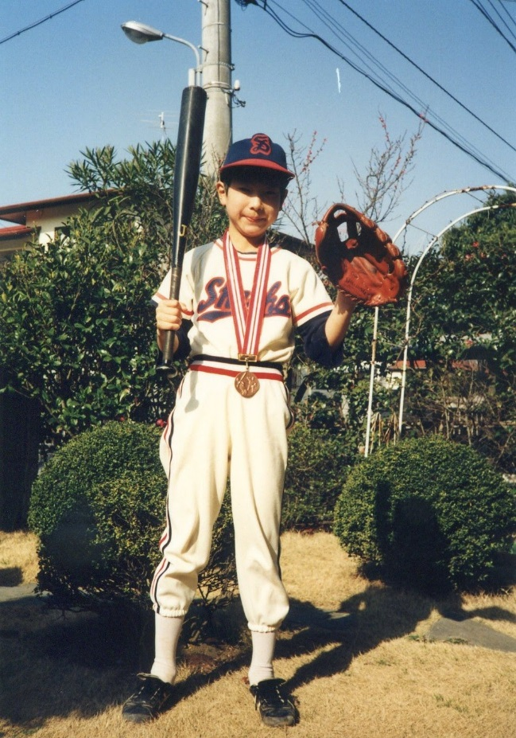
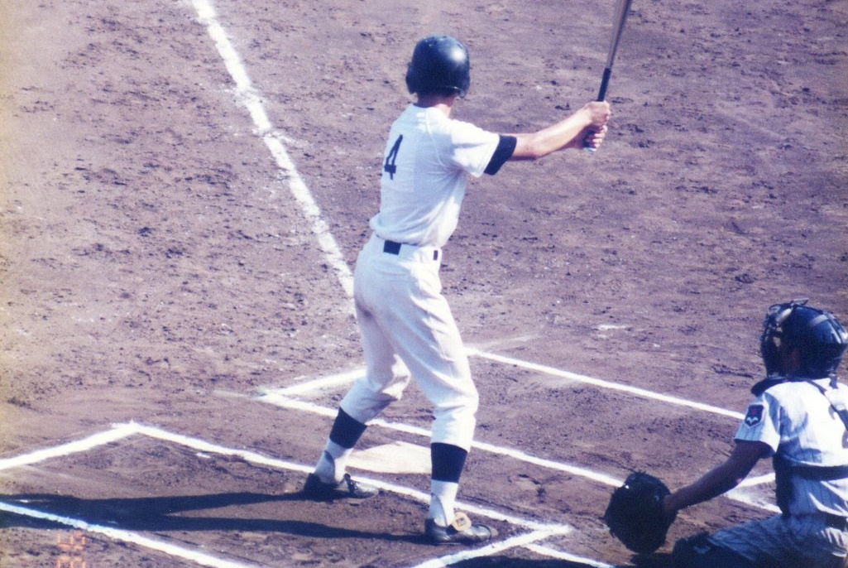
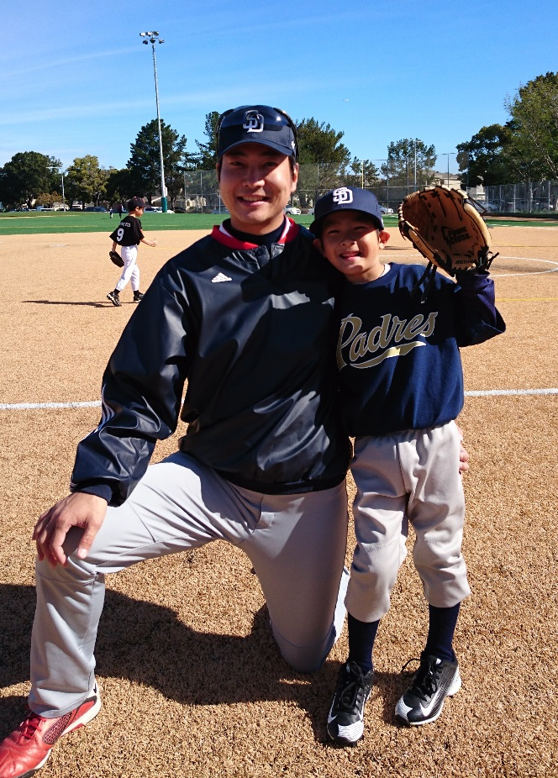
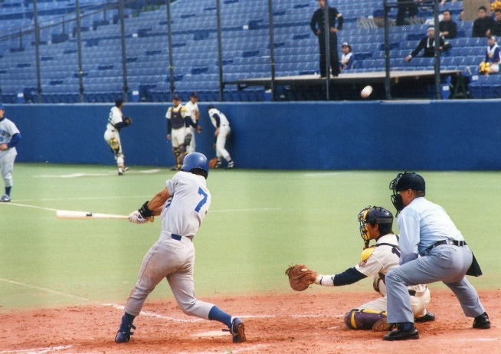
I love
Baseball !!

Slide 4
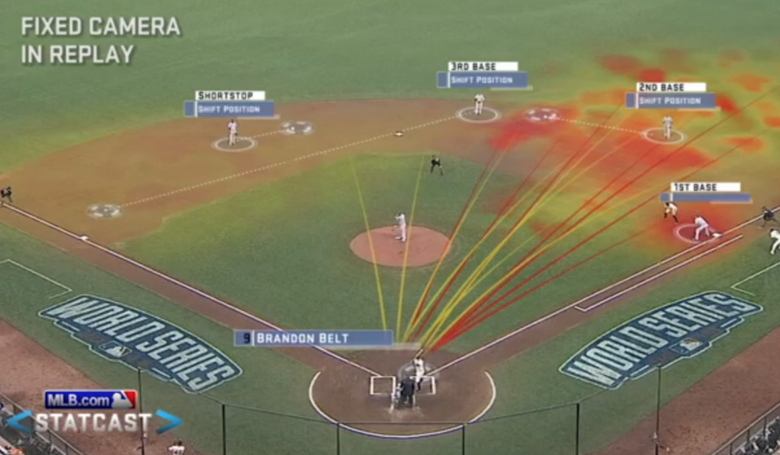
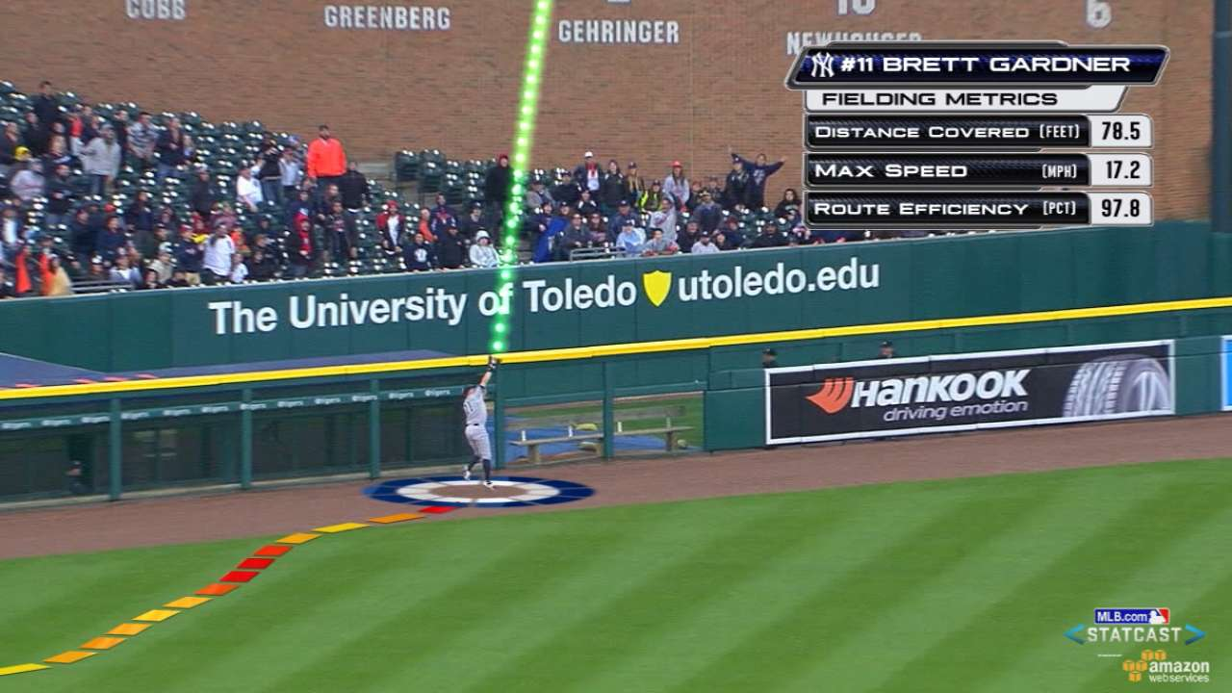
Baseball is now all about “Data”….

Slide 5
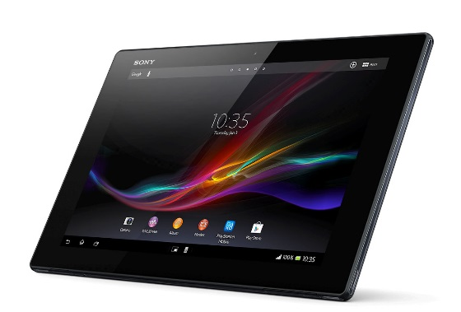
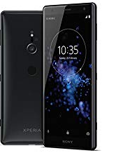
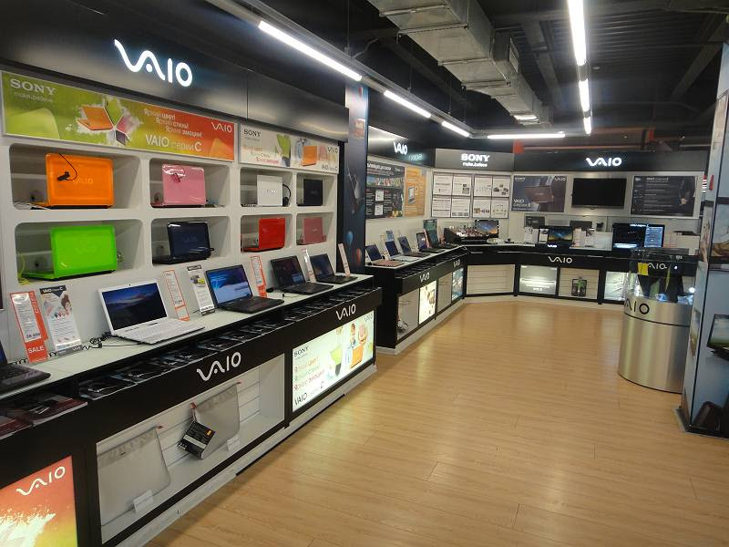
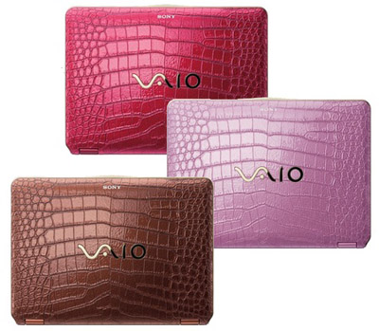
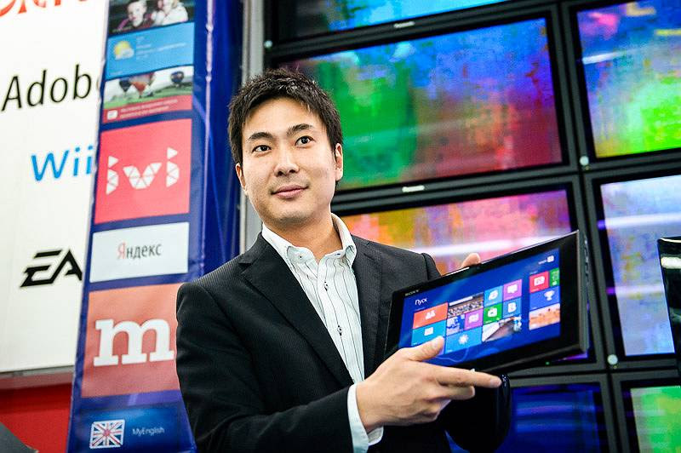

My job, My career
Business Management
2004 – 2010
: Tokyo
Sales
Marketing
2010 – 2013
: Moscow
2013 – now
: USA
2013 : San Diego
2014 : Atlanta
2015- : Bay Area

Slide 6
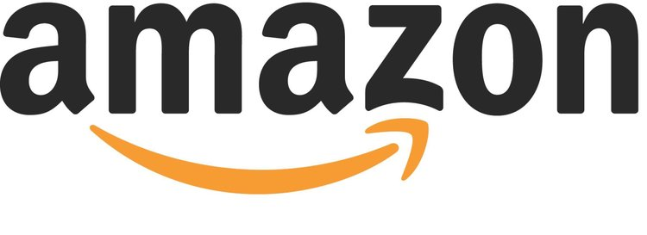
AMS : Amazon Marketing Services

Slide 7
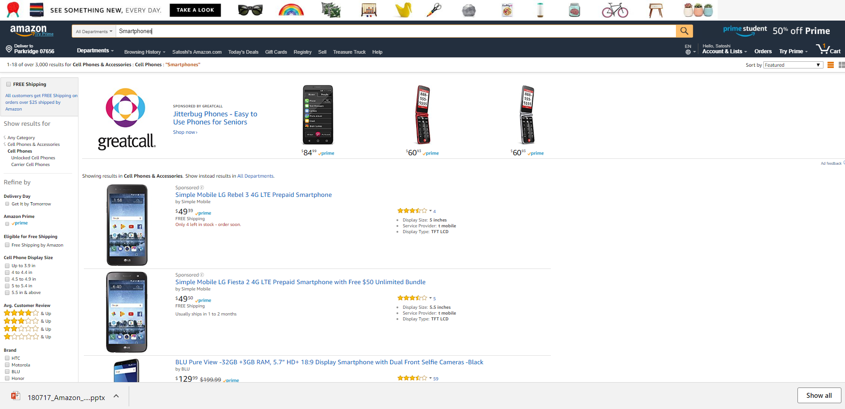
What is AMS : Amazon Marketing Services?
Headline Search
Sponsored Products

Slide 8

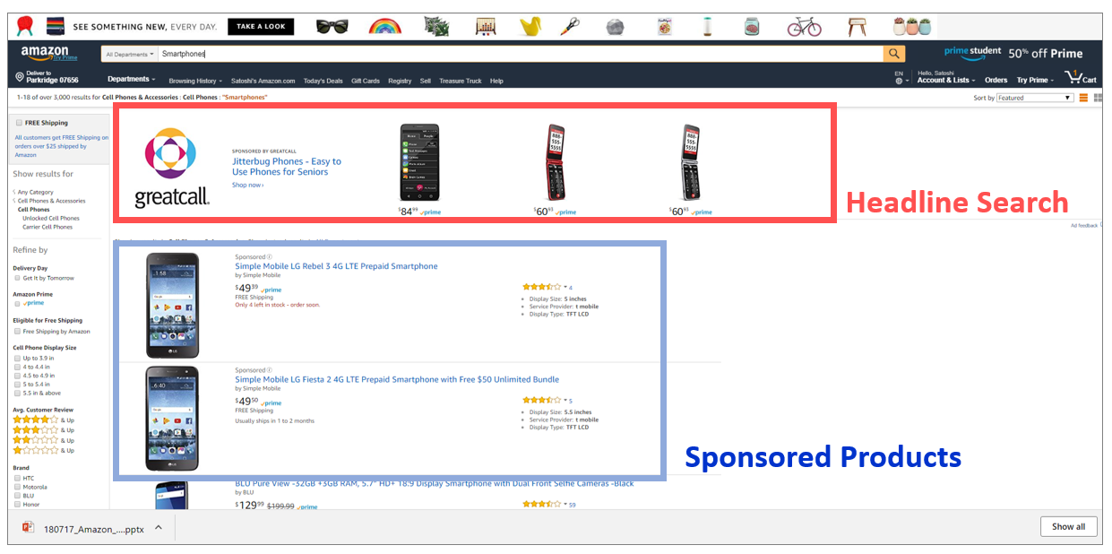
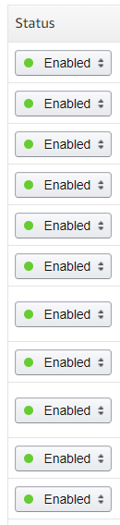
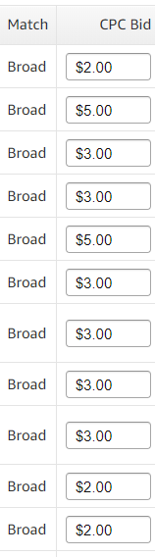
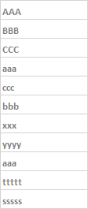
Bid by word

Slide 9
1, 2, 3 steps
Impression
Click
Purchase
(= See the Ad)
Cost is charged
when Ad is clicked
Ultimate goal is to
maximize purchase
(= Sales)

Slide 10
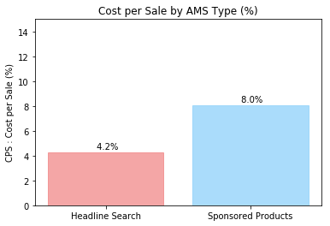
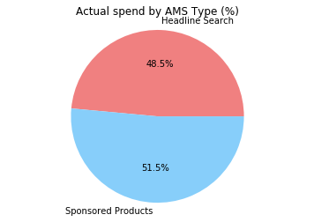
Result of past 2 years investment
Efficient !!
Source : Actual result 2016 – 2018 June
Proposal : Put all the money on “Headline Search” ?

Slide 11
Detailed Analysis on AMS Type

Slide 12
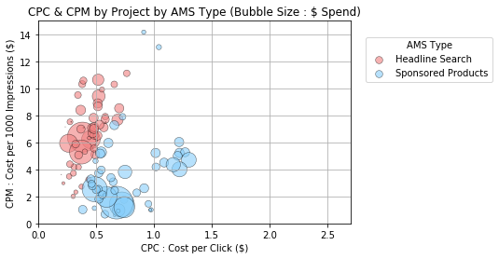
CPC & CPM by Project
CTR : High
(= Higher click # per impression)
CTR (Click through rate)
CPC : Low
CPM : High
CTR : Low
CPC : High
CPM : Low
(= Lower click # per impression)
Source : Actual result 2016 – 2018 June

Slide 13
Analysis by “Search Words”

Slide 14
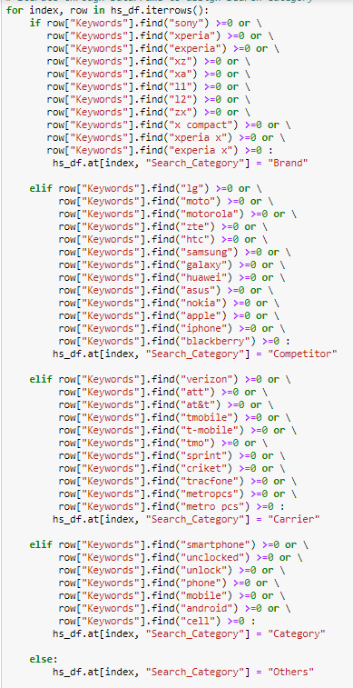
Analysis by Word for Headline Search & Sponsored Products
“iterrows” & “if”
11,289 words
“Brand”
“Competitor”
“Category”

Slide 15
Search Words Analysis for Headline Search

Slide 16
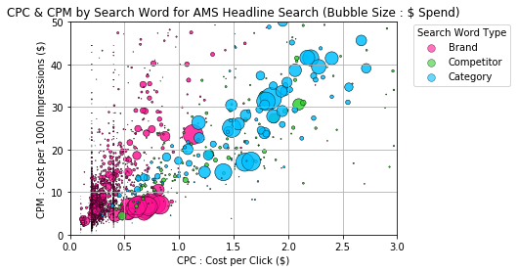
Headline Search CPC & CPM plot
“Category” Search Words
CPC : High
“Brand”
Search Words
CPC : Low
Source : Actual result 2017 Oct – 2018 June

Slide 17
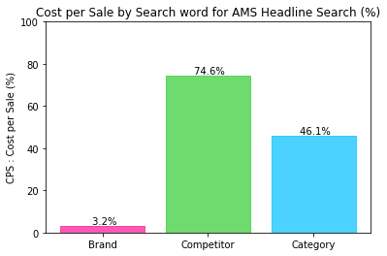
Headline Search Cost per Sale
Cost is too high for the sales.
= ROI is too low.
Source : Actual result 2017 Oct – 2018 June

Slide 18
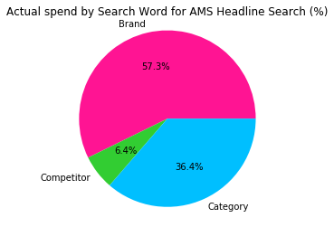
Headline Search Actual Spend % by Word type
Source : Actual result 2017 Oct – 2018 June

Slide 19
Search Words Analysis for Sponsored Products

Slide 20
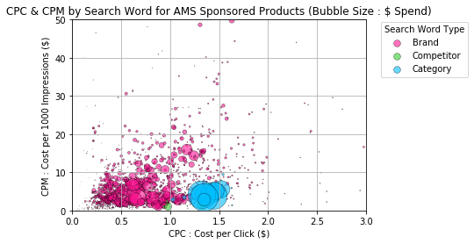
Sponsored Products CPC & CPM plot
Source : Actual result 2017 Oct – 2018 June

Slide 21
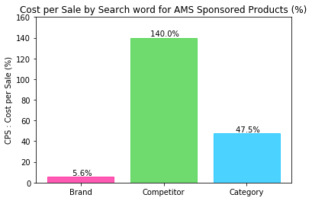
Sponsored Products Cost per Sale
Source : Actual result 2017 Oct – 2018 June

Slide 22
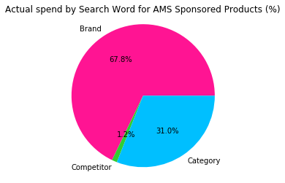
Sponsored Products Actual Spend % by Word type

Slide 23
Headline Search vs. Sponsored Products

Slide 24
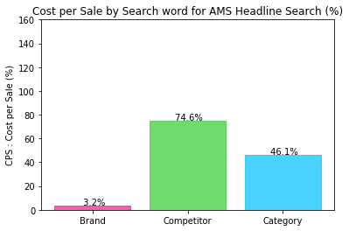
Headline Search vs. Sponsored Products Cost per Sale
Headline Search
Sponsored Products
Source : Actual result 2017 Oct – 2018 June
Can we conclude “Headline Search” with “Brand” is the best?

Slide 25
t-test

Slide 26
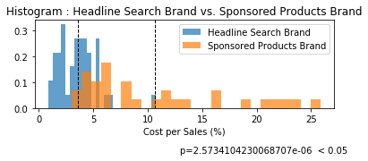
Histogram
Difference is significant
Source : Actual result 2017 Oct – 2018 June

Slide 27

People who search by our “Brand” names.
= People who already know us.
Others = People who don’t know us
I know you !!
Who are you?

Slide 28
Headline Search vs. Sponsored Products Cost per Sale
Headline Search
Sponsored Products

Slide 29
1, 2, 3 steps
Impression
Click
Purchase
(= See the Ad)
Cost is charged
when Ad is clicked
Ultimate goal is to
maximize purchase
(= Sales)

Slide 30
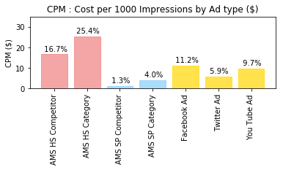
CPM Comparison

Slide 31
Conclusion
“Headline Search” with “Brand” search words is the most efficient in terms of return on sales
For advertisement perspective, we should monitor the effectiveness of each type of AMS and evaluate them with other ad spots outside Amazon
Limitations on data analysis
Seasonality and Products features are not counted on this analysis
The effectiveness might vary in accordance with the amount we spend/timing
“Sales” includes all company products, such as other category products

Slide 32
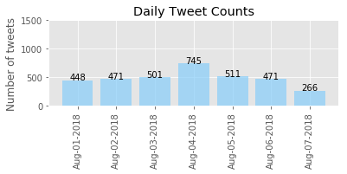
Next steps….
Use Daily Tweets count to decide Ad investment amount and to evaluate the ad effectiveness.

Slide 33
EOF

