Slide 1

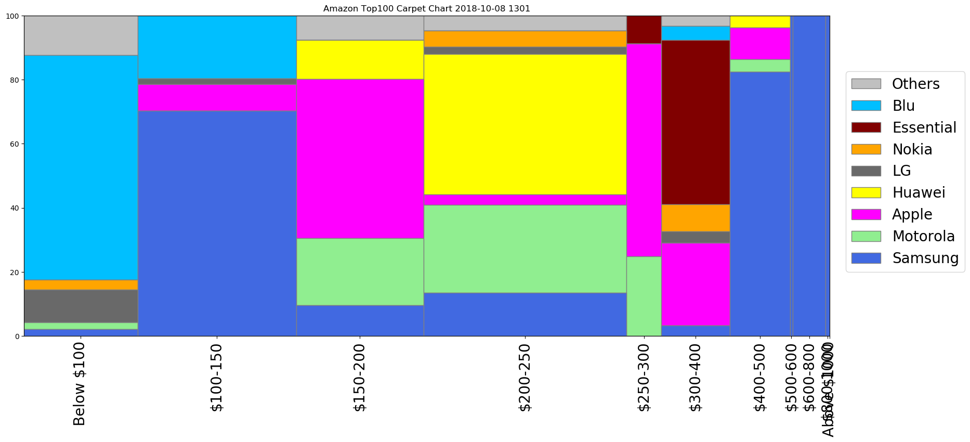
Carpet Chart (Vendor Share by Price-band in Top 100)

Slide 2
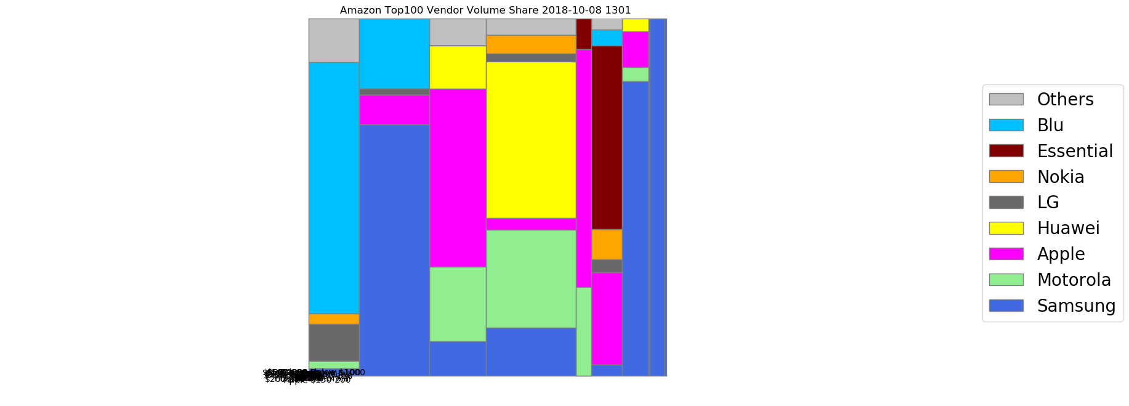
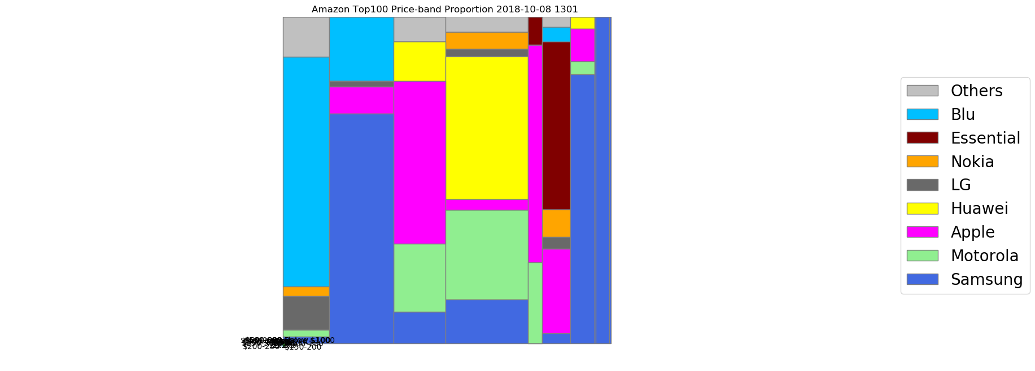
Vendor Share & Price-Band Proportion (in Top 100)

