Slide 1
Project 1
Aug 2018
Satoshi Iriyama

Slide 2
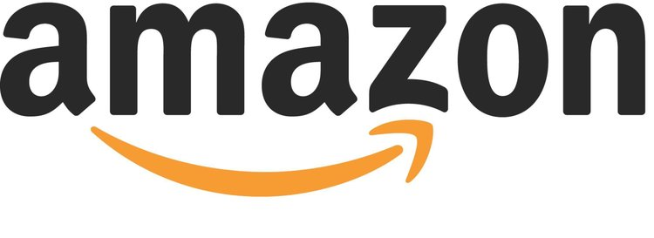
AMS : Amazon Marketing Services

Slide 3
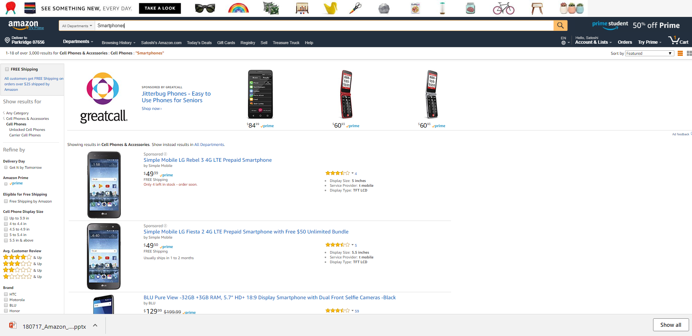
What is AMS : Amazon Marketing Services?
Headline Search
Sponsored Products

Slide 4

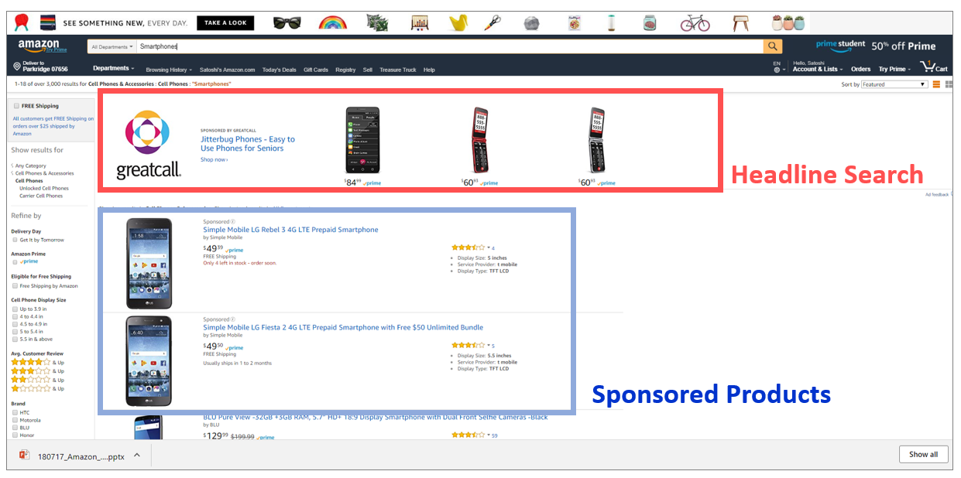
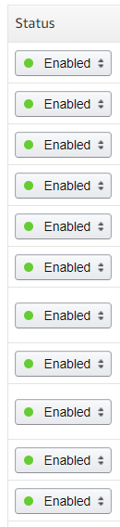
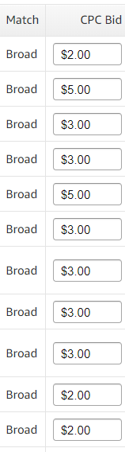
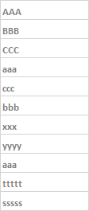
Bid by word

Slide 5
1, 2, 3 steps
Impression
Click
Purchase
(= See the Ad)
Cost is charged
when Ad is clicked
Ultimate goal is to
maximize purchase
(= Sales)

Slide 6
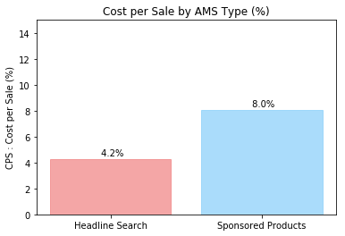
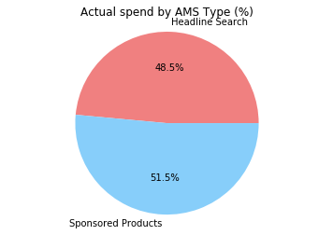
Result of past 2 years investment
Efficient !!
Source : Actual result 2016 – 2018 June
Proposal : Put all the money on “Headline Search” ?

Slide 7
Detailed Analysis on AMS Type

Slide 8
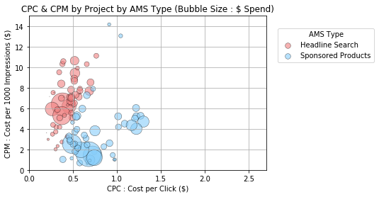
CPC & CPM by Project
CTR : High
(= Higher click # per impression)
CTR (Click through rate)
CPC : Low
CPM : High
CTR : Low
CPC : High
CPM : Low
(= Lower click # per impression)
Source : Actual result 2016 – 2018 June

Slide 9
Analysis by “Search Words”

Slide 10
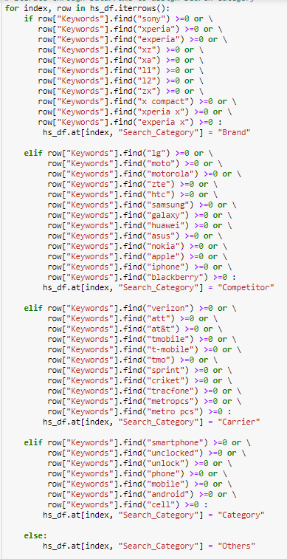
Analysis by Word for Headline Search & Sponsored Products
“iterrows” & “if”
11,289 words
“Brand”
“Competitor”
“Category”

Slide 11
Search Words Analysis for Headline Search

Slide 12
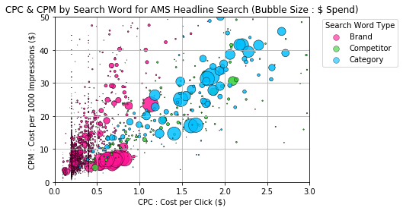
Headline Search CPC & CPM plot
“Category” Search Words
CPC : High
“Brand”
Search Words
CPC : Low
Source : Actual result 2017 Oct – 2018 June

Slide 13
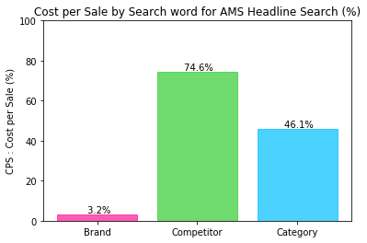
Headline Search Cost per Sale
Cost is too high for the sales.
= ROI is too low.
Source : Actual result 2017 Oct – 2018 June

Slide 14
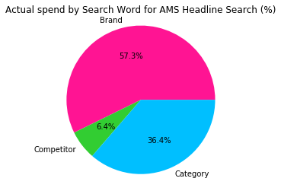
Headline Search Actual Spend % by Word type
Source : Actual result 2017 Oct – 2018 June

Slide 15
Search Words Analysis for Sponsored Products

Slide 16
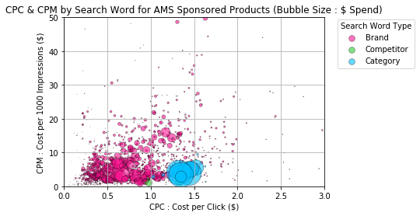
Sponsored Products CPC & CPM plot
Source : Actual result 2017 Oct – 2018 June

Slide 17
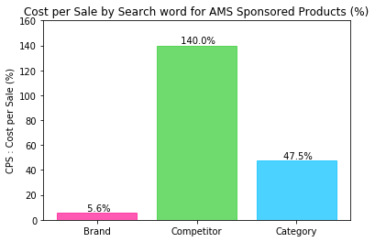
Sponsored Products Cost per Sale
Source : Actual result 2017 Oct – 2018 June

Slide 18
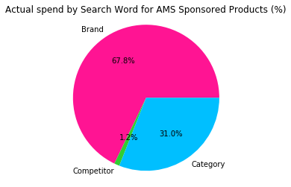
Sponsored Products Actual Spend % by Word type

Slide 19
Headline Search vs. Sponsored Products

Slide 20
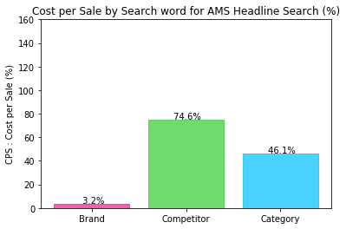
Headline Search vs. Sponsored Products Cost per Sale
Headline Search
Sponsored Products
Source : Actual result 2017 Oct – 2018 June
Can we conclude “Headline Search” with “Brand” is the best?

Slide 21
t-test

Slide 22
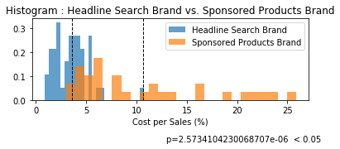
Histogram
Difference is significant
Source : Actual result 2017 Oct – 2018 June

Slide 23

People who search by our “Brand” names.
= People who already know us.
Others = People who don’t know us
I know you !!
Who are you?

Slide 24
Headline Search vs. Sponsored Products Cost per Sale
Headline Search
Sponsored Products

Slide 25
1, 2, 3 steps
Impression
Click
Purchase
(= See the Ad)
Cost is charged
when Ad is clicked
Ultimate goal is to
maximize purchase
(= Sales)

Slide 26
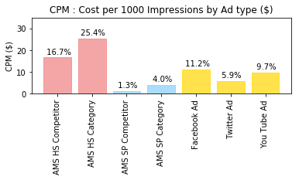
CPM Comparison

Slide 27
Conclusion
“Headline Search” with “Brand” search words is the most efficient in terms of return on sales
For advertisement perspective, we should monitor the effectiveness of each type of AMS and evaluate them with other ad spots outside Amazon
Limitations on data analysis
Seasonality and Products features are not counted on this analysis
The effectiveness might vary in accordance with the amount we spend/timing
“Sales” includes all company products, such as other category products

Slide 28
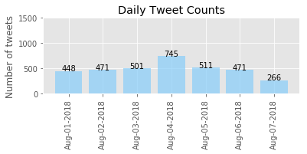
Next steps….
Use Daily Tweets count to decide Ad investment amount and to evaluate the ad effectiveness.

Slide 29
EOF

