Slide 1
The Problem & Its Real Ceiling
• Classify public statements as True / False from text + metadata (speaker, party, subjects, context).
• Low-ceiling task: ~62–69% binary accuracy across model families and methods.
• Why: verifying claims needs external world knowledge the text lacks; human truth labels are judgment calls with limited agreement; some statements aren't verifiable from inputs.
• Aim: a principled, honestly-evaluated system — not a vanity accuracy number.
Private & Confidential
Notes:
How do you know the ceiling? Published benchmarks cluster there; my results landed in the same band. 65% sounds weak? Floor is 50% for balanced binary, so it's real signal but task-capped — the responsible response is calibrated confidence and abstention. This slide sets expectations for every modest number later.

Slide 2
Target Framing: 6 Labels → Binary
• Source: 6 ordinal truthfulness levels.
• Middle split: 3 truer → True, 3 falser → False.
• Why: near-balanced target (≈56/44) keeps accuracy meaningful, no majority-class shortcut.
• Sensitivity check: moving ambiguous "half-true" to False leaves conclusions unchanged.
Private & Confidential
Notes:
Why not drop the middle / 2-vs-4? Dropping shrinks a small set; imbalance makes accuracy misleading; middle split is balanced and conventional. Half-true really True? Hardest call — placed True for balance, but sensitivity check shows robustness either way. Sensitivity check = re-run the whole eval with one debatable decision flipped.

Slide 3
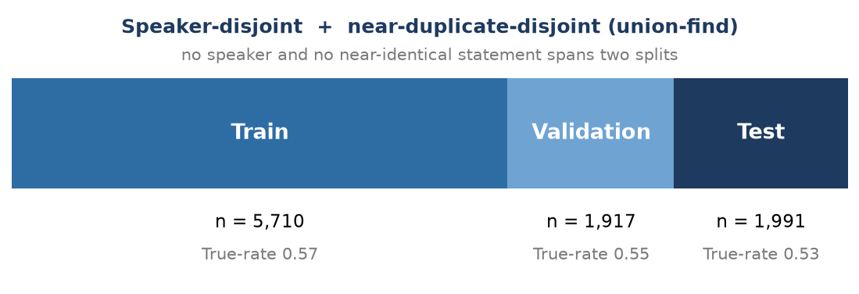
Data Integrity: The Split That Prevents Cheating
• Naive random splits leak: frequent speakers appear in train and test → model learns "this person lies", not the claim.
• My split: speaker-disjoint AND near-duplicate-disjoint (union-find) — no speaker or near-identical statement spans two splits.
• Dropped contradictory duplicates (identical text, conflicting labels).
• Train 5,710 / Val 1,917 / Test 1,991; matched balance (True-rate 0.57 / 0.55 / 0.53).
Private & Confidential
Notes:
Why speaker leakage matters: it's a shortcut; my explainer later quantifies it's real and hurts accuracy — which is why I split to prevent it. Union-find: merges linked items (shared speaker or near-dup text) into clusters assigned whole to one split; guarantees no link crosses train/test. Strongest methodology slide — most candidates random-split and miss this.

Slide 4
Evaluation Methodology: Metrics & Protocol
• Beyond accuracy: balanced accuracy, macro-F1, ROC/PR-AUC, and calibration (Brier + ECE).
• Cost asymmetry: a false positive (falsehood labelled True) lets misinformation through — the costlier error; threshold can reflect that.
• Protocol: calibrator + threshold fit on validation, reported on untouched test.
• Bootstrap CIs; McNemar's test for the paired comparison.
Private & Confidential
Notes:
Why ECE/Brier? System acts on confidence; a model can be accurate yet overconfident. Why val-fit/test-report? Tuning on test = peeking = inflated; this keeps numbers out-of-sample. Definitions — balanced acc: average per-class accuracy. Macro-F1: per-class F1 averaged. Brier: mean squared error of probability vs outcome. ECE: groups by stated confidence, checks if "80% sure" is right 80% — lower = trustworthy. McNemar: paired test on the cases where two models disagree.

Slide 5
Zero-Shot Predictor
• Base: gemma-4-31B-it (open; serverless on Together; LoRA-fine-tunable under the same id → shared base, no confound).
• Prompt: statement + metadata, missing fields marked [unknown].
• Elicitation: decision + logprob — model answers True/False; confidence from the True/False token's logprob.
• Baseline (calibrated, test): acc 0.668, ECE 0.061.
Private & Confidential
Notes:
Why this model? Scale-tested candidates; a 9B Qwen and Gemma hit the literature range, OpenAI 20B/120B sat at chance; Gemma won the full-set comparison and is the one base that's both serverless and fine-tunable under one id — so no model-swap confound. Logprobs: the API exposes the probability the model assigned its chosen token; exp(logprob) = real confidence, not a performed number.

Slide 6
Fine-Tuned Predictor (LoRA SFT)
• LoRA supervised fine-tuning on the same gemma-4-31B-it base.
• Training data: conversational JSONL — prompt as system+user, assistant = single True/False token; loss on the label only (train_on_inputs=auto).
• Train split only (5,710); validation file for eval-loss. Eval loss 0.32 → 0.199 over 3 epochs (from the training run).
• Serving: fine-tuned Gemma isn't serverless → short-lived dedicated endpoint, create→infer→guaranteed teardown (~14 min, ~$2).
Private & Confidential
Notes:
LoRA = trains small low-rank adapters on top of a frozen base; cheap, fast, enough to shift behaviour. Why label-token-only? Learn to produce the answer, not echo the prompt. Why an endpoint now? Base served serverless, but fine-tuned Gemma can't; endpoint only for eval, deleted in a guaranteed-teardown block. Low train loss = learned the signal; whether it transfers is what the disjoint test answers. Eval-loss 0.32 → 0.199 is from the fine-tuning job's training log (3 epochs).

Slide 7
The Fair Comparison & Results
Fine-tuning beats the matched zero-shot baseline by +3.1 pts (p < 1e-6). Calibration cuts ECE by ~0.22; fine-tuning itself does not improve it.
• Same test split, same calibration, same elicitation → only fine-tuning differs.
Predictor | Acc | Bal-acc | Macro-F1 | ROC-AUC | PR-AUC | Brier | ECE
Zero-shot, logprob (baseline) | 0.668 | 0.662 | 0.663 | 0.711 | 0.690 | 0.218 | 0.061
Fine-tuned (LoRA SFT, decision) | 0.699 | 0.694 | 0.694 | 0.749 | 0.722 | 0.203 | 0.052
secondary · score elicitation, not matched | 0.700 | 0.699 | 0.699 | 0.715 | 0.680 | 0.227 | 0.108
Clean fine-tuning effect (matched elicitation): Δacc +0.031 [+0.019, +0.043], McNemar p < 0.001. Calibration: ECE 0.061 → 0.052.
Secondary (score-mode): highest accuracy yet ~4× worse calibrated (ECE 0.108 vs 0.052) — accuracy ≠ trustworthiness.
Private & Confidential
Notes:
Only 3.1 points? On a ~65% ceiling, a significant gain over a matched baseline is meaningful — accuracy is capped on this task. Note what did NOT move: the ECE difference vs the matched baseline is +0.0097 [-0.0057, +0.0270], which straddles zero, so fine-tuning buys accuracy and not calibration. Why show score-mode? It's the contrast that proves accuracy ≠ calibration. Frame: train fine-tunes; val fits calibrator+threshold for both; test scored once identically — only fine-tuning differs.
Variance caveat: results vary slightly run-to-run due to non-deterministic inference even at temperature 0; the fine-tuning effect is +0.031 [+0.019, +0.043], McNemar p=6.3e-07. A live refetch of the same prompts reproduced every metric to within 0.003.

Slide 8
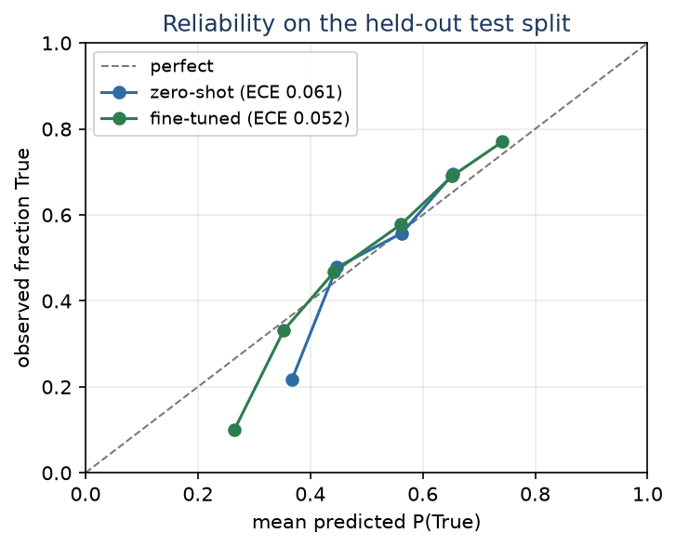
Calibration: The Real Win
• Raw confidence is miscalibrated → temperature/Platt scaling, fit on validation, corrects it.
• Calibration cuts ECE 0.316 → 0.061 (+0.255 [+0.213, +0.279]); fine-tuning does not improve calibration (+0.010, CI straddles zero).
• For a tool that acts on confidence (abstain, escalate, flag), trustworthy probabilities are the operationally useful property.
Private & Confidential
Notes:
Temperature/Platt = simple post-hoc corrections fit on held-out data remapping raw probabilities so stated confidence matches real frequency; I fit several on validation and selected the best. Why not isotonic? Needs more data, overfits ~1,900 rows — future work. Say cold: calibration doesn't change the answer or accuracy — it makes the confidence number honest. The diagram shows both calibrated models on test; the fine-tuned curve sits closest to the diagonal (lowest ECE).

Slide 9
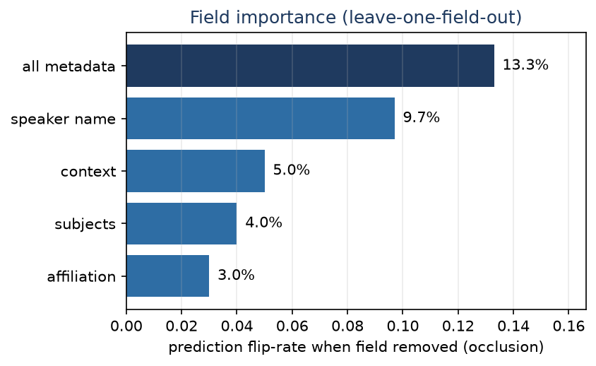
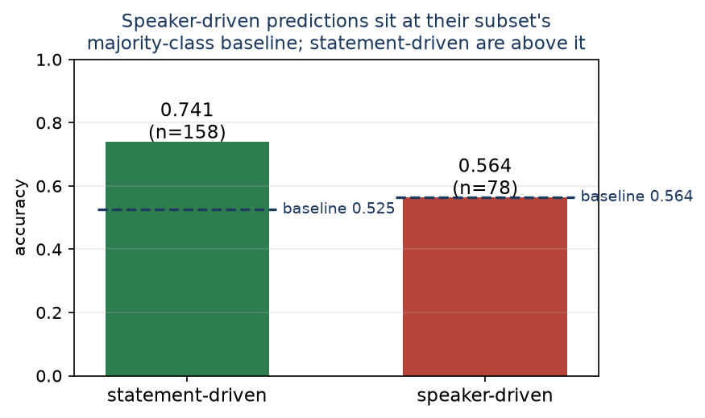
Explainer: Faithful Attribution Beats Plausible Stories
• explain(model, points, labels) — model-agnostic, either predictor.
• Two layers: leave-one-field-out occlusion (faithful by construction) + model's own rationale (plausible, not necessarily faithful).
• Removing speaker flips 10% of predictions, all metadata 13.3%.
• Speaker-driven predictions sit at the majority-class baseline of their subset (0.564 vs 0.564, Δ = +0.000 [-0.141, +0.128]); statement-driven are +0.215 [+0.108, +0.285] above theirs.
• Rationale-occlusion agreement 0.457 is indistinguishable from chance (permutation p = 0.19): the model's self-explanations carry no detectable information about what actually drove the prediction.
Private & Confidential
Notes:
Why two methods? Occlusion is causal — change input, watch real output; rationale is readable but unverified, so I lead with occlusion and treat rationales as hypotheses. On agreement: 0.457 looks like a moderate faithfulness rate, but the permutation null is 0.436 (p=0.19) — the categories overlap and a rationale cites 1.6 of 5 on average, so the chance floor is high. The honest reading is that rationales carry no DETECTABLE signal about the true driver, which is evidence of absent signal rather than a measured faithfulness rate. Shortcut helps or hurts? Speaker-driven predictions land at their subset's majority-class rate (0.564 vs 0.564) — no signal beyond the class prior — while statement-driven sit +0.215 above theirs. Causal confirmation of slide 3's leakage risk. n=78 for the speaker subset, so the interval is wide; this rules in 'no better than the prior' without ruling out a small effect.

Slide 10
Findings & Future Work
• Story: a low-ceiling task evaluated leakage-free; fine-tuning gave a significant accuracy gain over matched zero-shot (+0.031, p=6e-07) but NO calibration gain; post-hoc calibration is what buys confidence quality (ECE 0.316 → 0.061); the explainer showed speaker-driven predictions perform at the majority-class baseline and that self-rationales agree with the true driver only at chance.
• Optimized for honest, defensible evaluation over a vanity number.
• Future work: logprob elicitation everywhere; richer calibration (isotonic); ensembling zero-shot + fine-tuned; production abstention from the coverage-accuracy curve; alternative elicitations (score-mode trade-off); DPO if ranked data existed.
Private & Confidential
Notes:
Another week? Push abstention into a selective-prediction system on the calibrated confidence; ensemble both predictors; resist chasing accuracy past the ceiling. One thing to remember: accuracy and trustworthiness are different axes — fine-tuning's real value was honest confidence, and every claim is reproducible from the code. Closes the loop to slide 1.

