Slide 1
The Problem & Its Real Ceiling
Classify public statements as True/False from text + metadata (speaker, party, subjects, context)
This is a low-ceiling task: ~62–69% binary accuracy across model families and methods [1]
Why: verifying claims needs external world knowledge the text lacks; human truth labels are judgment calls with limited agreement; some statements aren't verifiable from inputs
Aim: a principled LLM-based evaluation pipeline
[1] Yu et al., Open, Closed, or Small Language Models for Text Classification?, In Arxiv'23

Slide 2
Mapping the 6 Labels To Binary Classification
Source: 6 ordinal truthfulness levels
Middle split: 3 truer → True, 3 falser → False
Why: near-balanced target (≈56/44) keeps accuracy meaningful, no majority-class
Sensitivity check: moving ambiguous "half-true" to False leaves conclusions unchanged

Slide 3
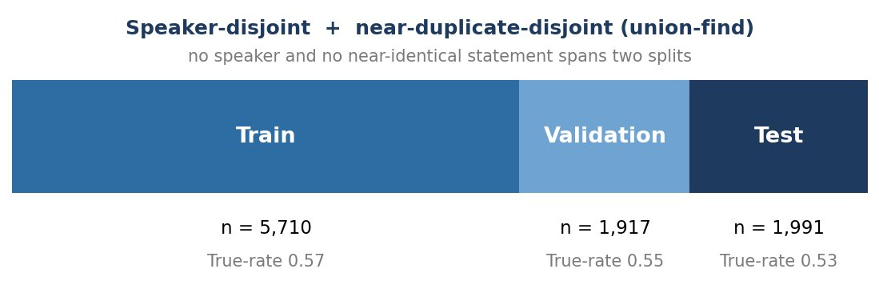
Data Integrity: Split That Prevents Cheating
Naive random splits leak: frequent speakers appear in train and test → model learns "this person lies" not the claim
My split is the following:
Dropped contradictory duplicates (identical text, conflicting labels)
Matched class balance across splits, thus, the train/test comparison isn't distorted by class drift

Slide 4
Evaluation Methodology: Metrics & Protocol
Beyond simple accuracy: balanced accuracy, macro-F1, ROC/PR-AUC, and calibration (Brier + ECE)
Cost asymmetry: a false positive lets misinformation through and it is the costlier error; threshold can reflect that
Protocol: calibrator + threshold fit on validation set, reported on untouched test. Bootstrap CIs; McNemar's test for the paired comparison

Slide 5
Zero-Shot Predictor
Base: Gemma-4-31B-it (open; serverless on Together.ai; LoRA-fine-tunable under the same id → shared base, no confound)
Prompt: statement + metadata, missing fields marked [unknown]
Elicitation: decision + logprob — model answers True/False; confidence from the True/False token's logprob [2]
Baseline (calibrated, test): acc 0.668, ECE 0.053
[2] https://docs.together.ai/docs/inference/chat/logprobs

Slide 6
Fine-Tuned Predictor (LoRA SFT)
LoRA supervised fine-tuning on the same Gemma-4-31B-it model
Training data: conversational JSONL
prompt as system+user, assistant = single True/False token
loss on the label only (train_on_inputs=auto)
Train split only (5,710); validation file for eval-loss. Eval loss 0.32 → 0.199 over 3 epochs
Serving: fine-tuned Gemma isn't serverless, thus, we use a short-lived dedicated endpoint

Slide 7
The Fair Comparison & Results
Same test split, same calibration, same elicitation; only fine-tuning differs
Predictor | Acc | Bal-Acc | Macro-F1 | ROC-AUC | PR-AUC | Brier | ECE
Zero-shot (decision/logprob) | 0.668 | 0.662 | 0.662 | 0.711 | 0.679 | 0.217 | 0.053
Fine-tuned (LoRA SFT, decision) | 0.701 | 0.695 | 0.696 | 0.749 | 0.716 | 0.201 | 0.027
Zero-shot (score) | 0.700 | 0.699 | 0.699 | 0.715 | 0.660 | 0.225 | 0.117
Clean fine-tuning effect (matched elicitation): Δacc +0.033 [+0.021, +0.045], McNemar p < 0.001. Calibration: ECE 0.053 → 0.027.
Secondary (score-mode): highest accuracy yet ~4x worse calibrated (ECE 0.117 vs 0.027) Therefore, accuracy ≠ trustworthiness

Slide 8
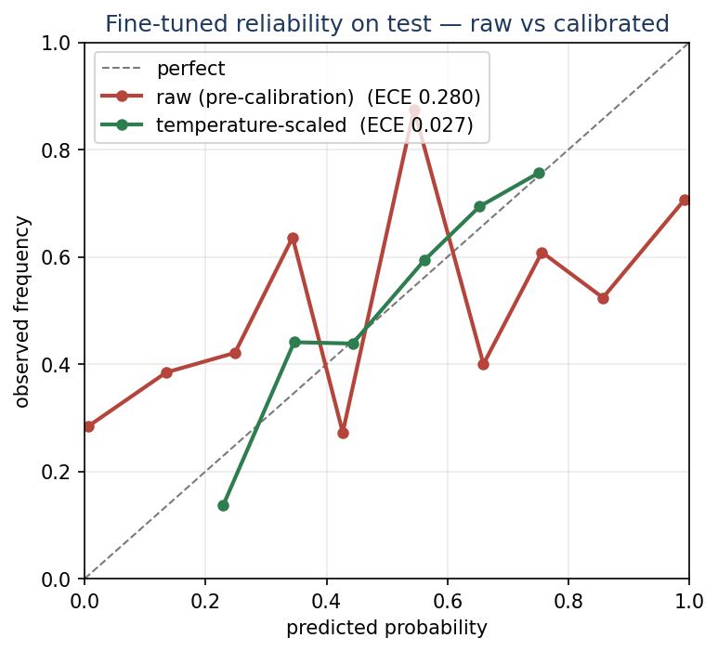
Calibration: The Real Win
Raw fine-tuned confidence is badly overconfident (SFT pushes probabilities toward 0/1); temperature scaling, fit on validation, corrects it: fine-tuned ECE 0.280 → 0.027 on test (~10× reduction); reliability curve moves onto the diagonal.
For a tool that acts on confidence (abstain, escalate, flag), trustworthy probabilities are the operationally useful property.
Notes:
SFT overconfidence: the fine-tune is trained to emit a single hard True/False token, which pushes its raw probabilities toward 0/1 — so raw confidence is systematically overconfident (raw ECE 0.280 on test). Temperature scaling = divide the model's logits by one scalar T (fit on the validation split) before the softmax; T>1 softens the distribution and removes the overconfidence. It is monotonic, so it never changes which class wins — accuracy is unchanged; only the confidence numbers become honest. Here it cuts ECE ~10x: 0.280 → 0.027. I fit several calibrators on validation and selected the best (temperature won). Why not isotonic? It needs more data and would overfit ~1,900 rows. Say it cold: calibration doesn't change the answer or the accuracy — it makes the confidence number trustworthy.
Secondary cross-model point: even after both are calibrated, the fine-tuned model is better calibrated than the zero-shot baseline (ECE 0.027 vs 0.053).

Slide 9
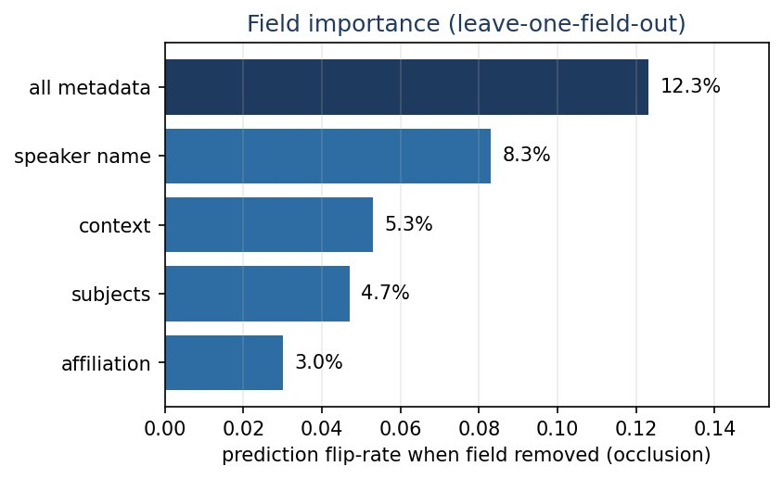
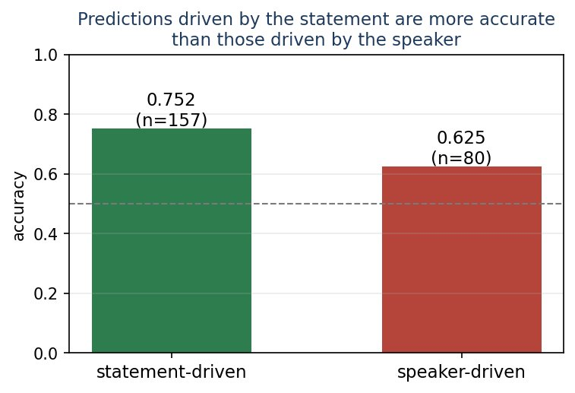
Explainer: Faithful Attribution Beats Plausible Stories
explain(model, points, labels): model-agnostic, either predictor
Two layers 1) leave-one-field-out occlusion (faithful by construction) 2) model's own rationale (plausible, not necessarily faithful)
Findings
removing speaker flips 8.3% of predictions
removing all metadata 12.3%
rationales only ~46% faithful to the true driver
speaker-driven predictions less accurate (statement-driven 0.752 vs speaker-driven 0.625)

Slide 10
Findings & Future Work
Findings
a low-ceiling task evaluated leakage-free
fine-tuning gave a significant accuracy gain (+3.3 pts, p<0.001) over zero-shot and halved calibration error
the explainer exposed a speaker shortcut that hurts and showed self-rationales are unreliable
Future work
logprob elicitation everywhere
richer calibration (isotonic)
ensembling zero-shot and fine-tuned
alternative elicitations (score-mode trade-off)

