Slide 1
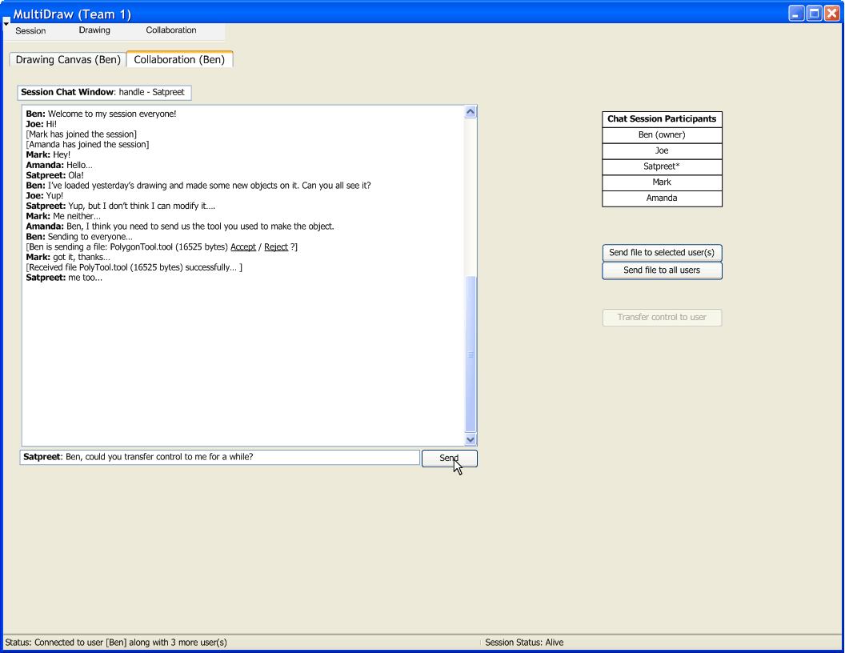

Slide 2
Iterations
Iteration 1:
  Understand underlying technology
  Connect to another peer; (use old GUI)
  Pass an object over network; Acknowledge reception of object in some way;
Iteration 2:
  Establish a hierarchy of objects sent over network
  Acknowledge reception and recognize object received
Iteration 3:
  Setup networking model (how we send/receive events, canvas, objects, etc.)
  Make new GUI supporting collaboration (…. continued)

Slide 3
Iterations
Iteration 3 (… continued):
  Make canvas receive a session “owner’s” canvas in real-time
  Display network object feedback on chat window (layered event feedback)
  (Optionally) Make P2P chat work
Iteration 4:
  Implement transfer of “ownership”
  Loading and saving session (canvas + objects)
  Dynamic tool loading
  Tool sending and receiving over network
  Network robustness/optimization

