Slide 1
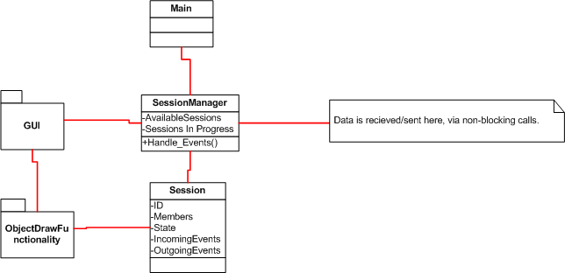
Structural View
Notes:
Intent is to have a dedicated session manager, which will abstractly handle a number of sessions.
Whether it is practical / achievable to have multiple sessions on canvas will be realized as class progresses.
Intend to make heavy use of object draw functionality, although it will need to be somewhat reworked obviously.

Slide 2
Development Plan-Config management
Primary plan is to use SVN, which served most of our subgroups well during first project.
Allows offline work, and is convenient to use.
Limited use of googledocs for some online meetings/live collaboration.

Slide 3
Development Plan-Responsibilities
Ben : Liaison, Architecture & Communication models
Joe:
Amanda: Documentation control,
Mark:
Satpreet:

