Slide 1
Multi-draw

Slide 2
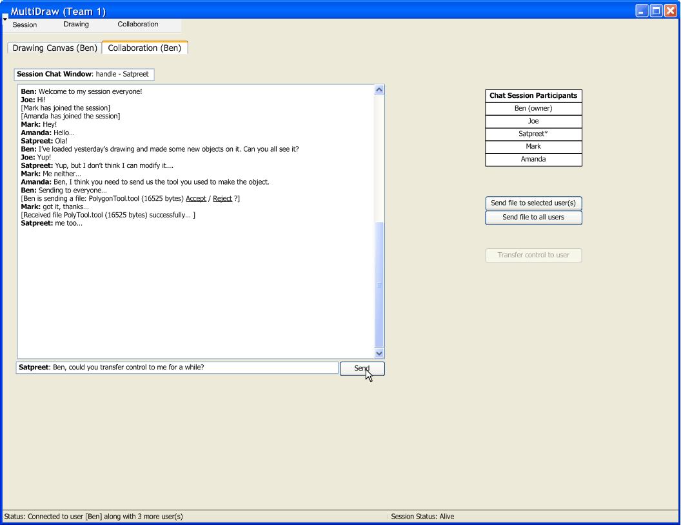

Slide 3
Iterations
Iteration 1:
  Understand underlying technology
  Connect to another peer; (use old GUI)
  Pass an object over network; Acknowledge reception of object in some way;
Iteration 2:
  Establish a hierarchy of objects sent over network
  Acknowledge reception and recognize object received
Iteration 3:
  Setup networking model (how we send/receive events, canvas, objects, etc.)
  Make new GUI supporting collaboration (…. continued)

Slide 4
Iterations
Iteration 3 (… continued):
  Make canvas receive a session “owner’s” canvas in real-time
  Display network object feedback on chat window (layered event feedback)
  (Optionally) Make P2P chat work
Iteration 4:
  Implement transfer of “ownership”
  Loading and saving session (canvas + objects)
  Dynamic tool loading
  Tool sending and receiving over network
  Network robustness/optimization

Slide 5
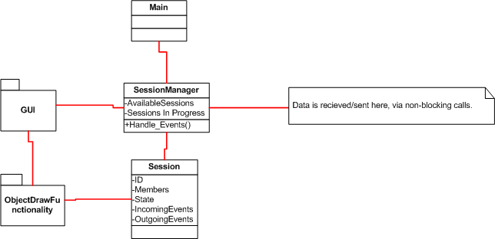
Structural View
Notes:
Intent is to have a dedicated session manager, which will abstractly handle a number of sessions.
Whether it is practical / achievable to have multiple sessions on canvas will be realized as class progresses.
Intend to make heavy use of object draw functionality, although it will need to be somewhat reworked obviously.

Slide 6
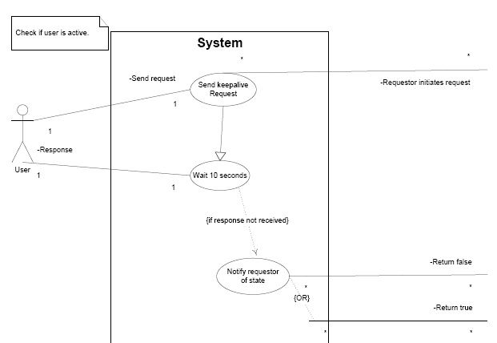
Behavioral View-keepalive Use Case
Notes:
We have drawn out several use cases such as
Draw Tool
Select Tool
Eraser Tool
Modify Object Color
Move Object
Start Session
KeepAlive Request
Passing Control,
Save Session,
Load Session,
Etc…

Slide 7
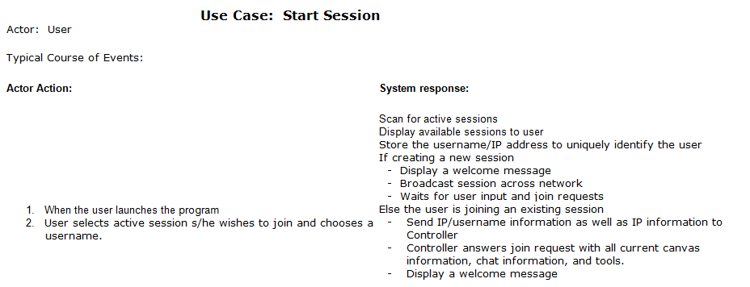
Behavioral View-Join Session Use Case
Notes:
This is an example of how all of our use cases are mapped out.
This case specifically main actor actions to invoked the ‘Joining’ of our sessions.

Slide 8
Development Plan - Process
Amanda

Slide 9
Development Plan-Config management
Primary plan is to use SVN, which served most of our subgroups well during first project.
Allows offline work, and is convenient to use.
Limited use of googledocs for some online meetings/live collaboration.

Slide 10
Development Plan-Responsibilities
Ben : Liaison, Architecture & Communication models, Implementer/tester
Joe: Technical documentation control, Implementer/tester
Amanda: Non-technical documentation control, Implementer/tester
Mark: Implementer/tester
Satpreet: Implementer/tester

Slide 11
Development Plan - Schedule
Mark

Slide 12
Development Plan - Risks
Amanda

