Slide 1
Multi-draw

Slide 2
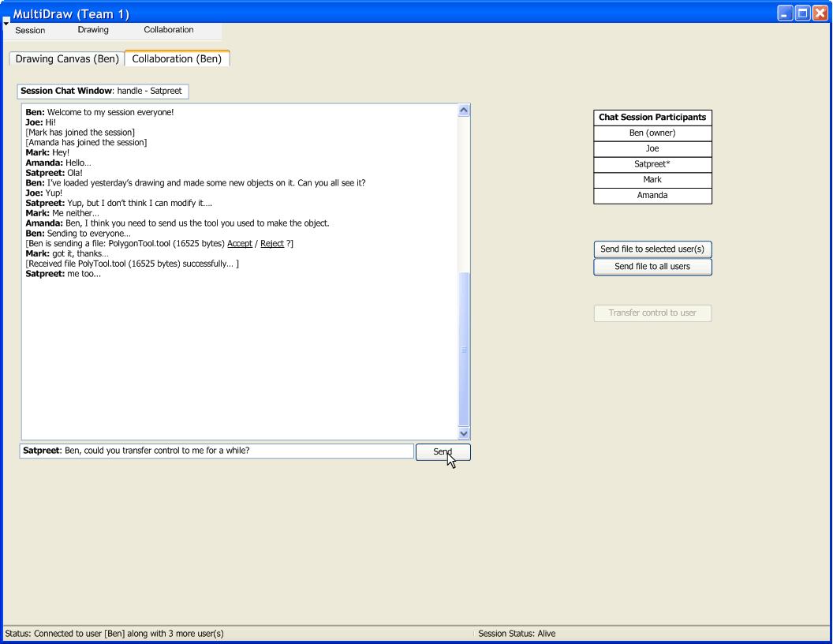

Slide 3
Iterations
Iteration 1:
  Understand underlying technology
  Connect to another peer; (use old GUI)
  Pass an object over network; Acknowledge reception of object in some way;
Iteration 2:
  Establish a hierarchy of objects sent over network
  Acknowledge reception and recognize object received
Iteration 3:
  Setup networking model (how we send/receive events, canvas, objects, etc.)
  Make new GUI supporting collaboration (…. continued)

Slide 4
Iterations
Iteration 3 (… continued):
  Make canvas receive a session “owner’s” canvas in real-time
  Display network object feedback on chat window (layered event feedback)
  (Optionally) Make P2P chat work
Iteration 4:
  Implement transfer of “ownership”
  Loading and saving session (canvas + objects)
  Dynamic tool loading
  Tool sending and receiving over network
  Network robustness/optimization

Slide 5
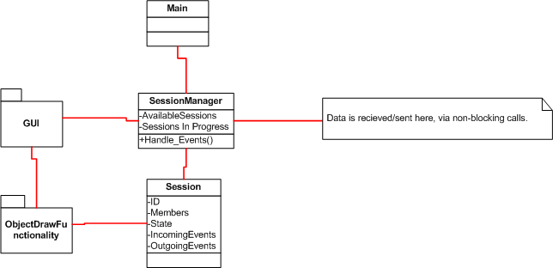
Structural View
Notes:
Intent is to have a dedicated session manager, which will abstractly handle a number of sessions.
Whether it is practical / achievable to have multiple sessions on canvas will be realized as class progresses.
Intend to make heavy use of object draw functionality, although it will need to be somewhat reworked obviously.

Slide 6
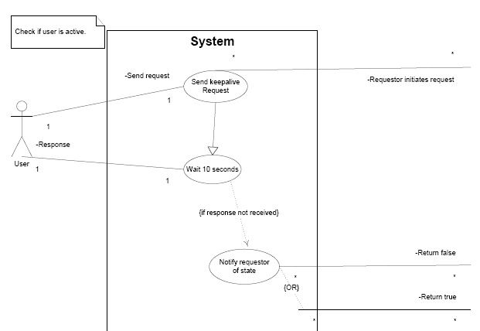
Behavioral View-keepalive Use Case
Notes:
We have drawn out several use cases such as
Draw Tool
Select Tool
Eraser Tool
Modify Object Color
Move Object
Start Session
KeepAlive Request
Passing Control,
Save Session,
Load Session,
Etc…

Slide 7
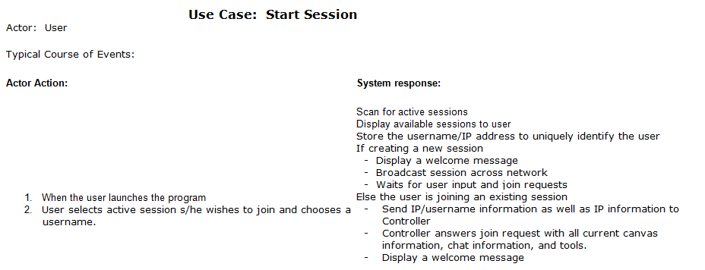
Behavioral View-Join Session Use Case
Notes:
This is an example of how all of our use cases are mapped out.
This case specifically main actor actions to invoked the ‘Joining’ of our sessions.

Slide 8
Development Plan - Process
Amanda

Slide 9
Development Plan-Config management
Primary plan is to use SVN, which served most of our subgroups well during first project.
Allows offline work, and is convenient to use.
Limited use of googledocs for some online meetings/live collaboration.

Slide 10
Development Plan-Responsibilities
Ben : Liaison, Architecture & Communication models, Implementer/tester
Joe: Technical documentation control, Implementer/tester
Amanda: Non-technical documentation control, Implementer/tester
Mark: Implementer/tester
Satpreet: Implementer/tester

Slide 11
Schedule
First Iteration (04/09-04/16):
Be able to deploy classes as web services
Load objects in the main program
Start a session
Second Iteration (04/16-04/23)
Save and call an object’s XML file representation
Peer-to-peer collaboration to share tools, objects
Dynamic object loading
Final iteration (04/23/09-05/06/09)
Multiple users can make requests
Save and resume a session

Slide 12
Use Case: Save Session
Actor: User Typical course of Events:
Actor Action: | System response:
1. The user clicks Save Session on the Control Panel | The objects are saved to a file The file is deployed to a repository
2. The user clicks on Resume Session on the Control Panel | 3. The program calls the objects when the session resumes

Slide 13
Building Blocks- Object’s properties are callable
Component
Name
Methods
Variables

Slide 14
Class web service structure
Classes can be accessed remotely through a web service
The classes methods are defined in an interface
A service utility class calls the class methods
A locator utility class parses the incoming request for the URL and determines where to send the response
A SoapBindingImpl utility class attaches the URL to the remote procedure call
A SoapBindingStub utility class provides an endpoint

Slide 15
Users collaborate via remote access
Write code for each component
Create the component interface
Create a web service description language file (WSDL)
Generate the implementation classes from the WSDL:
Create a web service deployment descriptor file (WSDD) specifying the URL location, service name and parameters defining the objects to send and receive
Deploy the web service in a web container (Tomcat)
Call the web service in the main program

Slide 16
Use XML messages to transport data
Create a document that will be passed between peer computers
Define tags
Use Java to read the messages to process data
Handle events and session changes

Slide 17
Process & Risk Slides

Slide 18
Process Model
Iterative , Incremental development
Incremental design with short stages is ideal for a month-long project
Establishes working builds at the end of each iteration
Build upon previous framework to expand scope
Conducive to teamwork, and modularization will be introduced in later iterations
  after the basic framework is established

Slide 19
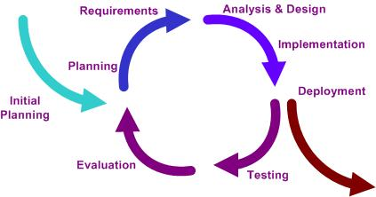
Cyclic development
Modifications will fit into simple modules
Each iteration should analyze goals and reassess iteration plans if necessary
Each iteration cycle has distinct phases with specific goals.

Slide 20
Risks
Assessed risks in terms of the probability of occurrence and the severity if realized
Divided these risks into severity categories
Brainstormed to create a list of possible risks that might impact the project at some point
  Ranging from code inefficiency problems to teamwork or deadline difficulties
  Example: Test is not conducted on a specific system component.

Slide 21
Risks
Each risk was then examined for a potential approach that would lessen its negative impact
Ex.
  Test correct component, but examine the incorrect data for possible accidental bug discovery.
  Have multiple testers with overlapping bug investigations.

Slide 22
Risk Examples
Insufficient time to realize each iteration fully
  Plan ahead to determine how much time may be spent on each iteration.
  Make iterations short with related tasks.
Unavailable team members at crucial times
  Contact information available
  Firm meeting plans established ahead of time
Requirement ambiguity
  Resolve ambiguities as a team in the planning phase
Missing final deadline
  Establish “soft deadlines” to ensure project is on par

