Slide 1
Minimizing Churn in the Chord P2P Network
Thomas Hansen
Satpreet Singh
22C:196 - Spring 2009
May 7th 2009
Final Presentation

Slide 2
Project Objectives
TO STUDY CHURN:
To investigate the causes for churn
To study it’s effects on P2P network performance
To understand the difference between random-churn and adversarial-churn
EXPERIMENTS:
To simulate k-replication on a unidirectional Chord network and note the improvement in resilience
To add randomization to the (a) search or (b) routing algorithm and note the improvement in resilience
Above experiments to be done for both random-churn and adversarial-churn

Slide 3
PyChord
We developed
PyChord: A Python based simulator for Chord
Chord Testbench
(Message & Churn generator, Test-cases and clock)
Chord Network Model
(Messages, Nodes, Finger Tables, Churn, Metrics, Churn Handling algos)
Visualizer
(Graphics)
Logger
(Metrics analysis, storage)
Metrics Collected: Failure Rate, Avg. path length

Slide 4
Chord & Churn Handling
Messages array
Node instances
Finger-tables
Failure Modes….?
CHURN HANDLING:
Backup Successors
Randomized routing
Randomized replication

Slide 5
Churn Handling
CHURN HANDLING:
Delta replication

Slide 6
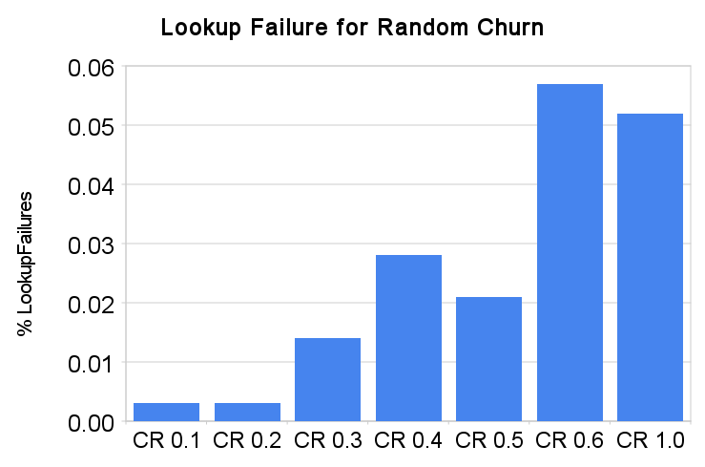
Experimental Results:

Slide 7
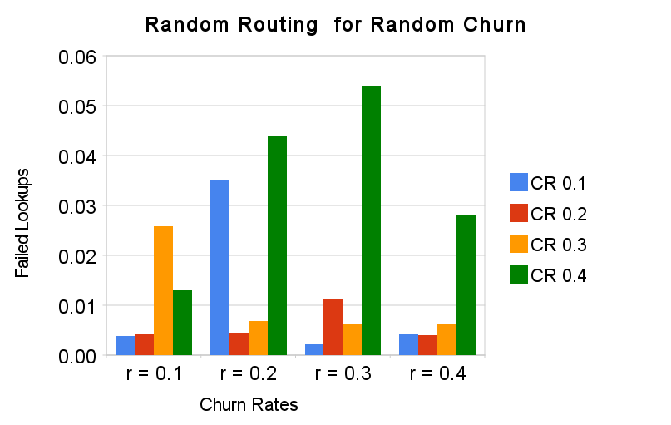
Experimental Results:

Slide 8
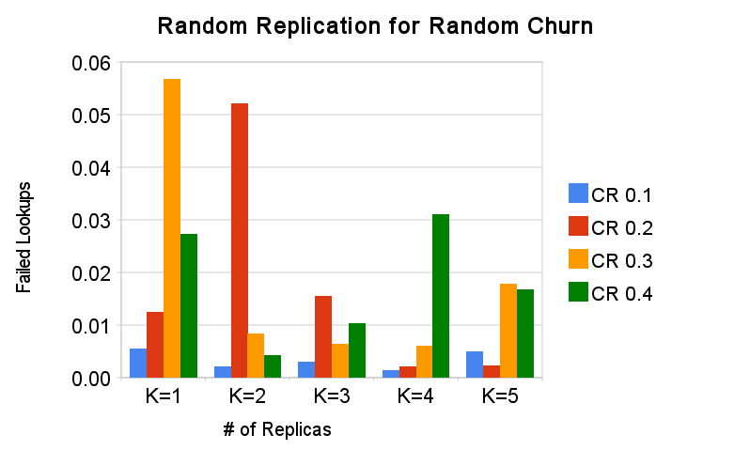
Experimental Results:

Slide 9
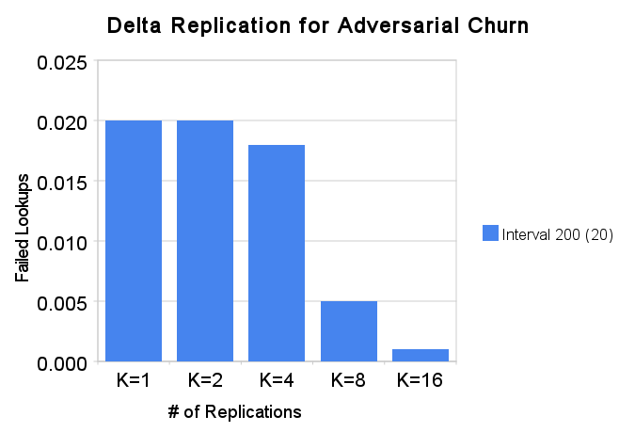
Experimental Results:

Slide 10
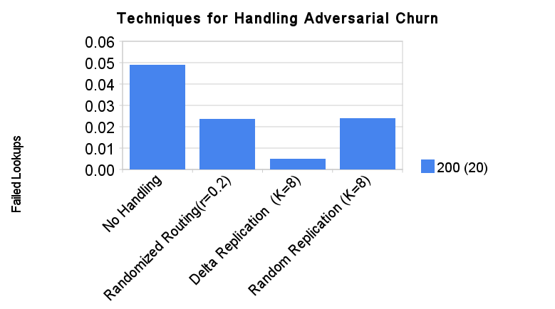
Experimental Results:

Slide 11
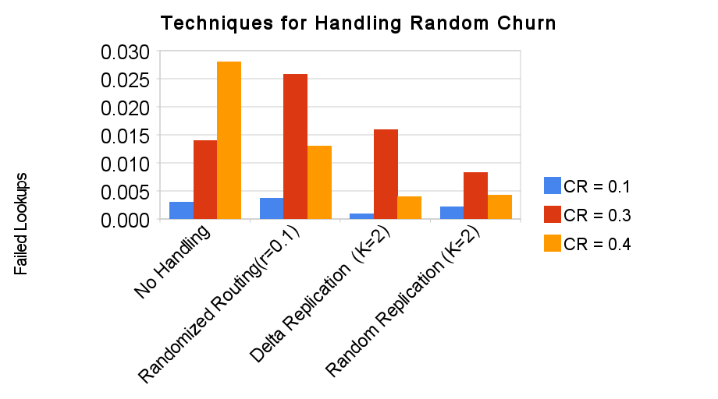
Experimental Results:

Slide 12
Wrapping up…
Conclusion:
Some redundancy required to deal with Churn.
Results with Delta-Replication were most impressive
Lessons Learnt etc.
Immense learning experience. Distributed system bugs!
Might have taken on too much by developing PyChord
Challenge: complexity vs. performance vs. effort
Demo
PyChord Visualization
Adversarial Churn
Questions… ?

