Slide 1
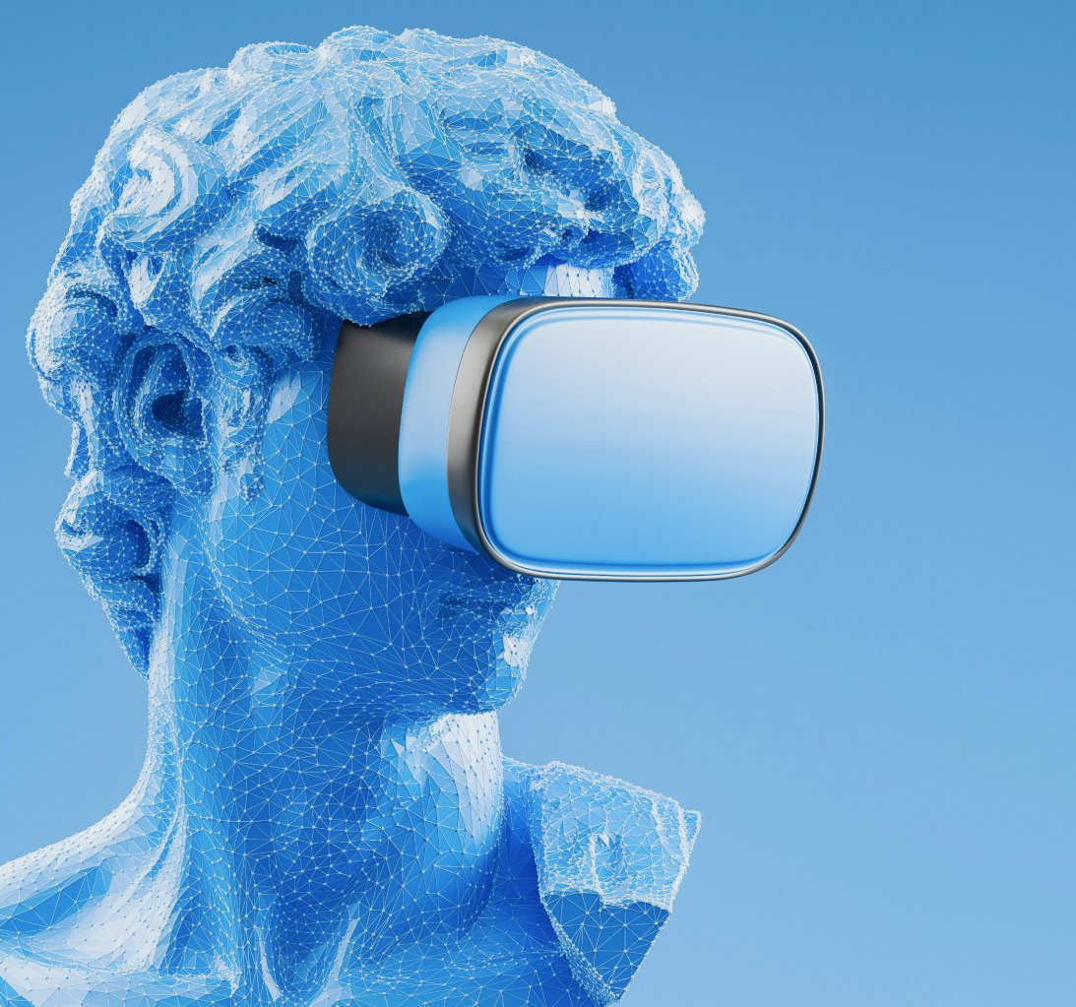

3rd April 2025
Virtual Reality Project Proposal :
Review of TVMC:Time-Varying Mesh Compression Using Volume Tracked Reference by Guodong Chen, Filip Hácha, Libor Váša, Mallesham Dasari
Project Proposal - Andrew Xie, Srotriyo Sengupta, Satrajit Ghosh
VR
Technology
Electrical and Computer Engineering

Slide 2
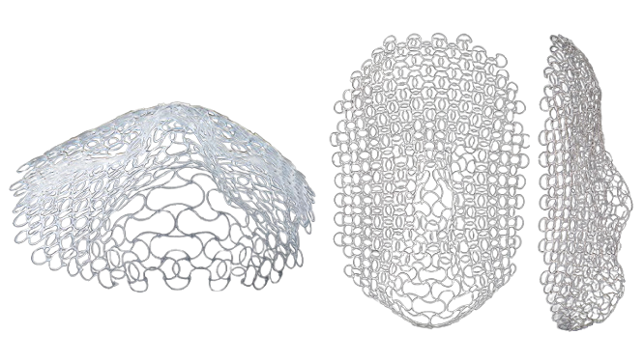
Why is the Problem Significant?
Time-Varying Meshes (TVMs) are crucial for applications like AR/VR, digital humans, telepresence, and 3D video streaming — but their large size and dynamic topology make them hard to store and transmit efficiently.
Current compression methods (e.g., Google Draco, V-DMC) often treat each frame independently or rely on weak temporal correlations, leading to suboptimal compression and high decoding times.
TVMC (Chen et al., MMSys 2025) introduces a novel compression strategy using volume tracking and reference mesh extraction, claiming lower bitrates (4–6 Mbps) and reduced decoding time (by 66.1%).
These advancements could enable real-time, bandwidth-efficient 3D mesh streaming, unl
ocking smoother XR experiences on limited hardware or networks. Therefore, it is vital to review and validate the claims in the TVMC paper, as well as to identify any limitations or areas of improvement that could further advance compression techniques and the broader field of dynamic mesh processing.

Slide 3
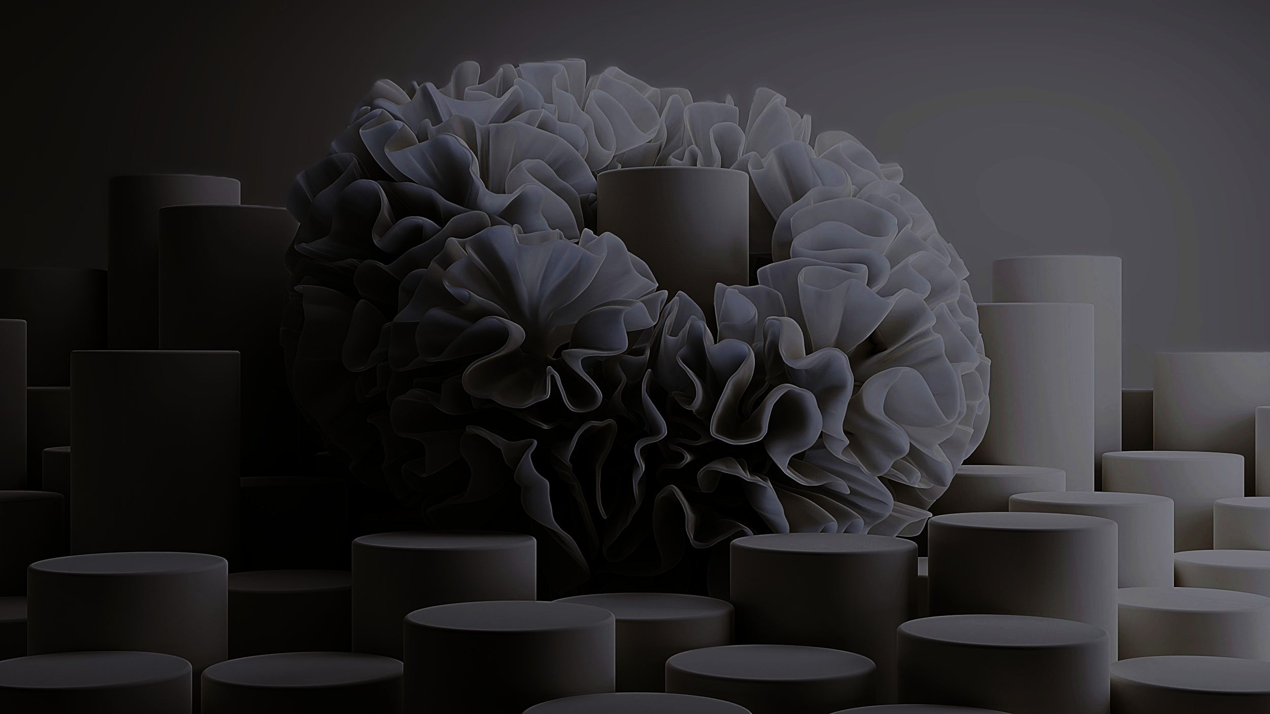
Approach Under Evaluation

Slide 4
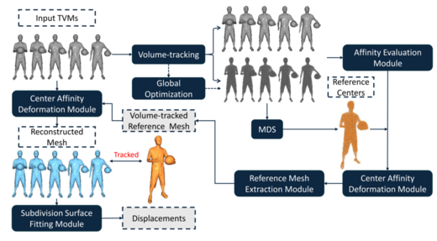
Primary Solution: We are evaluating TVMC – Time-Varying Mesh Compression Using Volume-Tracked Reference Meshes proposed by Guodong Chen, Filip Hácha, Libor Váša, and Mallesham Dasari (ACM MMSys 2025).
Key Approach:
Uses ARAP (As-Rigid-As-Possible) Volume Tracking to align mesh frames.
Applies Multidimensional Scaling (MDS) to refine volume centers.
Generates a self-contact-free reference mesh from the group of frames.
Computes displacement fields and compresses them using Draco.
Figure: Pipeline overview adapted from TVMC: Time-Varying Mesh Compression Using Volume-Tracked Reference Meshes by Chen et al.

Slide 5

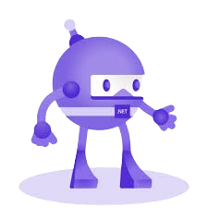
Progress So Far
Successfully built and ran the full TVMC pipeline inside Docker, following official instructions.
Verified outputs: reference meshes, displacement fields, and compressed files.
Evaluation scripts reproduced key results on the basketball_player dataset.
Challenges Encountered
Environment setup inside Docker (Python + .NET 7.0 + Open3D) required manual configuration.
Minor issues with conda environment activation and .NET SDK version mismatches.
Required extra steps to transfer generated files from Docker to the local machine.

Slide 6
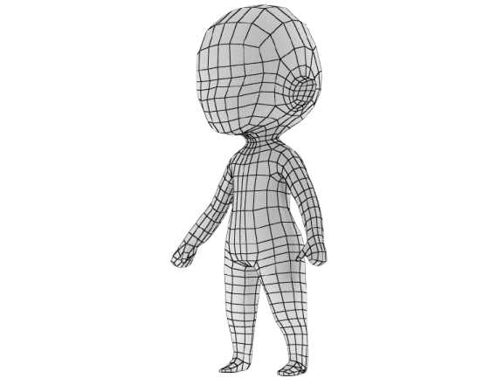
Next Steps
Plan to run TVMC on a local machine using the provided setup instructions.
Intend to evaluate the system on a custom dataset not provided in the paper or repository.
This will help us analyze the method’s generalization and robustness to new inputs.

Slide 7
Evaluation Plan
We will evaluate the performance of TVMC using both objective and qualitative metrics.
Our baseline for comparison will be Google Draco, a widely-used open-source 3D compression library.
🔗 GitHub: GitHub - google/draco: Draco is a library for compressing and decompressing 3D geometric meshes and point clouds. It is intended to improve the storage and transmission of 3D graphics.
We are exploring two evaluation approaches:
TVMC + Draco (Integrated): Already used in the paper to encode reference meshes and displacement fields.
Draco Only (Standalone): Apply Draco directly to each mesh frame individually, without TVMC's volume-tracking-based compression.
Metrics for comparison:
Bitrate: Measure final compressed file size.
Distortion: Use metrics like PSNR or mesh-to-mesh error between original and reconstructed frames.
Decode Speed: Evaluate runtime latency of decoding compressed meshes.
Evaluation Scripts:
We will use TVMC's built-in Python scripts (evaluation.py, objective_results_basic.py) for automated metric generation and figure plotting.
Visual Comparison:
Side-by-side visualization using tools like Open3D or Meshlab for mesh quality analysis.
We also plan to experiment with TVMC on our own machine using custom datasets (beyond those in the paper) to test generalization and robustness.

