Slide 1
IMDB Data Analysis
Rohan Ravindra Saraf (B00804752)
Satrio Baskoro Yudhoatmojo (B00818460)

Slide 2
Problem Statement:
IMDb is the world most popular sites for movies, TV and celebrity content which has been around since 1990, but being a huge website it difficult to know various details about the movies, celebrities and different correlations in between them.
This application aims to give better analysis and experience to the users by giving the curated analysis about the different movies based on their corresponding IMDB scores, revenue generated and also gives a broader view to the user to see what movies they can watch and what is its statistics.
Performing all this analysis on such a huge data might be difficult using the structures DB but this is somewhat eased by using the NoSQL-DB.
Reading all the analysis in just textual format is also somewhat tedious and time consuming. Hence we have designed the line and bar graphs to visualize the data in a better way.

Slide 3
Software Design/Technologies and Tools Used:
Database: We have used the NoSQL DB “MongoDB” to store all the data. It is basically Open source, document based and also it provides the support to store unstructured and can be retrieved in different forms.
Data is stored in database name “movies” and inside the database there is a collection named “movies”.
Frontend: After the data being retrieved in python, we have displayed the data in a user friendly manner using HTML, CSS and JavaScript.HTML, gives user the provision to give the input to the application by either selecting year, selecting genre, sliding the lower and upper bound of the IMDB Score etc.
Backend: we have used Python programming language for performing the analysis stated in the proposal. Python programming language will be used to retrieve data from MongoDB and transform the data into the needed format for the analysis.
Middleware: To wrap the whole project and create a connection we have used micro-framework “Flask” as the scaffolding for developing the web-based application.

Slide 4
Operations/Queries Supported:
All the queries are “select” queries, we fire the queries to the MongoDB Dataset, retrieve the data and we then represent it in the format as needed.
We simply need to pass the parameter as an input like:
Year → year of the movie released
Genre → Movies from the specific year of specific genre.
Range slider → Slider to give the lower and upper bound of the IMDB Score.
These operations is facilitated by the mongo query ‘find’.
Following are the queries supported by this application:

Slide 5
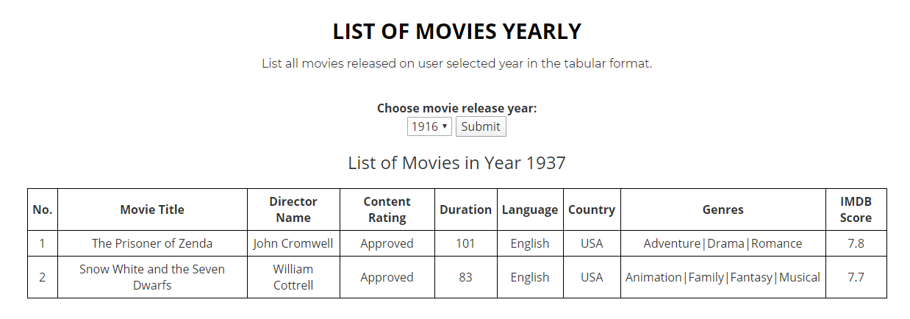
Query 1: List of movies yearly
This query help us to list the all movies for the selected year in the tabular format.
We take the “year” as an input from the user via a drop down menu. After he clicks submit, we fire a select query in the MongoDB Database to fetch all the movies released in that particular year.

Slide 6
Brainstorming Activity
Generate ideas.
Use games and exercises to “warm up” your creative thinking.
When ideas slow down, try another exercise to generate fresh ideas.
Breaking into smaller groups may be helpful.
Use a computer to capture every comment/idea.

Slide 7
Summarize
Review ideas.
Vote on top candidates and consolidate.
Check requirements and restrictions.
Trim list to top 5-10 ideas.

Slide 8
Next Steps
Describe what happens next:
Research the ideas generated?
Follow up with larger group?
Generate action items for follow-up:
Start turning ideas into reality.

