Slide 1
Contact center

Slide 2
o
Introduction
u
Definition, technologies, sample
Technology
t
CTI, TDM, VOIP, evolution
l
Prerequisite
i
Resume
n
e

Slide 3
What is ?
Contact Centre is a centralized/distributed office used for the purpose of receiving or transmitting a large volume of requests by telephone.
Insurance/
telemarketing
HR/RECRUITING
A Contact Centre, also known as Customer Interaction Centre (CIC) is a central point of any organization from which all customer contacts are managed.
Through contact centers valuable information about company are routed to appropriate people, contacts to be tracked and data to be gathered.
HEALTH CARE
ORDER TAKING

Slide 4
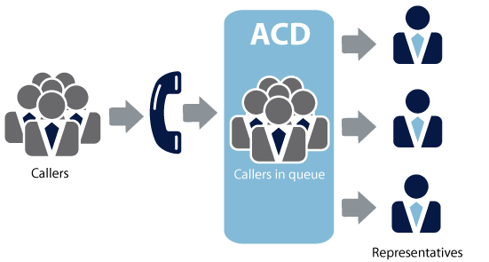
Automatic call distribution
(ACD)
ACDs are telephone systems that route calls, prioritize calls, and play recorded messages.
They record the number of calls in the system, the number of dropped calls, and the average hold time.
The most important functions of an ACD system are call routing and data collection.

Slide 5
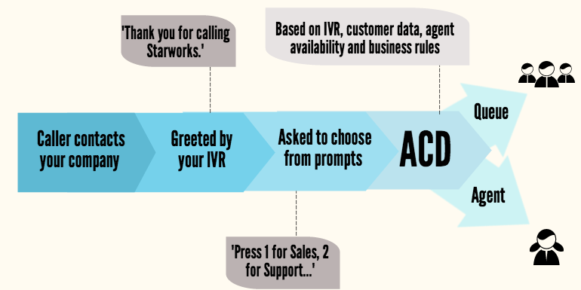
ACD Scenario

Slide 6
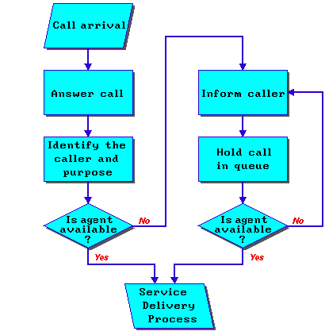
Automatic call distribution
ACDs collect and store data about each call.
Using the data, the ACD creates management reports that are used to monitor and evaluate contact center efficiency.
Managers can determine the number of calls abandoned, the average hold time of calls, and other statistics.

Slide 7
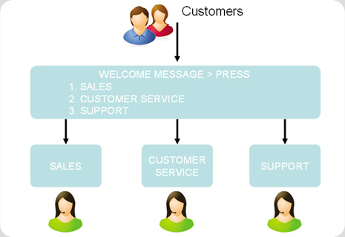
IVR ( Interactive voice response)
IVR solutions enable users to retrieve information including bank balances, flight schedules, product details, order status, movie show times, and more from any telephone

Slide 8
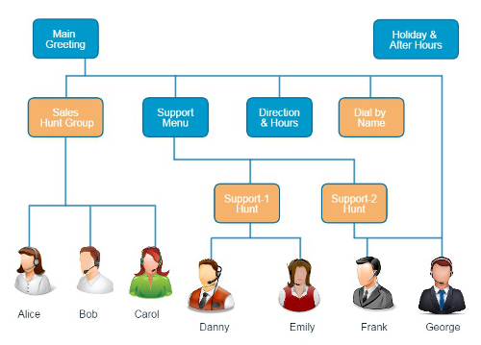
Interactive Voice Response
IVR solutions have used pre-recorded voice prompts and menus to present information and options to callers, and touch-tone telephone keypad entry to gather responses.
Modern IVR solutions also enable input and responses to be gathered via spoken words with voice recognition.

Slide 9
Types of contact center
Contact center
Inbound
Telemar
keting
Web Contact Center
Outbound

Slide 10



Inbound & outbound

Slide 11
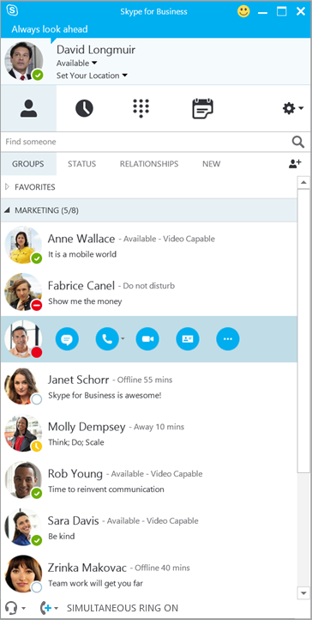
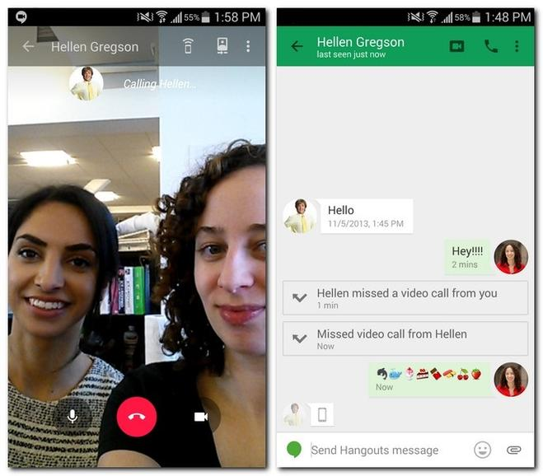
What is CTI?
Computer–Telephony Integration
Technology that allows interactions on a telephone and a computer to be integrated or coordinated.
Run on either a user's desktop, or an unattended server

Slide 12
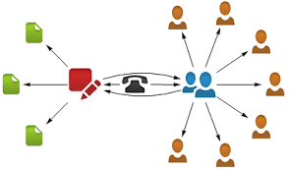
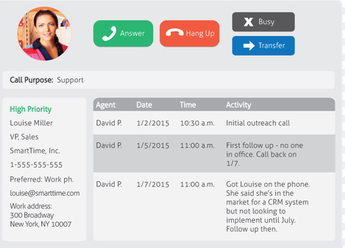
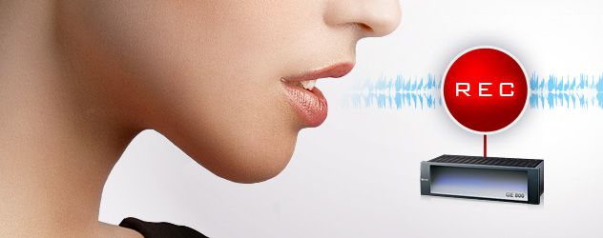
Cti common function?
Client Function
Server Function
Popup Screen
Phone control
Transfer
Dialing
Callcenter
Advanced Call reporting
Call Routing
Call recording

Slide 13
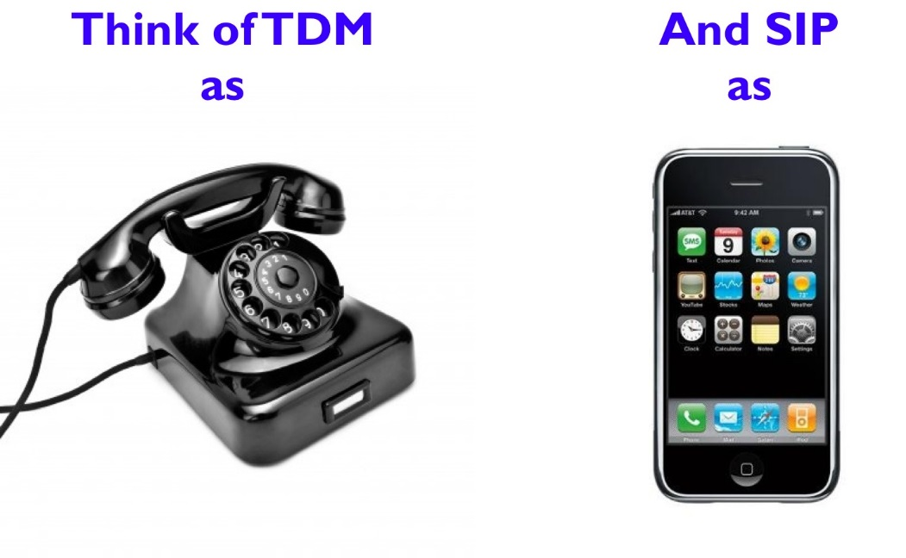
IP Telephony vs TDM for the Contact Center
Technologies that use the Internet Protocol's packet-switched connections to exchange voice, fax, and other forms of information that have traditionally been carried over the dedicated circuit-switched connections of PSTN
Time division multiplexing (TDM) describes traditional phone services, set up over a phone line.
+ Positif:
Voice Quality
+ positif :
Cost
Call Routing :
calls can easily be routed to anywhere
- Negatif:
Bandwidth Utilization
Troubleshooting: if your Internet is
Down, it difficult to determine
the problem
-- Negatif :
Voice Quality
Troubleshooting:TDM more difficult to manage, as a dedicated staff or time is needed to move lines and extensions, as well as to troubleshoot problems.
Cost

Slide 14
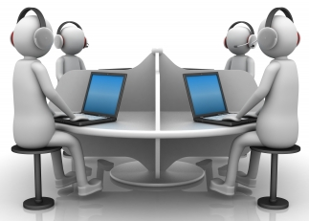
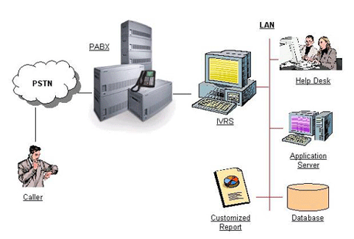
Tdm
Contact-center topology
Client Application
(OnTrace)
Headset
Database
Client Environment
Server Environment
Line-carrier
PABX Card
MSI/Extension Card
Application Server
Database
TCP/ip
Contact Center

Slide 15
Tdm - prerequisite
Application Server
CTI API
C#
T-SQL Language
Network (socket/tcp) programming
OnTrace Client
C#
Network (socket/tcp) programming
T-SQL Language

Slide 16
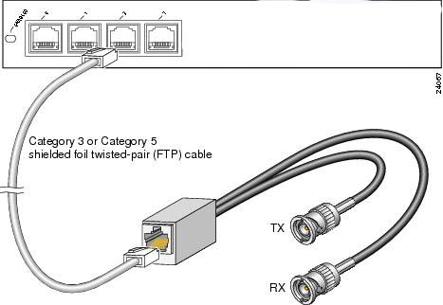
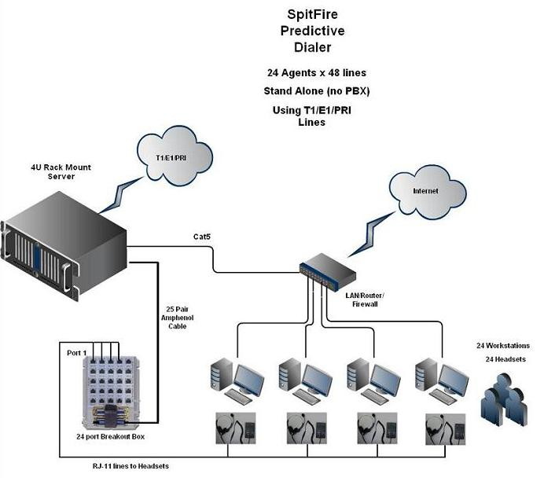
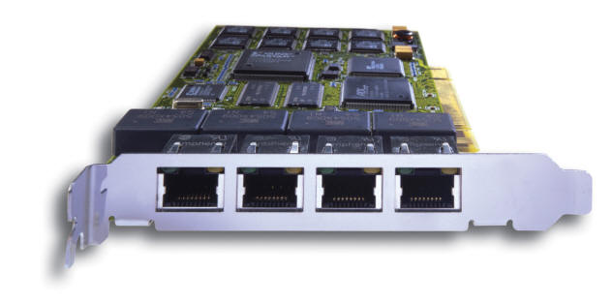
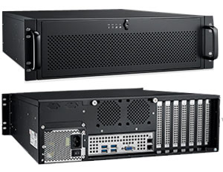
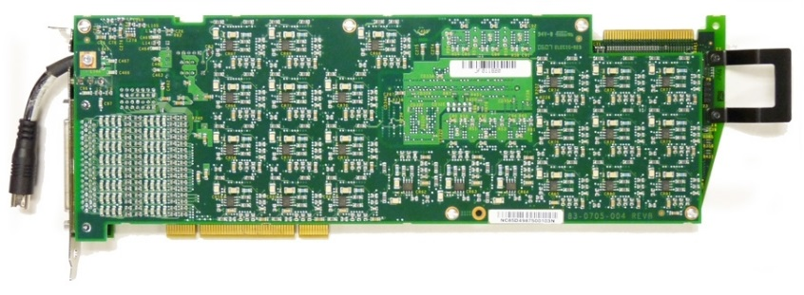
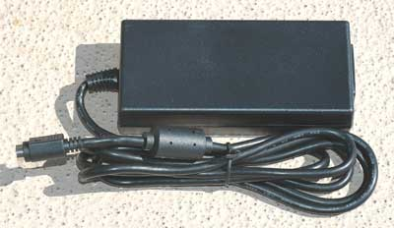
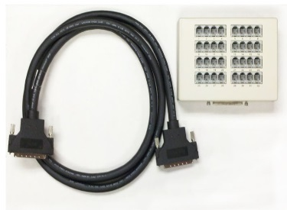
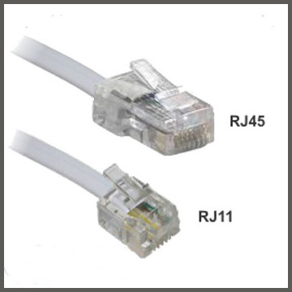
Tdm - Server environment

Slide 17
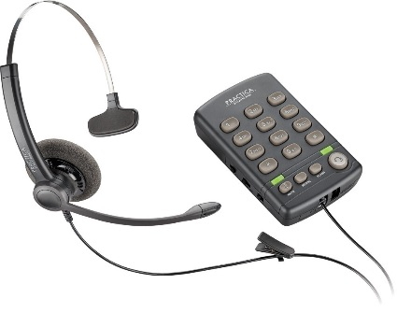
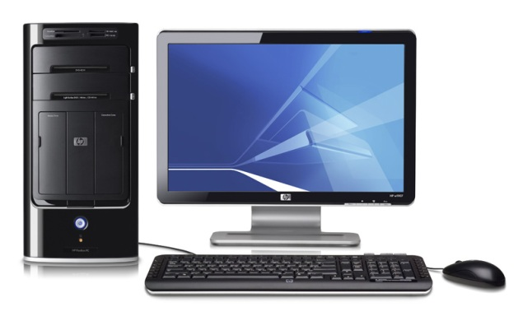
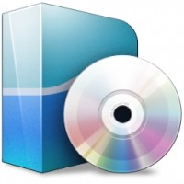
Tdm - Client Environment
OnTrace

Slide 18

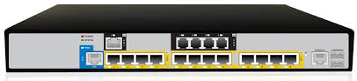


TDM VS VOIP?

Slide 19
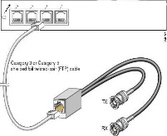
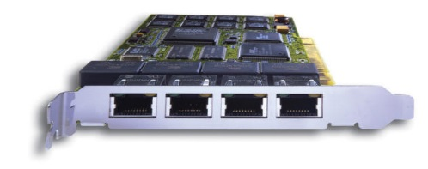




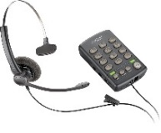


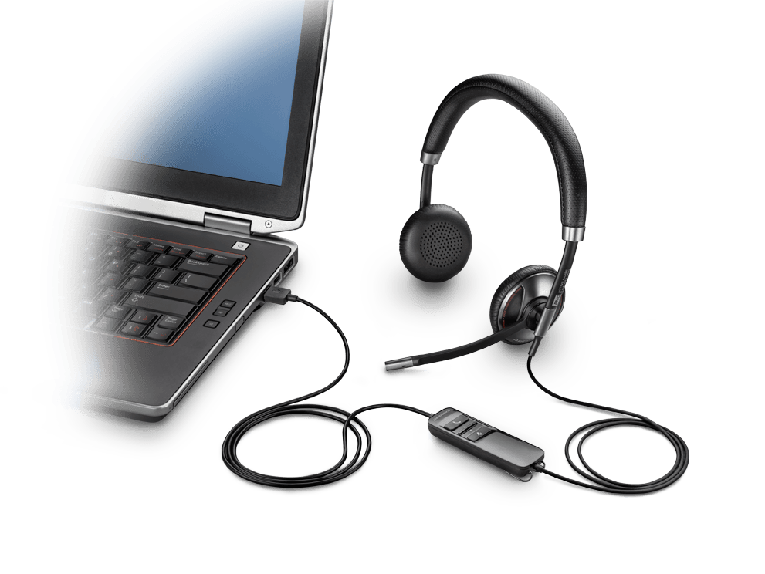
resume
Application Server
CTI API
C#
T-SQL Language
Network (socket/tcp) programming
TDM
Contact Center
OnTrace
OnTrace Client
C#
Network (socket/tcp) programming
T-SQL Language
IP telephony

Slide 20
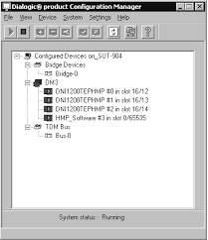
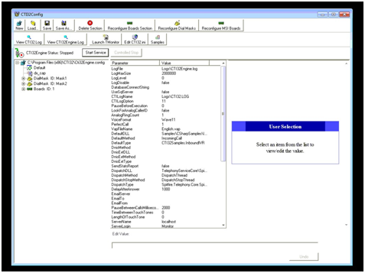







Application’s Topology
Read
Read
Load libraries
Cti32 libraries
OnTraceLog.dll
OnTraceDialogic.dll
OnTrace
Tcp/IP
OnTraceGateway.cs
OnTraceGateway.cs
Client
Server

Slide 21


Server Application’s topology
Cti32 libraries
Messenger/Chat
Port 9151
Monitoring
Port 9353
OnTraceLog.dll
OnTraceDialogic.dll
Threading
TCPListener
Port 9050
Recording
OnTraceGateway.cs
OnTraceSession
Telephony Control
Logging
SessionStatus
AgentStateStatus
ProductID
DialResult
callTime
dialNumber
agentName

Slide 22
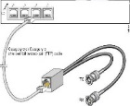


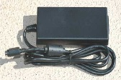

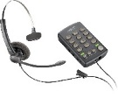


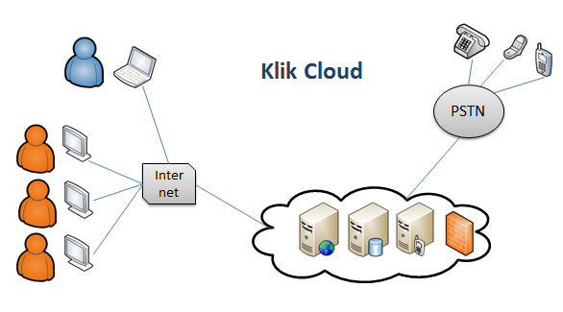
today
Application Server
CTI API
C#
T-SQL Language
Network (socket/tcp) programming
TDM
IP telephony
OnTrace Client
C#
Network (socket/tcp) programming
T-SQL Language
Contact Center
Future
OnTrace

Slide 23
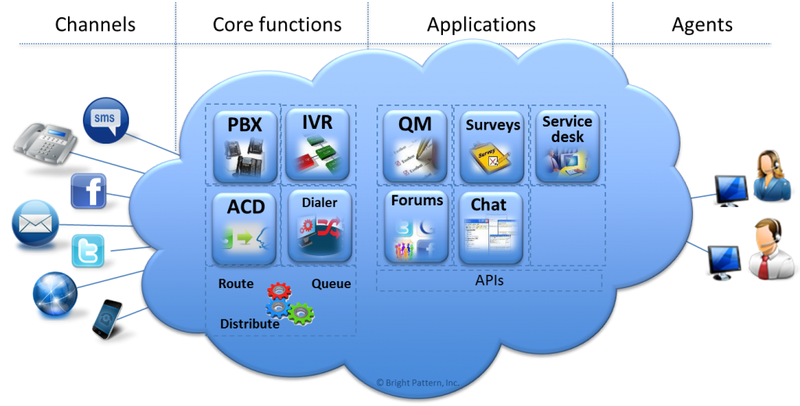

Current

Slide 24
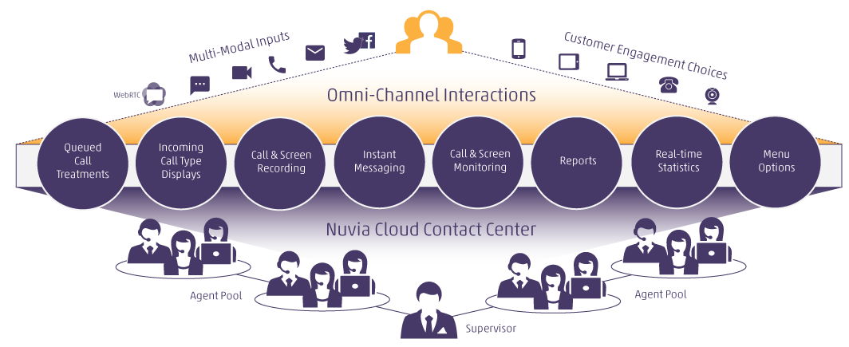
Future

