Slide 1
Factory Analytics
Investor Presentation
Unified operating intelligence for modern factories
Consolidated from App, Backend, and Web Architecture decks

Slide 2
Investment Thesis
Why this product can scale in industrial environments
Factory Analytics digitizes production planning, execution, and quality into one operating system.
Role-specific experiences drive daily adoption: mobile workflows for line teams and web analytics for leadership.
A modular backend and standardized data flow create a scalable platform for multi-factory expansion.

Slide 3
Problem and Strategic Opportunity
Manufacturers need real-time visibility and operational discipline
Pain Points Today
Opportunity With Factory Analytics
Fragmented tools create blind spots between planning, line execution, and quality control.
Manual reporting delays corrective actions, increasing rework and missed dispatch targets.
Supervisors and operators work from different data sources, causing decision latency.
Single data model aligns floor operations with management decisions in near real time.
Closed-loop quality workflows reduce defect leakage and improve accountability.
Architecture supports phased rollout from one line to multi-site deployments.

Slide 4
Platform Overview: Three Integrated Layers
App architecture + backend flow + web architecture
Factory Floor App: role-based workflows for station setup, production updates, and quality capture.
Backend Orchestration: secured request pipeline with validation, business services, and a generic data access layer.
Web Control Tower: real-time dashboards, order segmentation, and lifecycle tracking for production leadership.
Result: one operational truth from line input to executive KPI reporting.

Slide 5
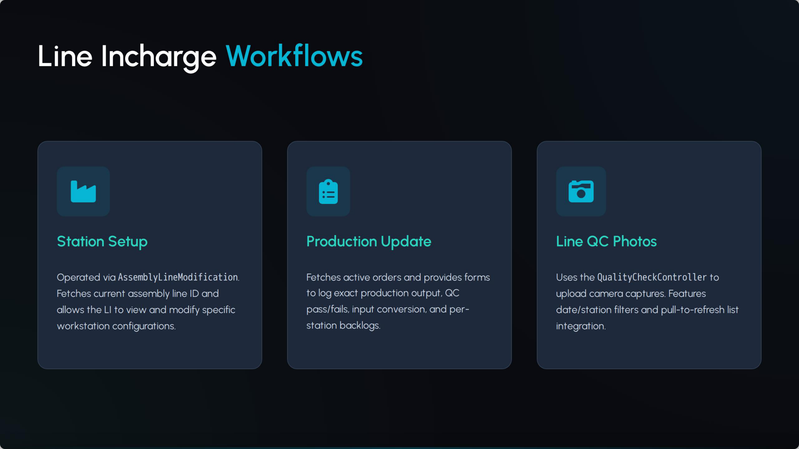
Layer 1: Factory Floor App
Source: Factory Analytics App Architecture
Designed for two critical personas: Line Incharge and Production Incharge.
Captures production updates and quality evidence at the point of execution.
Handles unstable connectivity with resilient sync and recovery patterns.
Creates high-frequency operational data without increasing floor complexity.

Slide 6
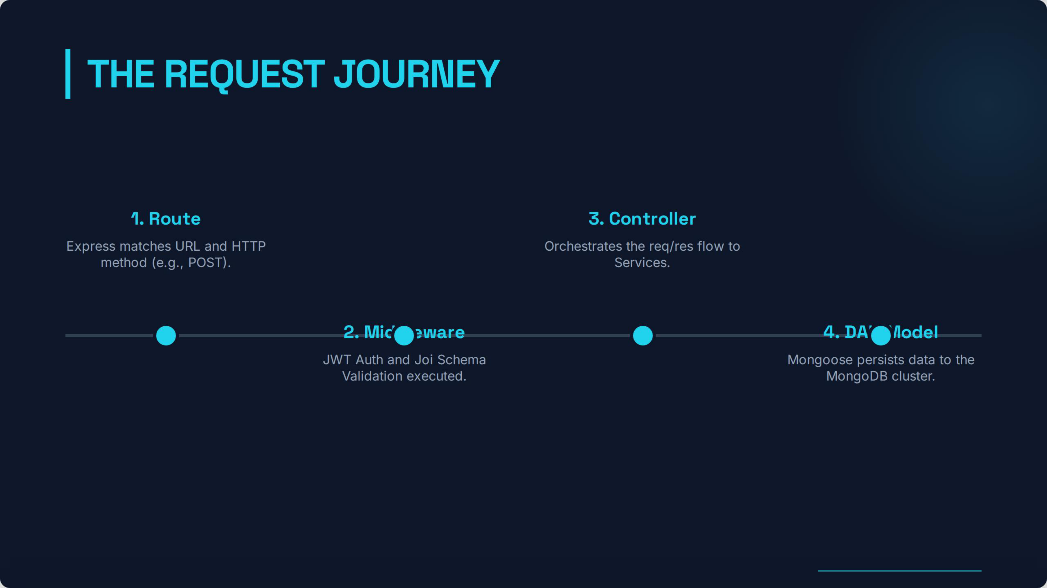
Layer 2: Backend Architecture Flow
Source: Factory Analytics Backend Architecture Flow
Every request moves through a strict route -> middleware -> service -> data pipeline.
Security and validation guardrails enforce clean inputs before business logic execution.
Layered responsibilities improve maintainability and accelerate feature iteration.
Architecture is built for scale and predictable API behavior across clients.

Slide 7
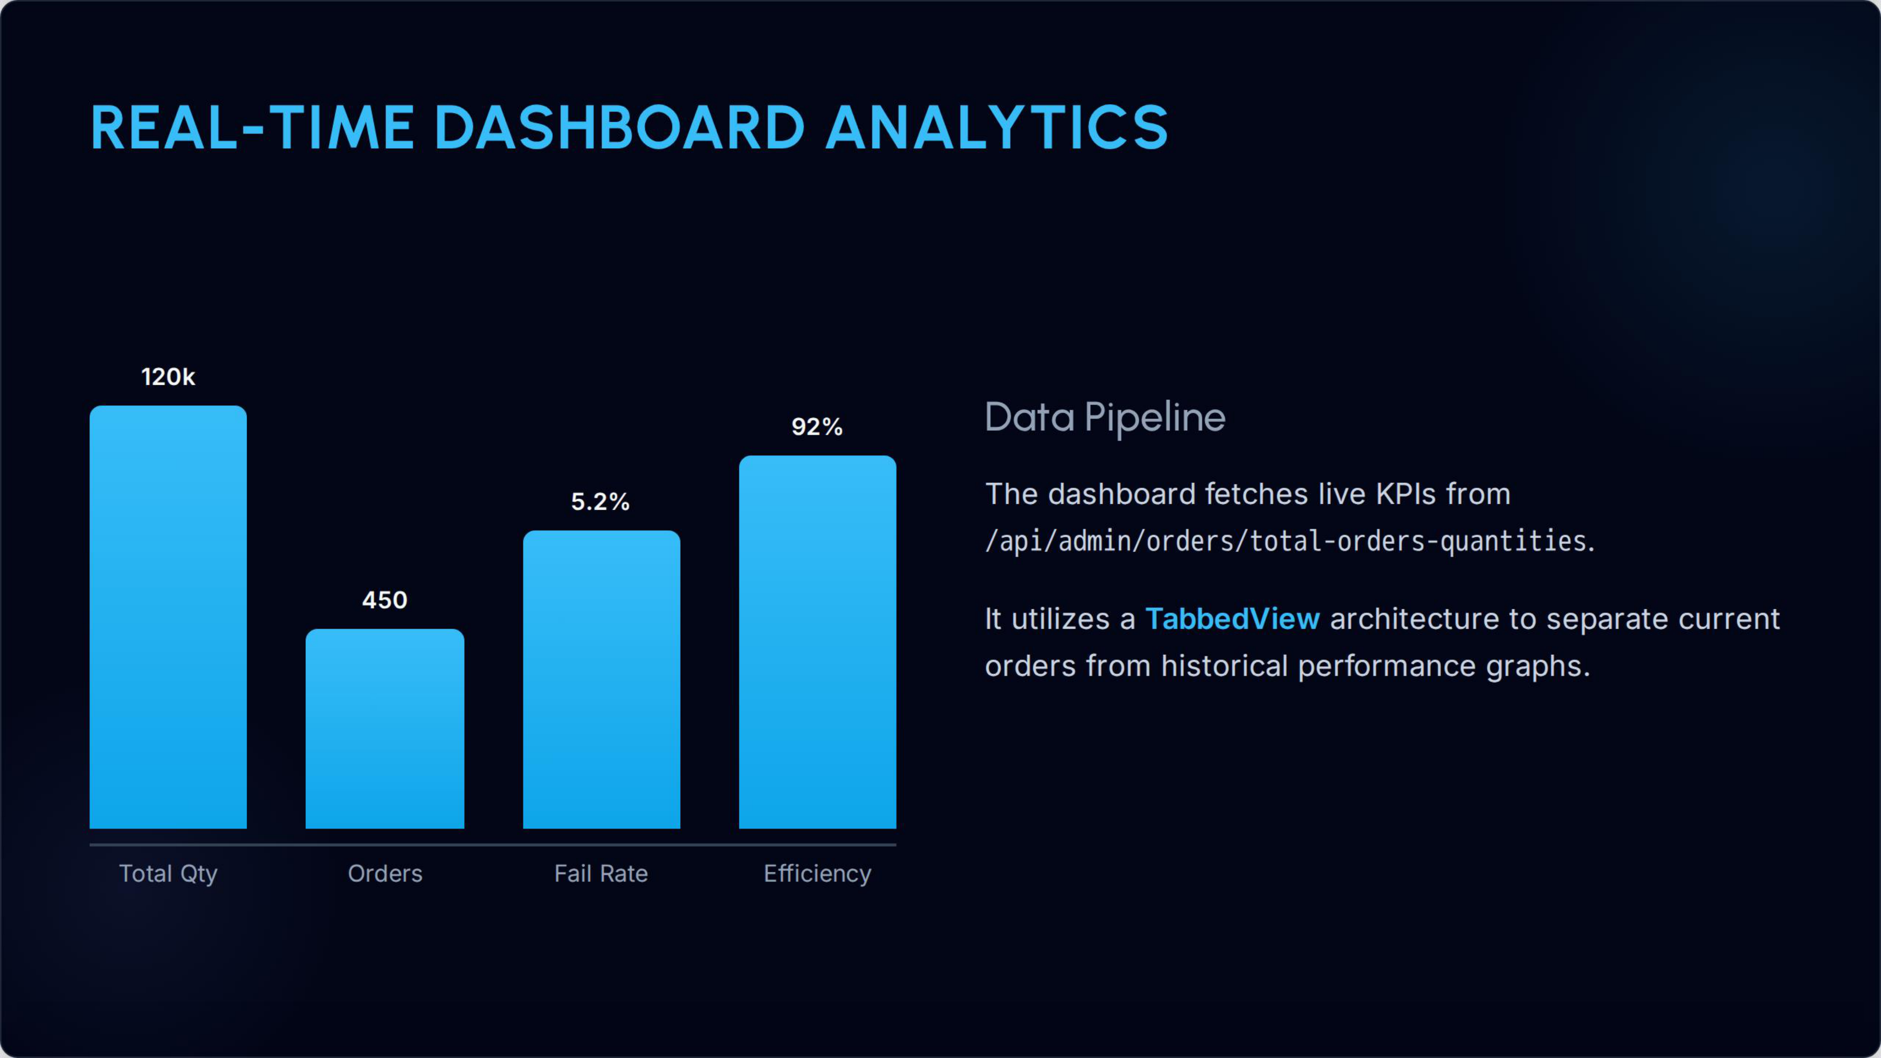
Layer 3: Web App Architecture
Source: Factory Analytics Web App Architecture
Management dashboard turns live production data into actionable KPIs.
Separates customer orders and self-production for clearer planning decisions.
Supports real-time monitoring of efficiency, throughput, and fail rates.
Serves as the command center for line-level and plant-level performance.

Slide 8
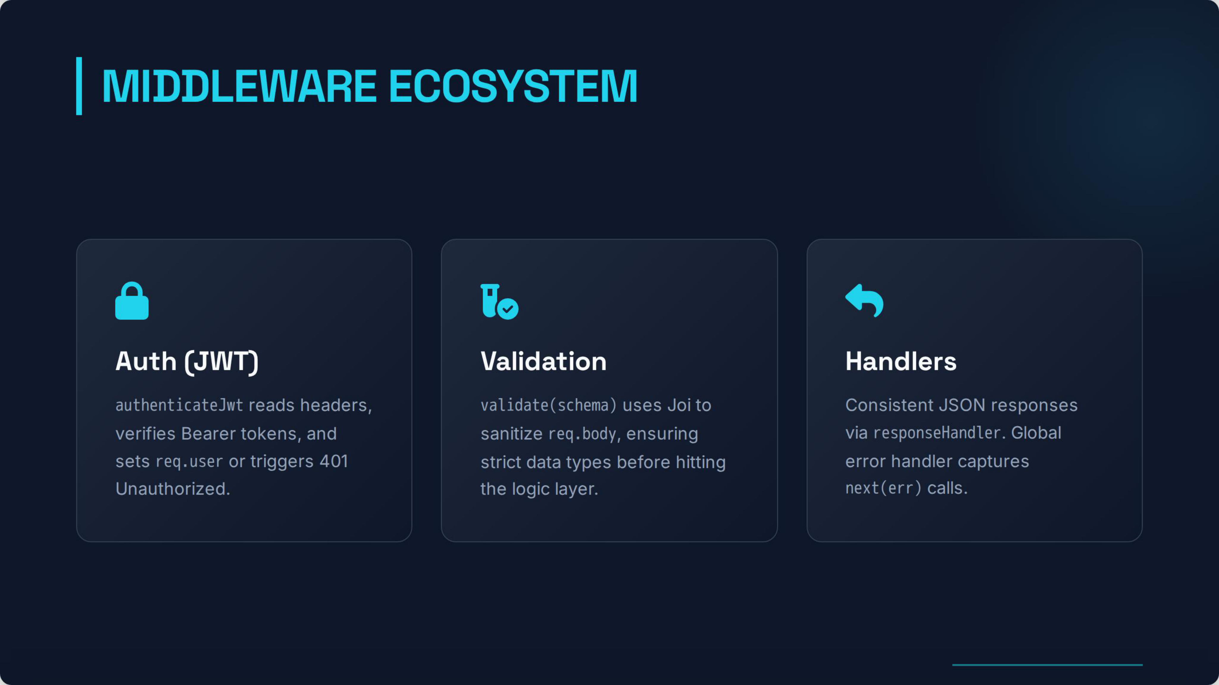
Industrial-Grade Reliability and Security
Operational trust is core to product defensibility
Session continuity and token refresh prevent workflow disruption during shifts.
Middleware-based auth and input validation protect critical production data.
Global error handling and standardized responses simplify incident resolution.
Resilience features are designed specifically for noisy, bandwidth-variable factory environments.

Slide 9
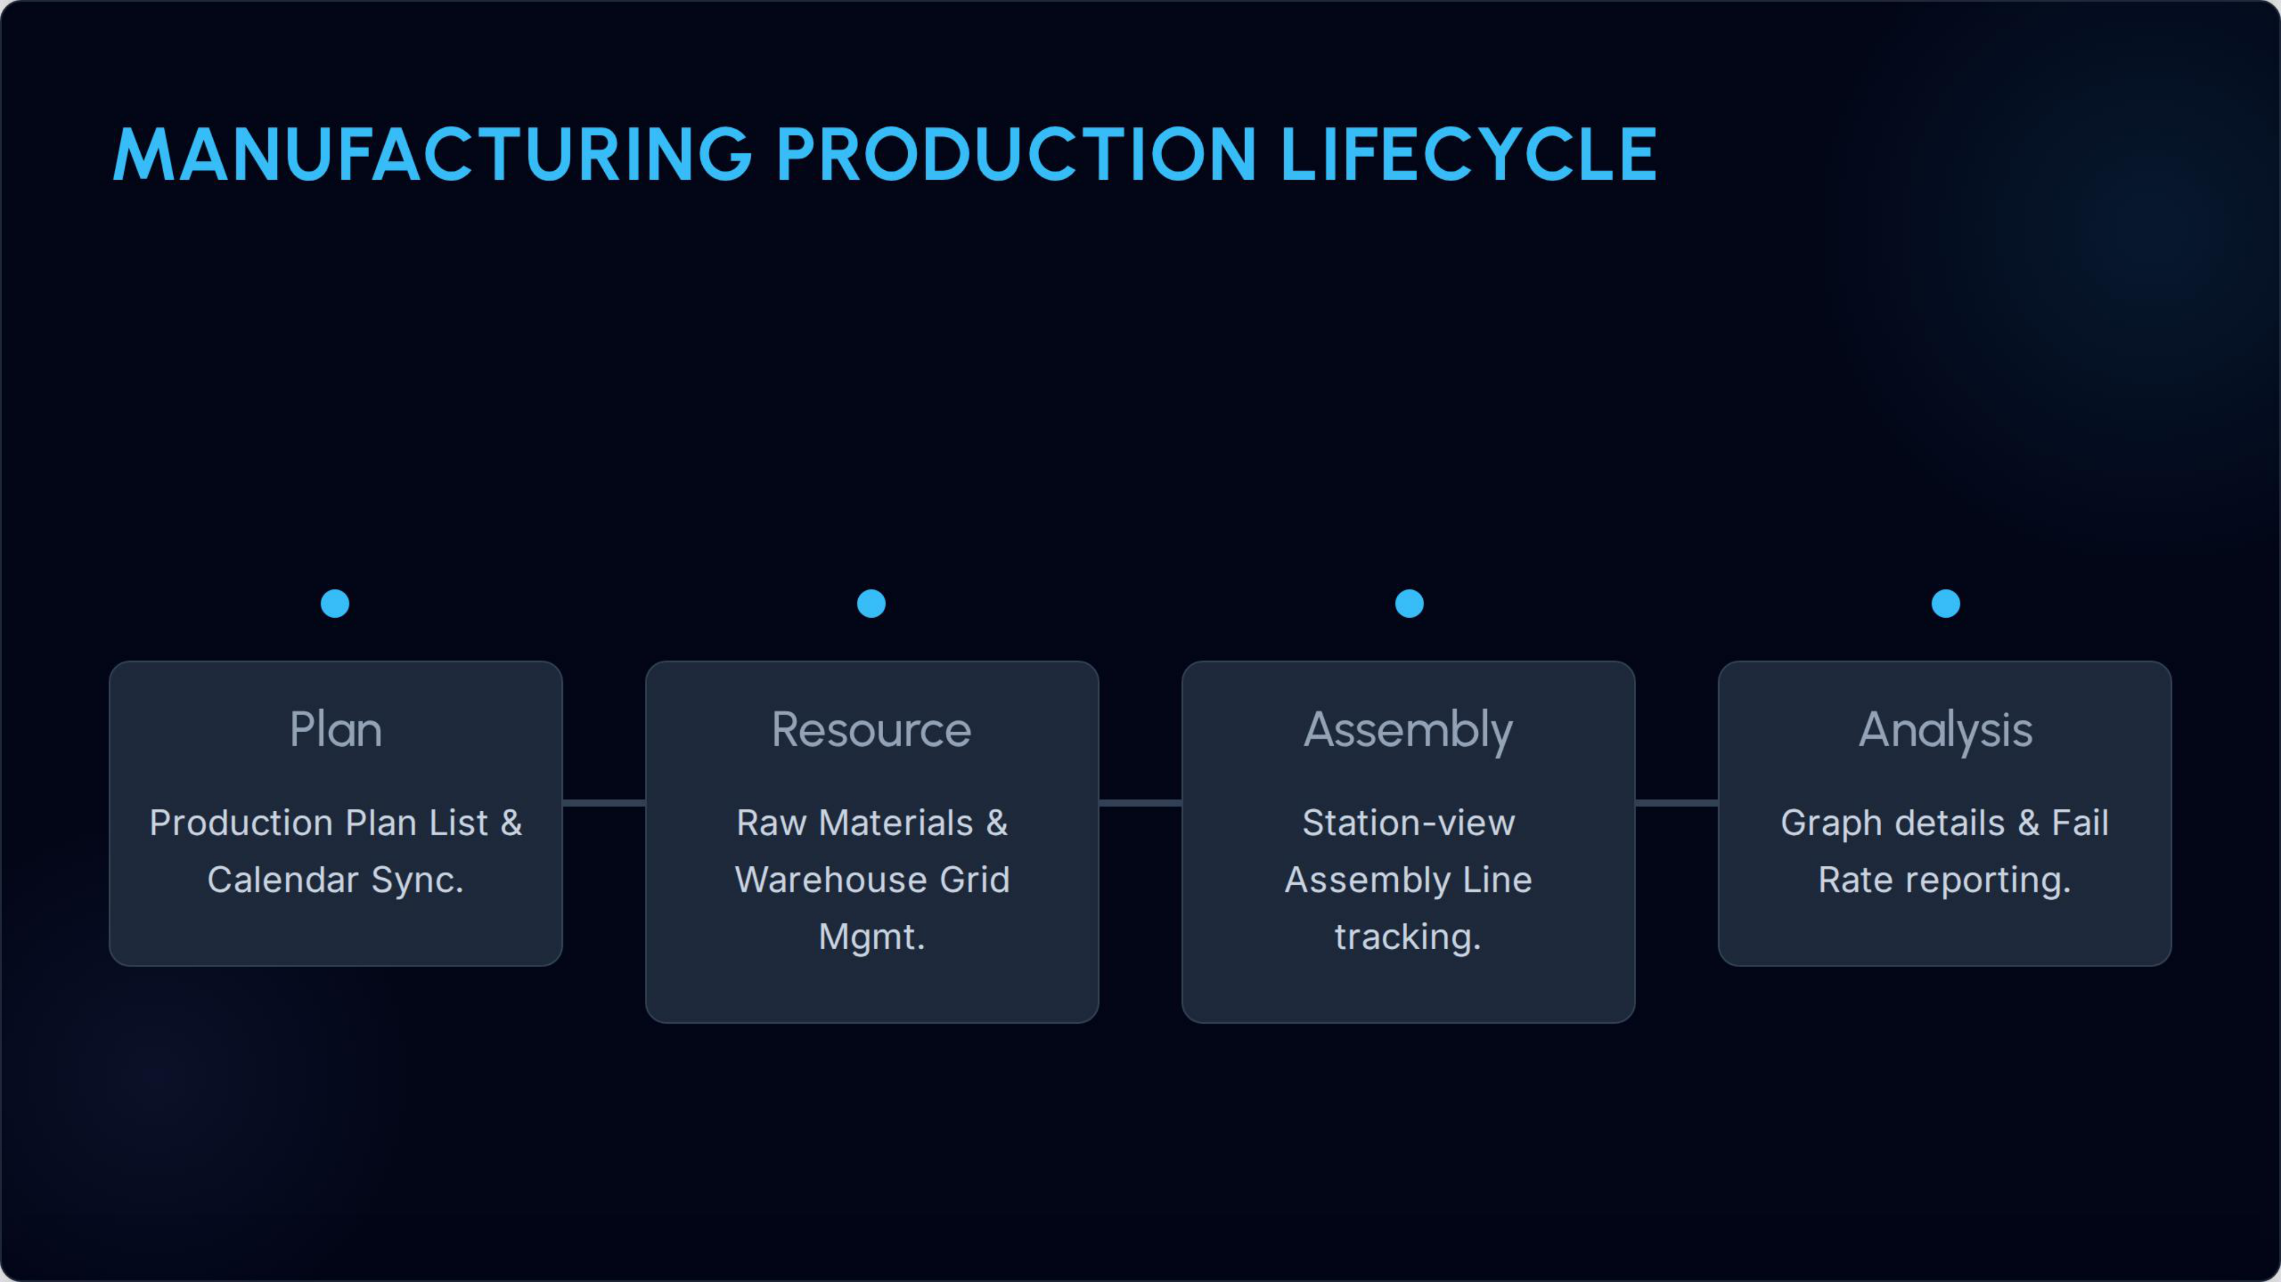
Closed-Loop Operating Intelligence
From planning to analysis in one connected lifecycle
Plan -> Resource -> Assembly -> Analyze becomes a measurable digital loop.
Production events feed dashboards continuously, not only end-of-day summaries.
Quality and throughput trends can be acted on before losses compound.
This feedback loop is the foundation for margin expansion at scale.

Slide 10
Business Model and Expansion
Scalable commercialization path
Monetization
Expansion Path
Subscription SaaS priced by factory site and active production lines.
Implementation services for integration, onboarding, and role-based training.
Premium analytics modules for advanced benchmarking and forecasting.
Land with pilot line, then expand within plant and to sister facilities.
Use role-based adoption data to drive upsell across departments.
Build ecosystem integrations for ERP/MES interoperability over time.

Slide 11
Execution Roadmap (Next 18 Months)
Focused milestones for investor confidence
Product Milestones
Commercial Milestones
H1: harden core workflows, role governance, and reliability telemetry.
H2: launch benchmark dashboards and automated exception alerting.
H3: add multi-site rollup analytics and enterprise admin controls.
Pilot conversion playbook with quantified ROI by line and shift.
Expand from pilot customers into multi-line annual contracts.
Establish channel partnerships for faster manufacturing vertical penetration.

Slide 12
Funding Use and Success Metrics
Capital allocation linked to measurable outcomes
Product and engineering: reliability, analytics depth, and integration velocity.
Customer success: deployment playbooks and measurable time-to-value reduction.
Go-to-market: focused pipeline in manufacturing segments with repeatable motion.
Core KPIs: deployment cycle time, weekly active users, defect trend reduction, and revenue retention.

Slide 13
Consolidation Notes
How the three source decks were unified
App Architecture contributed role-based floor workflows and resilience design.
Backend Architecture Flow contributed secure request lifecycle and layer governance.
Web App Architecture contributed dashboards, lifecycle visibility, and planning surfaces.
All three are preserved below as technical appendix snapshots for diligence review.

Slide 14
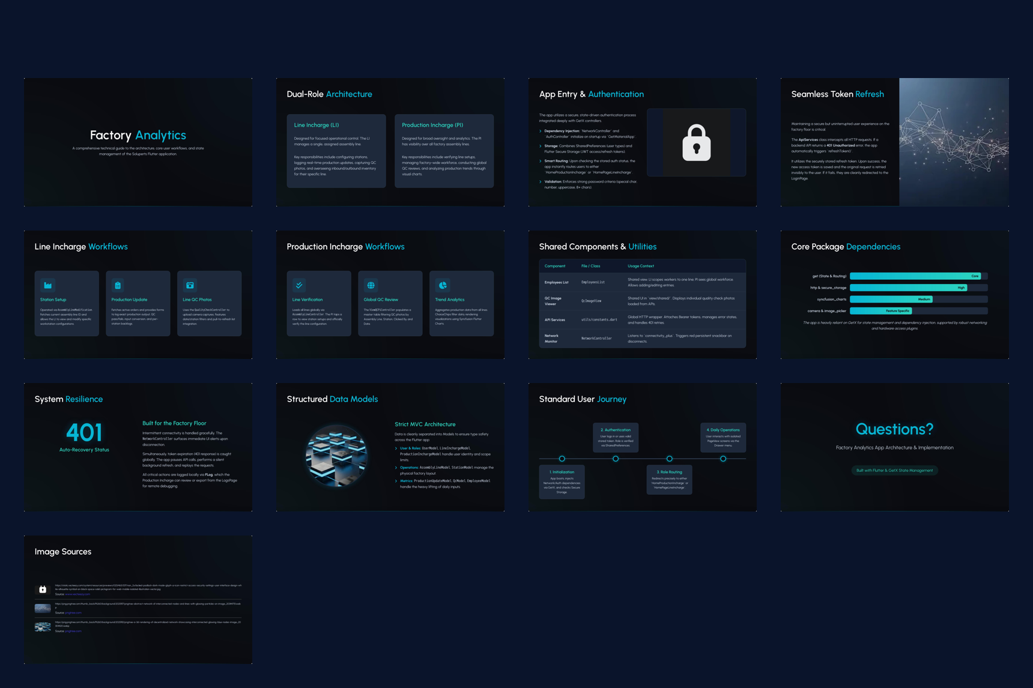
Technical Appendix Snapshot
Factory Analytics App Architecture (13 source slides)

Slide 15
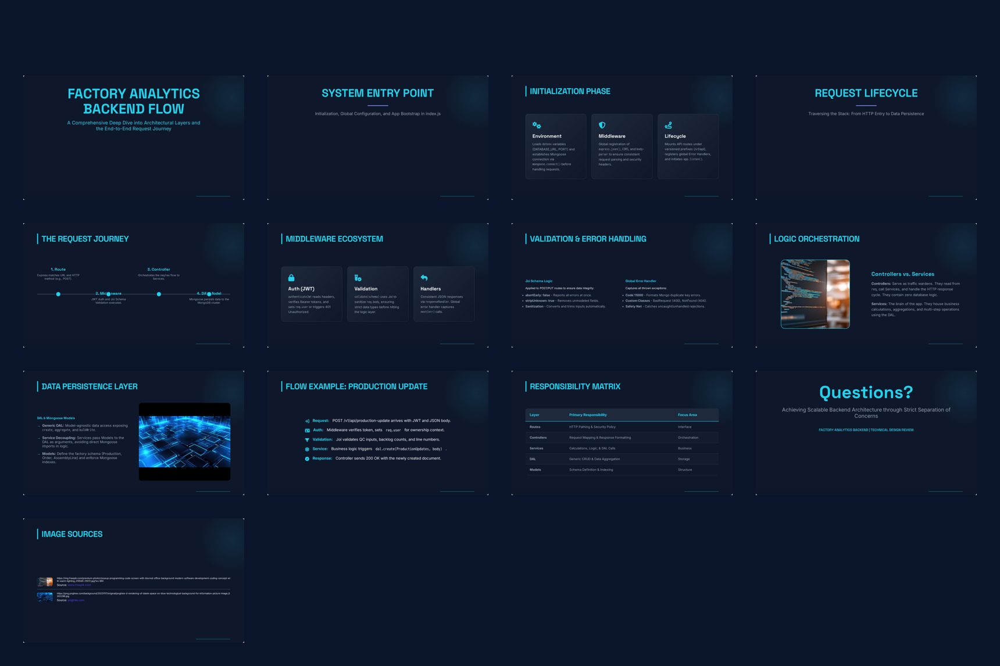
Technical Appendix Snapshot
Factory Analytics Backend Architecture Flow (13 source slides)

Slide 16
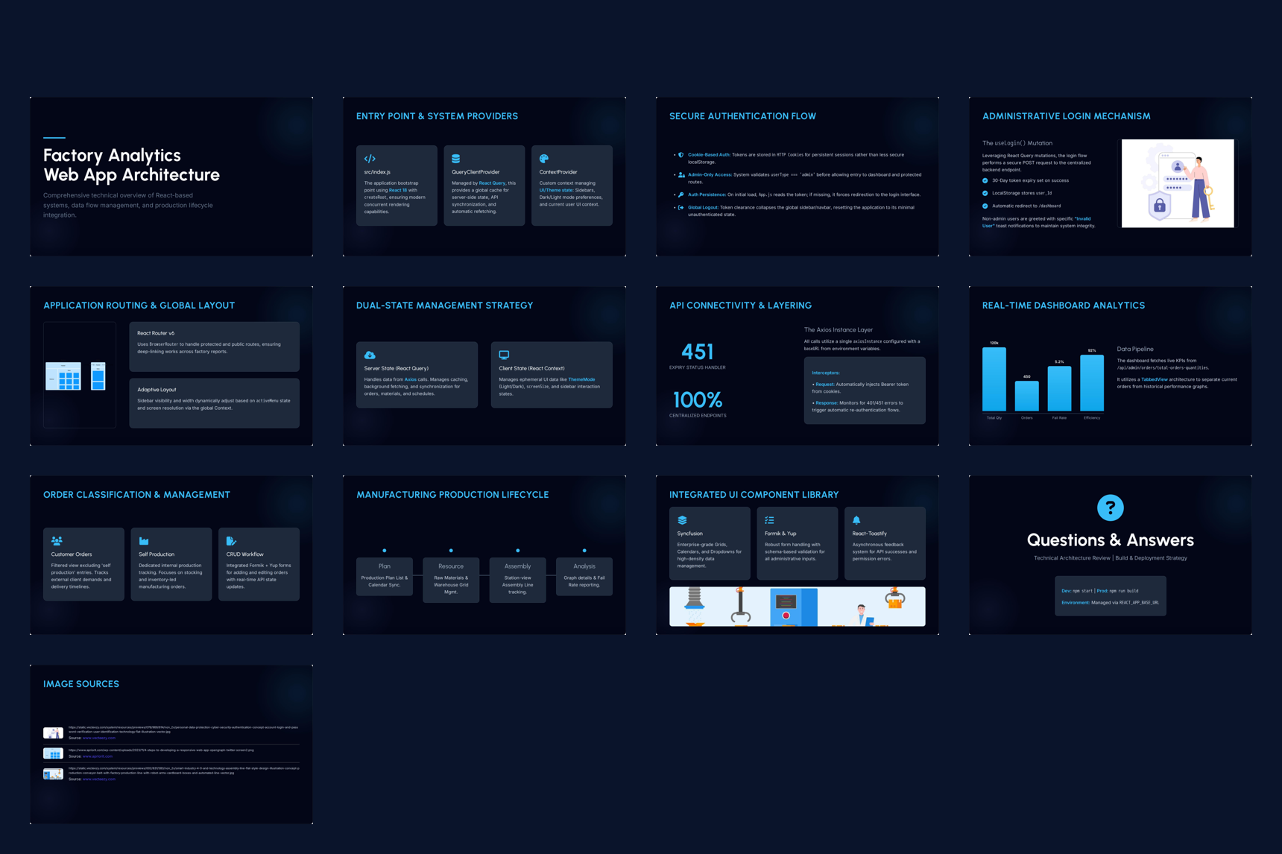
Technical Appendix Snapshot
Factory Analytics Web App Architecture (13 source slides)

Slide 17
Thank You
Factory Analytics | Investor Discussion
Factory Analytics is built to convert shop-floor data into repeatable operational gains.
The product architecture is deployment-ready, scalable, and role-anchored.
Next step: align on pilot scope, target outcomes, and expansion milestones.

