Slide 1



Slide 1
DSC530 Data Exploration and Analysis
Customer Churn Prediction
Sathish Manthani | email: smanthani@my365.bellevue.edu

Slide 2
Introduction
Customers are the most valuable assets of any business.
Retaining customers is one of the basic needs of the organizations regardless of the industry.
So, I would be performing exploratory data analysis on the bank customer dataset to identify customers who are about to churn. These kind of predictive analytics would help Finance managers identify the existing issues of such customers and target them for possible promotions to increase the chances of retention.

Slide 3
Questions
What variables help in predicting the customer attrition
What are the top customers that are about to churn
Do Female customers churn more than the Male customers?

Slide 4
Dataset used
Kaggle - Bank Churn Modeling
https://www.kaggle.com/barelydedicated/bank-customer-churn-modeling

Slide 5
Variables in the dataset
Variable Name | Variable Description
CustomerId | Customer Identification number
Surname | Surname of the customer
CreditScore | Credit score of the customer
Geography | Country name where the belongs to
Gender | Gender of the customer. Possible values are Male or Female
Age | Age of the customer
Tenure | Tenure of the customer with the bank
Balance | Account balance of the customer
NumOfProducts | Number of products that the customer owns
HasCrCard | Indicator if the customer also has a credit card product with the bank.
IsActiveMember | Indicator if the customer is in force with the bank
EstimatedSalary | Estimated salary of the customer
Exited | Indicator if the customer exited (attrited) from the bank

Slide 6
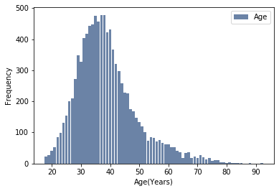
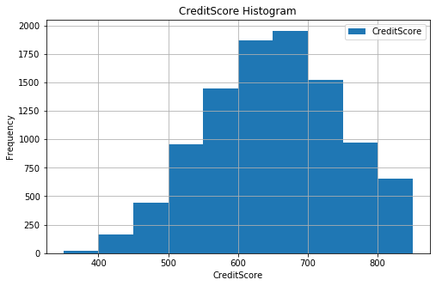
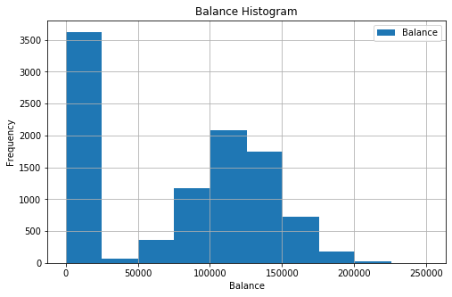
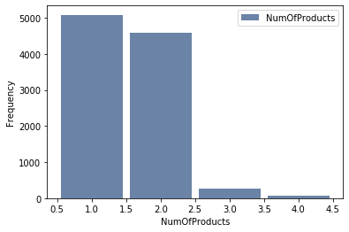
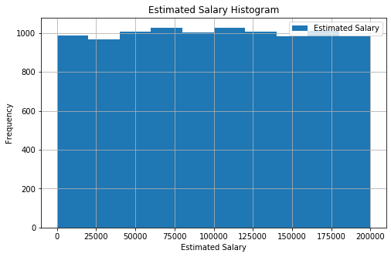
E
Histograms of the variables

Slide 7
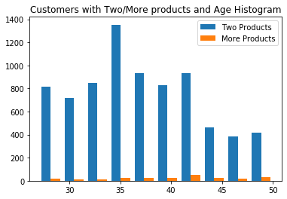
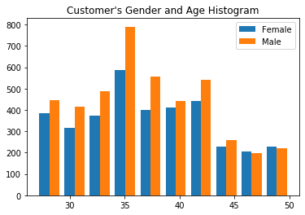
E
Probability Mass Function(PMF)

Slide 8
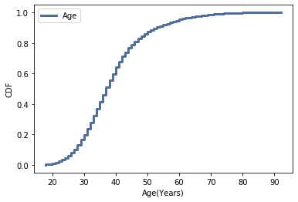
E
Cumulative Distribution Functn(CDF)
From the CDF plot, I can see the Median age (at CDF=0.5) is 37-38 years.

Slide 9
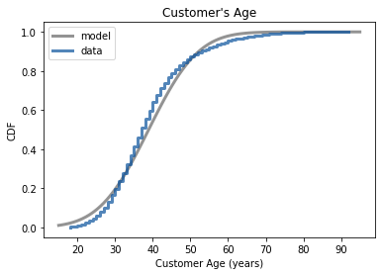
E
Model Vs Actual CDF Curve
Its clear that Age is a pretty good fit. Although there is a slight variation in the data compared to model, the model explains the data very well.

Slide 10
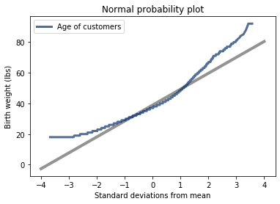
E
Normal Probability Plot
We can see that Age variable deviates from the model at the start and towards end.
That means Age is normally distributed for the most part except for young and older customers.

Slide 11
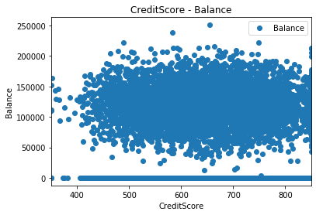
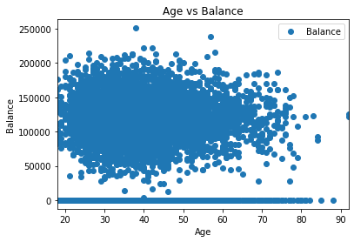
Scatter Plots

Slide 12
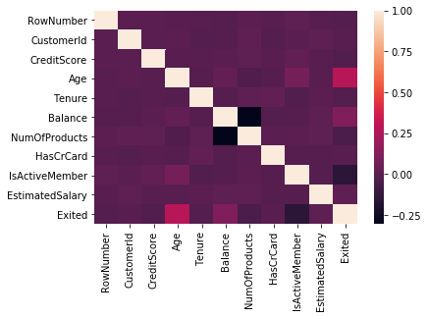
Correlation
Age and Balance variables are linearly related to Customer's exit status.
Relationship with other variables is very weak. It's important to remember, correlation doesn't mean causation.

Slide 13
Null Hypothesis Testing
I took following question for Null Hypothesis Testing:
Do Female customers churn more than the Male customers?
In order to prove that point, my Null Hypothesis test would be:
Customers of any gender churn equally**.
Alternate hypothesis test would be
Female customers churn differently than the Male customers

Slide 14
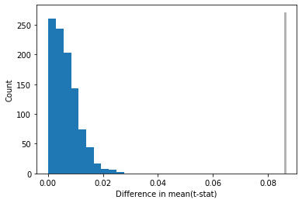
Null Hypothesis Testing
Distribution of Test Statistics Distribution past the actual value doesn’t exist, so that means null hypothesis is not true.
p-value is basically probability that the test statistic under the null hypothesis exceeds the actual value.
Since the p-value is less than 1%, the null hypothesis is rejected.
Our initial assumption of Female customers exited more than Male customers is true and is not by chance.

Slide 15
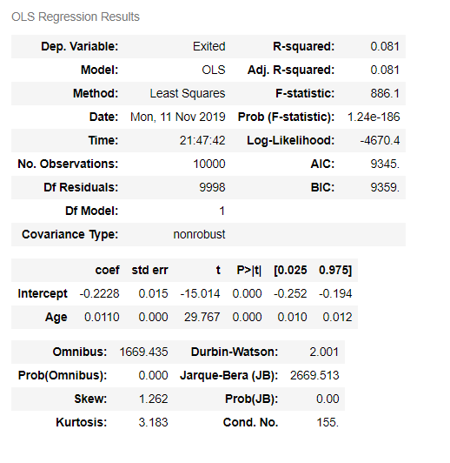
Linear Regression
Linear model for Exited ~ Age
From the summary of the model, we can understand a few things:
1. Intercept of the line is -0.2228
2. Slope of the line is 0.0110 and its p-value is 0 which means it is statistically significant.
3. R-squared value is 0.081. That means the this linear regression model can only explain 8.1% of the variation in the
data. 8.1% is not a lot of predictive power. The greater the R2, the better predictive power of the model would
be.

Slide 16
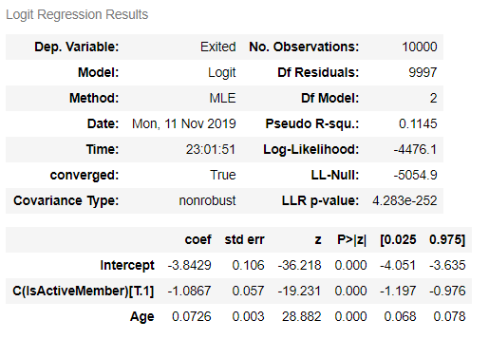
Logistic Regression
Linear model for Exited ~ Age + C(IsActiveMember)
Interpretation:
1. Age and IsActiveMember variables are statistically significant since their p value is 0.
2. Coefficient of Age variable is 0.0726 which means for every year increase in Age ,controlling for IsActiveMember, Exit value's log odds would increase by 7.26%.
3. Coefficient of IsActiveMember variable is -1.0867 which means for every True value in isActiveMember, controlling for Age, Exit value's log odds go down by 108%.
3. R-squared value is 0.1145 that means the model can only explain 11.45% of the overall variance of the data. That's not a lot of predictive power.

Slide 17
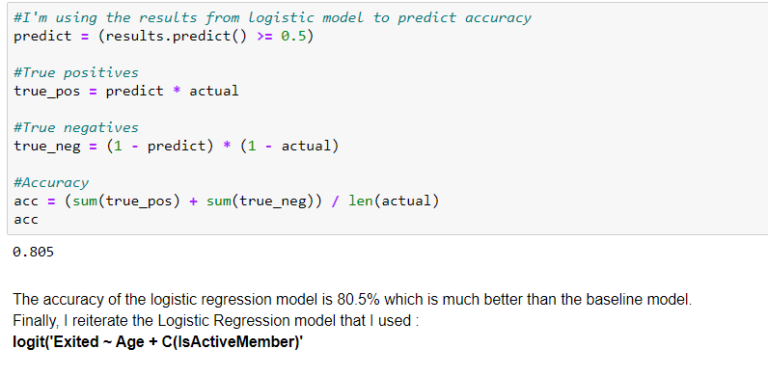
Logistic Regression - Accuracy

Slide 18

Slide 11
THANK YOU

