Slide 1
Energy Crisis
-Biofuel & Nanotechnology
Webb Wu

Slide 2
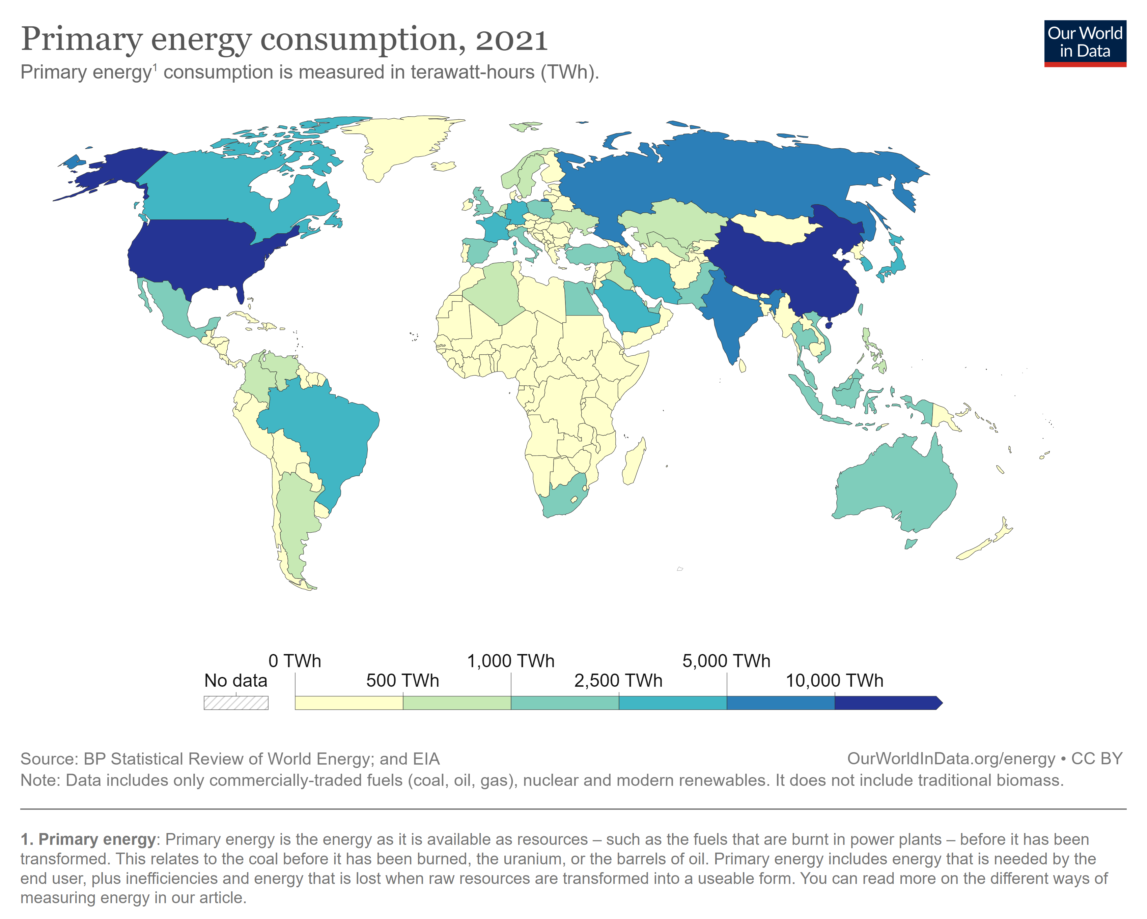

Slide 3
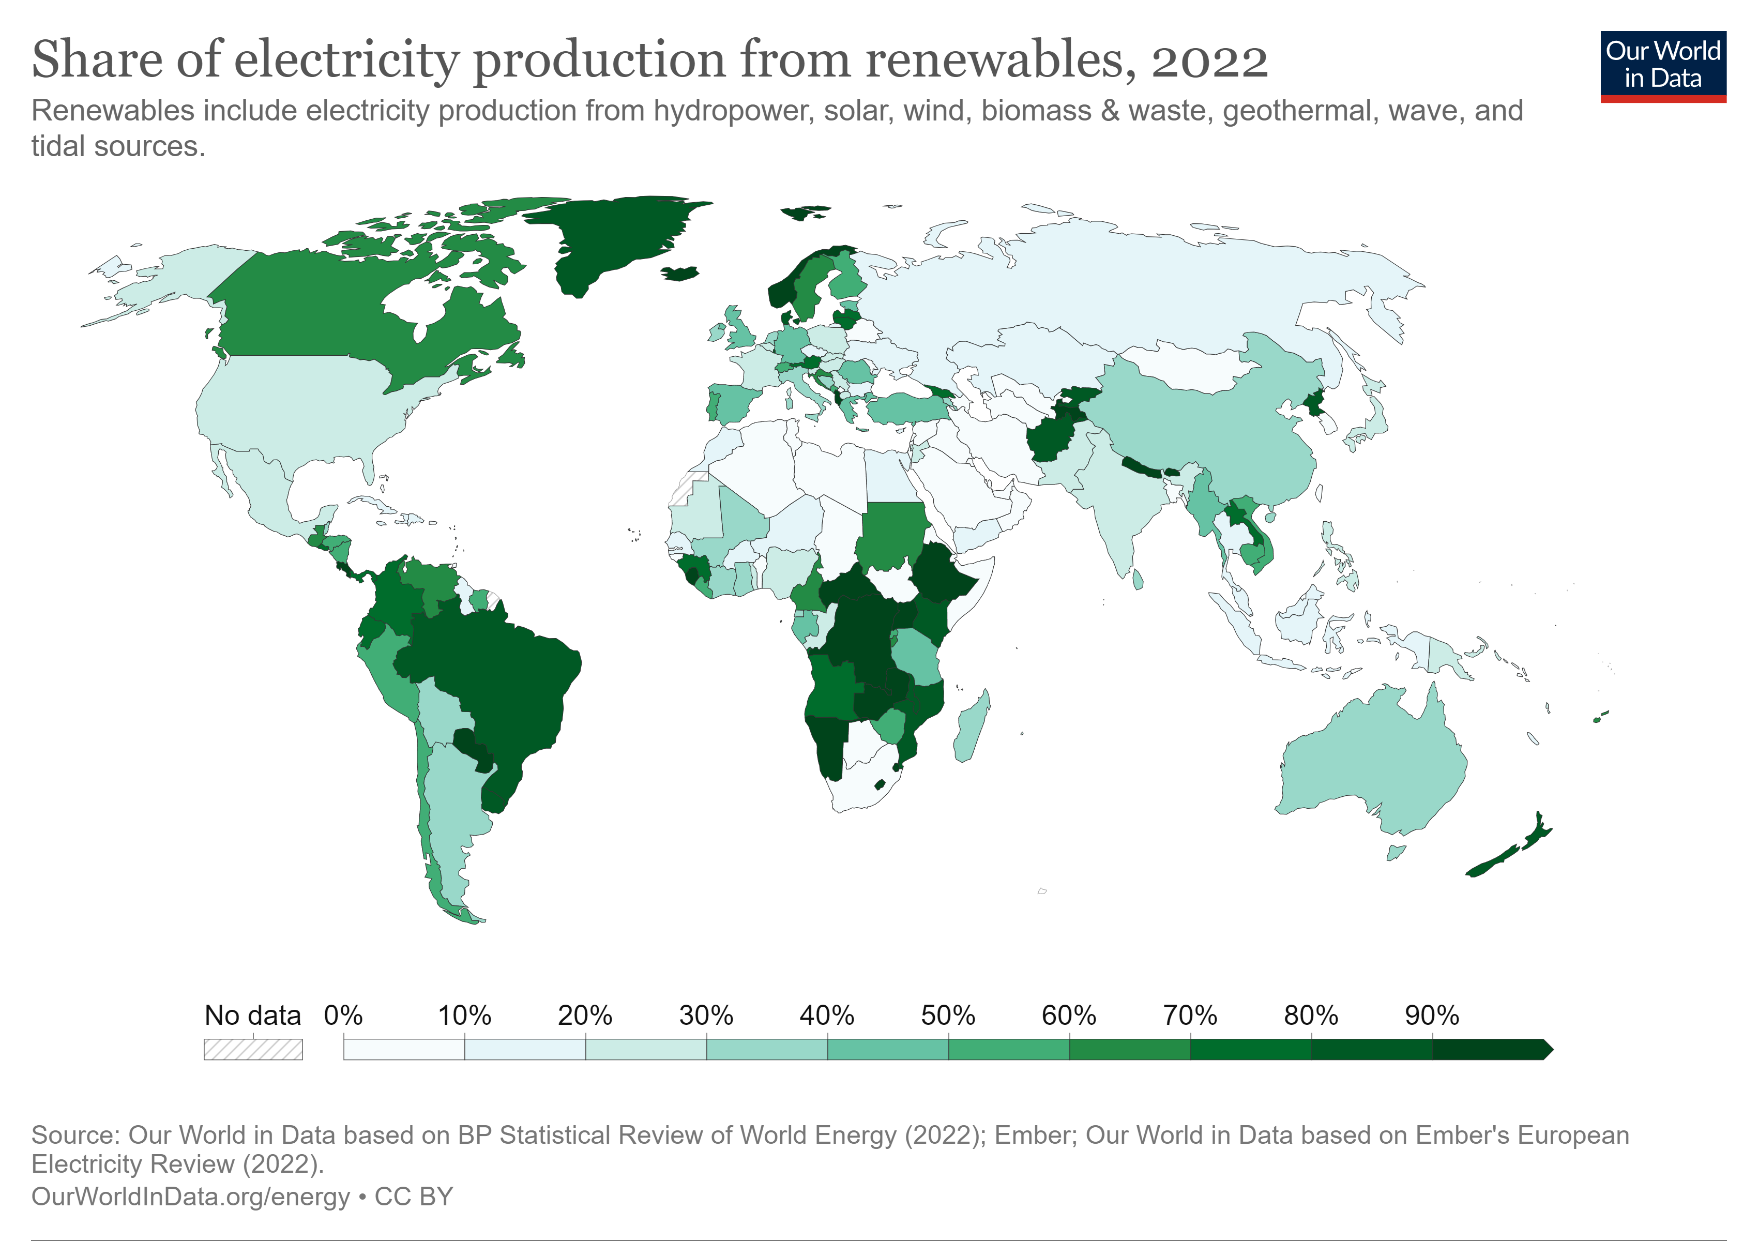
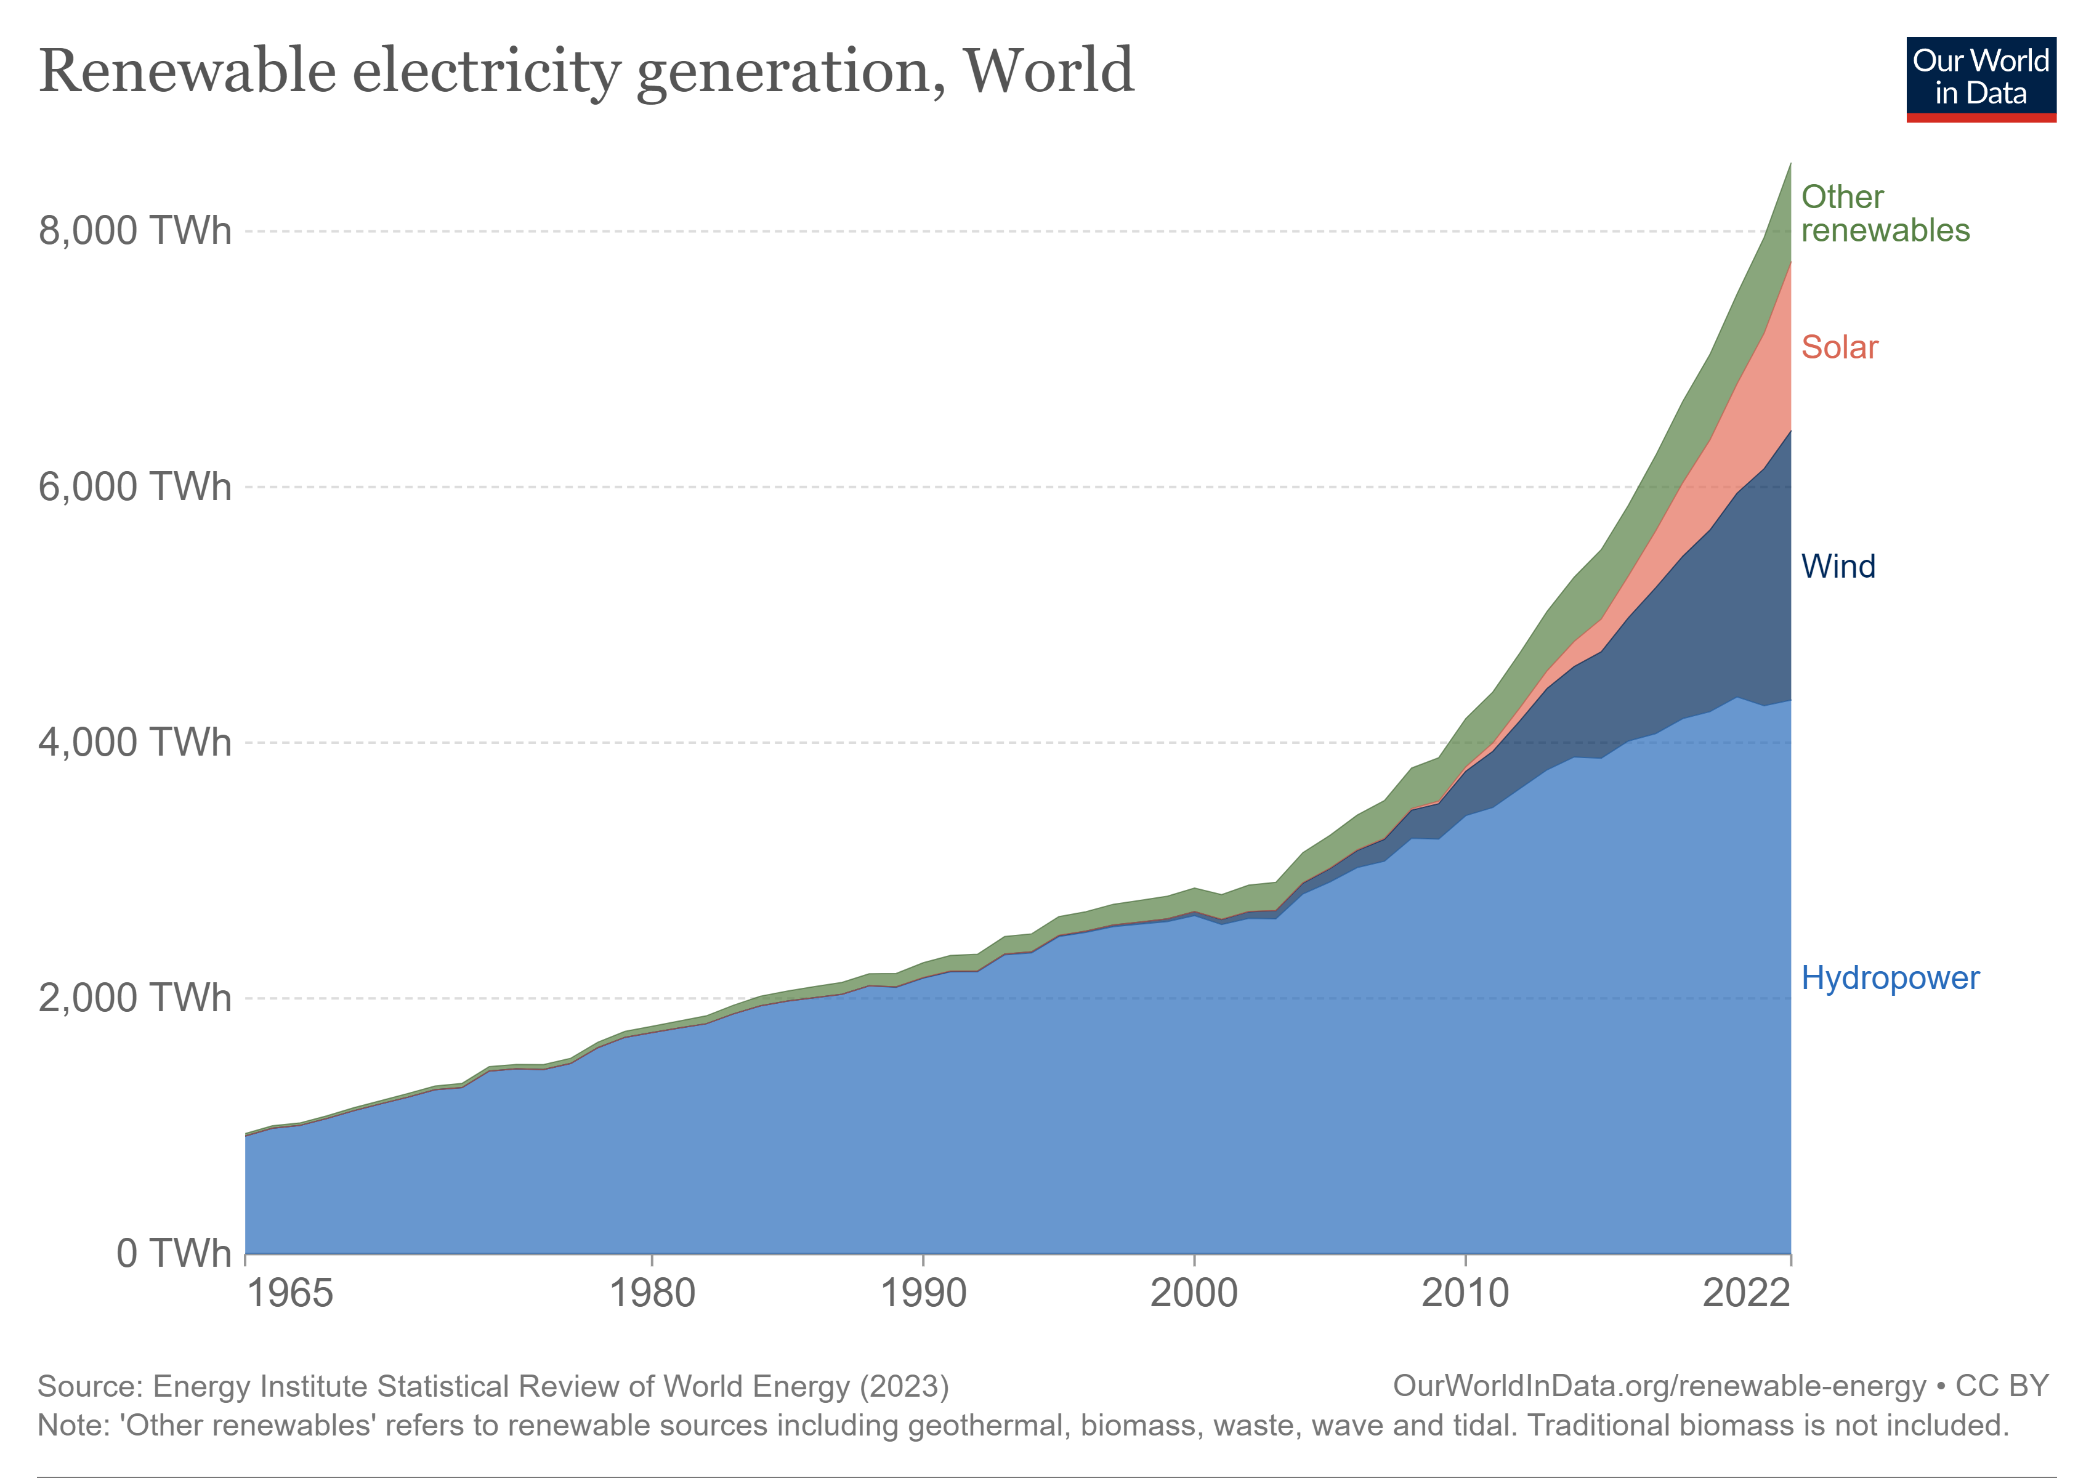

Slide 4
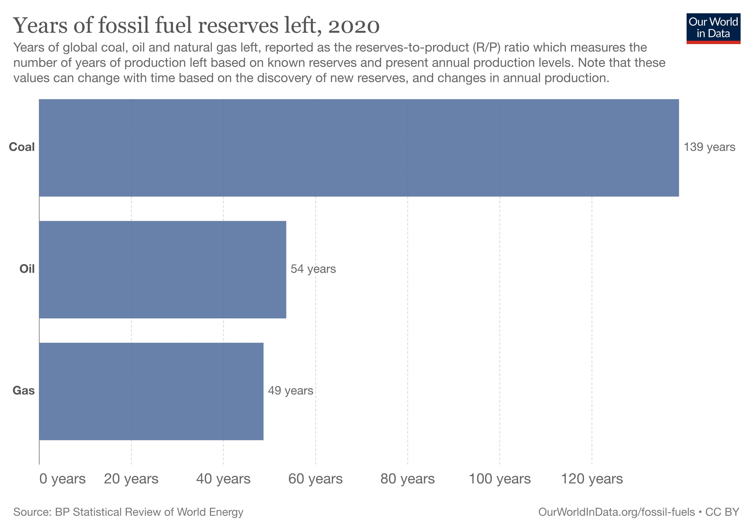

Slide 5


Slide 6

Biofuel Explained
From organic matter, such as plants, crops, algae, and organic waste
Renewable and Sustainable

Slide 7
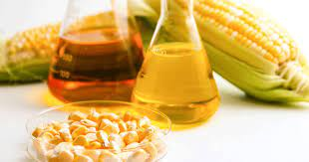
Example: Bioethanol
C6H12O6 → 2 C2H5OH + 2 CO
6CO2 + 6H2 O + sunlight → C6 H12 O6 + 6O2
E10 Petrol is widely used

Slide 8
Nanotechnology in Biofuel
Catalysts and Process Enhancements
Enzyme Immobilization
Nanostructured Materials for Fuel Storage
Nanosensors for Quality Control
Combustion Enhancements
Engine Coatings and Lubricants
Pollution Control

Slide 9
Experiment Materials
Different biofuels (e.g., biodiesel, bioethanol)
Various nanomaterials (e.g., metal nanoparticles, metal oxides)
Combustion chamber (compatible with the experimental setup)
Measurement instruments (e.g., emissions analyzer, calorimeter)
Test fuels without nanomaterials for comparison

Slide 10
Key Takeaways
Biofuels are renewable, reduce carbon emissions, and enhance energy security.
Nanotechnology improves biofuel production processes and combustion efficiency.
Nanoparticles act as catalysts, enhance combustion, and reduce emissions.
Nanostructured coatings and filters enhance engine efficiency and pollution control.

Slide 11

Questions
Any Qs?

