Slide 1


Energy Crisis
Biofuel & Nanotechnology
Webb Wu
Tonbridge School, UK
28/07/2023

Slide 2
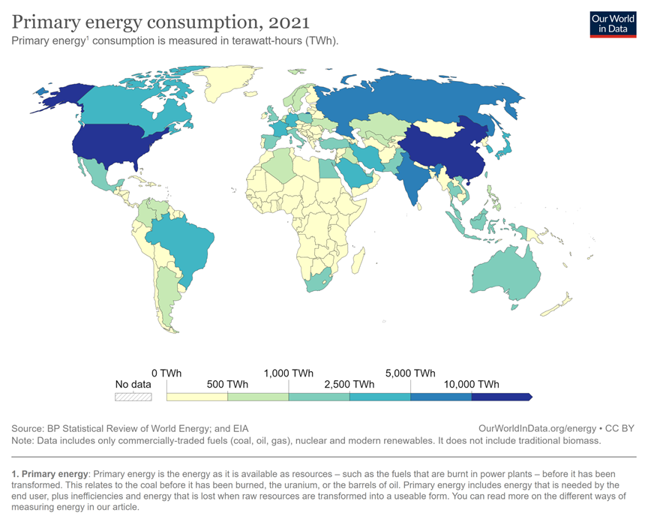

Slide 3
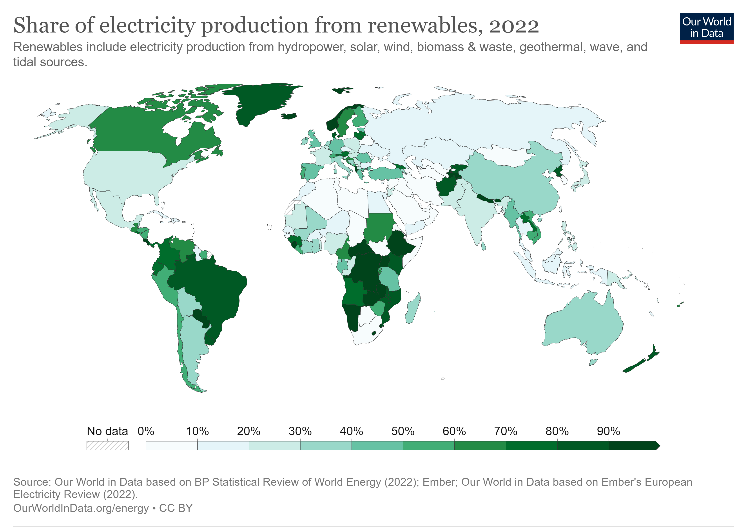
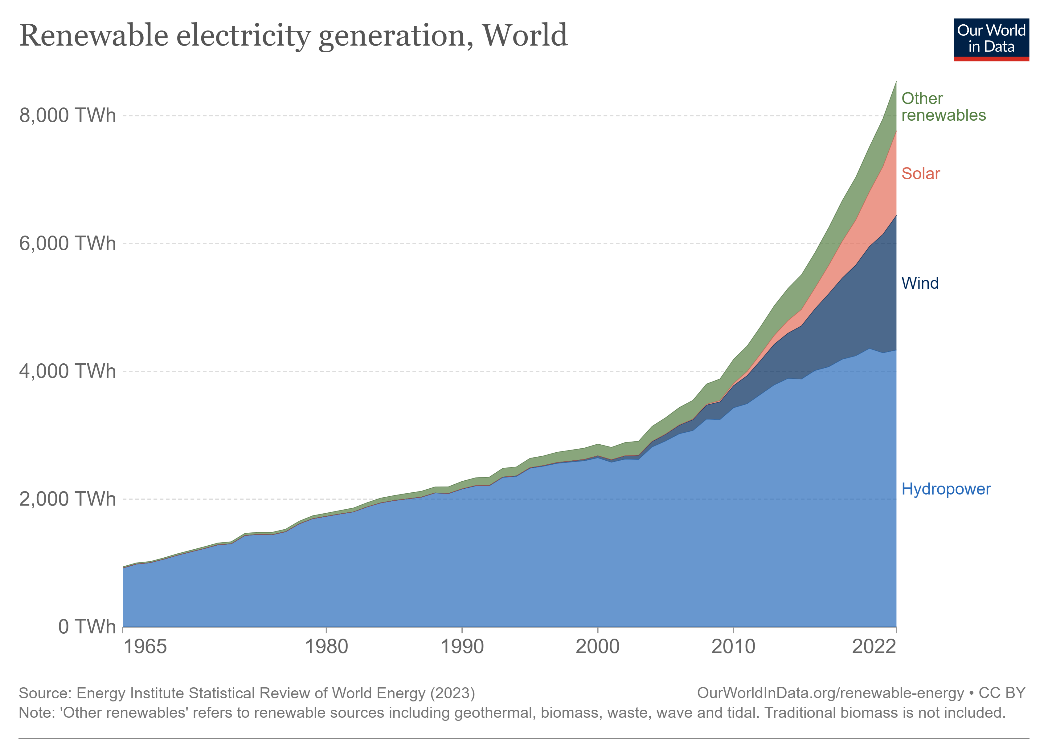

Slide 4
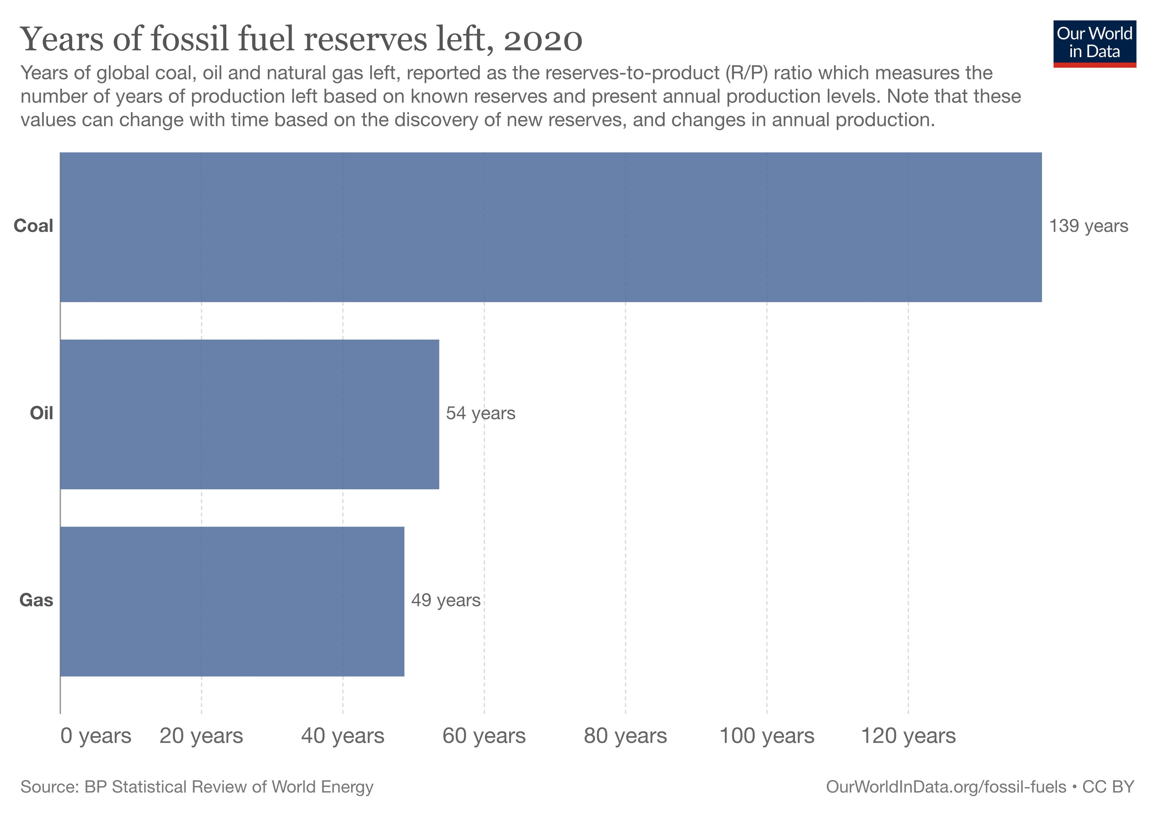

Slide 5
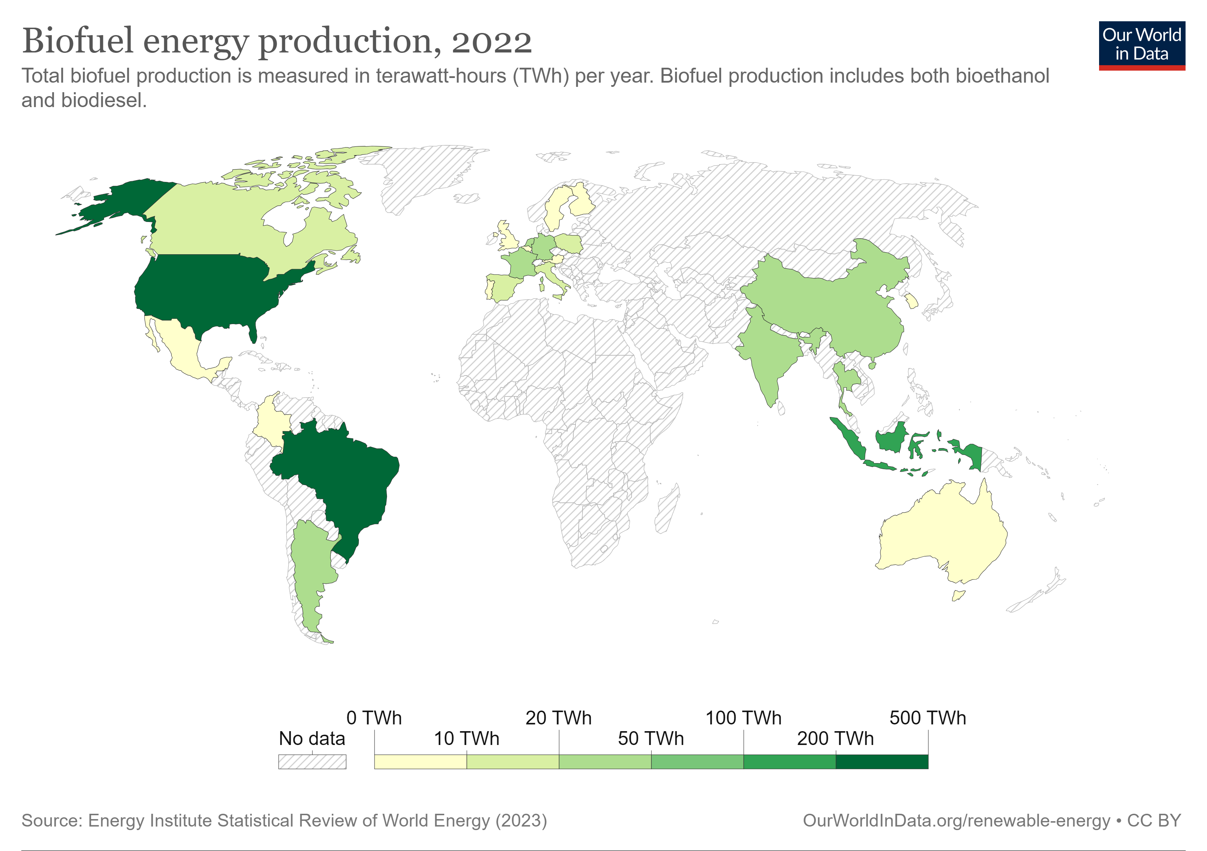

Slide 6
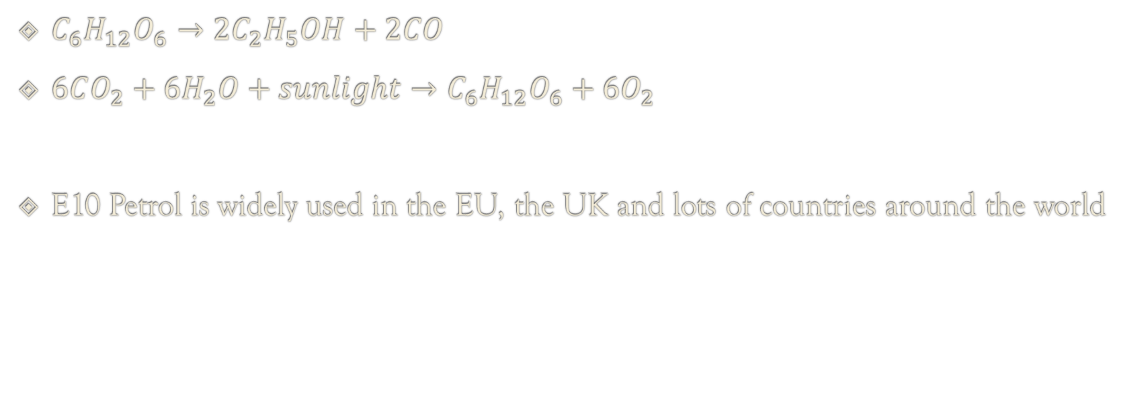
Biofuel Example: Bioethanol
$C_{6}H_{12}O_{6}→2C_{2}H_{5}OH+2CO$
$6CO_{2}+6H_{2}O+sunlight→C_{6}H_{12}O_{6}+6O_{2}$
E10 Petrol is widely used in the EU, the UK and lots of countries around the world

Slide 7
Biodiesel is produced in the United States and used in conventional diesel engines, directly substituting for or extending supplies of traditional petroleum diesel. Soybean biodiesel has a positive energy balance, meaning that soybean biodiesel yields 4.56 units of energy for every unit of fossil energy consumed over its life cycle.’ (US EPA)

Slide 8
Disadvantages of biofuel
Lower energy density than fossil fuels,
Require more fuel to produce the same amount of energy.
For example, ethanol has about two-thirds of the energy content of gasoline, and biodiesel has about 90% of the energy content of diesel.

Slide 9
Hypothesis & Title
Silver Nanoparticle (AgNPs) & Carbon Nanotubes (CNTs) improve the combustion efficiency ( energy output / time )
Test for improvements on rate of combustion of biofuel (vegetable oil) using silver nanoparticles (AgNPs) and carbon nanotubes (CNTs)

Slide 10
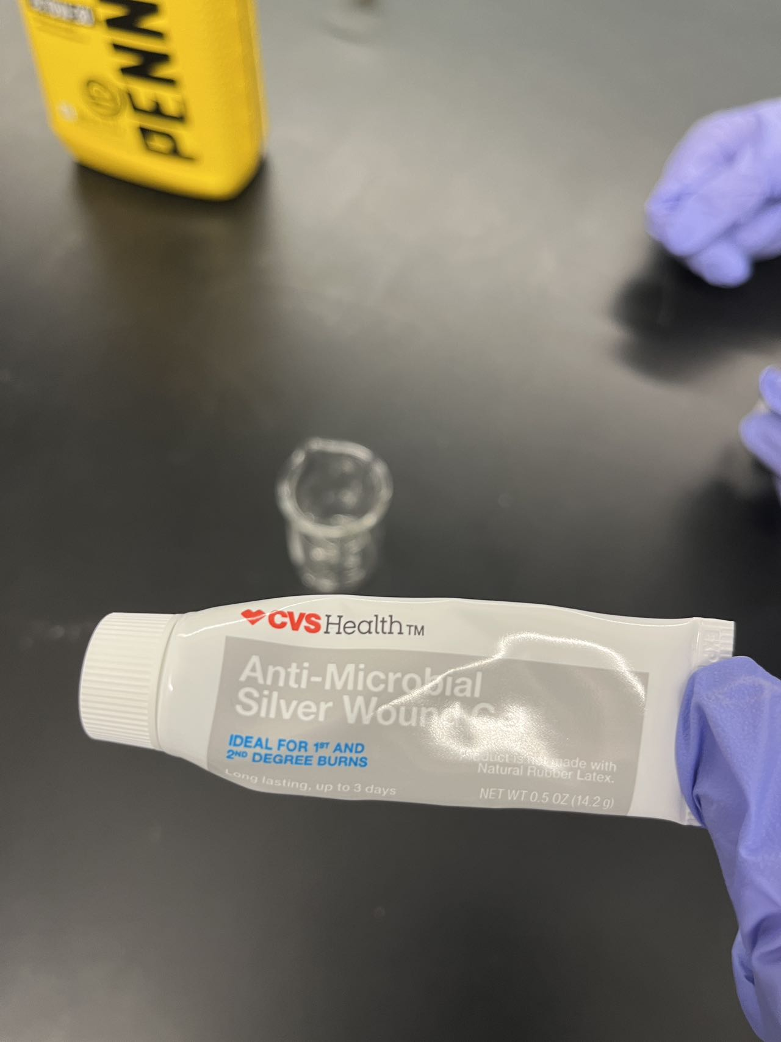
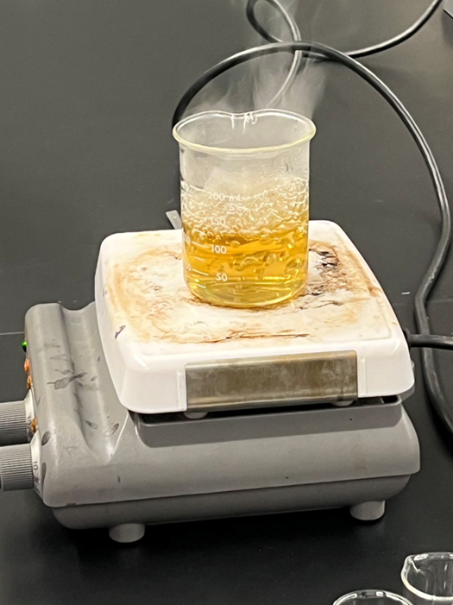

Experiment Procedures
Extracting Silver Nanoparticles from CVS wound gel

Slide 11
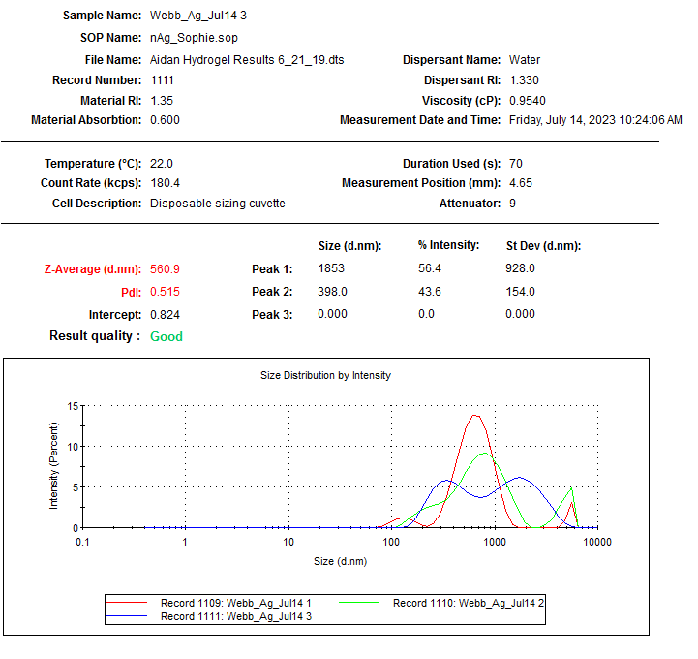
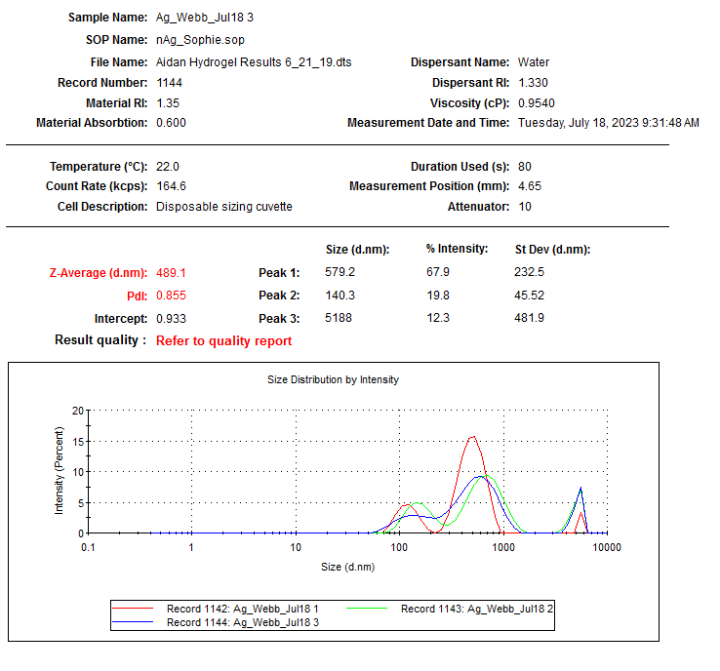

Slide 12
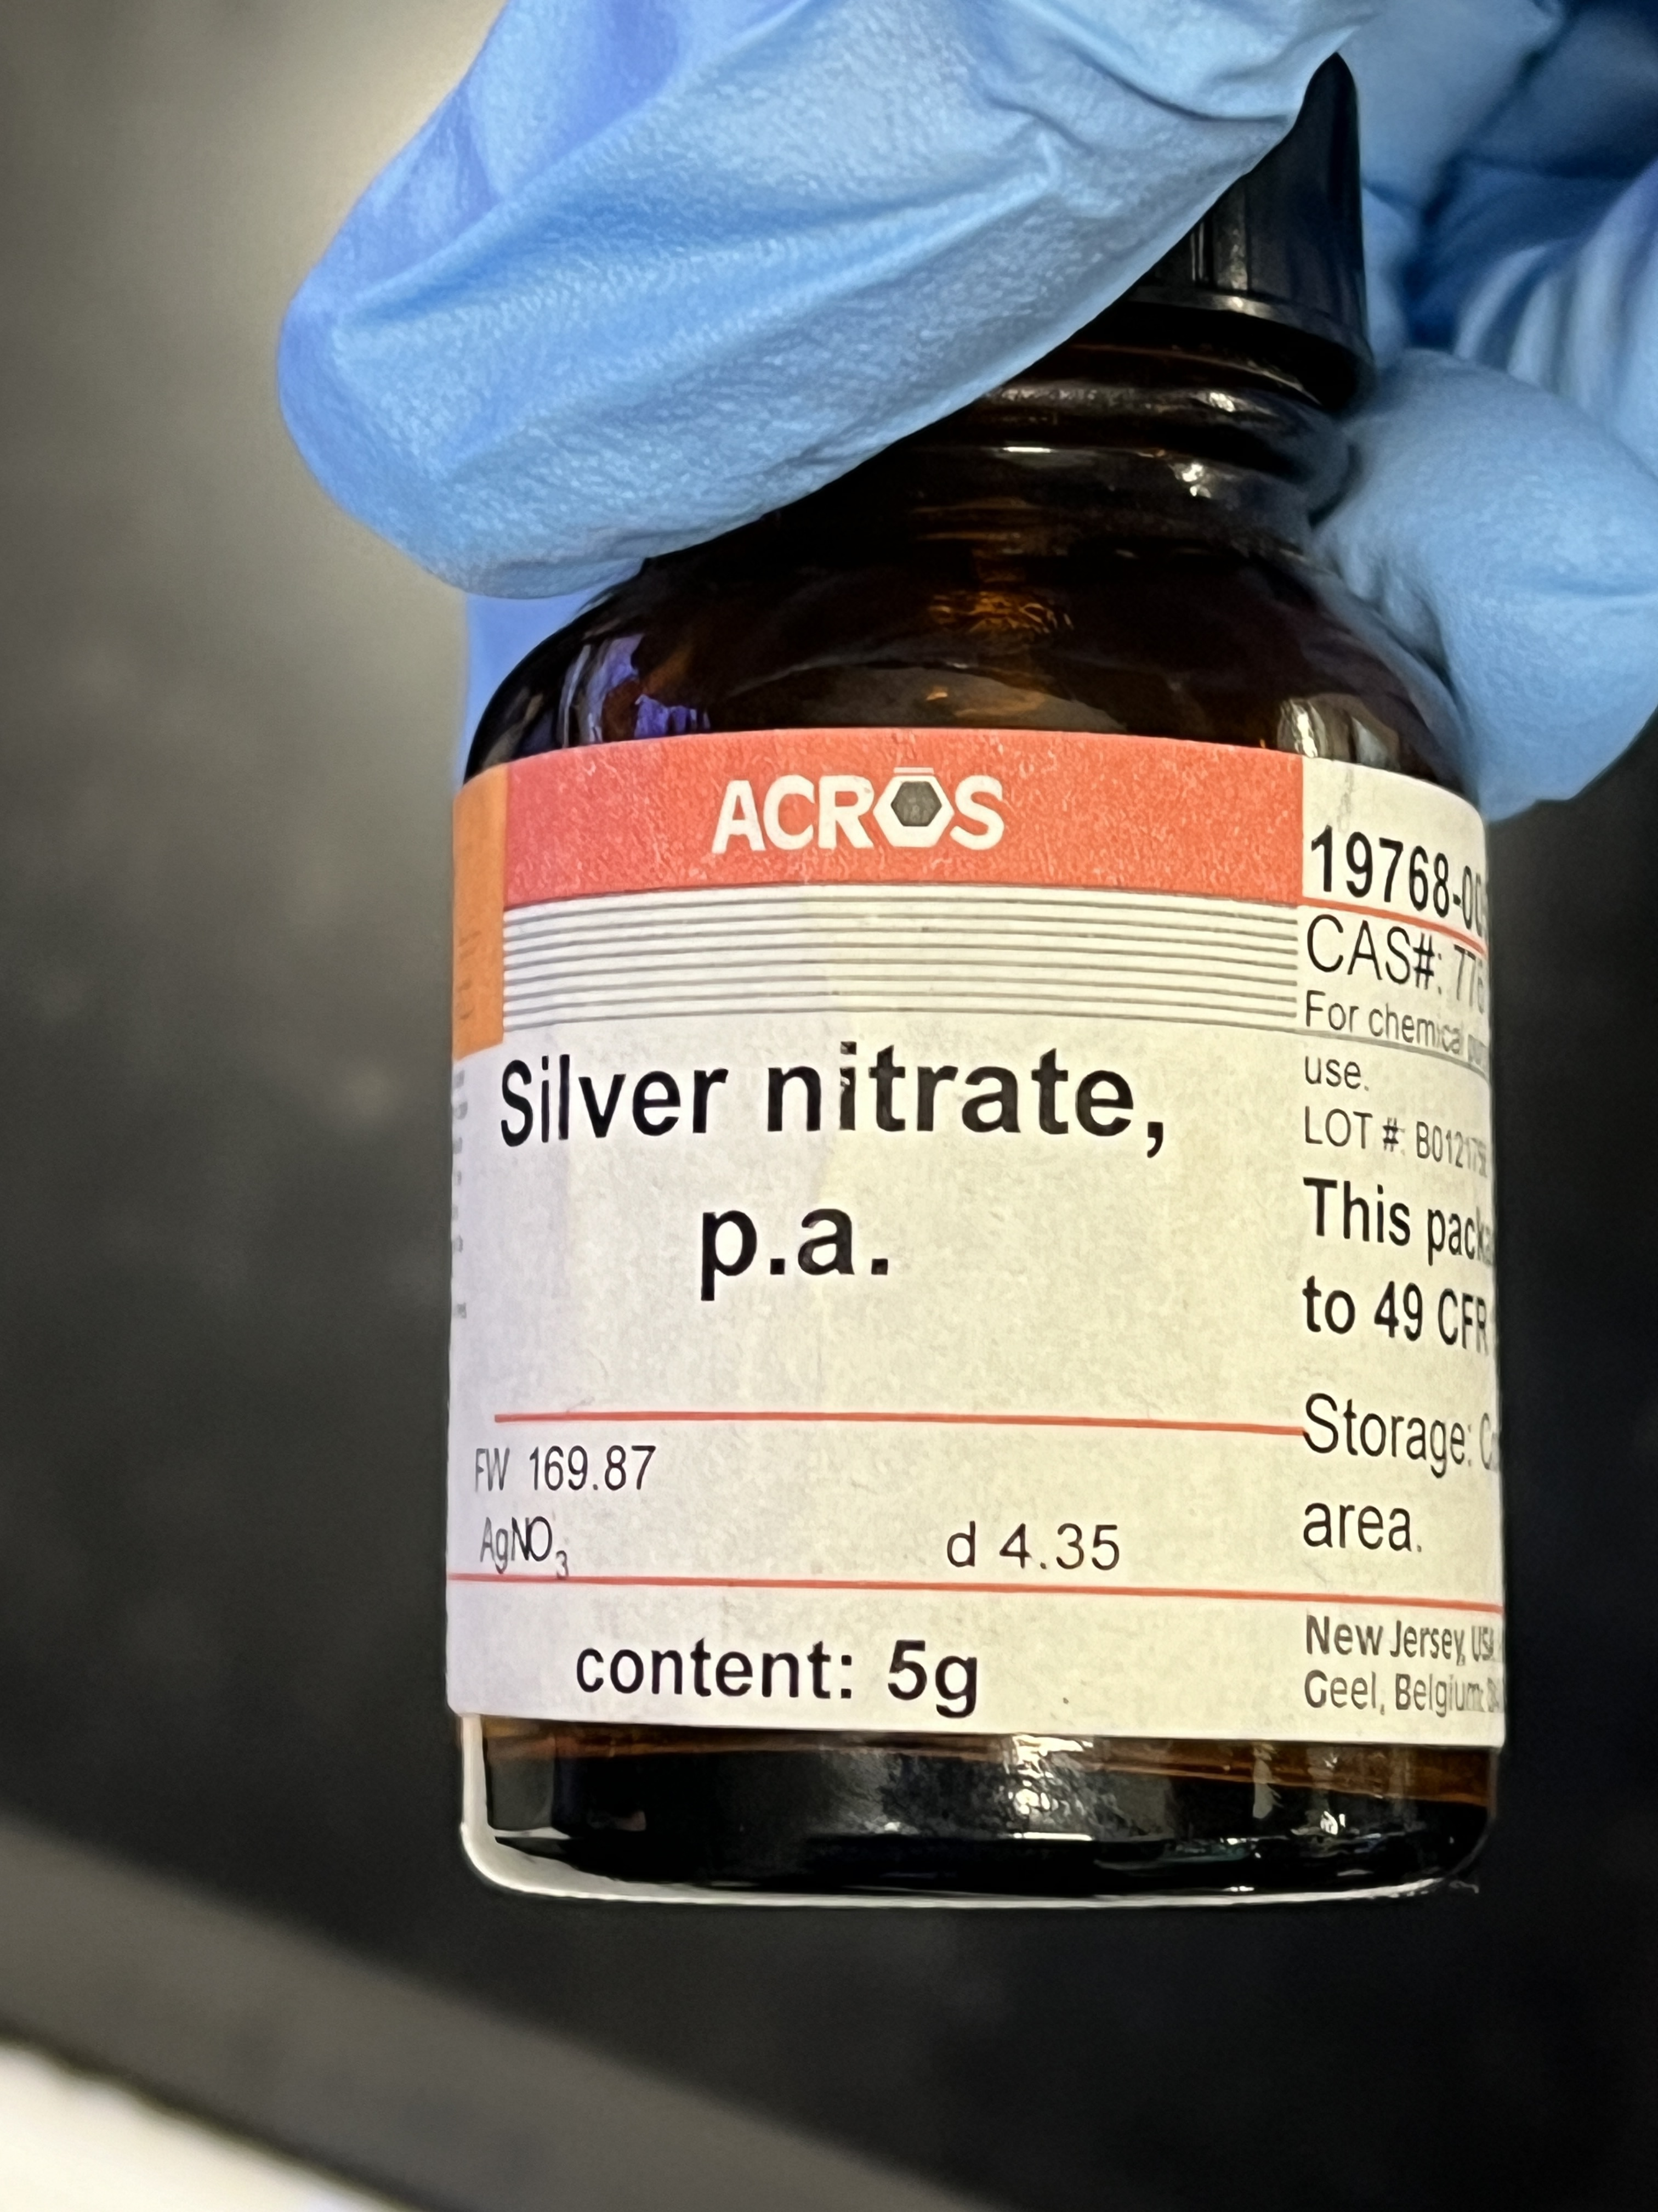
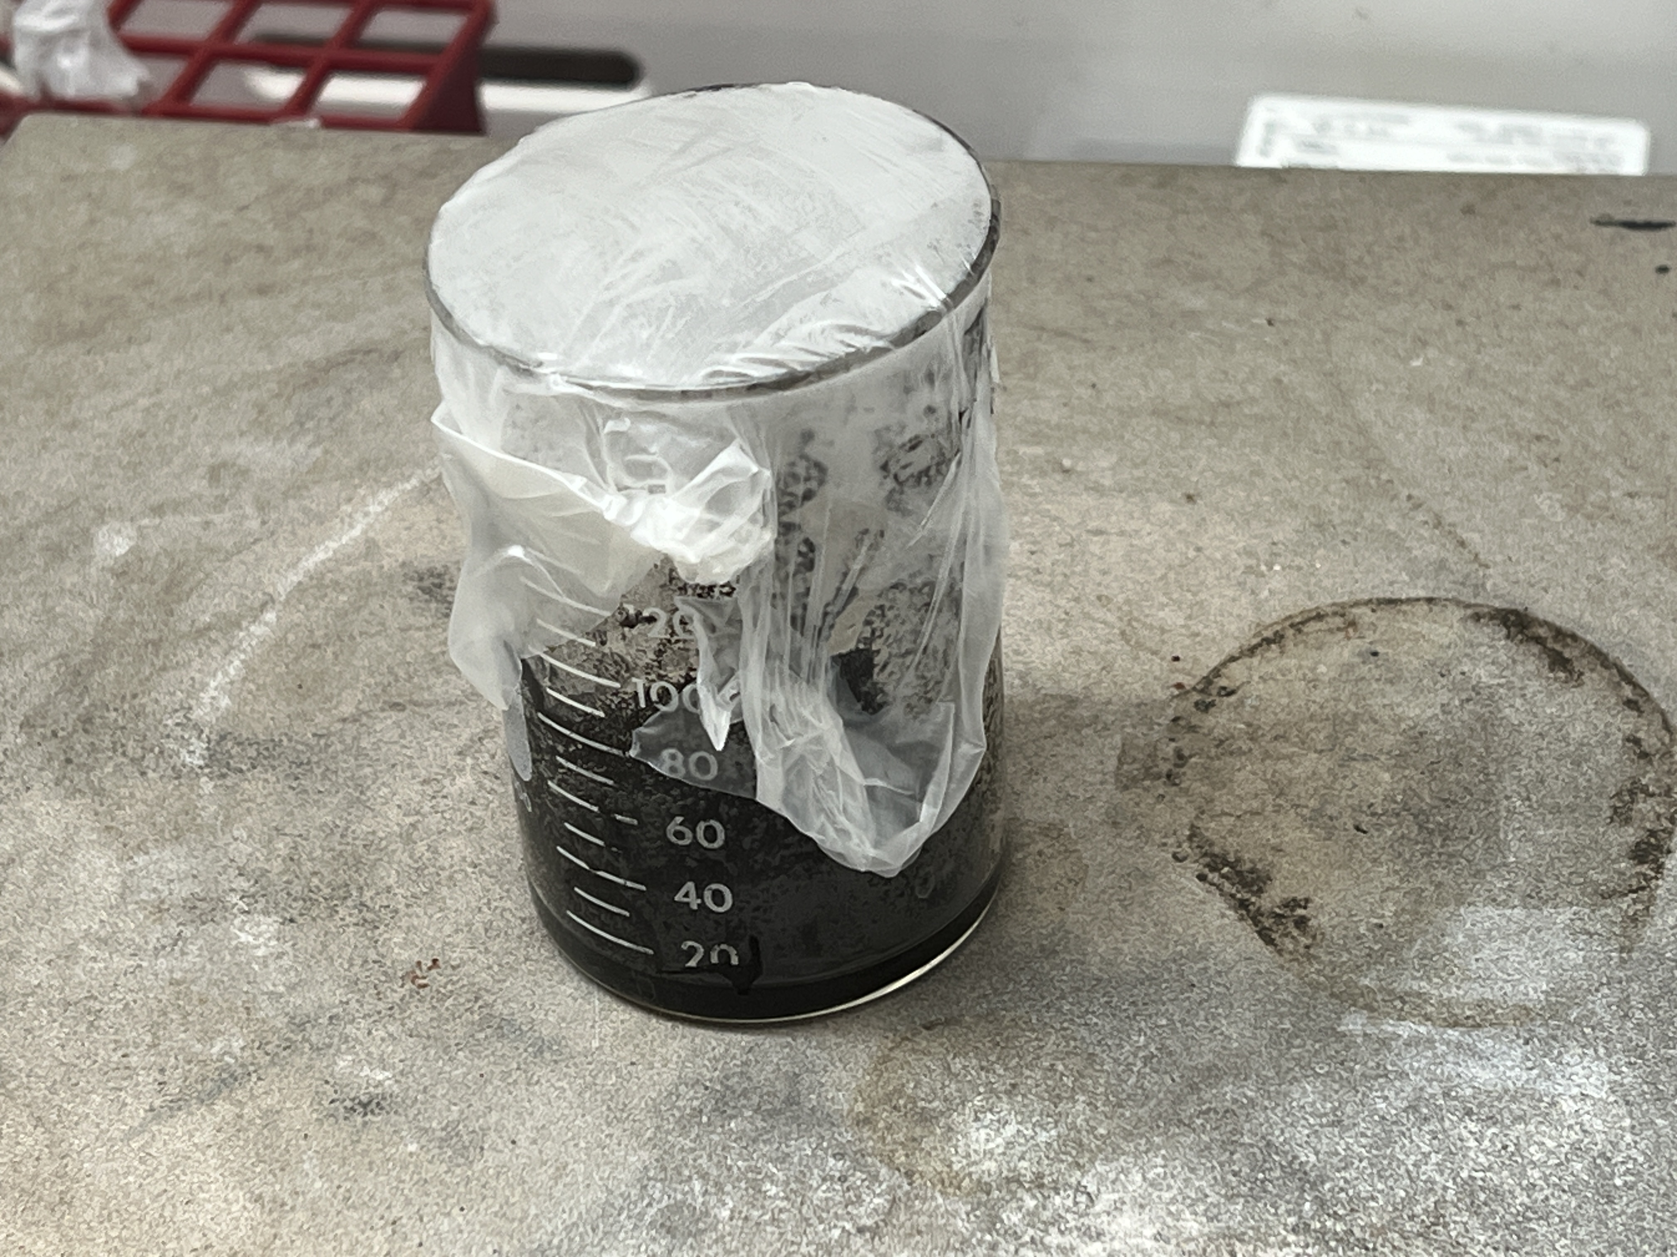
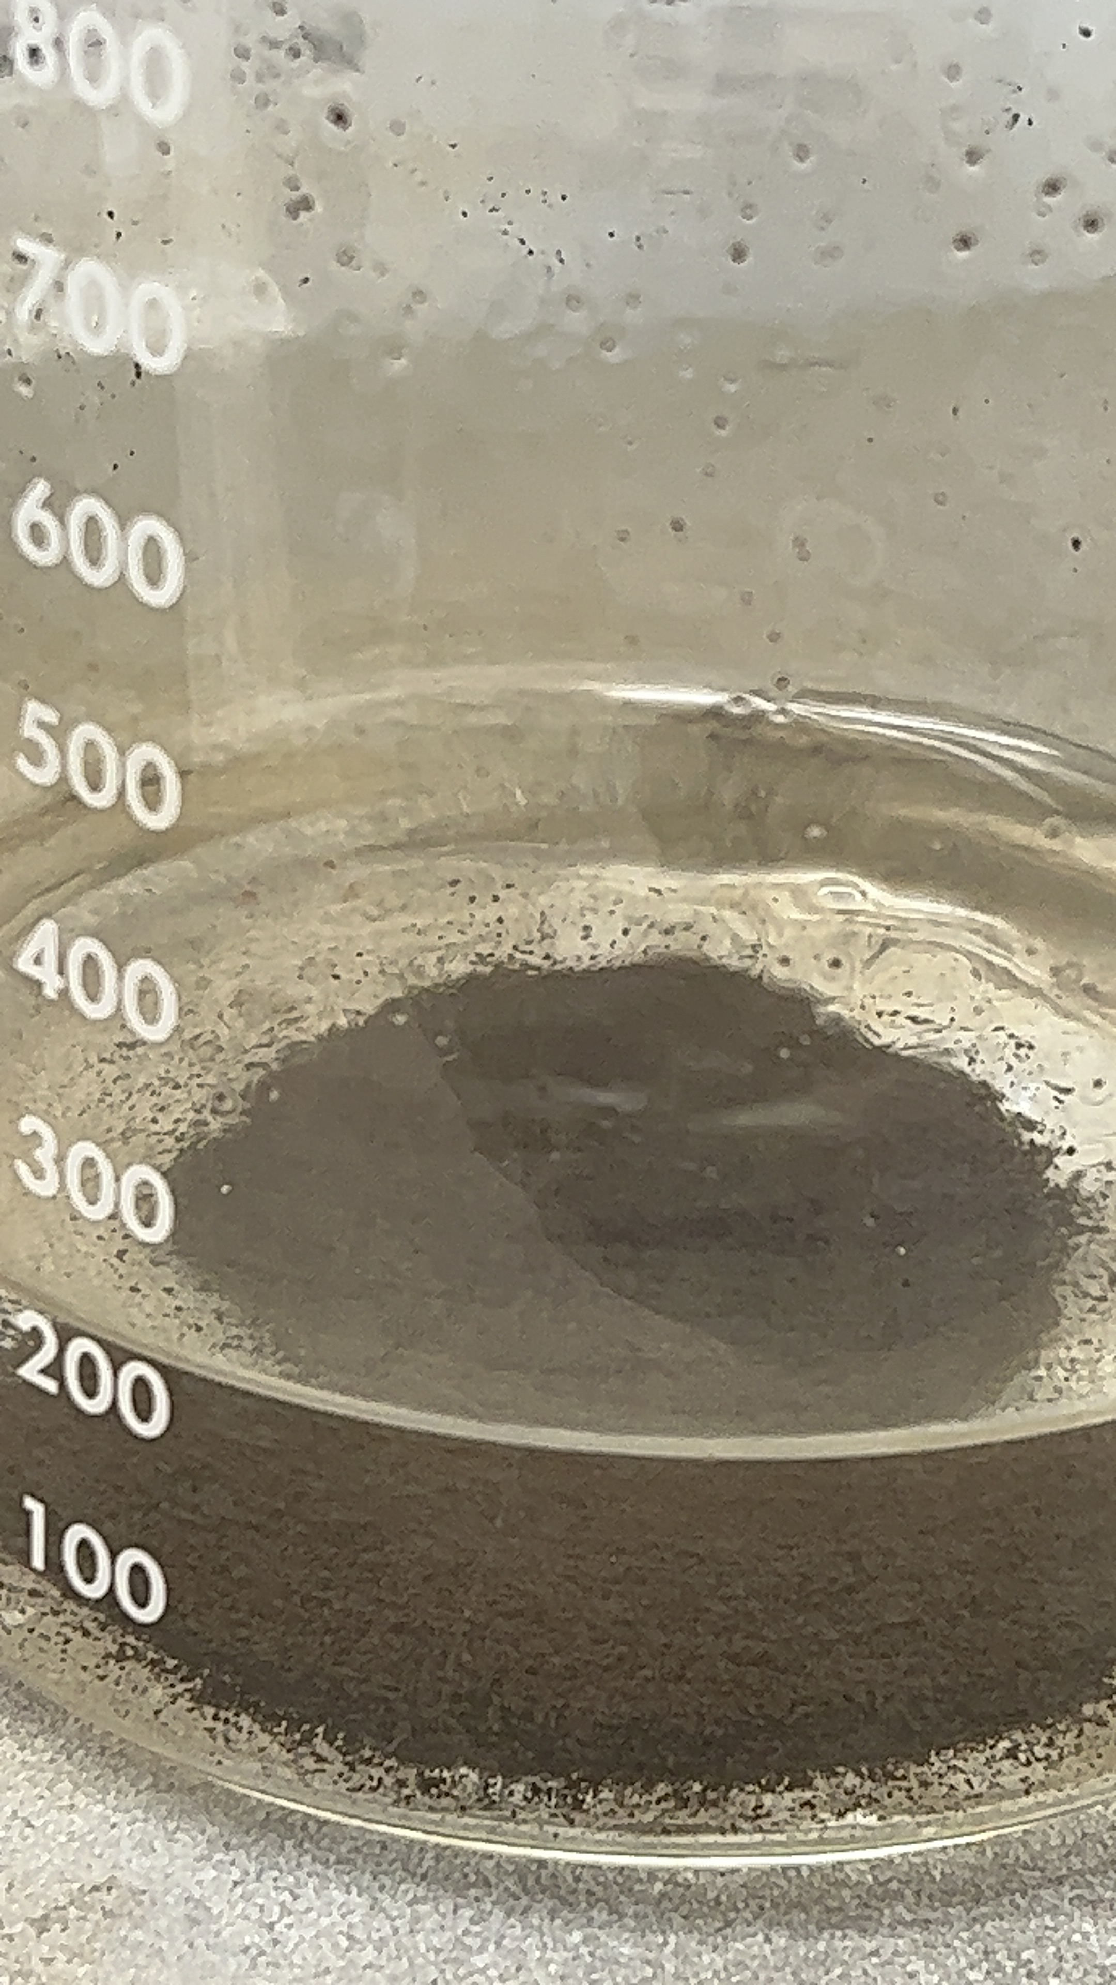
Experiment Procedures
Precipitation between silver nitrate and sodium hydroxide

Slide 13
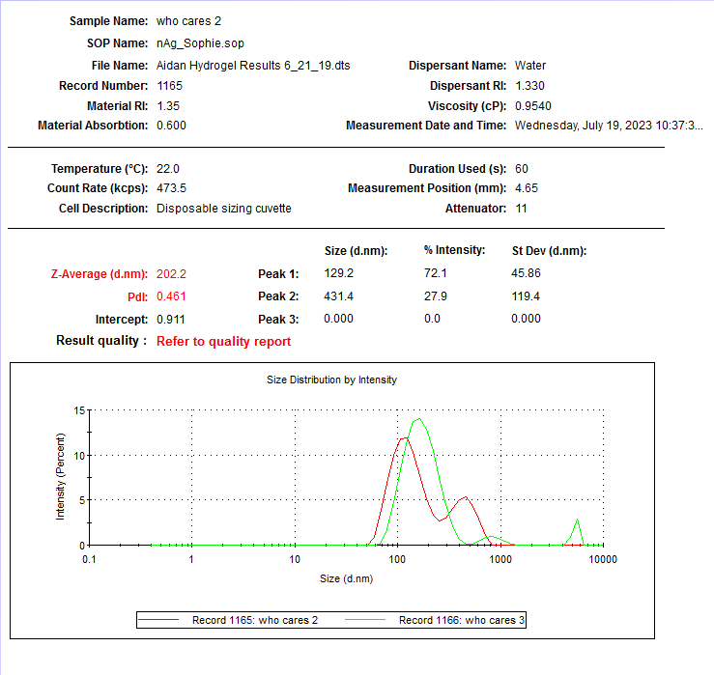
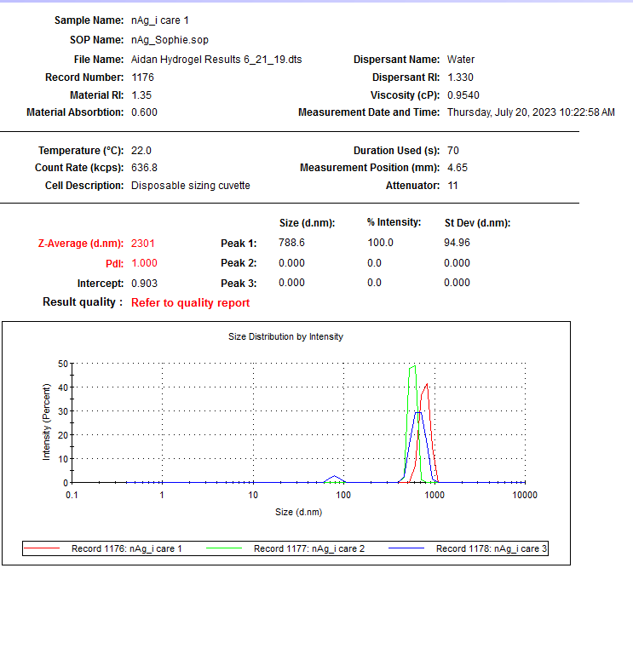

Slide 14
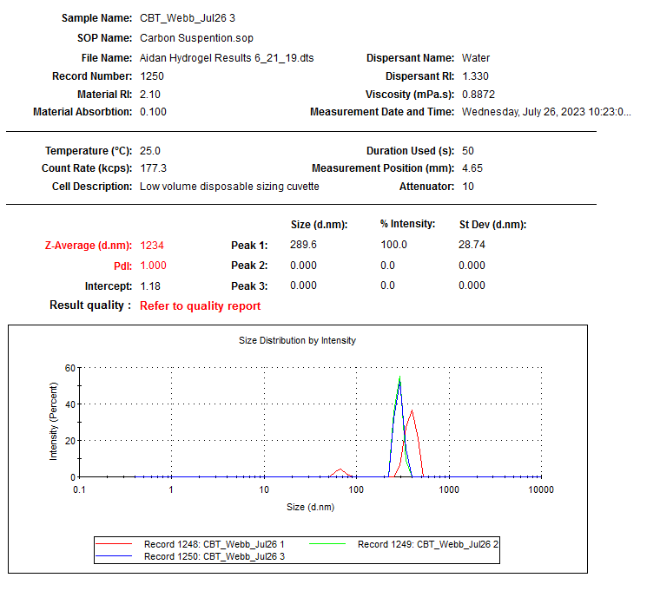
DLS Result of CNTs

Slide 15
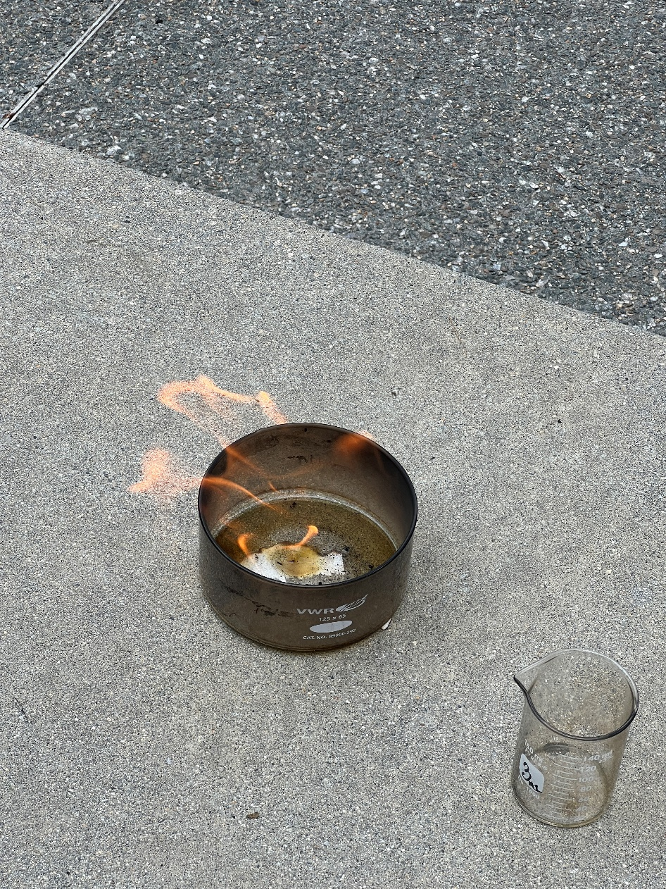
Combustion Experiment & Results
Control – 3’ 17’’
AgNPs – 2’ 44’’
CNTs – 2’ 28’’
16.8 % and 24.9 % rise in combustion efficiency is recorded for
AgNPs and CNTs, respectively.

Slide 16
Any Questions?

Slide 17
Acknowledgement
Sincere gratitude to:
Guidance, Feedback & Support
From Prof. T. Webster
Assistance & Encouragement
From Amanda Vera
And all my lab colleagues!

Slide 18
Thank you
&
Have a wonderful summer!

