Slide 1

Research update
Webb Wu

Slide 2
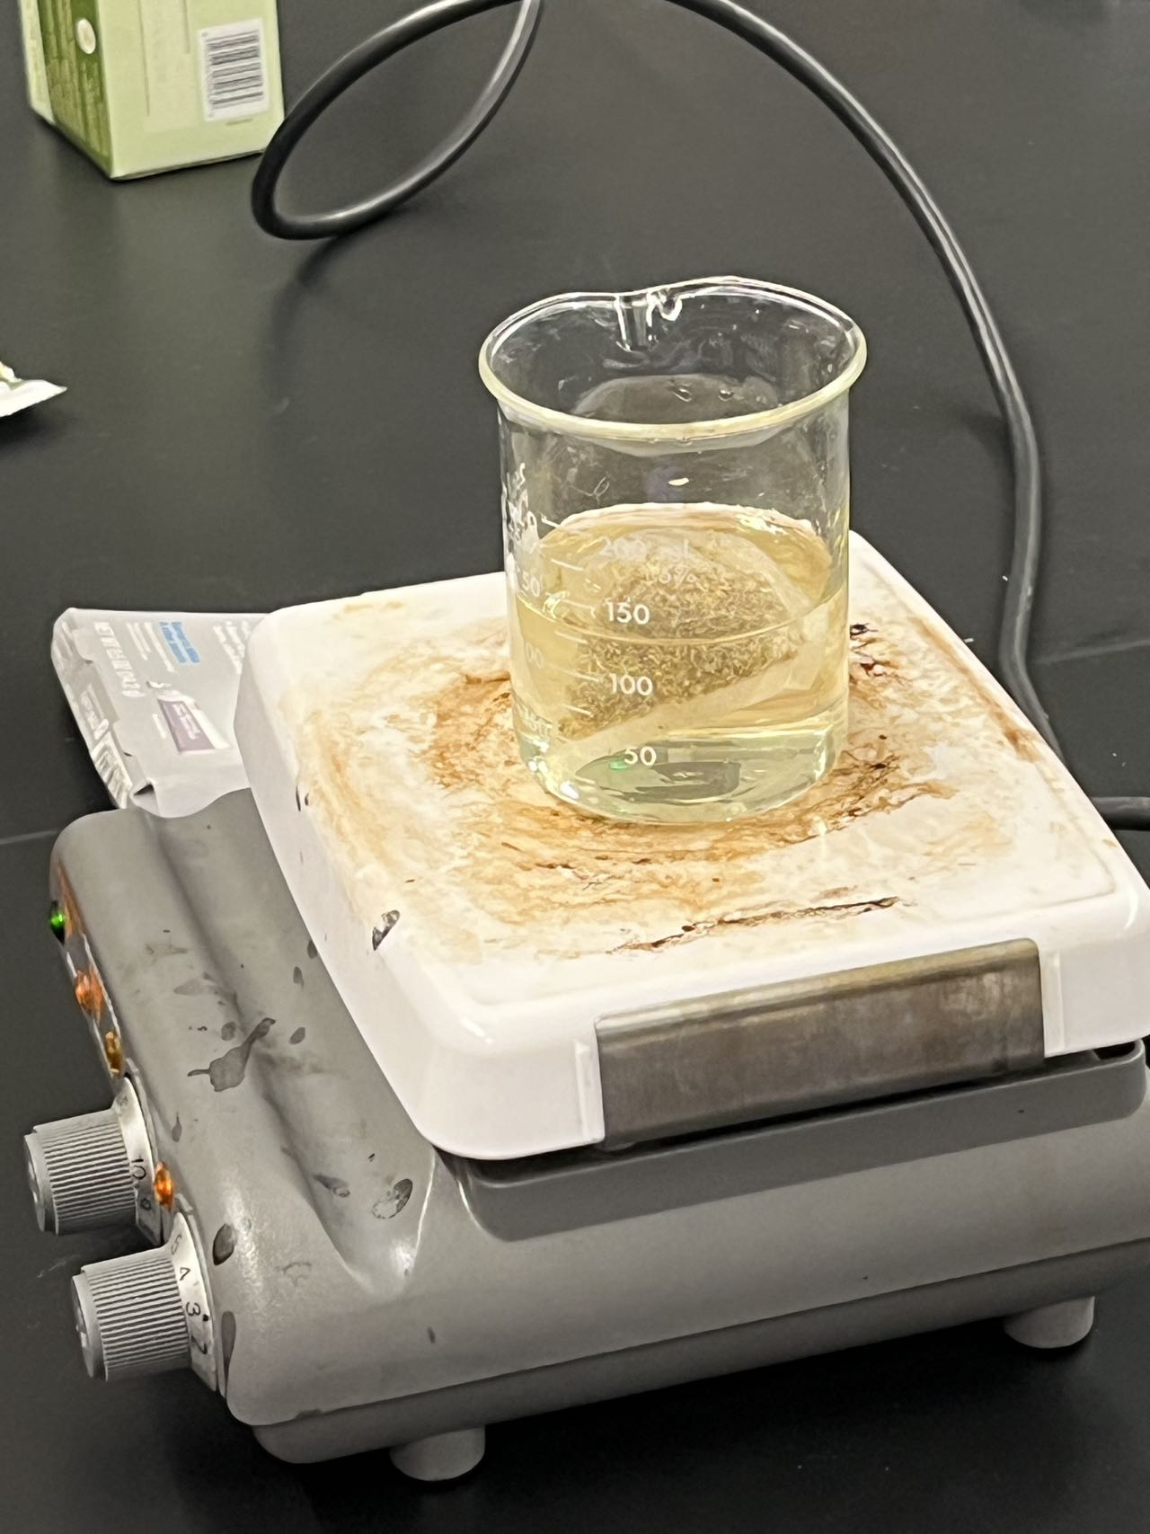
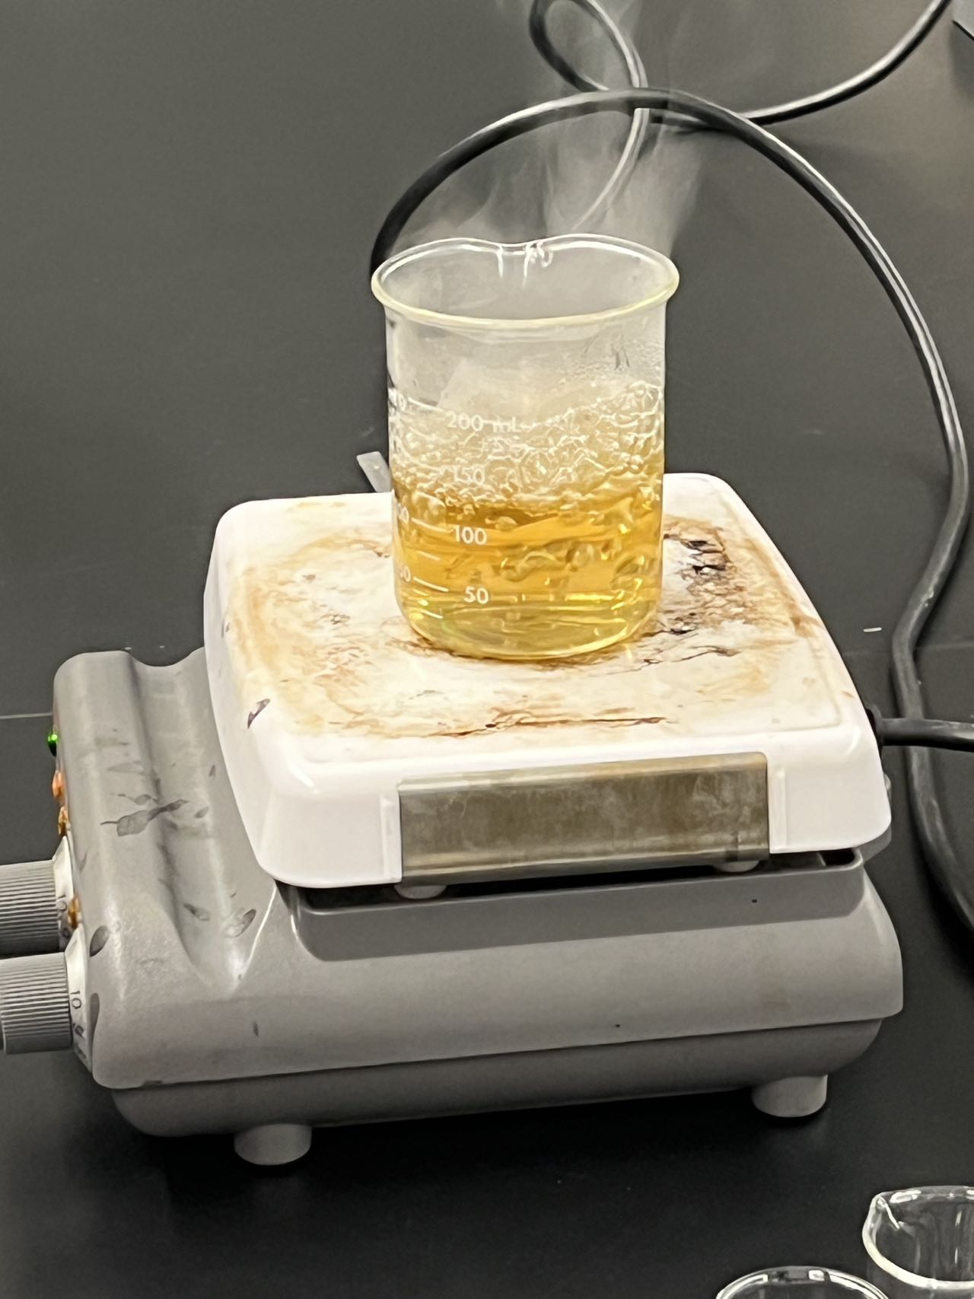
Review

Slide 3
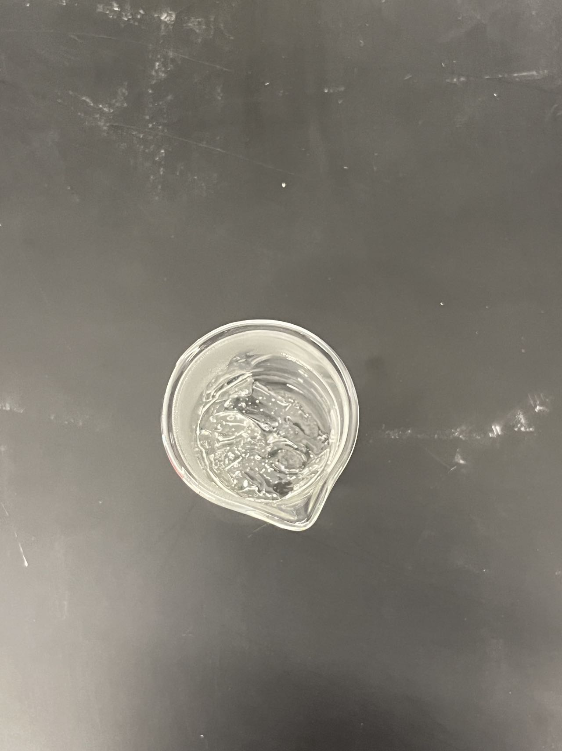
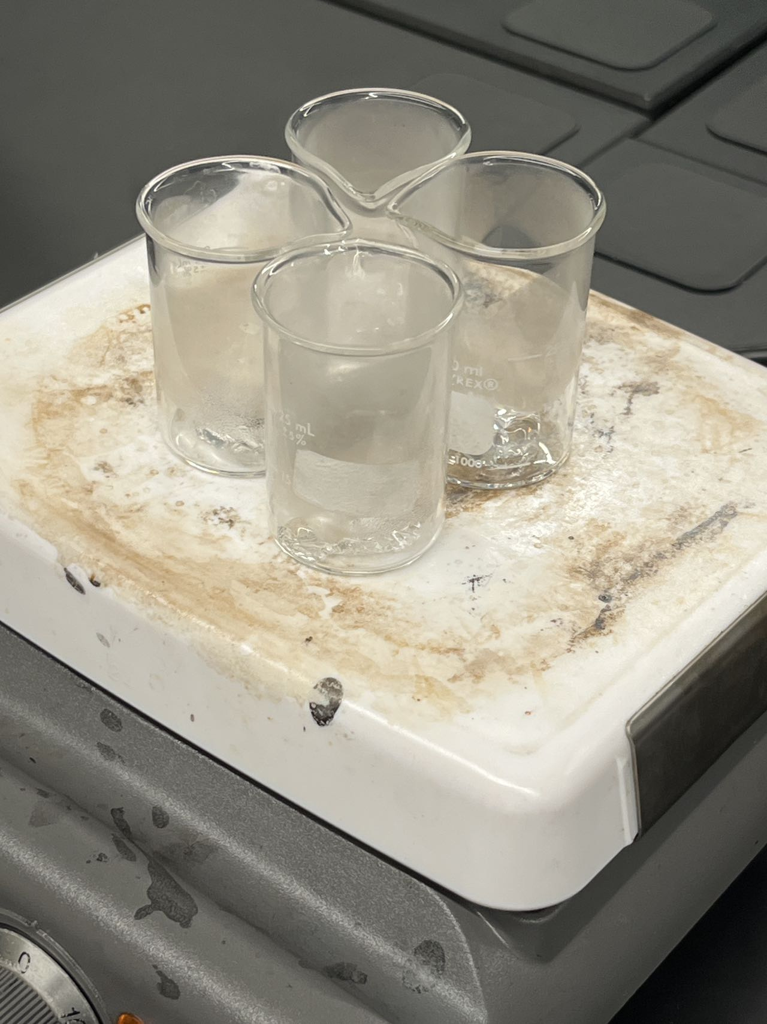

Slide 4
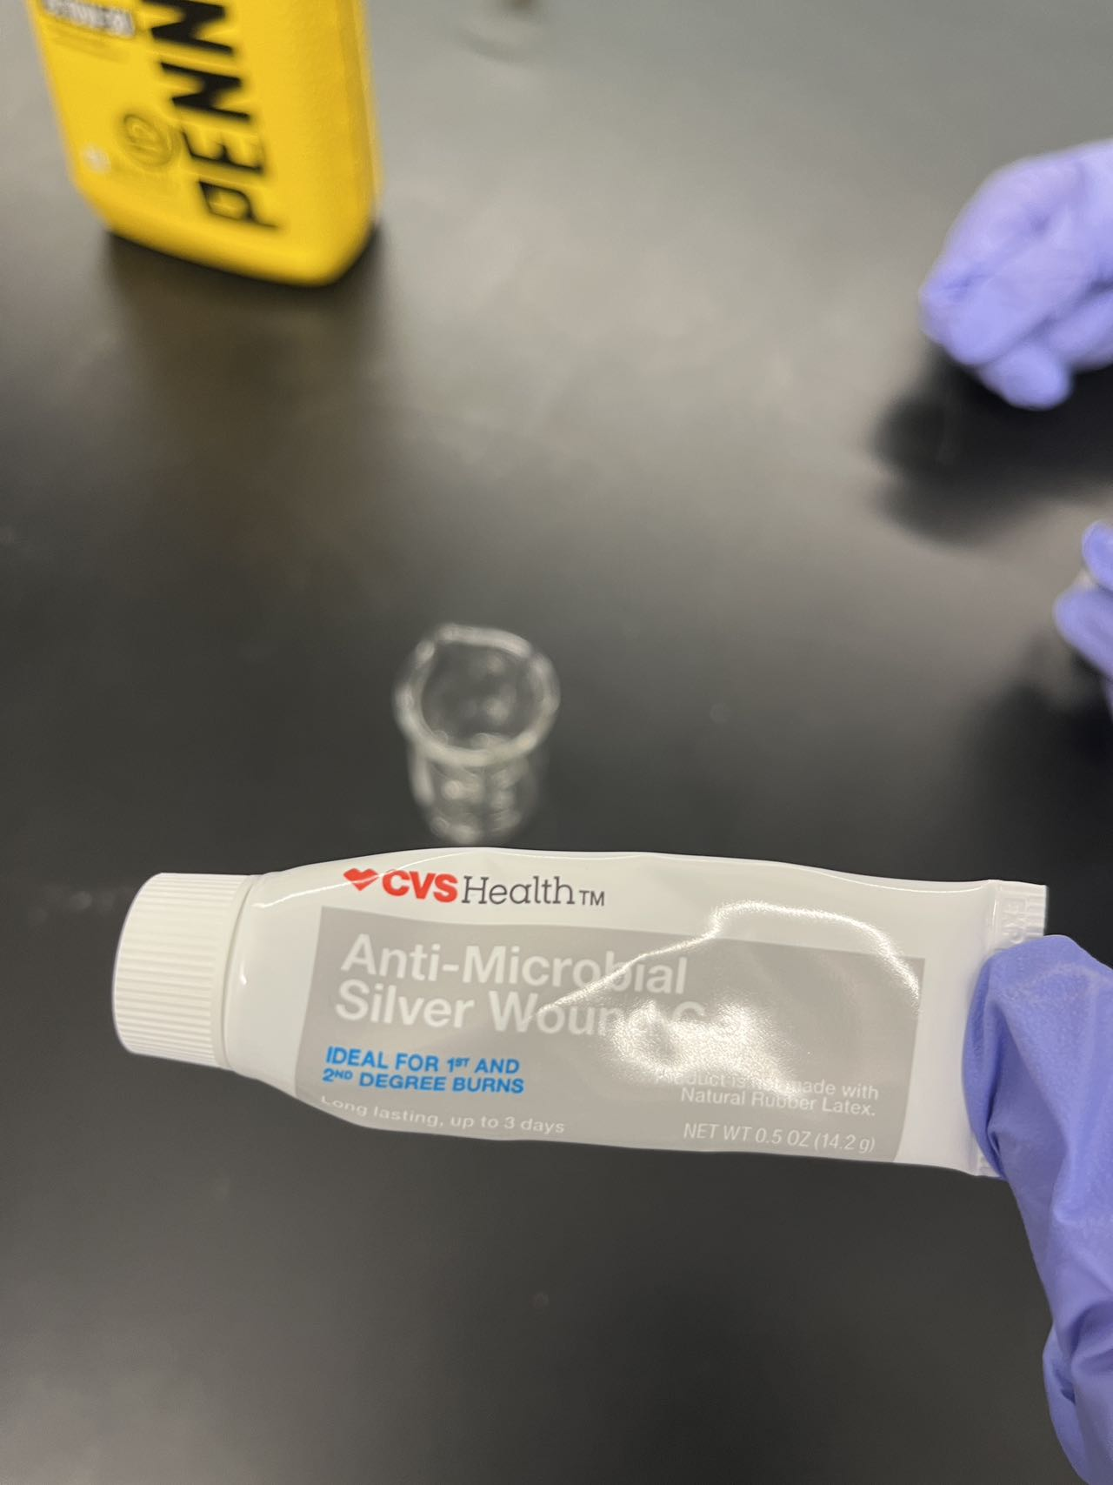


Slide 5
Following Experiment Protocol
Select different biofuels.
Prepare a control sample of each biofuel without nanomaterials.
Prepare separate test samples of each biofuel with a specific nanomaterial added.
Ensure proper mixing for dispersion of nanomaterials.
(Biofuels: Corn Based Ethanol, E10 petrol(if available), biodiesel from veg oil)
For comparison also try conventional petrol/diesel
Set up a controlled combustion chamber.
Stabilize the combustion chamber at the desired temperature.
Introduce the control sample of each biofuel and monitor combustion.
Record combustion-related data (emissions, temperature, energy).
Repeat the process for each test sample, introducing biofuels with different nanomaterials.

Slide 6

Any Qs

