Slide 1


Biofuel
Research update
Webb Wu

Slide 2
Recap
Using Silver Nanoparticle
Improving Combustion Efficiency
Anti-Bacterial

Slide 3
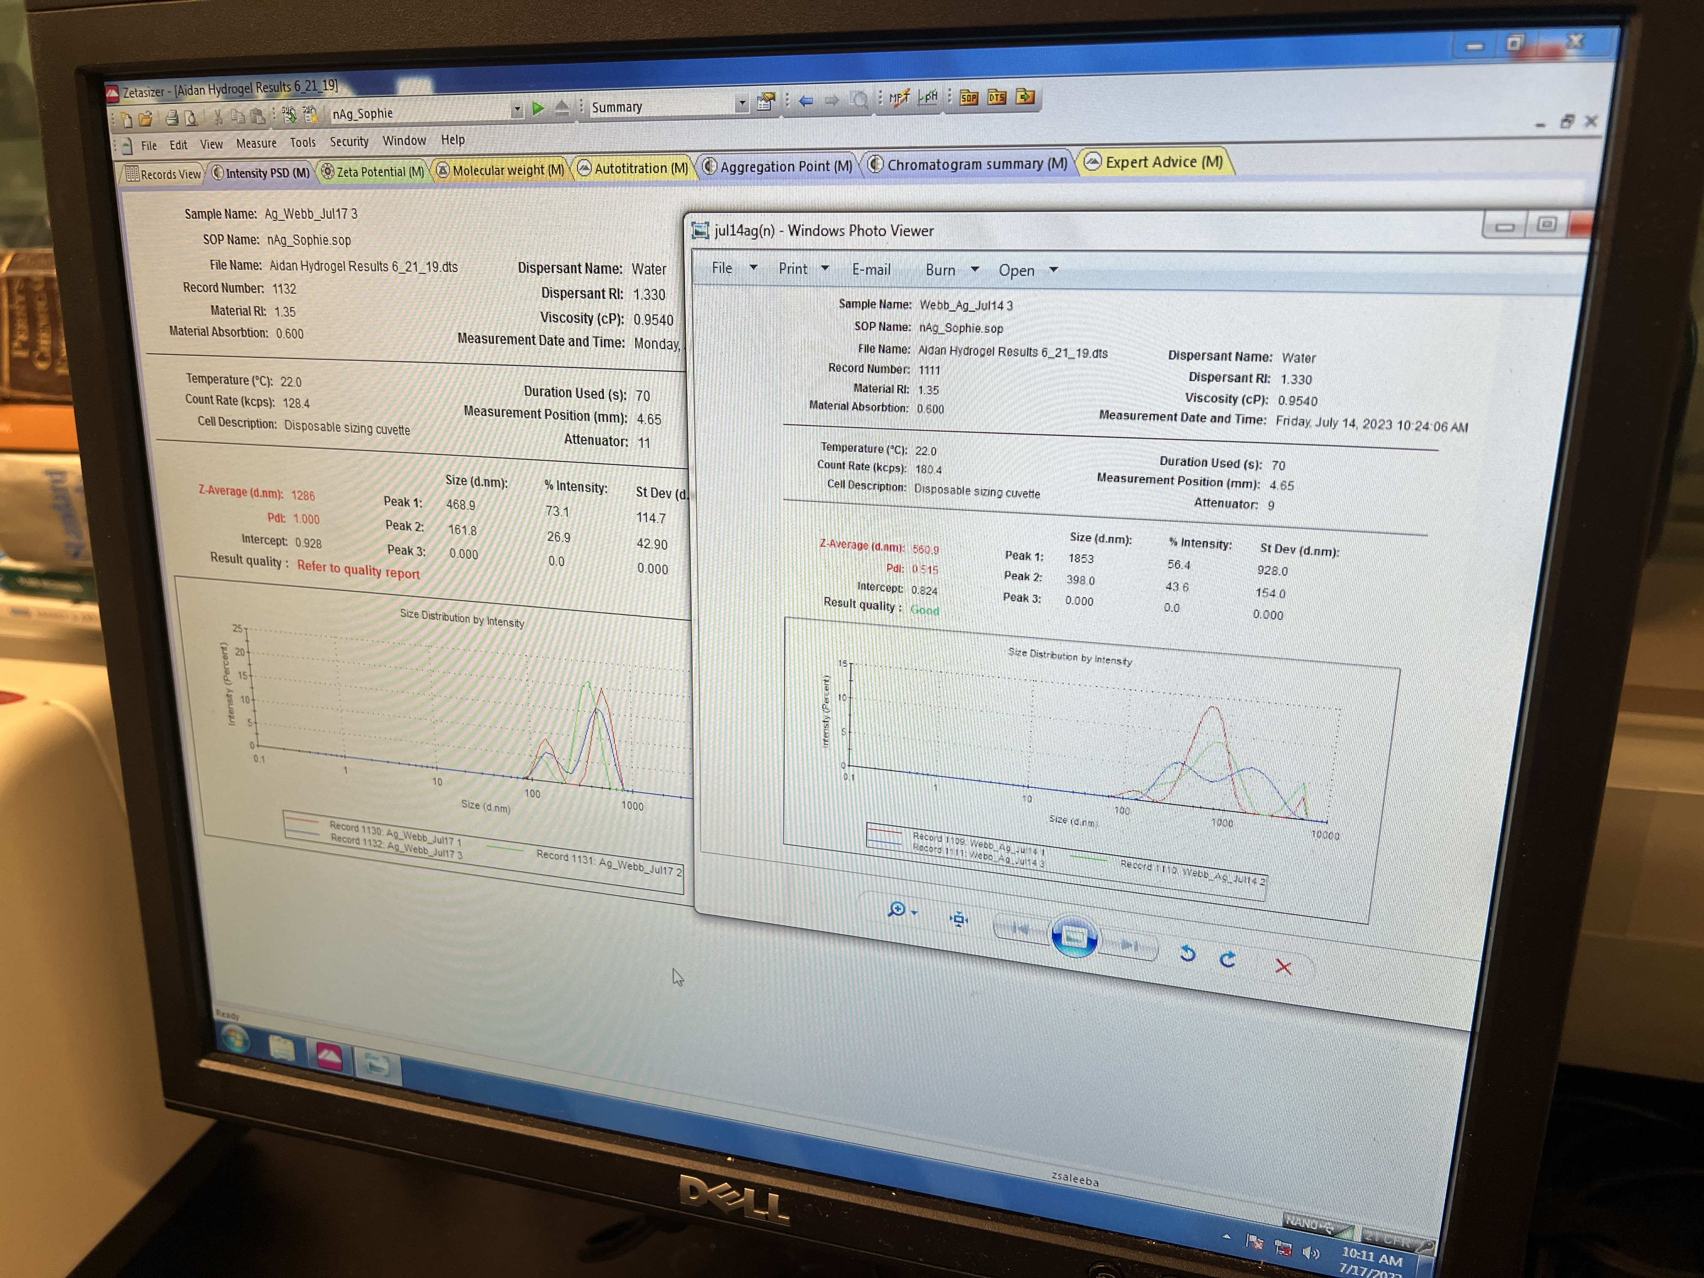

Slide 4
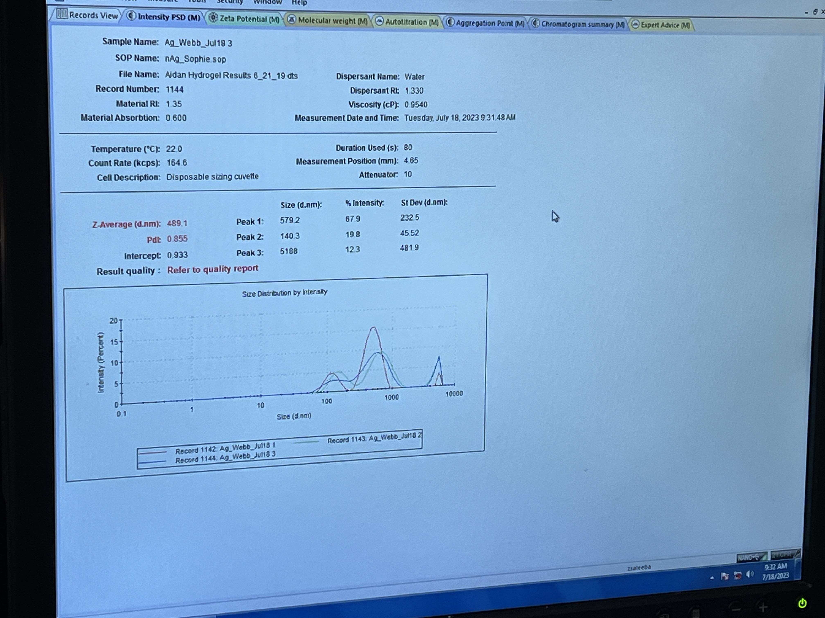
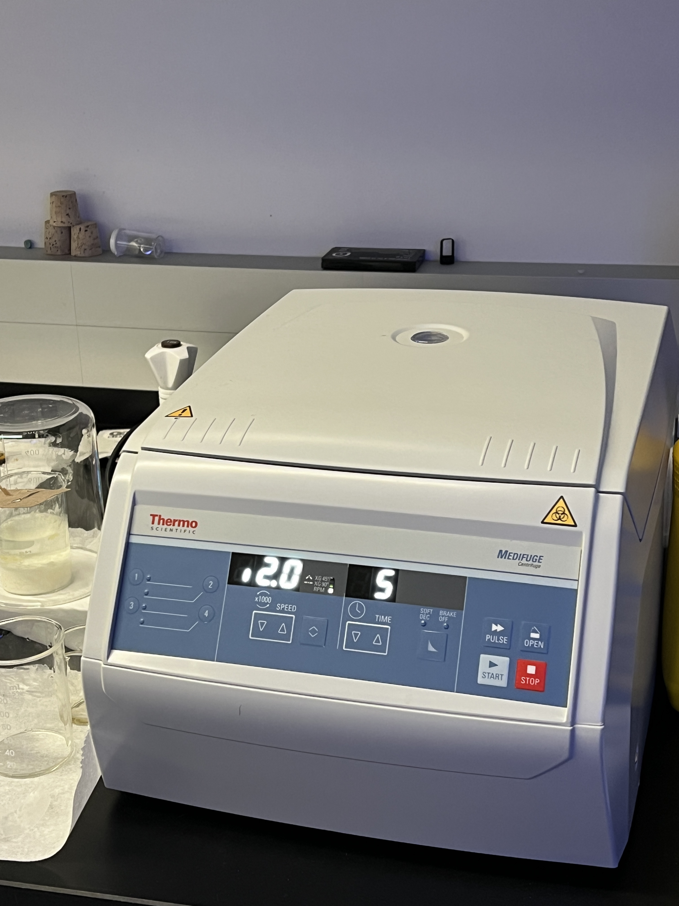

Slide 5
Further Experiments
Biofuels (e.g., ethanol, biodiesel, vegetable oil)
Silver nanoparticle catalyst
Nanofoam insulation
Spirit burner/Bunsen burner
Thermometer
Stopwatch
Balance

Slide 6
Further Experiment
Select biofuels and label glass beakers.
Prepare silver nanoparticle catalyst and mix with biofuels.
Set up combustion area with burner, thermometer, and insulation.
Measure and record initial biofuel temperature.
Ignite the burner and monitor temperature change.
Record highest temperature reached.
Repeat for each biofuel with/without catalyst and insulation.
Perform multiple trials.

Slide 7

Any Qs ?

