Slide 1
TimeCart
Premium watch e-commerce platform — Next.js 16, Supabase, Prisma 7
Documentation Team · September 2026

Slide 2
Agenda
• What it is
• System architecture
• Key features
• Database design
• Workflows
• API surface
• Testing & next steps

Slide 3
What it is

Slide 4
Product
• Premium watch storefront: browse, search, cart, checkout, tracking, reviews
• Customer and admin experiences in one Next.js app
• Auth via Supabase, relational data in Postgres
• Email notifications via Resend

Slide 5
Architecture

Slide 6
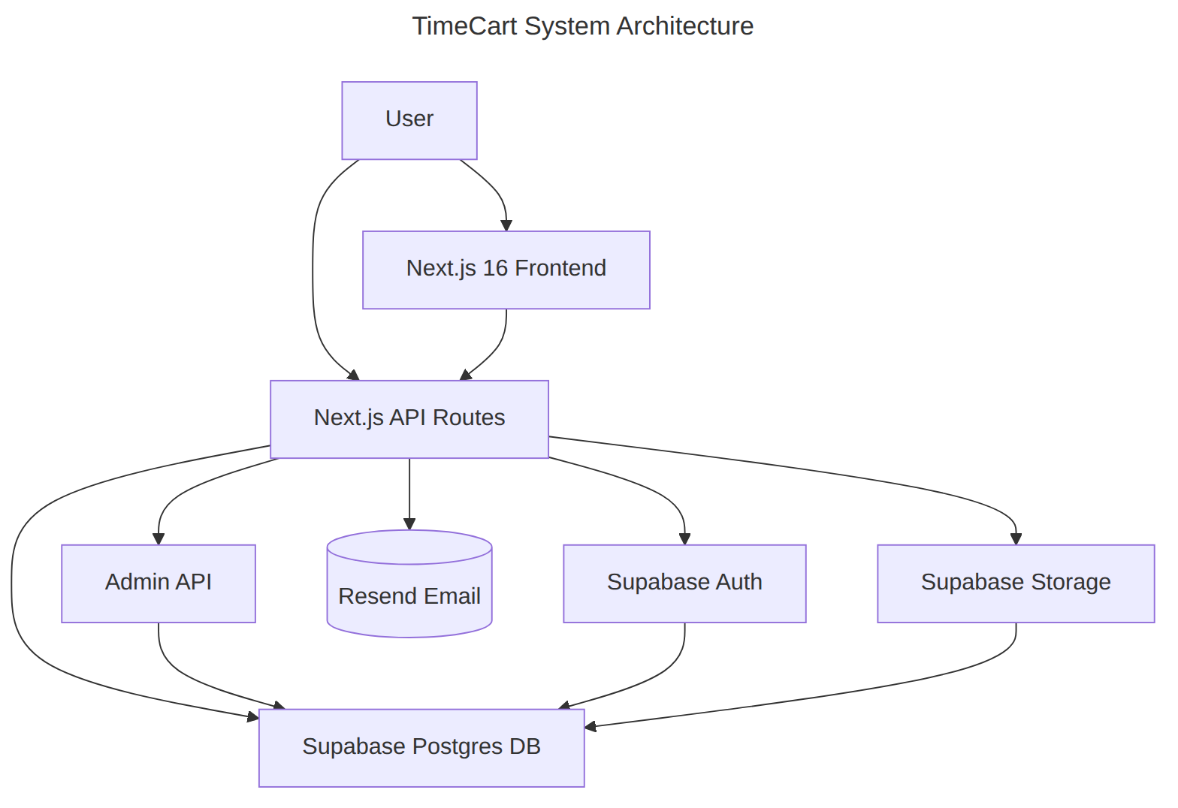
System Architecture
Client → Next.js app → Supabase (Postgres / Auth / Storage) + Resend

Slide 7
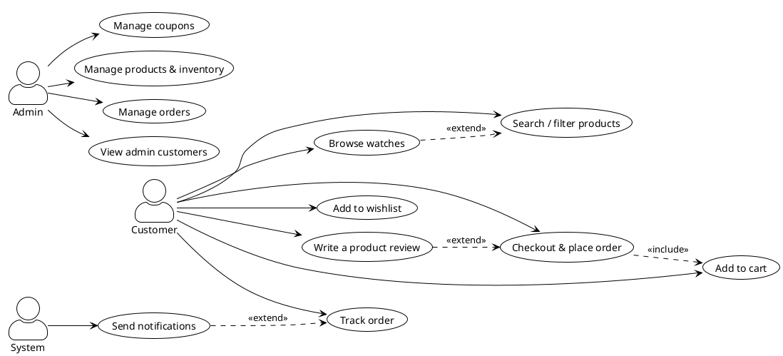
Key Features
• Wishlist & cart
• Orders with full status lifecycle
• Product reviews with images
• Coupon system + usage tracking
• Admin: products, coupons, orders, customers
Use case overview

Slide 8
Database

Slide 9
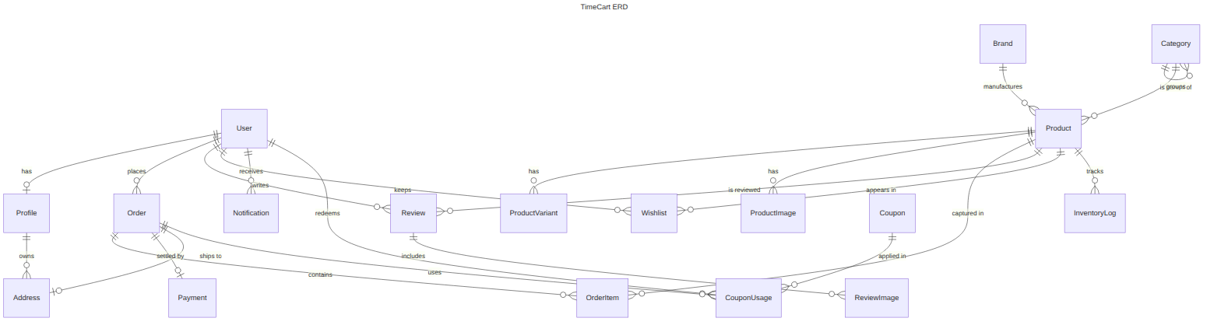
Entity Relationship Diagram
23 tables, 10 enums (Prisma schema)

Slide 10
Core Tables
Table | Purpose
User / Profile | accounts, roles, contact
Product / Variant | catalog + stock
Order / OrderItem | purchases
Payment | order settlement
Review | product feedback
Coupon / CouponUsage | discounts

Slide 11
Workflows

Slide 12
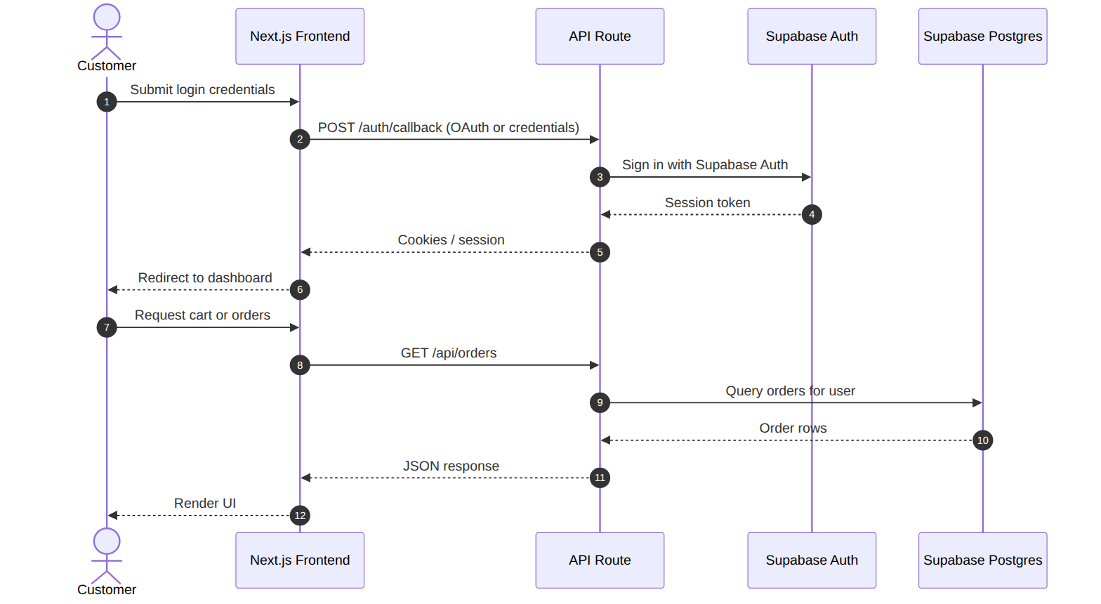
Authentication & Session
Login → Supabase Auth → session → data access

Slide 13
Thank You
TimeCart — Where Time Meets Style

