Slide 1


Slide 2
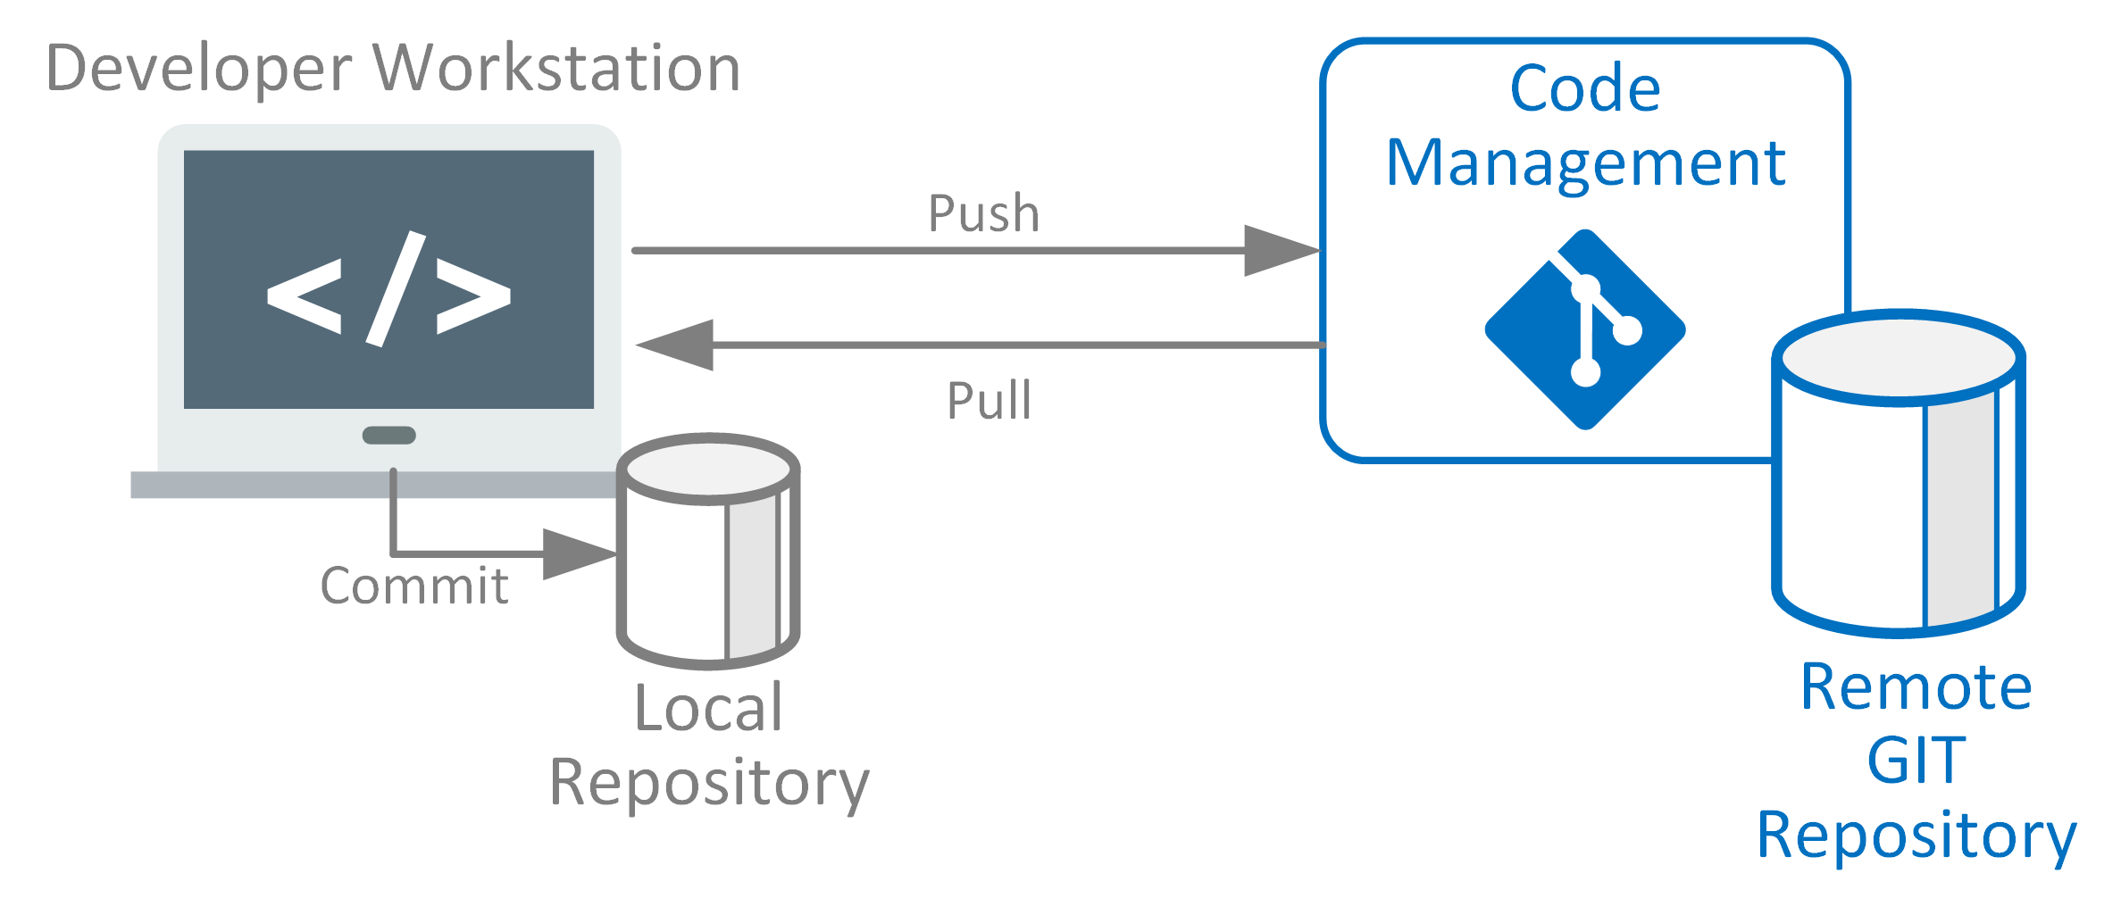
Source Code Management (SCM)
Source code management (SCM) is used to track modifications to a source code repository. SCM tracks a running history of changes to a code base and helps resolve conflicts when merging updates from multiple contributors. SCM is also synonymous with Version control.

Slide 3
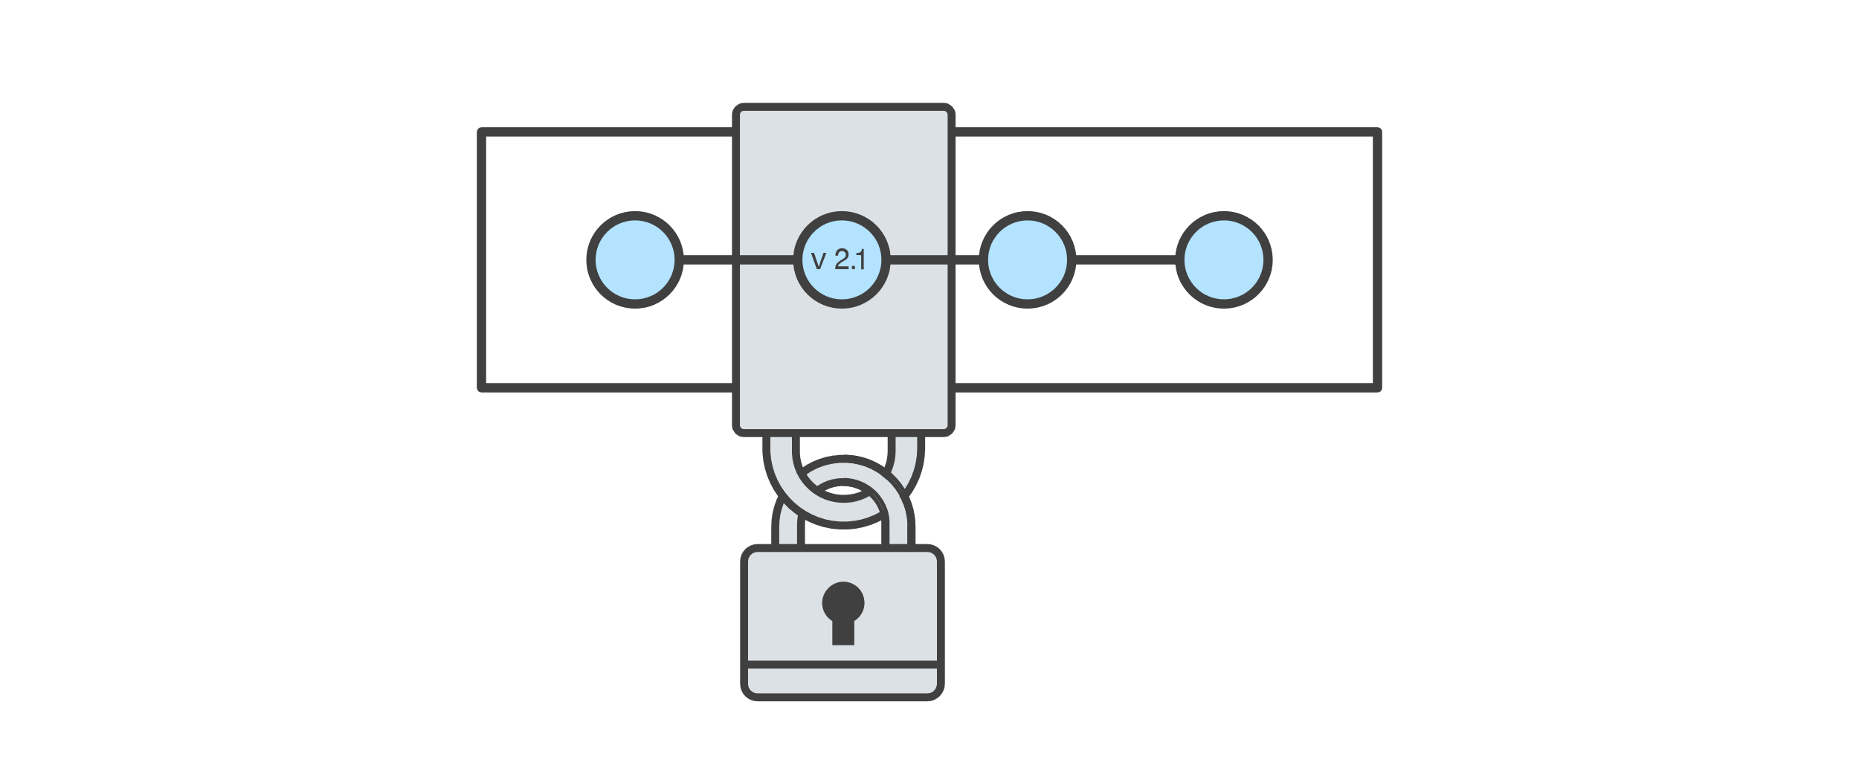
Benefits of SCM
Work together in teams
Version history
Generate release notes
Backup of code
Version Control
Version control, also known as source control, is the practice of tracking and managing changes to software code. Version control systems are software tools that help software teams manage changes to source code over time.

Slide 4

Benefits of Version Control
Managing and Protecting the Source Code:
The Version Control System helps manage the source code for the software team by keeping track of all the code modifications. It also protects the source code from any unintended human error and consequences.
Keeping Track of All the Modifications Made to the Code:
The team working on the project continuously produces new source codes and keeps making amendments to the existing code.

Slide 5
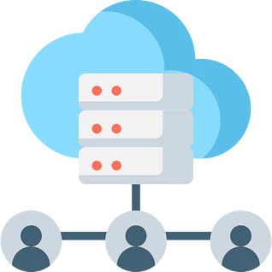
Comparing Earlier Versions of the Code:
Since all the versions of the code are saved, this makes it possible for developers to go back at any time and compare the earlier versions of the code to help fix the mistake while reducing disruption to all team members.
Helps in recovery in case of any disaster or contingent situations.
Reduce possibilities of errors and conflicts meanwhile project development through traceability to every small change.
Inform us about Who, What, When and Why changes have been made.
For each different contributor to the project, a different working copy is maintained and not merged to the main file unless the working copy is validated. The most popular example is Git, Helix core, Microsoft TFS,

Slide 6
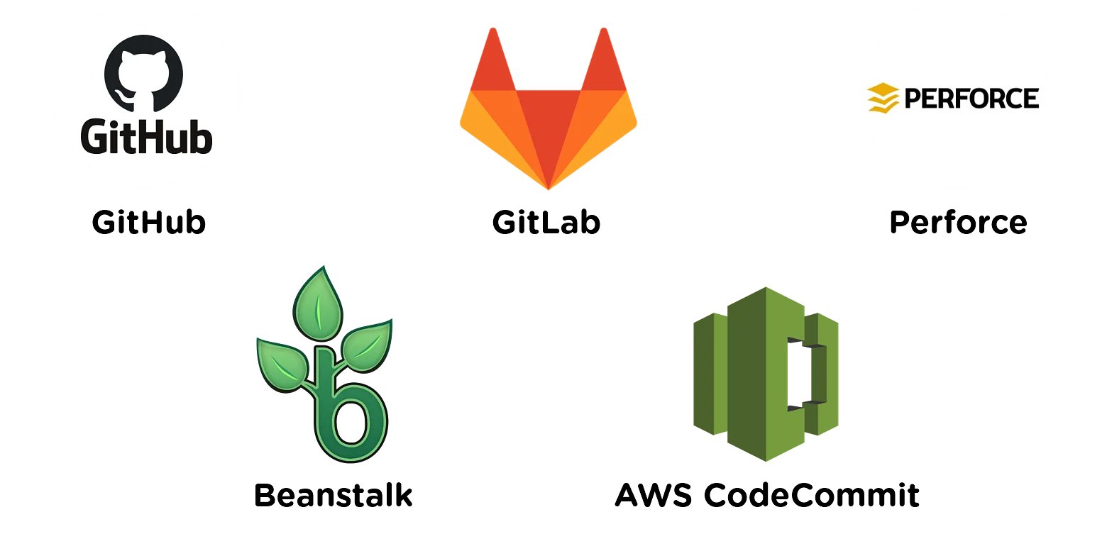
Available Version Control Systems

Slide 7
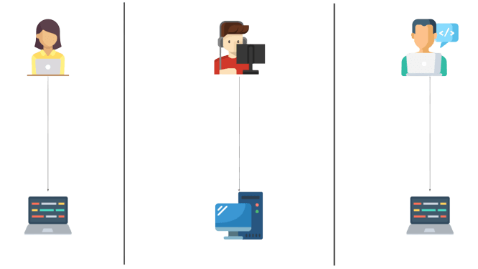
Types Version Control Systems
Local Version Control Systems
Centralized Version Control Systems
Distributed Version Control Systems
Local Version Control Systems: It is one of the simplest forms and has a database that kept all the changes to files under revision control. RCS is one of the most common VCS tools. It keeps patch sets (differences between files) in a special format on disk. By adding up all the patches it can then re-create what any file looked like at any point in time.

Slide 8
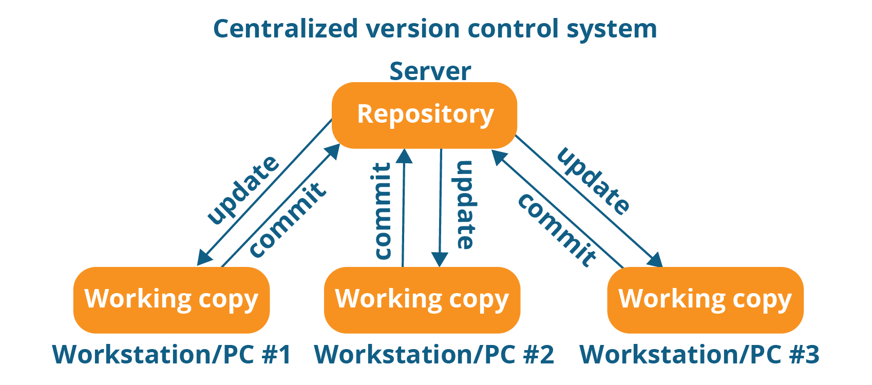
Centralized Version Control Systems: Centralized version control systems contain just one repository globally and every user needs to commit for reflecting one’s changes in the repository. It is possible for others to see your changes by updating.

Slide 9
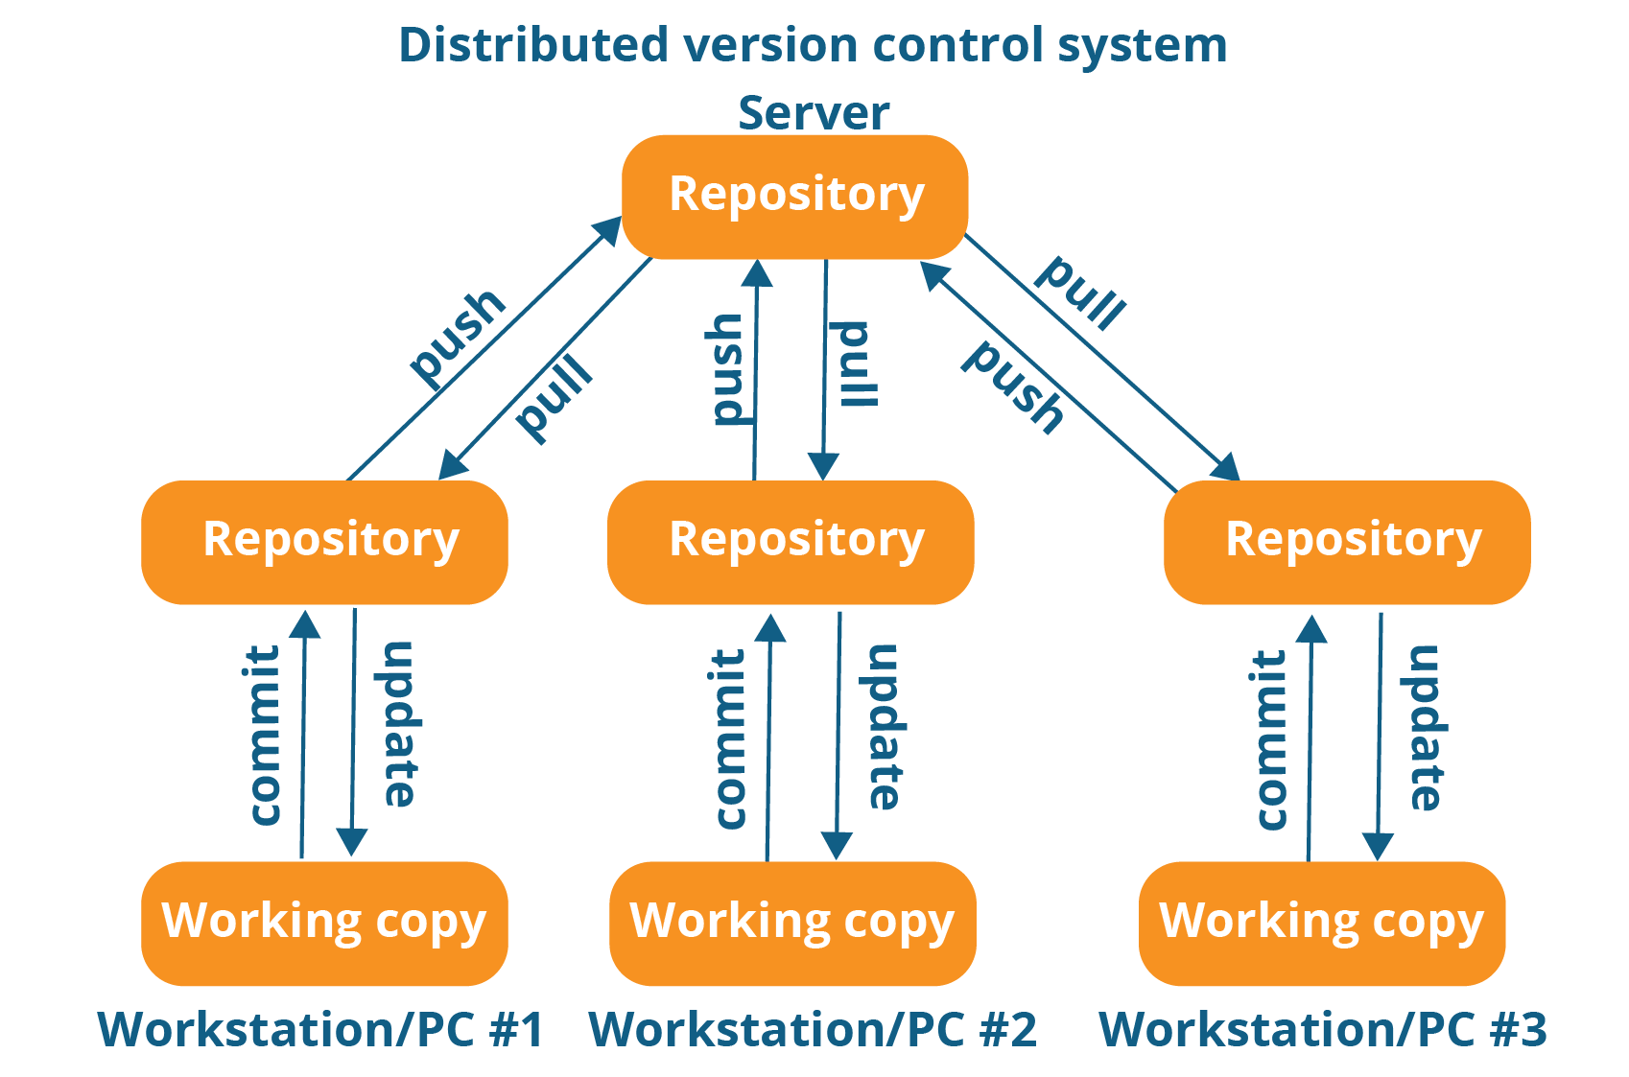
Distributed version control systems: contain multiple repositories. Each user has their own repository and working copy. Just committing your changes will not give others access to your changes. This is because commit will reflect those changes in your local repository and you need to push them in order to make them visible on the central repository. Similarly, When you update, you do not get others’ changes unless you have first pulled those changes into your repository.

Slide 10
History of Git
Git was created by Linus Torvalds in 2005 to develop Linux Kernel. It is also used as an important distributed version-control tool for DevOps.
Git is easy to learn and has fast performance. It is superior to other SCM tools like subversion, CVS, Perforce, and ClearCase.
Introduction to Git
Git is an open-source distributed version control system. It is designed to handle minor to major projects with high speed and efficiency. It is developed to co-ordinate the work among the developers.

Slide 11
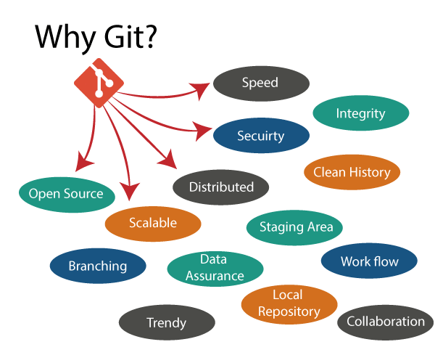
Why Git?
Over 70% of developers use Git!
Developers can work together from anywhere in the world.
Developers can see the full history of the project.
Developers can revert to earlier versions of a project.

Slide 12
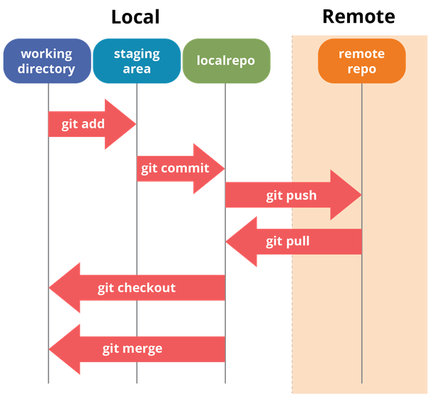
Git Workflow
Working Directory (working Tree)
Staging Area (Index)
Local Repository
Central Repository

Slide 13
Working Directory (working Tree): working directory, consists of files that you are currently working on. It is a file system where you can view and modify files. This is a Local repository where we can make add codes and make projects.
Staging Area (Index): The staging area can be described as a preview of your next commit. When you create a git commit, Git takes changes that are in the staging area and makes them a new commit. You are allowed to add and remove changes from the staging area.
Local Repository: This is your local repository where you commit changes to the project before pushing them to the central repository.
Central Repository: This is the main project on the central server, a copy of which is with every team member as a local repository.

Slide 14
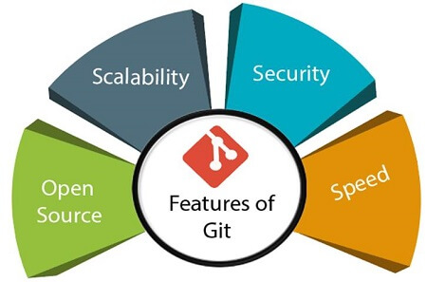
Features of Git
Open Source: Git is an open-source tool. It is released under the GPL (General Public License) license.
Scalable: Git is scalable, which means when the number of users increases, Git can easily handle such situations.
Security: Git is secure. It uses the SHA1 (Secure Hash Function) to name and identify objects within its repository.
Speed: Git is very fast, so it can complete all the tasks in a while. Most of the git operations are done on the local repository, so it provides a huge speed.

Slide 15
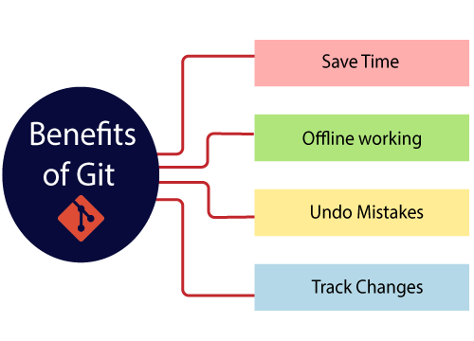
Benefits of Git

Slide 16
Saves Time: Git is lightning-fast technology. Each command takes only a few seconds to execute so we can save a lot of time as compared to login in to a GitHub account and finding out its features.
Offline Working: One of the most important benefits of Git is that it supports offline working. If we are facing internet connectivity issues, it will not affect our work. In Git, we can do almost everything locally.
Undo Mistakes: One additional benefit of Git is we can Undo mistakes. Sometimes the undo can be a savior option for us.
Track the Changes: Git facilitates with some exciting features such as Diff, Log, and Status, which allows us to track changes so we can check the status, and compare our files or branches.

Slide 17
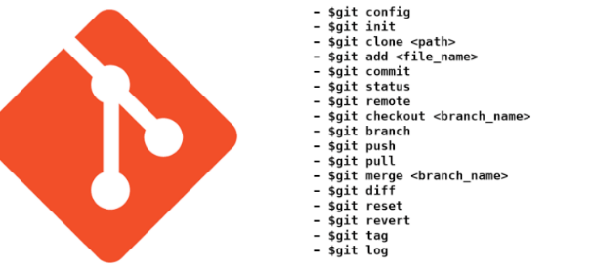
Popular Git Commands

Slide 18
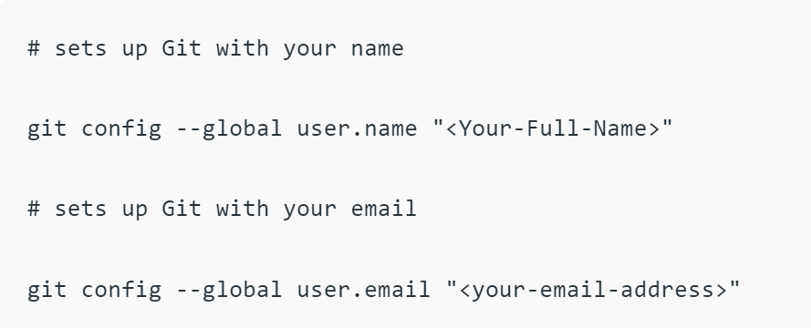
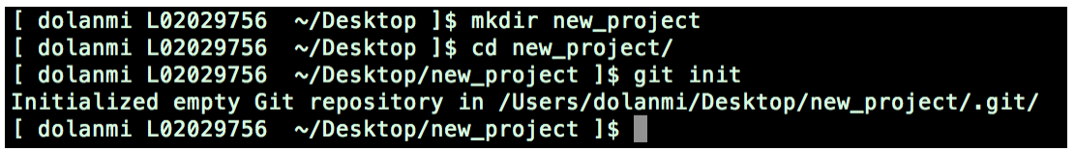
git config: This command allows you to specify the username and email address that will be used with your commits.
git init: A git repository must first be created before you can make commits or do anything else with it.

Slide 19
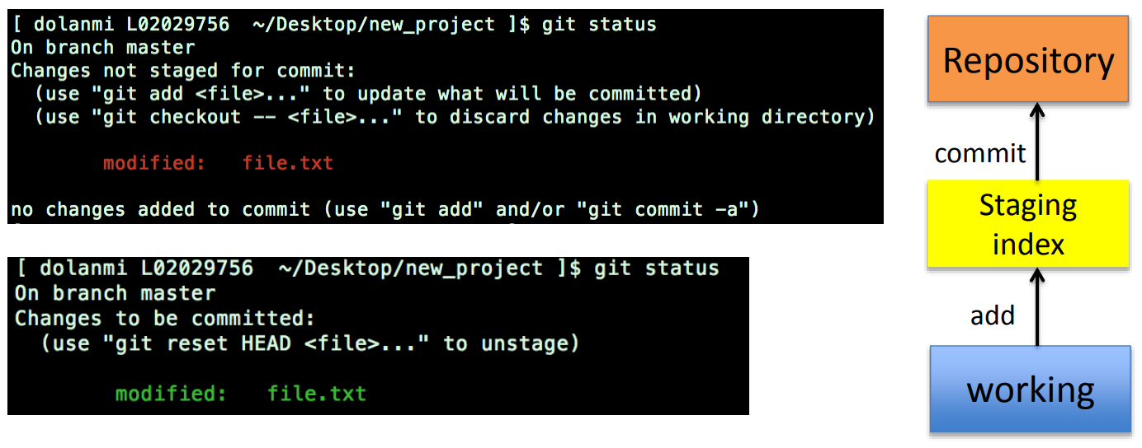
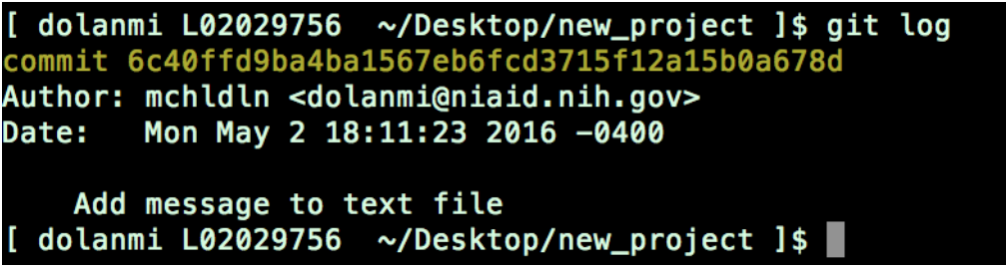
git status: It will display the status of the file, where are the files located.
git log: To check what is done.

Slide 20

git clone: We can add the original location as a remote so you can easily fetch from it again and push it if you have permissions.
$ git clone (URL)
git add: This command adds a single file or more than one file to the staging area.
$ git add (file name)
$ git add *

Slide 21

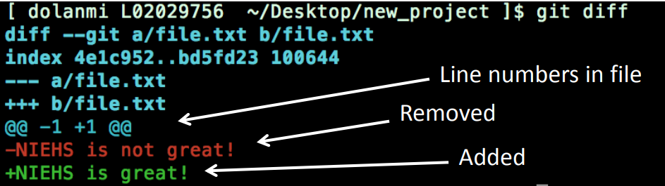
git commit: This command records or snapshots the file permanently in the version history.
$ git commit –m "<Type your commit message here>”
git diff: This command shows the file differences which are not yet staged.

Slide 22
Git Branch: We will discuss some of the commands used in the branch.
$ git branch : To list branches present in local repository.
$ git branch --list : To list all the branches
$ git branch <branch name> : To create a new branch.
$ git checkout <branch name> : To switch particular branch.
$git checkout –b <branch name> : Used create and switch branches.
$ git branch –d <branch name> : To delete the specific branch
$ git branch –m <old name> <new name> : To rename the branches.
$ git merge <branch name> : To merge the branches
$ git push origin -delete <branch name> : Delete a remote branch

Slide 23
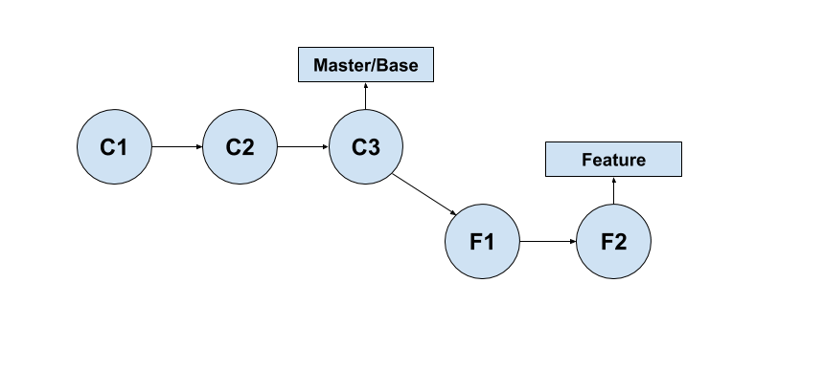
Git Merge :
Git 2-way merging
Git 3-way merging
2-way merge: A two-way merge is a simple case where merging involves only two snapshot.

Slide 24
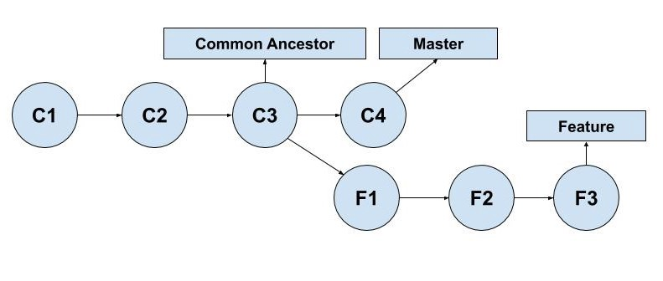
3-way merge: A three-way merge involves three snapshots. Two are the ones that are involved in a two-way merge, and the third one is the base file or the common ancestor with which these two files will be compared.

Slide 25
git remote: This command is used to connect your local repository to the remote server.
$ git remote <variable name> <URL>
git push:
This command sends the committed changes of the master branch to your remote repository.
$ git push <variable name> master
This command sends the branch commits to your remote repository.
$ git push <variable name> <branch>

Slide 26
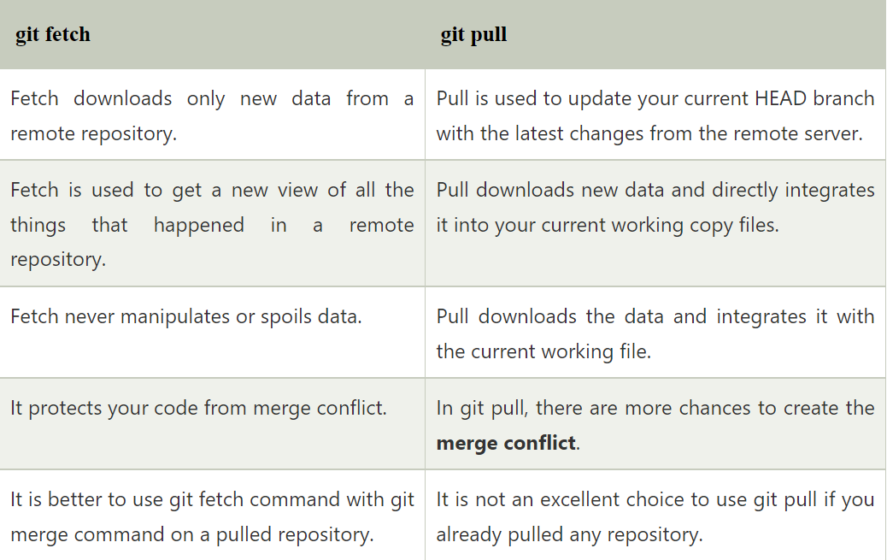
Git Fetch vs Git Pull

Slide 27
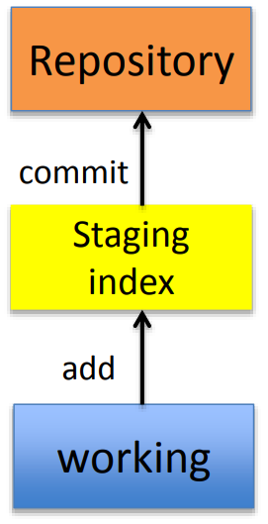
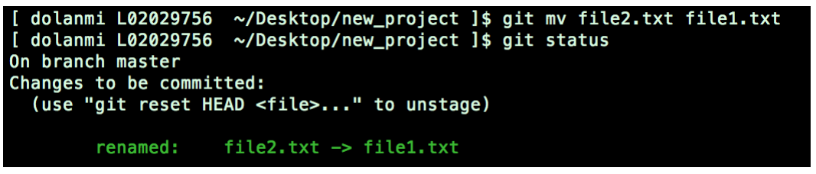
Delete files: It is not enough to delete the file in your working directory. You must commit the change.
$ git rm <file name>
Move(Rename): To move the files and rename we are using below command
Renaming file1.txt to file2.txt

Slide 28
Git Stash: Sometimes you want to switch branches, but you are working on an incomplete part of your current project. You don't want to make a commitment of half-done work. Git stashing allows you to do so. The git stash command enables you to switch branches without committing to the current branch.
Git stash: The directory gets cleaned and we can switch to other branches and work on them.
Git stash save: This command temporarily stores all the modified tracked files.
Git stash list: This command lists all stashed changesets.
Git stash apply: We can re-apply the changes that you just stashed by using the git stash command.
Git stash changes: It will show the file that is stashed and changes made on them.
Git stash pop: This command restores the most recently stashed files.
Git stash drop: This command discards the most recently stashed changeset.
Git stash clear: It will delete all the stashes that exist in the repository.
Git stash branch: It will create a new branch and transfer the stashed work to that.

Slide 29
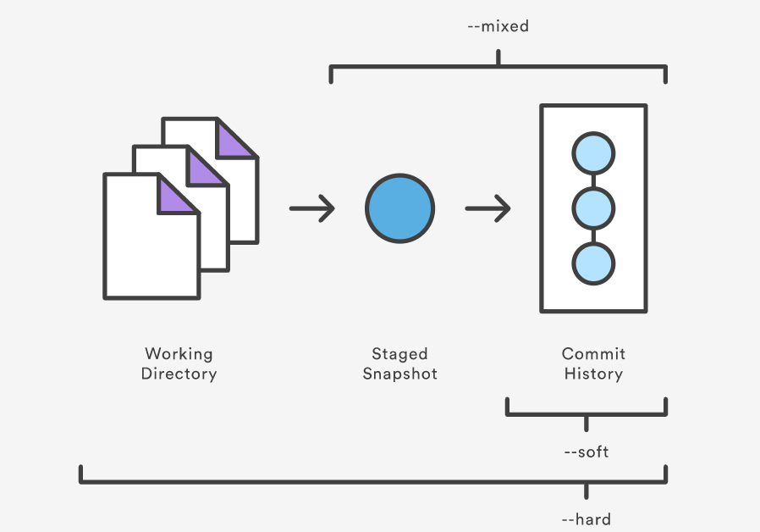
Git Reset: The term reset stands for undoing changes. The git reset command is used to reset the changes. The git reset command has three core forms of invocation.
$ git reset
Soft
Mixed
Hard

Slide 30
-- soft: When the --soft argument is passed, the ref pointers are updated and the reset stops there. The Staging Index and the Working Directory are left untouched.
$ git reset –soft head~1
-- mixed: This is the default operating mode. The ref pointers are updated. The Staging Index is reset to the state of the specified commit. Any changes that have been undone from the Staging Index are moved to the Working Directory.
$ git reset –mixed head~1
-- hard: This is the most direct and frequently used option. When passed --hard The Commit History ref pointers are updated to the specified commit. Then, the Staging Index and Working Directory are reset to match that of the specified commit
$ git reset –hard head~1

Slide 31

Revert: The git revert command is used for undoing changes to a repository's commit history.
$ git revert
Git Tags: Tags make a point as a specific point in Git history. Tags are used to mark a commit stage as relevant. We can tag a commit for future reference. Primarily, it is used to mark a project's initial point like v1.1.
Annotated tag
Light-weighted tag
When to create a Tag:
When you want to create a release point for a stable version of your code.
When you want to create a historical point that you can refer to reuse in the future.

Slide 32
$ git tag <tag name>
git tag: list all the available tags from the repository.
git show: It will display a description of the tags.
git tag -l ".* ” : It displays the available tags using a wild card pattern.
Git Cherry-pick: It is used to add changes from one branch to another branch, from one project to another project.
$ git cherry-pick <branch>

Slide 33
Git Rebase: Rebasing is a process to reapply commits on top of another base trip. It is used to apply a sequence of commits from distinct branches into a final commit. It is an alternative of git merge command.
$ git rebase <branch name>
Git Squash: In Git, the term squash is used to squash the previous commits into one. It is not a command; instead, it is a keyword. The squash is an excellent technique for group-specific changes before forwarding them to others. You can merge several commits into a single commit with the compelling interactive rebase command.
$ git squash

Slide 35
What is GitHub
GitHub is a Git repository hosting service that provides a web-based graphical interface.
GitHub is a web-based version-control and collaboration platform for software developers.
GitHub helps every team member work together on a project from any location while facilitating collaboration.
It offers both Distributed version control and Source code management (SCM) functionality of Git. It also facilitates some collaboration features such as bug tracking, feature requests, and task management for every project.

Slide 36
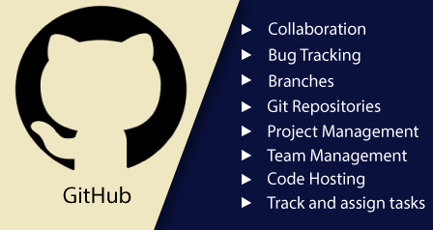
Features of GitHub
Collaboration
Integrated issue and bug tracking
Graphical representation of branches
Git repositories hosting
Project management
Team management
Code hosting
Track and assign tasks
Conversations
Wikisc (a website or database developed collaboratively by a community of users, allowing any user to add and edit content.)

Slide 37
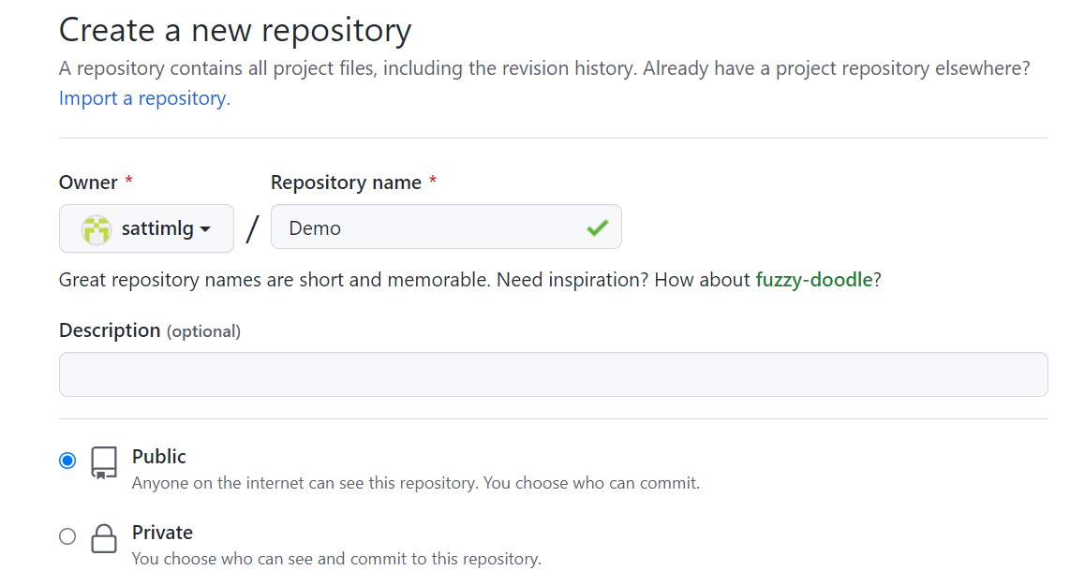
Creating Repo:

Slide 38
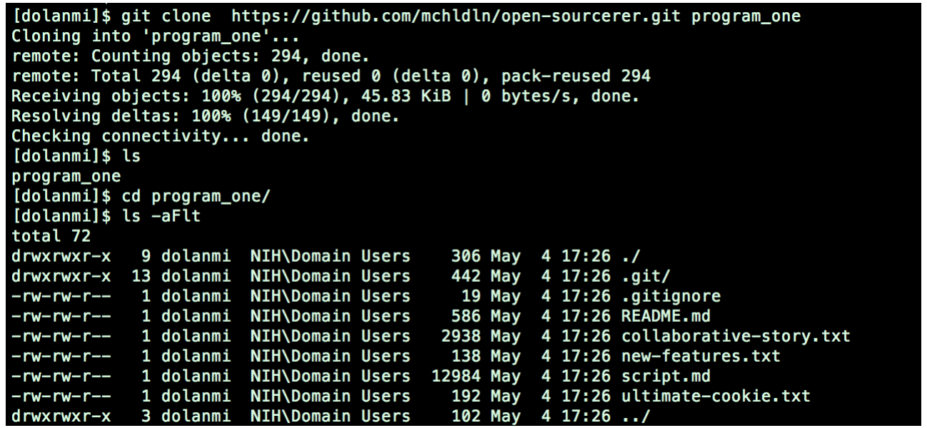
Copy/Clone files from remote repo to local repo
$ git clone <URL> <branch name>

Slide 39
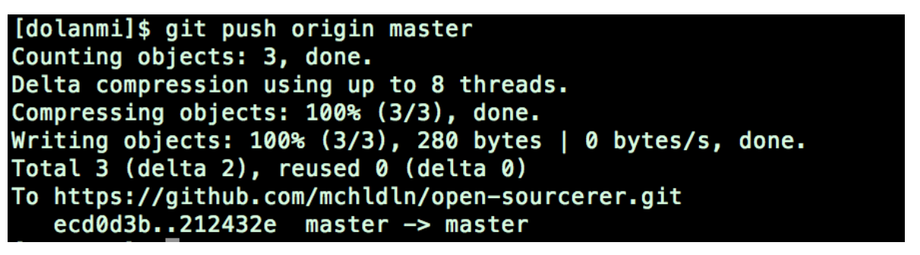
Pushing to a remote repo
$ git push <local branch> <branch name>

Slide 40
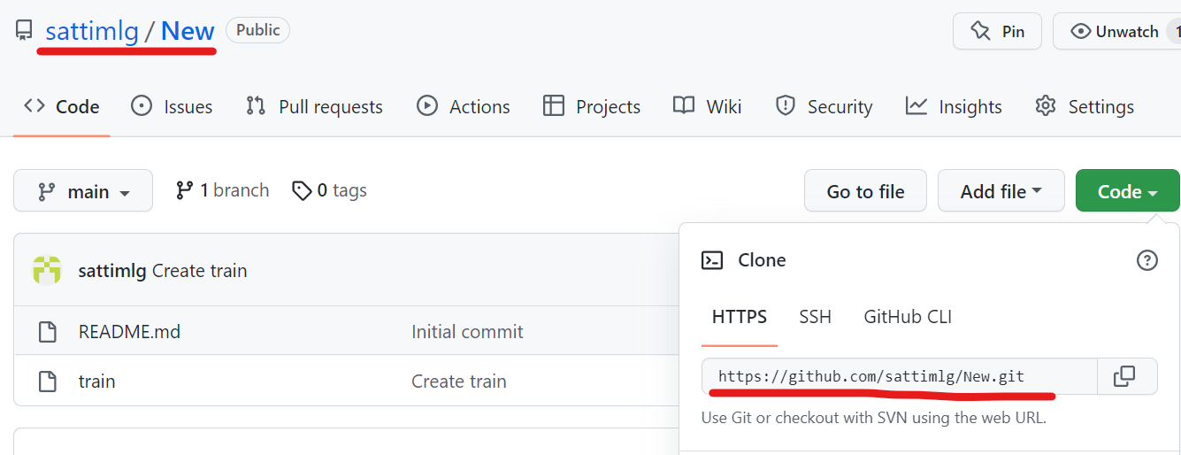
Repo name & Code:

Slide 41
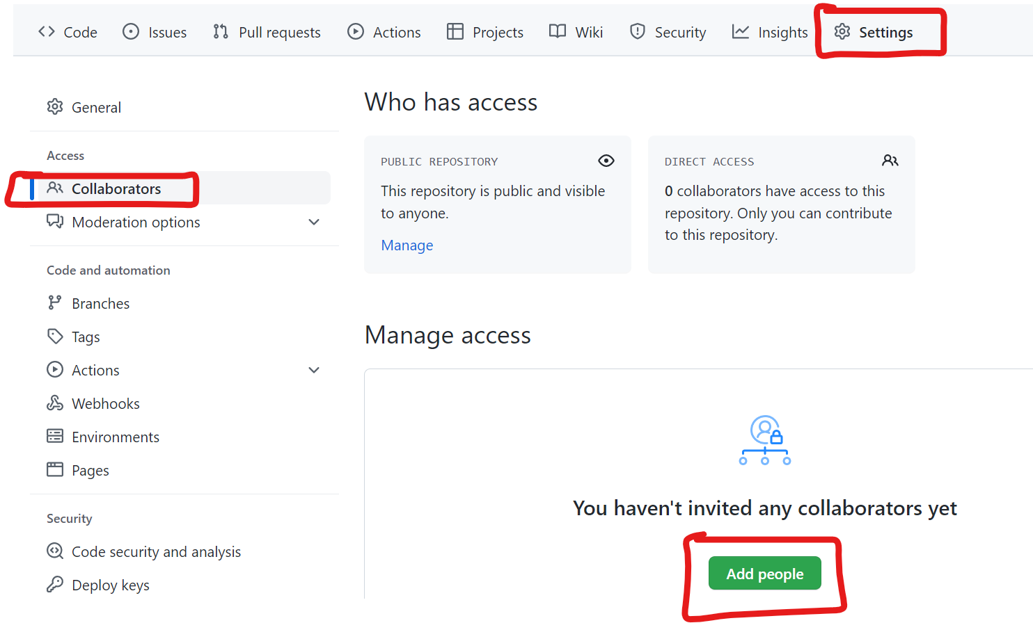
Collaborating:

Slide 42
Collaborating:

Slide 43
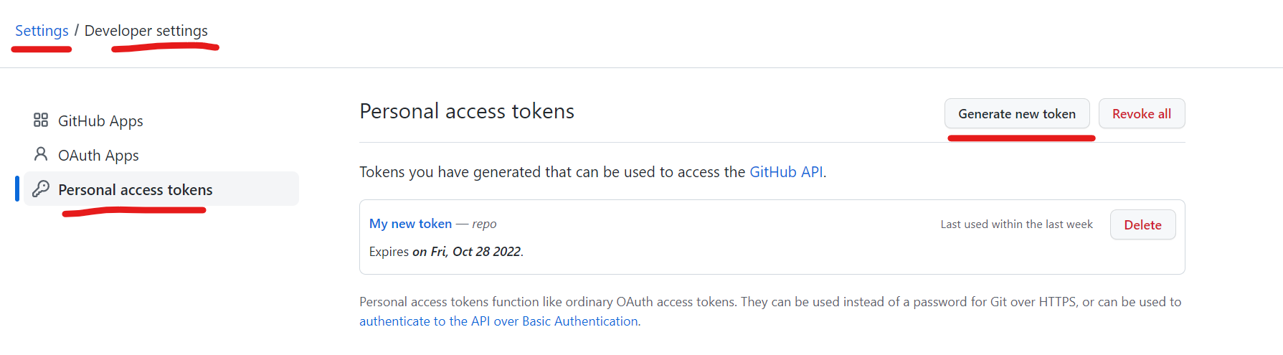
Generating Token:

Slide 44
Thank You

