Slide 1


Slide 2
Index
History of Linux
What is Linux
Features and Benefits of Linux
Linux Distribution
Kernel
Structure of Linux operating system
Difference between Linux and Windows
What is Command
Basic Linux Commands
User Management
Linux Groups
File Management
Networking Commands
Linux File Contents
File Compressions

Slide 3
History of Linux
Linux is a community of open-source Unix-like operating systems that are based on the Linux Kernel. It was initially released by Linus Torvalds on September 17, 1991.
What is Linux
Linux is a family of open-source, multi-tasking, multi-computer operating systems based on the Linux kernel.
Linux is typically packaged in Linux distribution.
The source code can be modified and distributed to anyone commercially or non-commercially under GNU- General public license

Slide 4
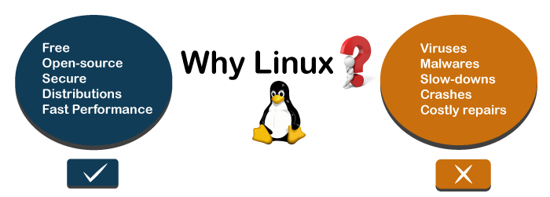
Features & Benefits of Linux
Open Source
Security & Privacy
Networking
Free to use
Stability & Flexible
Performance
Multi-tasking & Multi-user
Less Installation time

Slide 5

Linux Distribution

Slide 6
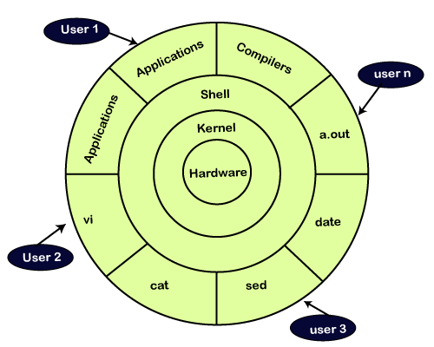
Kernel
Linux kernel is the core part of the operating system. It establishes communication between devices and software. Moreover, it manages system resources
Kernel Responsibilities:
Device Management
Memory Management
Process Management
Handling system calls

Slide 7
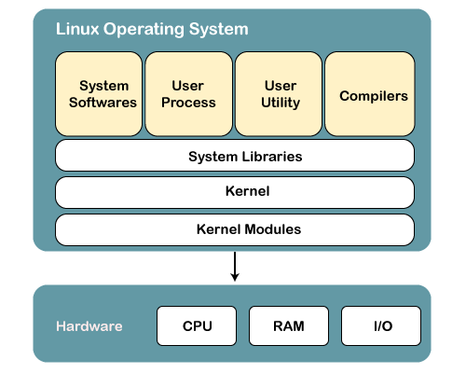
Structure of Linux Operating System

Slide 8
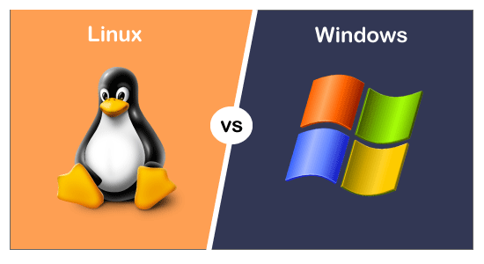
Difference between Linux & Windows
Open Source
Free to use
Secure
No Virus / Malware
Live CD software
Low Hardware cost
Customizable add features
Closed Source
Cost
Insecure
Virus / Malware
No
High hardware cost
Not Customizable

Slide 9

What is Command
A Linux command is a program or utility that runs on the command line.
A command line is an interface that accepts lines of text and processes them into instructions for your computer.
Basic Linux Command

Slide 10

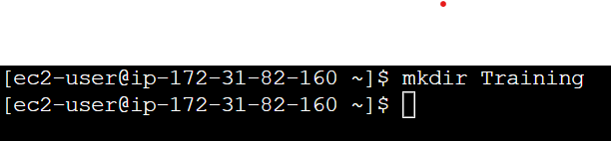
Touch: To create files.
Mkdir: To create folders.

Slide 11


ls: It will show file/folders present in directory.
cd: Changing directory.

Slide 12

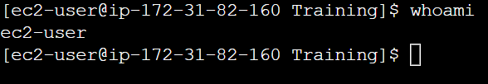
pwd: it will print working directory.
whoami: To check user name.

Slide 13

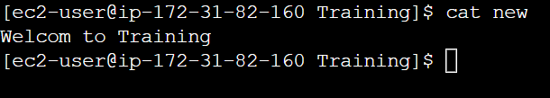
Vi filename/nano: it will open an editor to write content.
Cat filename: It will display content present in the file.

Slide 14
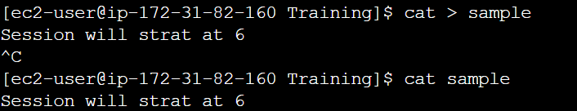
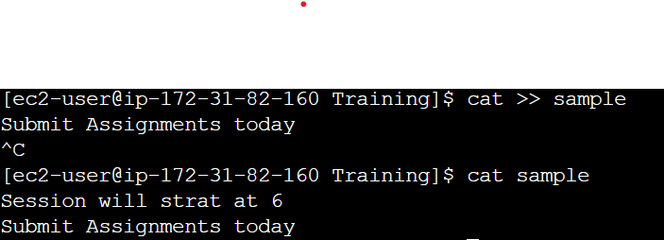
Cat > filename: it will override the content present in file.
Cat >> filename: It will add content without overriding the file.

Slide 15
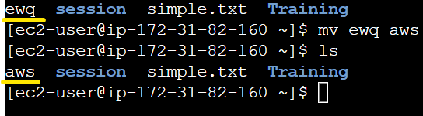
mv : To move file from one path to another path.
mv: It will use to rename the file or directory.

Slide 16
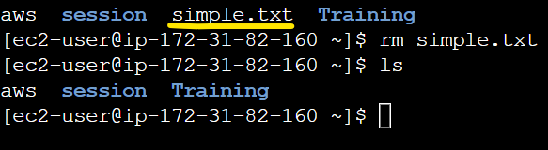
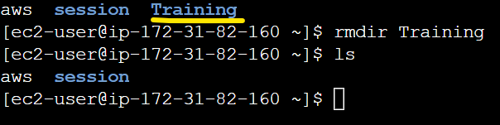
rm : To delete the file.
rmdir: To delete the folder.

Slide 17
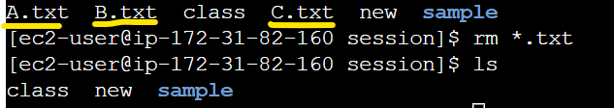
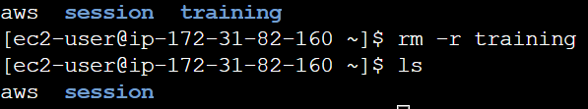
rm *. <extension>: To delete the multiple file with same extension.
rm -r: We can delete directory having sub directories inside the directory.

Slide 18
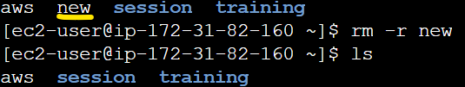
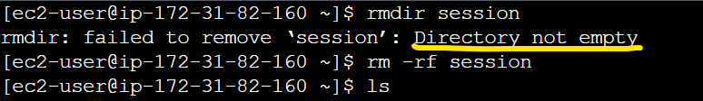
rm –f <filename>: To delet file forcefully.
rm -rf: To delete directory forcefully.

Slide 19


echo: To print the content.
sudo: Super user will active to do any commands done with administrative or root privileges

Slide 20
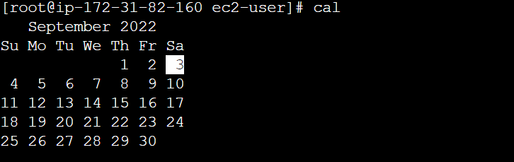
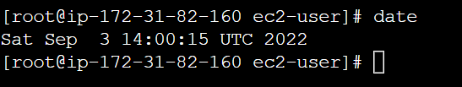
cal: It will display calender
date: It will display date

Slide 21


uname: It will print the Kernel name
Uname -r: To know about Kernel release

Slide 22
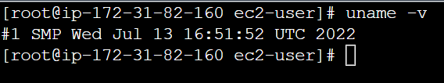

Uname -v: To know about Kernel version
Uname -m: To know about Kernel machine

Slide 23
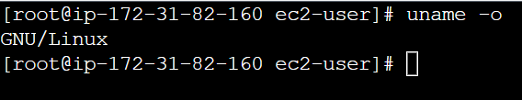
Uname -o: To know about Operating System
Uname -a: To know about complete details

Slide 24
User Management
User management can be done in 3 ways on Linux system
Graphical tools: It is easy & suitable for new users.
Command line tools: It includes commands like useradd, userdel, passwd, etc.
Edit the local configuration file directly using vi.

Slide 25

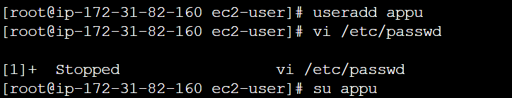
Root: Root user is a super user, He had all access to add user, delete user, login with other user account.
usseradd: To add the users. Cmd: useradd <name>

Slide 26
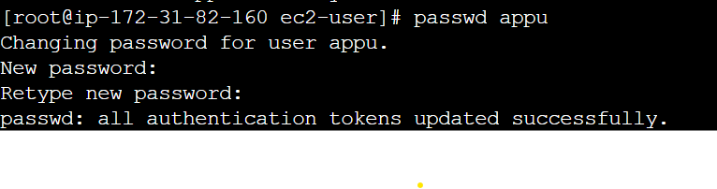

Passwd: User can set the password using command Passwd.
Cmd: passwd <name>
Openssl: Encrypted password can be generated using openssl command
Cmd: openssl passwd <name>

Slide 27
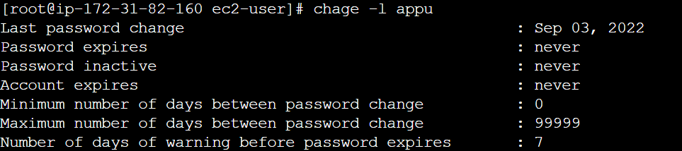
Change: To check the information about user. “-l” user list the info.
Cmd: change –l <name>
Userdel: It is used to delete the user.
Cmd: userdel –r <name>

Slide 28

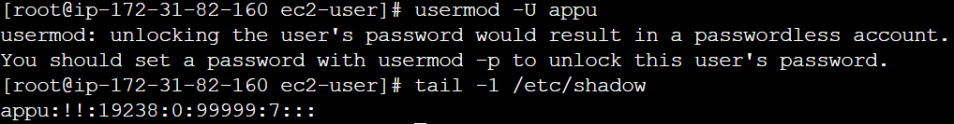
Disabling Password: To disable the password and user account it will help.
Cmd: usermod –L <name>
Unclock Password: To unlock and activating user account & password.
Cmd: usermod –U <name>

Slide 29
Linux Groups
Users can be listed in different groups. Group allow us to set the permission on the group level instead of setting permission on individual.
Group Add: It will create or add groups in our system.
Cmd: groupadd <name>

Slide 30

Group File: User can be a member for any group.
Cmd: vi /etc/group
Usermod: To edit the group members.
Cmd: usermod –a –G <group> <username>

Slide 31

Groupmod: To change the existing group names.
Cmd: groupmod –n <newgroup> <oldgroup>
Groupdel: To delete the groups permanently.
Cmd: groupdel <group>

Slide 32
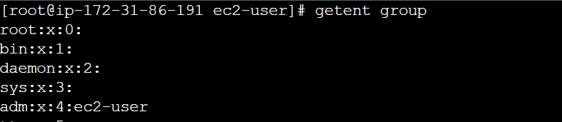
Getent: It will list all the available groups.
Cmd: getent group
Removing User from Group:
Cmd: gpasswd –d <user> <group>

Slide 33
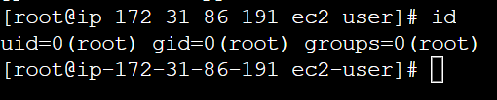
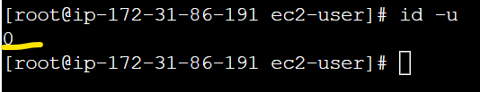
Id: Information about user ID & group ID
Id -u: To know about user ID

Slide 34

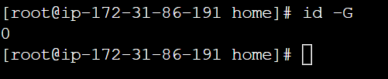
Id -g: Information about group ID
Id -G: To know about all group ID

Slide 35
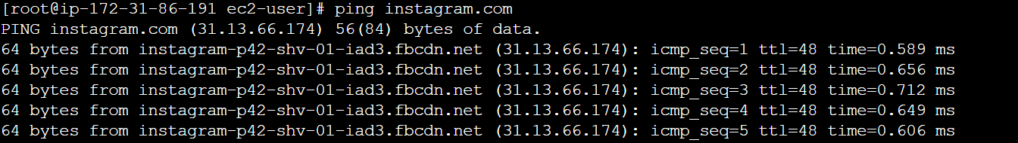
Networking Commands
Ping (Pocket Internet Groper): It is a utility normally used for testing connectivity between two systems on a network LAN WAN.

Slide 36
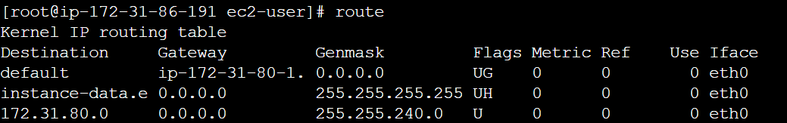
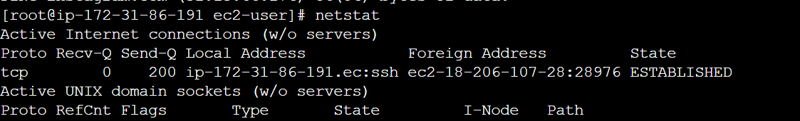
Route: It is an command line utility for displaying or manipulating IP routing table of Linux System
Netstat: It is a command line tool that displays useful information like network connections.

Slide 37
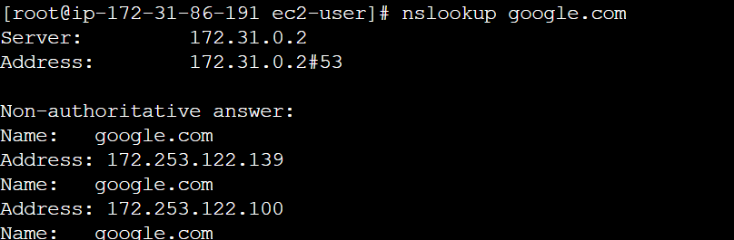
Host Command: It is will carrying out DNS lookups, It converts hostnames to IP address and IP address to hotsnames
Nslookup: It is used to query DNS resource record (RR) interactively and Non-interactively

Slide 38
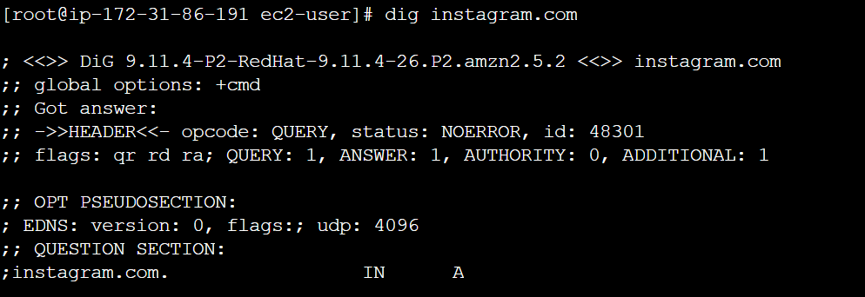
Dig (Domain Information Groper): It is used to query DNS related information like Records, CName, MX records etc

Slide 39
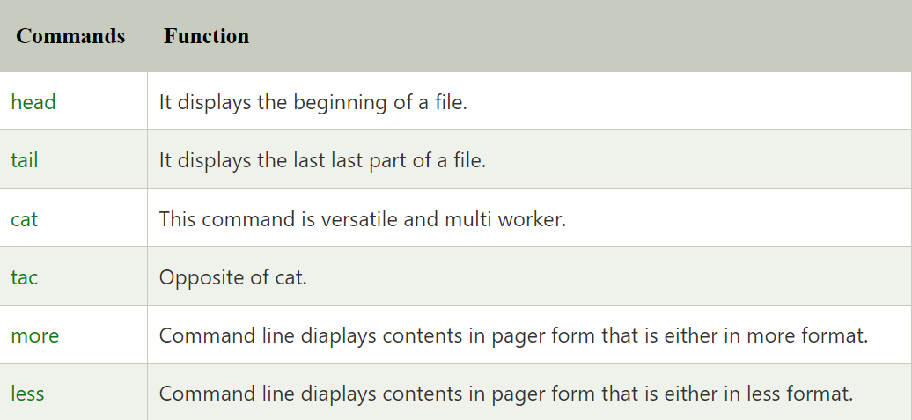
Linux File Contents

Slide 40
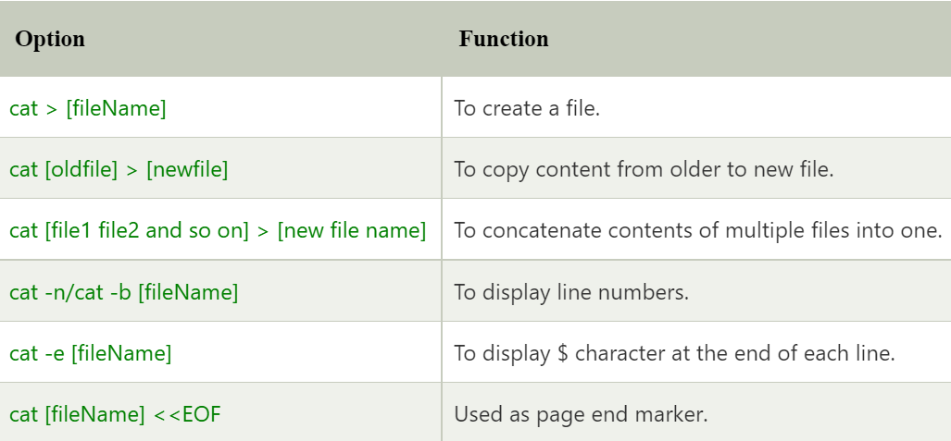
Cat

Slide 41
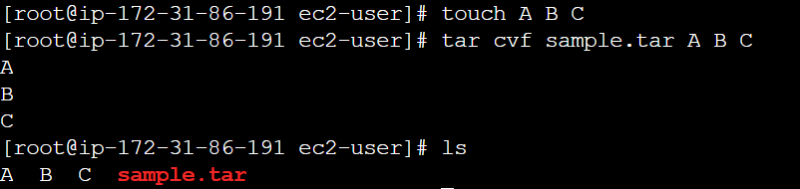
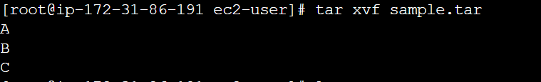
Linux File Compression
tar (tape Archive): It is used to generally pull number of files in to single file
Cmd: tar cvf <name.tar> <files> ------ tar the file
Cmd: tar xvf <name.tar> ----- Untar the file

Slide 42
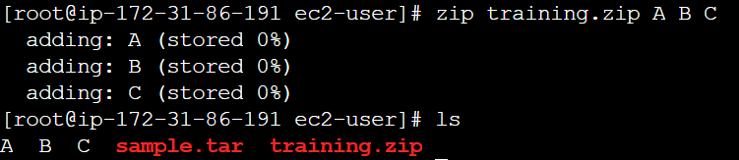
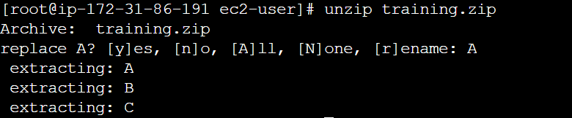
ZIP: It is same like tar, used compress the files. Zip contains more than one compressed file or directory
Cmd: zip <name.zip> <files> ------ zip the file
Cmd: unzip <name.zip> ----- Unzip the file

Slide 43
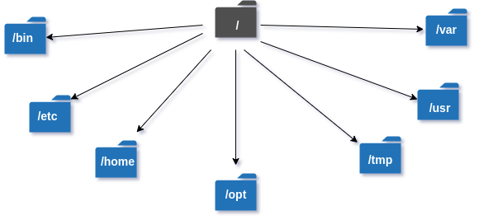
File Management
A directory is a file solo job of which is to store the file names and other related information.
/bin – binary or executable programs.
/etc – system configuration files.
/home – home directory.
/opt – optional or third-party software.
/tmp – temporary space, typically cleared on reboot.
/usr – User related programs.
/var – log files.

Slide 44
/bin: This directory contains user binaries, executable file, commands used by single user mode and common commands like cat, cd, cp, ls, etc.
/etc: This is directory where Linux configuration files present

Slide 45
/etc/shell: To check details about shells.
/home: This directory consists of individual files of particular user in the system.

Slide 46
/tmp: It is used to store the temporary files. Many of use /tmp to write the temporary files and to remove date when it is no longer needed.
/opt: This is reserved for installation add-on application software packages.

Slide 47
/usr: This directory is the location of user programs and files.
/var: This is standard subdirect tory of the root directory.

