Slide 1
GRAFANA · MONITORING & OBSERVABILITY
Node Exporter :9100
Monitoring Dashboard with Grafana
Exposes host metrics
Prometheus :9090
Scrapes & stores
Grafana + Prometheus + Node Exporter, running on Docker Compose
Grafana :3000
Queries & visualizes
Surya Ganiga (MT2025728) - GitHub
M.Tech Artificial Intelligence and Data Science

Slide 2
PART 1 · THE PROBLEM
Why we need monitoring
1
Failures are silent
Our project
Servers can experience high CPU usage, memory exhaustion, or low disk space without immediately crashing. Monitoring helps us detect these warning signs early and take action before they cause downtime.
A containerized monitoring lab. Node Exporter exposes system metrics, Prometheus collects and stores them, and Grafana turns them into real-time dashboards for CPU, memory, disk and network.
One command brings the whole stack up: docker compose up -d
2
Raw metrics are unreadable
Tools such as Node Exporter expose system metrics through a /metrics endpoint in plain-text format. Although this data is useful for machines, it is difficult for humans to interpret quickly. Grafana converts these metrics into visual dashboards, charts, and gauges.
3
No history or trends
A single metric reading shows only the current state of a system. Prometheus stores time-series data, allowing Grafana to display historical trends, identify resource usage spikes, and help us understand how system performance changes over time.

Slide 3
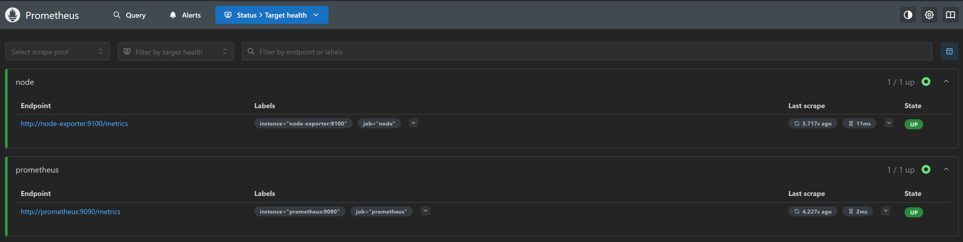
PART 1 · THE PROJECT
Architecture: three containers, one pipeline
Node Exporter
Port 9100
Prometheus
Port 9090
Grafana
Port 3000
Exposes host system metrics at /metrics
Scrapes metrics on a schedule and stores them
Queries Prometheus and displays dashboards

Slide 4
PART 2 · GRAFANA
What is Grafana?
An open-source platform to query, visualize and alert on metrics from many data sources.
Data sources
Dashboards & panels
Prometheus, Loki, MySQL, Elasticsearch and many more.
Graphs, gauges, stats and tables arranged on one page.
Open source, web UI on port 3000
Does not store metrics itself: it queries data sources
Same dashboard works for servers, apps, IoT and business data
Alerting
Community library
Rules that notify you when a metric crosses a threshold.
Ready-made dashboards at grafana.com, e.g. ID 1860.

Slide 5
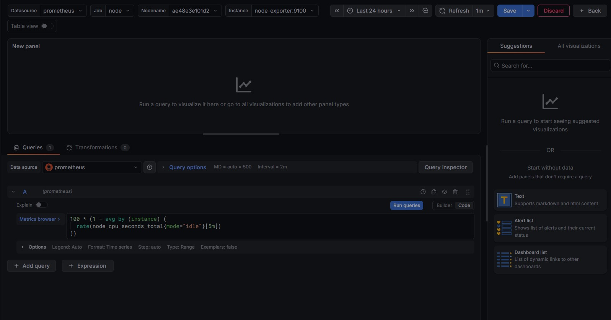
PART 2 · GRAFANA
How Grafana works
1
Data source
2
Query (PromQL)
3
Panel
4
Dashboard
Prometheus vs Grafana
Prometheus collects and stores metrics as time-series data.
Grafana connects to it, runs PromQL queries and draws the results as panels.
Why PromQL Matters
Retrieves specific metrics from large volumes of monitoring data
Calculates rates, averages and resource utilization.
Powers Grafana panels and can support alerting rules.

Slide 6
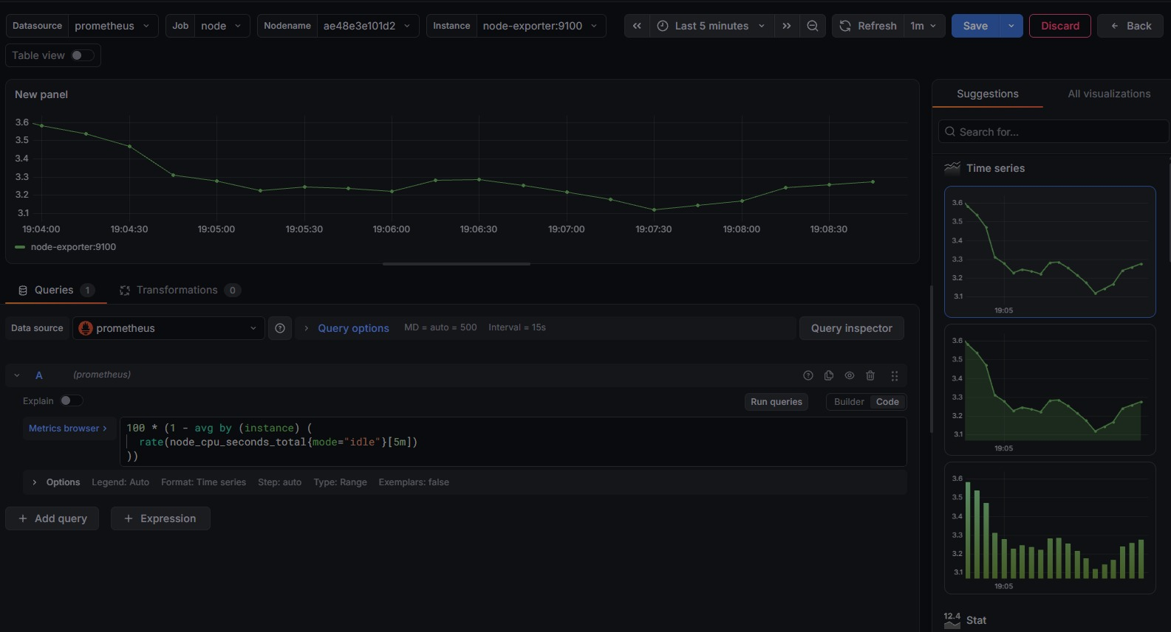
PART 2 · GRAFANA
How Grafana works
1
Data source
2
Query (PromQL)
3
Panel
4
Dashboard
Data source – Grafana connects to Prometheus, which stores system metrics collected by Node Exporter.
Query (PromQL) – Grafana sends queries to Prometheus to retrieve specific metrics, such as CPU utilization, memory usage and network traffic.
Visualization panel – The query results are displayed using graphs, gauges, tables and other visualizations, making system performance easier to understand.
Dashboard – Multiple panels are combined into a single dashboard to provide a centralized view of system health.

Slide 7
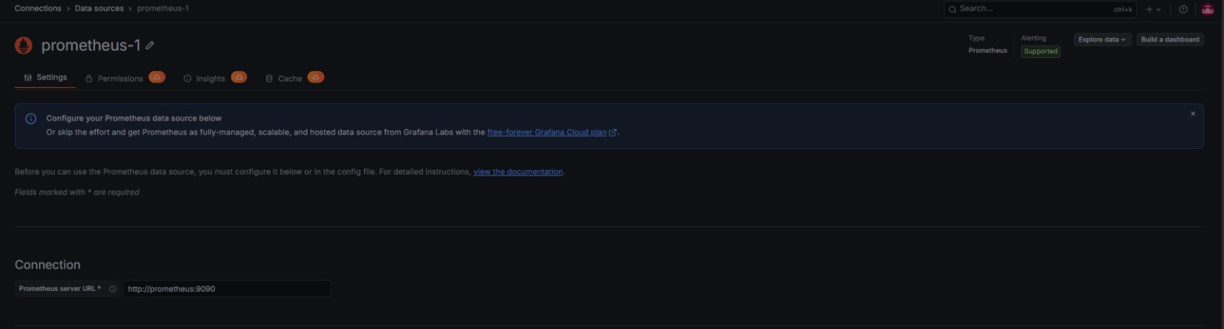
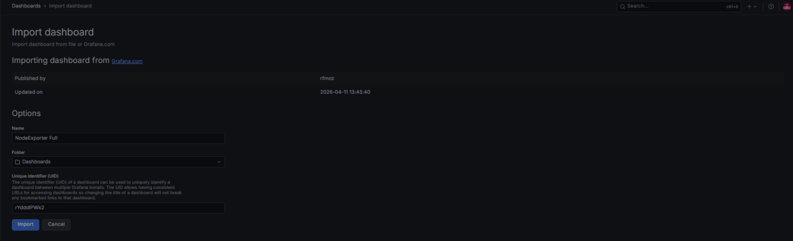
PART 3 · OUR USE OF GRAFANA
How we set it up
1
Start the stack
docker compose up -d starts Grafana, Prometheus and Node Exporter. Open Grafana at localhost:3000.
Data source page
2
Add the data source
Connections, Data sources, Prometheus. URL: http://prometheus:9090, then Save & Test.
3
Import the dashboard
Dashboard import page
Dashboards, Import, ID 1860 (Node Exporter Full), then pick the Prometheus data source.

Slide 8
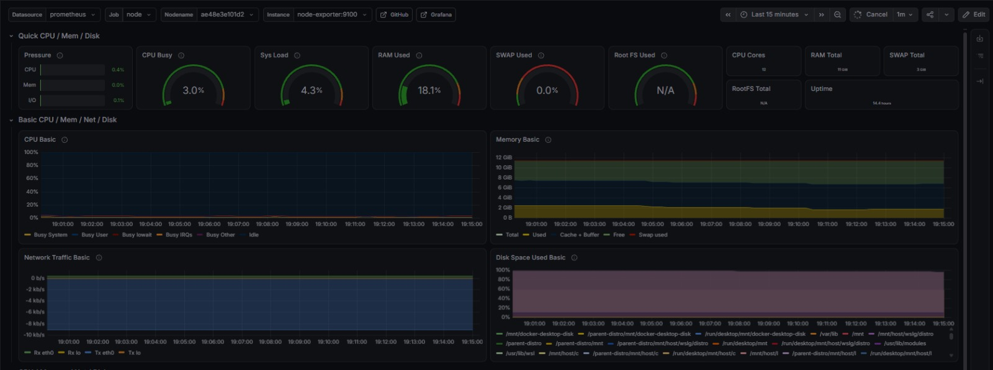
PART 3 · OUR USE OF GRAFANA : LIVE DASHBOARD
CPU : Sustained high utilization can indicate compute pressure
CPU
Usage per core and load average
Memory
Used, cached and free RAM
Disk
Space used and I/O activity
Network
Traffic in and out per interface

Slide 9
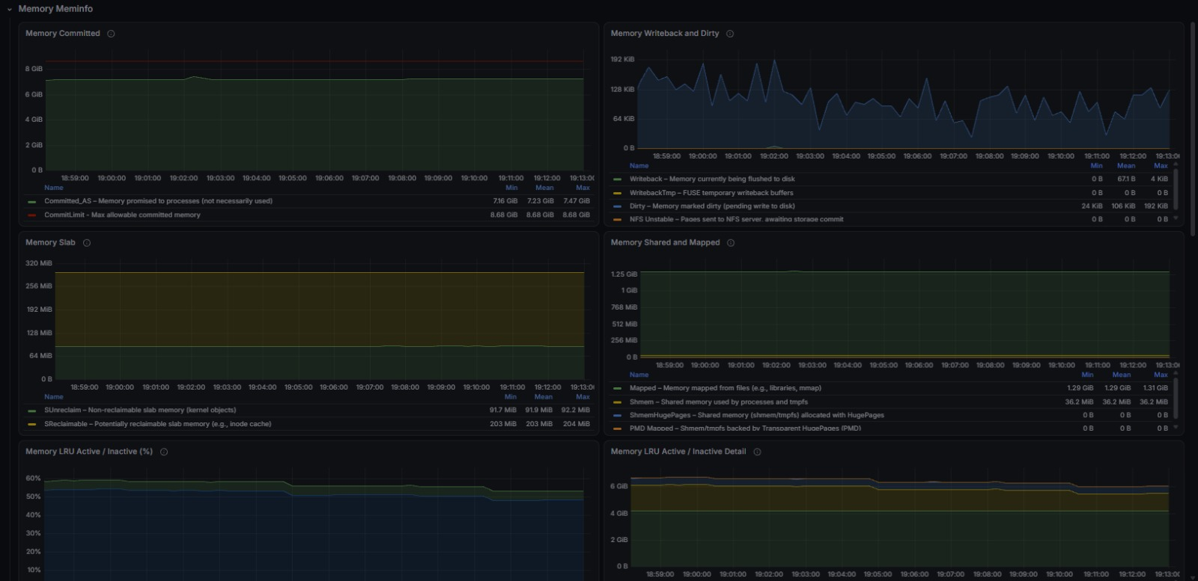
PART 3 · OUR USE OF GRAFANA : LIVE DASHBOARD
Memory : Low available memory can lead to Swapping\OOM failures
CPU
Usage per core and load average
Memory
Used, cached and free RAM
Disk
Space used and I/O activity
Network
Traffic in and out per interface

Slide 10
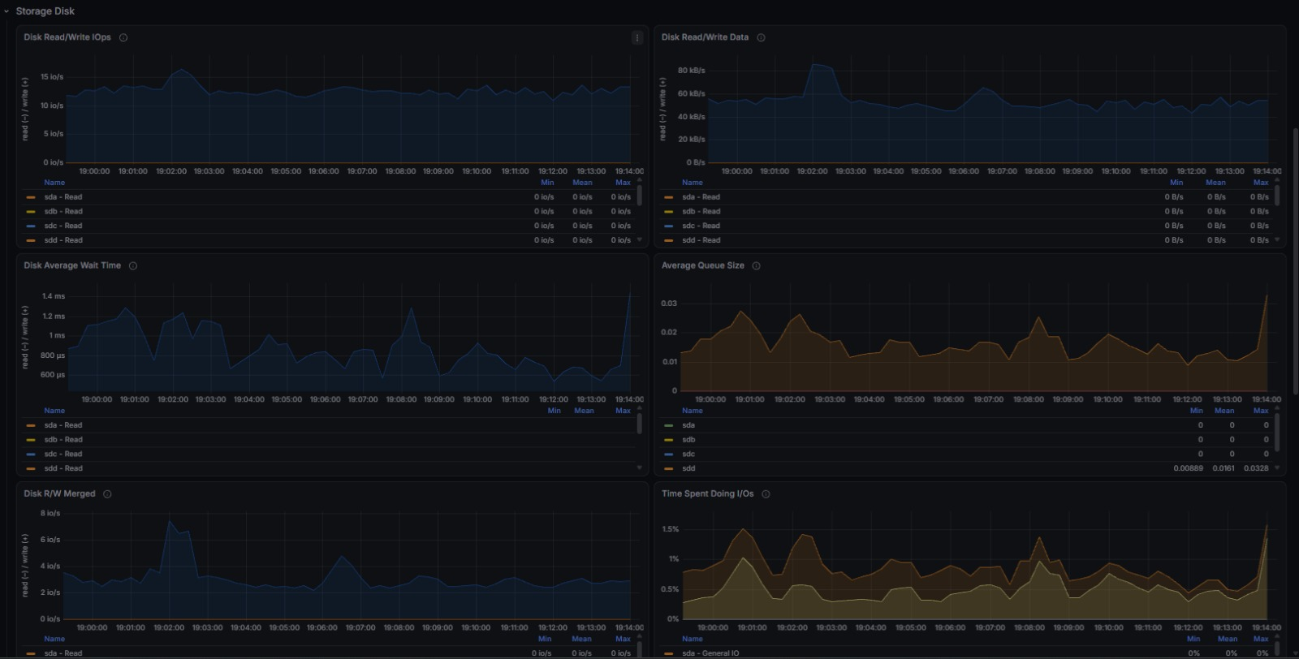
PART 3 · OUR USE OF GRAFANA : LIVE DASHBOARD
Disk : Low free space can prevent applications from writing data
CPU
Usage per core and load average
Memory
Used, cached and free RAM
Disk
Space used and I/O activity
Network
Traffic in and out per interface

Slide 11
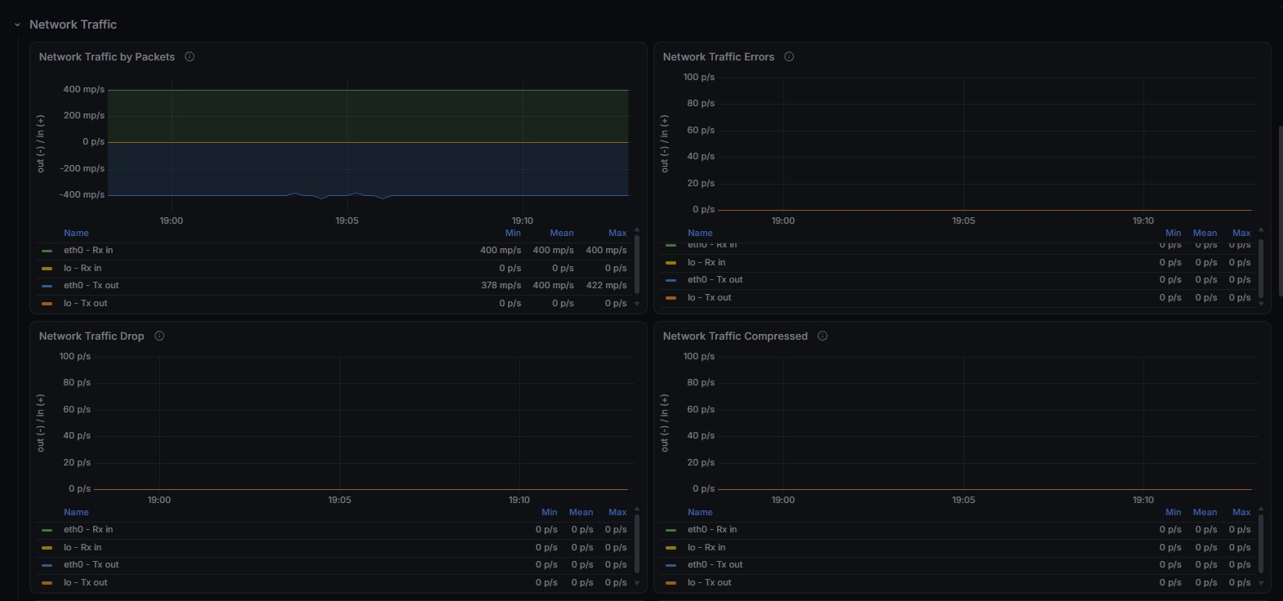
PART 3 · OUR USE OF GRAFANA : LIVE DASHBOARD
Network : Unusual traffic patterns may indicate congestion/unexpected activity
CPU
Usage per core and load average
Memory
Used, cached and free RAM
Disk
Space used and I/O activity
Network
Traffic in and out per interface

