Slide 1
pod
Kubernetes in Production
pod
pod
Deploying a Flask app with Deployments, Services, Ingress, ConfigMaps, Secrets and autoscaling
Project: parvvaresh/flask-k8s-production

Slide 2
PART 1 · THE PROJECT
The problem we are solving
Shipping a web app is easy. Running it reliably is not.
Crashes
One container dies and the app stays down until someone restarts it.
Traffic spikes
A fixed number of instances cannot follow demand.
Config and secrets
Keys and settings baked into the image or the code.
Manual releases
Hand-run deployments are slow and error-prone.

Slide 3
PART 1 · THE PROJECT
The application and its stack
GET /
Greeting message plus the app version
app/ Flask app + tests
Dockerfile image definition
k8s/
namespace.yaml
configmap.yaml
secret.yaml
deployment.yaml
service.yaml
ingress.yaml
hpa.yaml
.github/workflows/
ci, docker-build
deploy, pr-checks
GET /health
JSON status, used by Kubernetes probes
GET /secret
Returns API_KEY from the environment
Settings come from env vars: APP_MESSAGE, APP_VERSION, API_KEY. Served by gunicorn on port 5000 in a python:3.11-slim image.

Slide 4
PART 2 · KUBERNETES
What is Kubernetes?
An open-source container orchestrator, originally built at Google and now maintained by the CNCF. You declare the desired state; Kubernetes keeps reality matching it.
Self-healing
Restarts failed containers and replaces lost pods
Scaling
Adds or removes replicas as demand changes
Service discovery
A stable address with load balancing
Rolling updates
Ship new versions without downtime

Slide 5
PART 2 · KUBERNETES
How a cluster is built
Control plane
Worker node
API server
etcd
kubelet
kube-proxy
Scheduler
Controller manager
Container runtime
Your pods
Decides what should run
Runs what was decided

Slide 6
PART 2 · KUBERNETES
The building blocks we use
Pod
Smallest unit: our Flask container
Deployment
Keeps the desired number of pods running
Service
Stable internal endpoint for pods
Ingress
HTTP routing from outside the cluster
Namespace
Isolated space named demo
ConfigMap
Plain-text settings
Secret
Sensitive values like the API key
HPA
Autoscaling based on CPU

Slide 7
PART 3 · OUR IMPLEMENTATION
Our deployment at a glance
namespace: demo
Deployment · 3 replicas
flask pod 1 · :5000
Client
Ingress
flask.local
Service
flask-svc :80
flask pod 2 · :5000
flask pod 3 · :5000
ConfigMap · env vars
Secret · API_KEY
HPA · 2 to 6 pods

Slide 8
PART 3 · OUR IMPLEMENTATION
Namespace, ConfigMap and Secret
apiVersion: v1
kind: ConfigMap
metadata:
name: flask-config
namespace: demo
data:
APP_MESSAGE: "Hello from ConfigMap!"
APP_VERSION: "1.0"
apiVersion: v1
kind: Secret
metadata:
name: flask-secret
namespace: demo
type: Opaque
stringData:
API_KEY: "super-secret-key"
Namespace demo groups and isolates every resource
Settings live outside the image: change them without a rebuild
Heads-up: Secrets are only base64-encoded, and this repo commits the value in plain text. Fine for a demo; use a secret manager in production.

Slide 9
PART 3 · OUR IMPLEMENTATION
Deployment: running the pods
# simplified excerpt
replicas: 3
containers:
- name: flask
image: flask-k8s-demo:1.0
port: 5000
env:
APP_MESSAGE <- ConfigMap
APP_VERSION <- ConfigMap
API_KEY <- Secret
readinessProbe: GET /health
livenessProbe: GET /health
resources:
requests: 100m CPU, 128Mi
limits: 300m CPU, 256Mi
3 replicas
Pods share load and survive a failure
Probes on /health
Readiness gates traffic; liveness restarts a stuck pod
Requests and limits
Guides placement and caps CPU and memory

Slide 10
PART 3 · OUR IMPLEMENTATION
Service, Ingress and autoscaling
Service
Ingress
HPA
80 → 5000
flask.local
2 – 6 pods
ClusterIP service flask-svc selects app=flask-app and balances traffic across the pods.
Routes path / to flask-svc on port 80. Needs an ingress controller.
Scales the Deployment at 50% average CPU, measured against the 100m request. Needs metrics-server.

Slide 11
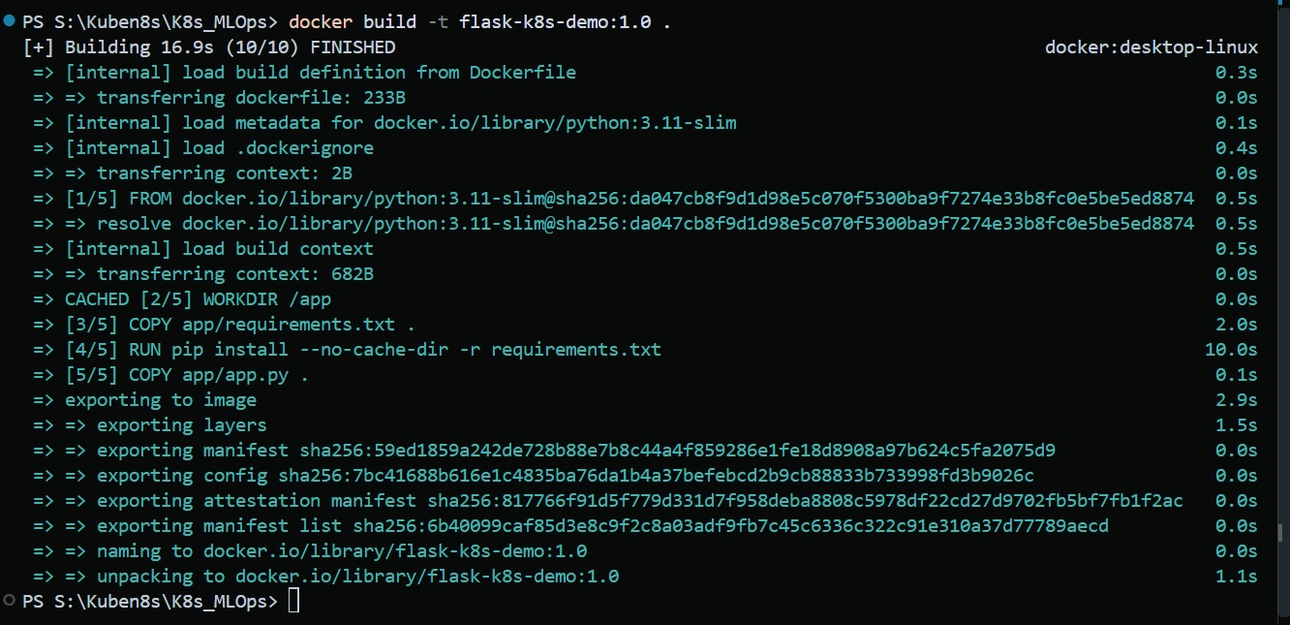
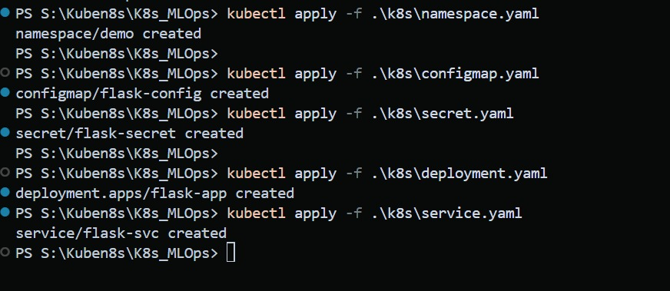
PART 3 · OUR IMPLEMENTATION
Build the image, apply the manifests
Docker build: 10/10 steps finished
Manifests applied one by one
Image built
python:3.11-slim base, tagged flask-k8s-demo:1.0, build time 16.9s.
docker build -t flask-k8s-demo:1.0 .
Applied in order
Namespace, ConfigMap and Secret first, then Deployment and Service.
kubectl apply -f .\k8s\<file>.yaml

Slide 12
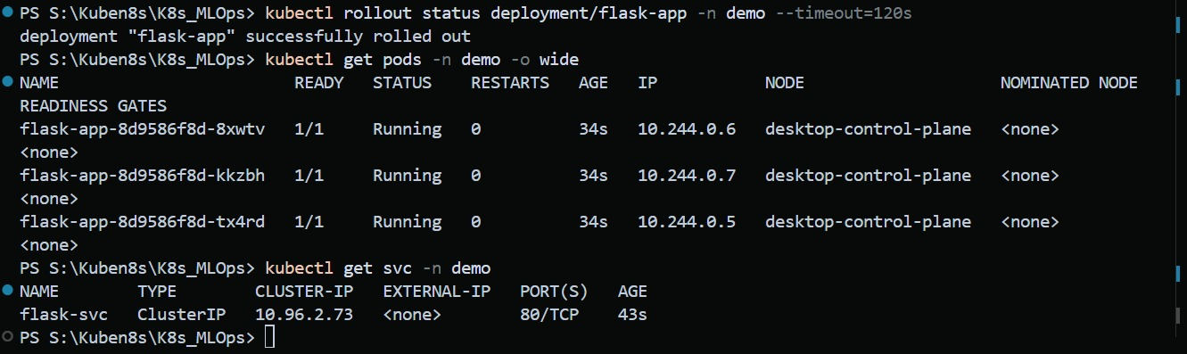
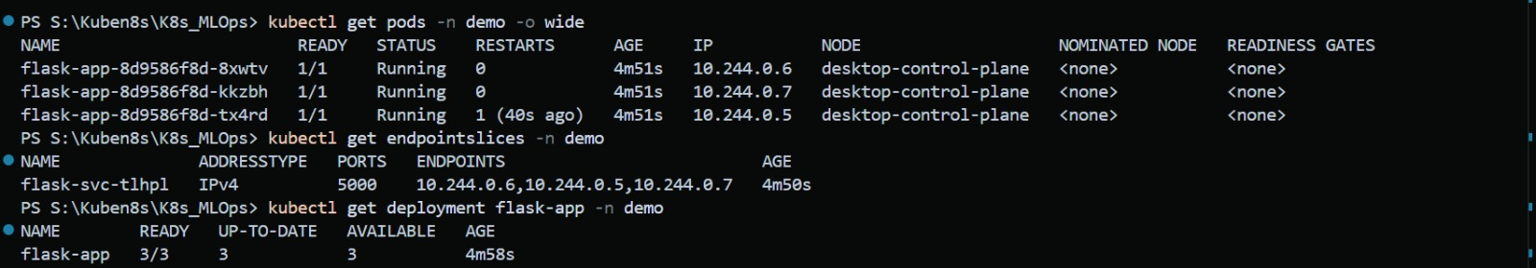
PART 3 · OUR IMPLEMENTATION
Verify the rollout
rollout status, get pods and get svc
3 pods Running
Rollout finished with all replicas ready and 0 restarts.
Service on port 80
ClusterIP flask-svc sends traffic to container port 5000.
pods, EndpointSlice and deployment
Endpoints match
The EndpointSlice lists all 3 pod IPs; deployment reads 3/3.

Slide 13
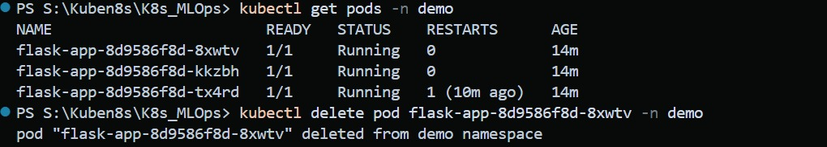
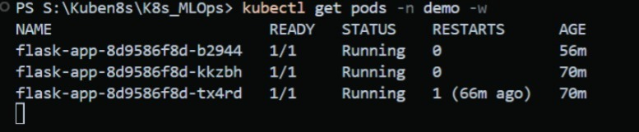
PART 3 · OUR IMPLEMENTATION
Self-healing: delete a pod
Delete one of the three pods by hand
Pod deleted
kubectl delete pod removes one of the three replicas.
ReplicaSet reacts
A new pod is created to restore the desired count of 3.
A replacement is already running
No manual step
Three pods are back to 1/1 Running on their own.

Slide 14
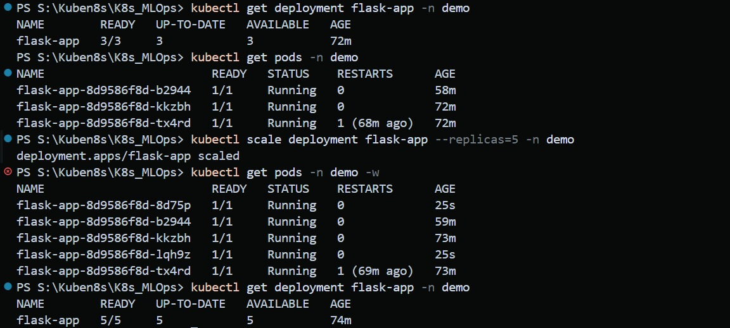
PART 3 · OUR IMPLEMENTATION
Scaling by hand: 3 to 5 replicas
kubectl scale deployment flask-app --replicas=5
One command
scale sets the replica count; the Deployment does the rest.
New pods in seconds
Two pods, 25s old, joined the three existing ones.
Deployment 5/5
READY, UP-TO-DATE and AVAILABLE all reach 5.

Slide 15
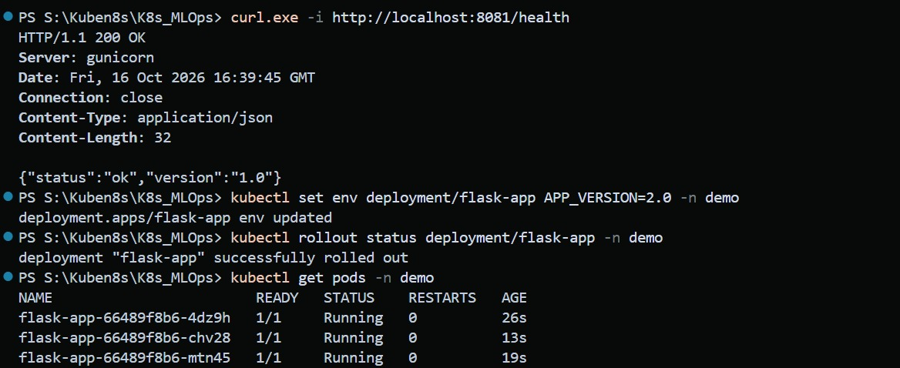
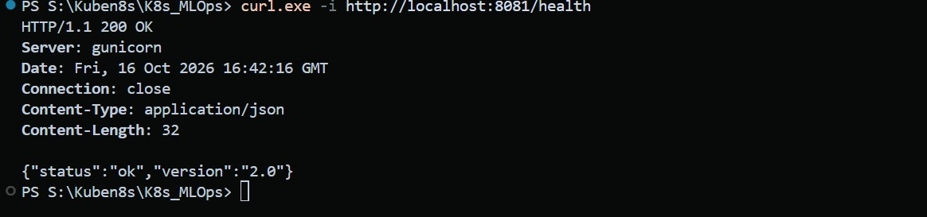
PART 3 · OUR IMPLEMENTATION
Rolling update: v1.0 to v2.0
Health check, set APP_VERSION=2.0, then rollout
No rebuild needed
kubectl set env changed APP_VERSION; the image stayed the same.
Pods replaced
New pods (hash 66489f8b6) took over from the old ones (8d9586f8d).
After the rollout, /health reports 2.0
Checked from outside
/health on localhost:8081 answered 1.0 before and 2.0 after.

Slide 16
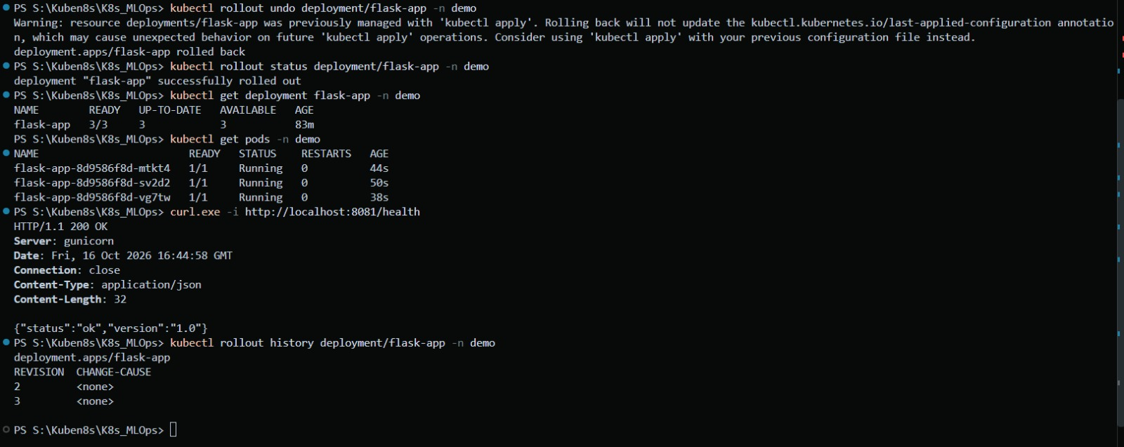
PART 3 · OUR IMPLEMENTATION
Rollback in one command
rollout undo, status, pods, health check and history
rollout undo
Returns the Deployment to its previous revision and replaces the pods.
Version is 1.0 again
/health answers 1.0 once the rollback has finished.
History and a caveat
Revisions 2 and 3 are kept. Undo skips last-applied, so re-apply the YAML.

Slide 17
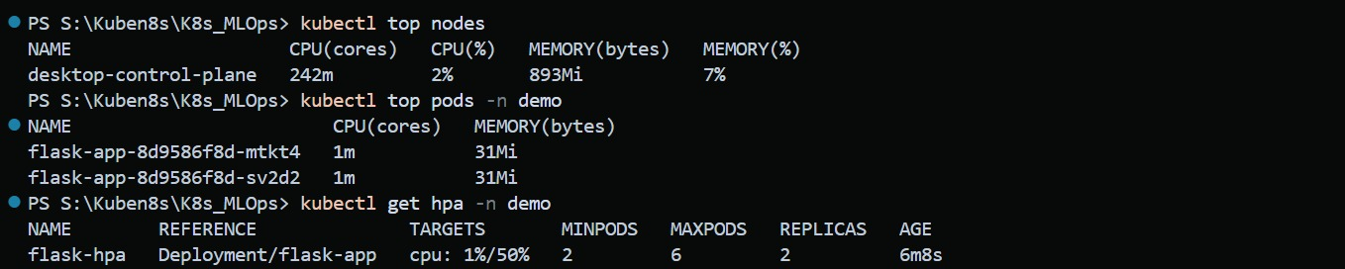
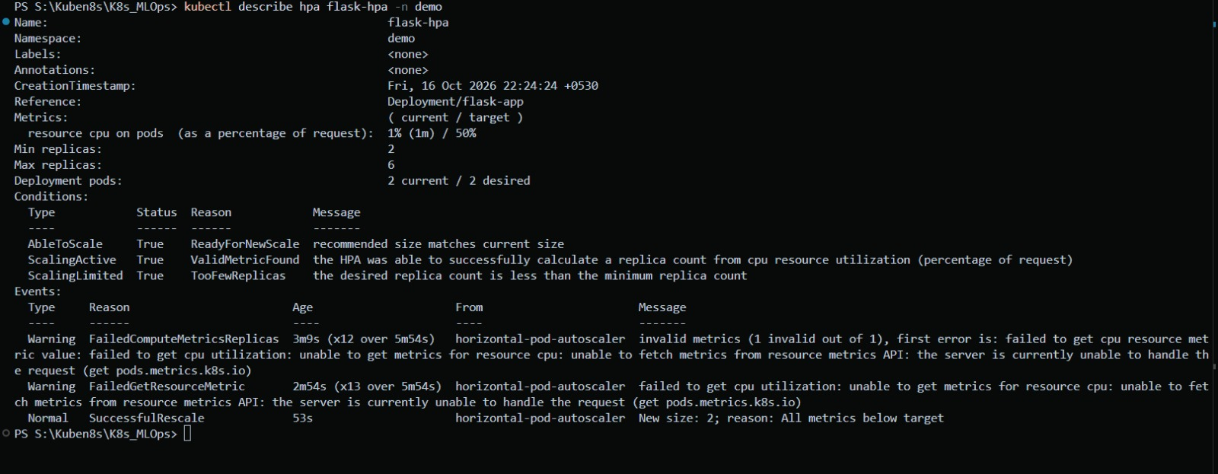
PART 3 · OUR IMPLEMENTATION
Metrics and the HPA
kubectl top and get hpa
metrics-server
top nodes and top pods read the same data the HPA uses.
Idle at the minimum
CPU at 1% of the 50% target keeps replicas at 2.
kubectl describe hpa: conditions and events
Early warnings
FailedGetResourceMetric appeared before the metrics API was ready.

Slide 18
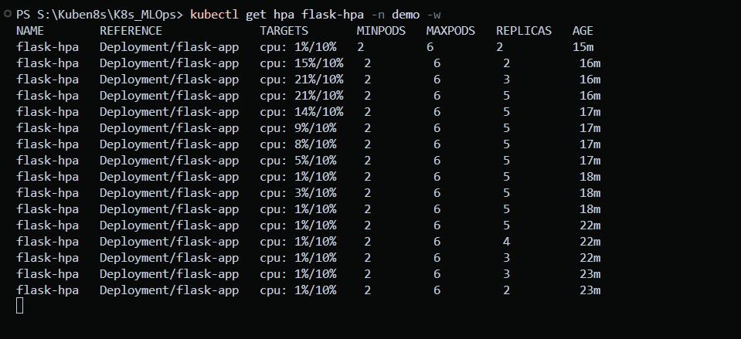
PART 3 · OUR IMPLEMENTATION
Autoscaling under load
kubectl get hpa flask-hpa -n demo -w
Lower demo target
This run uses a 10% CPU target so scaling shows quickly.
Scale up
CPU passed the target and replicas went 2, 3, then 5.
Scale down
CPU fell to 1%; a few minutes later replicas dropped back to 2.

Slide 19
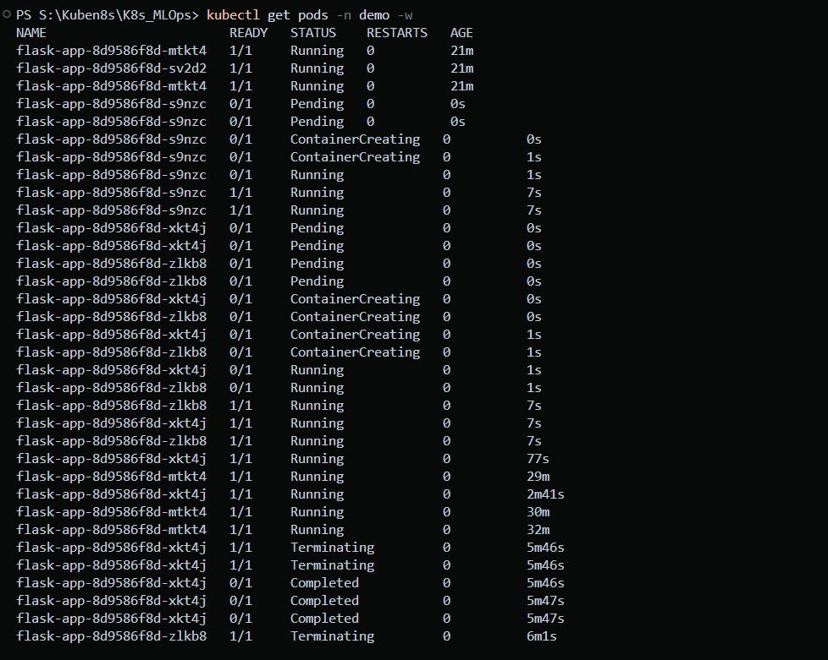
PART 3 · OUR IMPLEMENTATION
Pods during scale-up and scale-down
kubectl get pods -n demo -w across the test
Pending to Running
New pods are Ready (1/1) about 7 seconds after they appear.
Three pods added
Three new pods joined the original two, matching the HPA's 5 replicas.
Graceful scale-down
Extra pods show Terminating, then Completed, as load falls.

Slide 20
Key takeaways
1
Kubernetes keeps the desired state: 3 healthy pods, always reachable
2
Config and secrets live outside the image
3
Service and Ingress give one stable entry point
4
HPA scales 2 to 6 pods on CPU; probes give self-healing
5
GitHub Actions adds CI, image builds and a manual deploy
https://github.com/satts27/K8s_MLOps

