Slide 1
Time Complexity Analysis
Sattvik Sahai
CS 284 D
Department of Computer Science

Slide 2
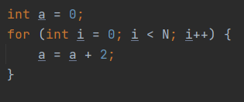
Big O notation
Example 1:
O(N)
O(1)
O(logN)
O(N²)

Slide 3
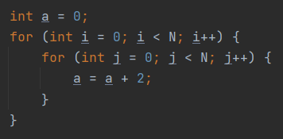
Big O notation
Example 2:
O(N)
O(1)
O(logN)
O(N²)

Slide 4
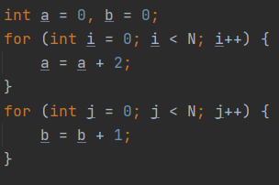
Big O notation
Example 3:
O(N)
O(1)
O(logN)
O(N²)

Slide 5
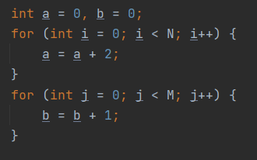
Big O notation
Example 4:
O(N²)
O(MN)
O(M+N)
O(N)

Slide 6
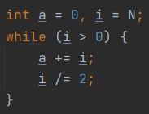
Big O notation
Example 5:
O(N)
O(1)
O(logN)
O(N²)

Slide 7
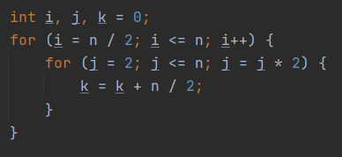
Big O notation
Example 6:
O(N logN)
O(N)
O(logN)
O(N²)

Slide 8
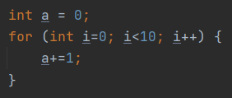
Big O notation
Example 7:
O(N)
O(1)
O(logN)
O(N²)

Slide 9
Sattvik Sahai
ssahai@stevens.edu

