Slide 1
📊 Sales & Profit Dashboard (2014–2017)
Prepared By: Sattwik Roy Data Analyst Intern – Elevate Labs

Slide 2
Dashboard Objective
To design an interactive dashboard using Power BI
Help business stakeholders analyze performance efficiently
Track key performance indicators such as Sales, Profit, and Orders
Visualize trends over time and across categories, regions, and segments

Slide 3
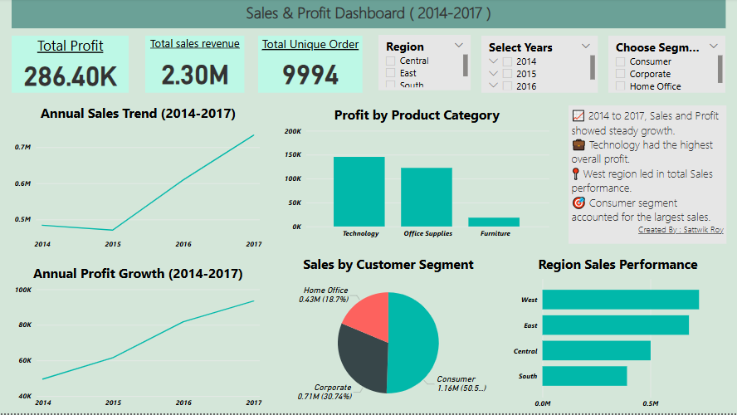
Power bi dashboard overview
This dashboard provides a clear and interactive visualization of:
Total Sales, Profit, and Order Volume
Year-wise sales & profit trends
Regional and Segment performance
Category-wise profit distribution
Filters for Region, Year, and Segment
help refine the analysis.

Slide 4
Key business insights (2014-2017)
Total Sales: ₹23 Lakhs
Total Profit: ₹2.86 Lakhs
Total Orders: 9994
Steady year-over-year growth in both sales and profit
Consumer Segment contributed the highest sales
Technology Category generated the highest profit
West Region showed strongest overall performance

Slide 5
Conclusion & recommendations
Focus on high-profit categories like Technology
Expand marketing and operations in West and East regions
Monitor Furniture category due to lower profit margins
Use this dashboard regularly to drive data-driven decisions
Continue refining KPIs and exploring deeper analytics in future

