Slide 1
An introduction to LaTeX
- a document preparation language
Shaun Cole
(adapted from a lecture by Cedric Lacey)

Slide 2
You can find these notes and some LaTeX examples on my web page: http://astro.dur.ac.uk/~cole/Intro_LaTeX_PG

Slide 3
What is LaTeX?
A document preparation system in which the source file contains both text and markup commands
Create source file using normal text editor
Run LaTeX program to see result
LaTeX program decides details of word spacing, line breaks, page breaks, position of figures & tables etc according to instructions in source file

Slide 4
Why use LaTeX?
Produces high-quality output with uniform style, e.g. for journals, conference proceedings
Style can be changed simply by global commands or by loading different macro packages
Lets you concentrate on content rather than formatting/layout
Very good for mathematics & equations
Automatic numbering & cross-referencing of sections, equations, figures, tables etc
Free! Runs on all operating systems
THE STANDARD for publications in physics, astronomy, maths

Slide 5
Useful books
Guide to LATEX
by H. Kopka & P. Daly
- describes standard features & some additional ones – HIGHLY RECOMMENDED!
The LATEX Companion
by Goossens, Mittelbach & Samarin
- describes lots more optional/additional features
- both in the Astronomy reading room

Slide 6
Useful websites:
A very brief overview to get you started:
http://www.tug.org/begin.html
A much more detailed introduction:
ftp://tug.ctan.org/pub/texarchive/info/
beginlatex/html/beginlatex.html
Another general introduction:
http://amath.colorado.edu/documentation/ LaTex

Slide 7
More websites:
A primer for typesetting equations in LaTeX:
http://www.maths.tcd.ie/~dwilkins/LaTeXPrimer/
some hints about including graphics:
http://merkel.zoneo.net/Latex/index.php?lang=en
Latex beamer
http://gking.harvadr.edu/files/beamerusrguidef.pdf
how to cite references using natbib package:
http://merkel.zoneo.net/Latex/natbib.php
references using BibTeX:
http://www.bibtex.org

Slide 8
Macros & tips for PhD theses in LaTeX
Durham PhD thesis macros:
http://www-old.cs.st-andrews.ac.uk/ ~eb/thesisclass.php
another example, with useful hints:
http://amath.colorado.edu/documentation/LaTeX/
thesis/sample/

Slide 9
LaTeX & TeX
The LaTeX program is actually written in a lower-level typesetting language TeX
If you want to install LaTeX on your own computer, have to install TeX first (or install TeX & LaTeX together)
But normal user can use LaTeX without knowing anything about TeX
Can use some TeX commands in LaTeX documents – but better to use LaTeX equivalents (added functionality, usually clearer & simpler)

Slide 10
How to install TeX & LaTeX
If you want to install TeX & LaTeX on your own laptop:
Linux: download teTeX distribution from www.tug.org/tetex
Windows: try MiKTeX from www.miktex.org
or TeXnicCenter from
sourceforge.net/projects/texniccenter
Mac OS X:
try gwTeX from ii2.sourceforge.net/tex-index.html
or TeXShop distribution (includes GUI) from
http://www.uoregon.edu/~koch/texshop

Slide 11
How to run LaTeX under Linux/Unix
Create a LaTeX source file with suffix '.tex', e.g. mypaper.tex, using a text editor
Use an editor which provides special features for LaTeX files e.g. emacs
Run LaTeX program: > latex mypaper.tex OR > latex mypaper (suffix .tex assumed!)
Producing a file mypaper.dvi
Can view on screen (if EPS figures) using > xdvi mypaper.dvi (OR > xdvi mypaper)

Slide 12
Producing Postscript output
Postscript (PS) files, suffix '.ps', are designed to be printed, but can be viewed on screen, e.g. Using gv (ghostview)
To produce .ps from .dvi: > dvips -o mypaper.ps mypaper.dvi
For this to work, included figures/graphics must be Encapsulated Postscript (EPS) files, suffix '.eps'
Then print: > lpr mypaper.ps
Or view on screen: e.g. > gv mypaper.ps

Slide 13
Producing PDF output
Portable Document Format (PDF) files are designed to be viewed on screen, e.g. using acroread, but can be printed from a PDF viewer
Three ways to make from LaTeX:
(1) from .ps file (output: mypaper.pdf) > ps2pdf mypaper.ps
(2) from .dvi file > dvipdf mypaper.dvi
(3) directly from .tex file (output: mypaper.pdf) > pdflatex mypaper.tex
For (3) to work, included figures/graphics must be either PNG (.png) or PDF (.pdf) (or JPEG (.jpeg, .jpg) in some versions)

Slide 14
Some other things....
There are programs which can convert your figures/graphics between different formats, e.g, .eps to .png e.g. in Linux can use display or convert, on MAC use preview
There are also programs which can convert your LaTeX files directly to HTML for web pages

Slide 15
How to run LaTeX under Windows
Basic procedure same as in Linux, i.e. file.tex (latex) -> file.dvi (dvips) -> file.ps OR file.tex (pdflatex) -> file.pdf
Much easier if install editor with built-in features for LaTeX, e.g.
WinShell (free) from www.winshell.de
WinEdt (costs US$30 for students) from www.winedt.com

Slide 16
How to run LaTeX under Mac OS X
Basic procedure same as in Linux, i.e.
file.tex (latex) -> file.dvi (dvips) -> file.ps
OR
file.tex (pdflatex) -> file.pdf
More convenient to work with PDF rather than PS on Macs
If you like a graphical front-end, try TeXShop from
http://www.uoregon.edu/~koch/texshop

Slide 17
Now a simple example
LaTeX demodoc.tex, with included figure fig.jpg

Slide 18
Structure of a LaTeX file
\documentclass[options]{class_name}
% documentclass determines overall structure
preamble – global commands which affect whole document
\begin{document}
text
+ instructions for including figures
\end{document}

Slide 19
Standard document classes
article : document has sections, subsections, sub-subsections, e.g. For paper in journal or conference proceeding \documentclass{article}
report : also has chapters, title page, table of contents, e.g. For L4 or PhD thesis
book : similar to report, but extra features for publication-quality book
letter : for writing letter – letterhead but no sections

Slide 20
Other document classes
Many people have created modified versions of standard classes. For these, you need class file, e.g. thesis.cls (modified report.cls), then \documentclass{thesis}
Each journal has its own style. Download .cls file from journal webpage
MNRAS: mn2e.cls (modified article.cls) \documentclass{mn2e}
ApJ, AJ: aastex.cls \documentclass{aastex}

Slide 21
Document class for L4 dissertation
Many people have created modified versions of standard classes, e.g. for writing PhD theses
For these, you need class file, e.g. duthesis.cls (modified report.cls) produces layout for Durham PhD thesis, which you can also use for L4 thesis
Download duthesis.cls from http://www-old.cs.st-andrews.ac.uk/~eb/thesisclass.php
Then begin document with \documentclass{duthesis}
See my example thesis_example.tex, also thesis_template.tex

Slide 22
Loading packages
Packages are used to add additional features, or to modify standard features of class
Need \usepackage command in preamble, e.g. \usepackage{amssymb} which adds extra math symbols
Needs file amssymb.sty to be in current directory or elsewhere in LaTeX search path

Slide 23
Splitting a document into different files
For long documents (e.g. PhD thesis) better to split into several files
e.g. File main.tex could contain: \documentclass{report} \begin{document} \input{chap1} \input{chap2} \end{document}
Inputs chap1.tex, chap2.tex
Effect is same as cutting & pasting chap1.tex etc into main.tex at position of \input command

Slide 24
Special characters for commands
These characters are used in a LaTeX file in markup commands: \ % # $ & ~ _ ^ { }
\ begins a command name
% begins a comment
{} delimit the arguments to commands and the range within which some commands act
$ starts/ends math mode
If you want %, &, $ to appear in document, need to type \%, \&, \$ in .tex file etc

Slide 25
Font sizes & styles
Can change overall fontsize using optional argument in \documentclass, e.g. \documentclass[12pt]{article}
For italics use \em, e.g. Some text {\em some text in italics} more text
For boldface use \bf, e.g. Some text {\bf text in bold} more text
Greek characters available in math mode, e.g. The $\alpha$-elements

Slide 26
Defining your own commands
Use \newcommand e.g. \newcommand{\etal}{{\em et al.}}
Effect is equivalent to replacing every appearance of \etal in file with {\em et al.}
Can also define commands with arguments
\newcommand\Bold[1]{{\bf #1}}
Then \Bold{this text} is equivalent to {\bf this text}

Slide 27
Chapters, sections, etc
e.g. \chapter{The model} \section{Dark matter halos} \subsection{Density profiles} \subsubsection{Some irritating details}
Heading will be printed using text in {}
Chapters, sections etc will be numbered automatically
e.g. Chapter 1, Section 1.2, Subsection 1.2.5, etc

Slide 28
Lists
LaTeX can make various kinds of lists, e.g. \begin{itemize} \item apples \item oranges \item bananas \end{itemize} will list items preceded by bullet-points
\begin{enumerate} etc will make list with items numbered 1,2,3 etc

Slide 29
Equations
In math mode, can have
Greek characters, e.g. \alpha
Other math symbols, e.g. \leq
Fractions, integrals etc
Subscripts, e.g. x_n
Superscripts, e.g. y^2
AMS-LaTeX package amsmath gives even more possibilities \usepackage{amsmath}

Slide 30
Text & displayed equations
Text equations are embedded in normal text and start and end with $, e.g. We define $y=x^2$.....
No equation numbers for text equations
Displayed equations appear on a separate line, and can have numbers, e.g. \begin{equation} y = x^2 \end{equation}
For multi-line equations, use \begin{eqnarray} etc

Slide 31

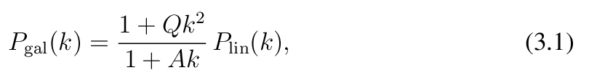
Equations: Example 1
You type:
You get:

Slide 32

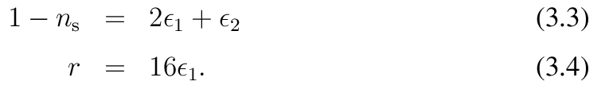
Equations: Example 2
You type:
You get:

Slide 33
Including graphics
Modern way to include graphics from file uses graphicx package: preamble must include \usepackage[dvips]{graphicx} (for dvips)
OR \usepackage[pdftex]{graphicx} (for pdflatex)
Then to include a graphics file \includegraphics[key=value,...]{file_name}
e.g. \includegraphics[width=8.5cm]{myplot}
Will load myplot.eps (for dvips) or myplot.png or myplot.pdf (for pdflatex) and rescale to width of 8.5cm

Slide 34
Floating figures
\includegraphics command will try to insert figure at that point if space on page, otherwise on next page, leaving blank space on current page
Better to let figure “float”, using figure environment, e.g. \begin{figure} \includegraphics[scale=0.6]{lumfun} \caption{The luminosity function} \end{figure}
This also gives the figure a caption and a number
WARNING: may need to tune figure placement manually

Slide 35
Tables
Make tables using \tabular environment, e.g. \begin{tabular}{lcc} galaxy & magnitude & redshift \\ NGC 891 & 15.5 & 0.02 \\ M87 & 14.8 & 0.01 \end{tabular}
Which left-justifies 1st column and centres 2nd and 3rd columns
& separates columns and \\ separates lines

Slide 36
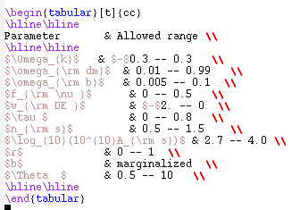
Tables: Example
You type:

Slide 37
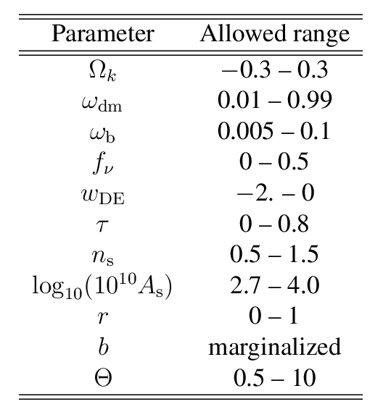
Tables: Example (continued)
You get:

Slide 38
Floating tables
Usually make tables “float” (like figures) using table environment, e.g. \begin{table}
\caption{Galaxy magnitudes and redshifts} \begin{tabular}{rlcc} ................ \end{tabular} \end{table}
Which also gives the table a caption and a number

Slide 39
Cross-referencing
Can cross-reference sections in a paper, equations, figures, tables using \label to create labels, and \ref to refer forward or back to them
e.g. to label a section: \section{Dark halos} \label{sec:halos}
Then to refer to it: We discuss the structure of dark halos in Section \ref{sec:halos}
LaTeX will insert actual section number
Cross-referencing info written to .aux file
Must run LaTeX TWICE to get final document

Slide 40
Cross-referencing figures & tables
Works similarly for figures & tables, e.g. \begin{figure} ............... \caption{The luminosity function} \label{fig:lumfun} \end{figure}
NB \label inside figure environment after \caption
Then to refer to it: We show in Fig.~\ref{fig:lumfun} that....
\ref{...} gets replaced by actual figure number in document

Slide 41
Cross-referencing equations
Similarly for equations, e.g. \begin{equation} P_a = \frac{y_3/x^2} \label{eq:p_a} \end{equation}
Then to refer to it: $P_a$ is defined in eqn.(\ref{eq:p_a})......
The brackets () here enclose the equation number in brackets, e.g. eqn.(3.2)

Slide 42
Bibliographic references – simple approach
Use the natbib package: \usepackage{natbib}
Create your bibliography (in alphabetical order): \begin{thebibliography}{} ........... \bibitem[Smith \& Jones (1990)]{Smi90} Smith, A., \& Jones, B., 1990, ApJ 231, 506 ............ \end{thebibliography}
One \bibitem for each article or book referred to
LaTeX will typeset your bibliography

Slide 43
Refering to a paper in the bibliography (using natbib)
Then to refer to a paper in the text, use \citet or \citep or \citeauthor or \citeyear, e.g.
\citet{Smi90} produces “Smith & Jones (1990)”
\citep{Smi90} produces “(Smith & Jones 1990)”
\citeauthor{Smi90} produces “Smith & Jones”
\citep[see][chap 6]{BT} produces “(see Binney & Tremaine, chap 6)”
\citep{Smi90,Cole12} produces “(Smith & Jones 1990; Cole 2012)”
See documentation on natbib for more possibilities

Slide 44
Bibliography with BibTeX
A more sophisticated approach is to store all your bibliographic data in a separate (or multiple) BibTeX file(s)
You then have to run the BibTeX program along with LaTeX
But different LaTeX documents can share the same BibTeX files, so you only ever need to enter references in the database once
See www.bibtex.org or “Guide to LaTeX” (Kopka & Daly) for more details
Compatable with natbib citation package

Slide 45
Example BibTeX entry
You create bibliographic database file, e.g. refs.bib
example entry:
@ARTICLE{Almeida2007a
author = {Almeida, C., Baugh, C.M. and Lacey, C.G.},
title = {The structural properties of galaxies in CDM},
journal = MNRAS,
year = 2007,
volume = 376,
pages = {1711-1726}
}
File begins...ends with \begin{thebibliography}...\end{the bibliography}
ADS will create entries in BibTeX format for you

Slide 46
Running BibTeX with LaTeX
Main LaTeX file (e.g. paper.tex) must specify (somewhere) bibliographic style, e.g.
\bibliographystyle{mn2e}
- loads file mn2e.bst
And specify where bibliography to appear & which databases to load, e.g.
\bibliography{refs}
- loads file refs.bib
Need to run LaTeX (e.g. latex paper), then BibTeX (bibtex paper) (creates file refs.bbl), then LaTeX again (TWICE)

Slide 47
latexdiff
Perl script for highlighting the differences between two versions of a LaTeX file
latexdiff oldfile.tex newfile.tex > diff_file.tex
latex diff_file
The resulting pdf/ps file shows the deleted text in red with a line through it and the inserted text in blue and underlined with a wavy line.

Slide 48
The End

