Slide 1



COMPETITIVE
ANALYSIS
Understanding how our competitors work and what should be our strategy.

Slide 2


TODAY'S AGENDA
1
Introduction to the Session
2
Agenda for our analysis
3
Competitive Analysis
4
Summary and Actionable Items

Slide 3





INTRODUCTION
In this session we will go through performing competitive analysis of the various players available in the job tech domain. We will then focus on one of these companies to understand their business model, marketing plan, marketing plan, social media strategies and growth tactics.
Sattyam

Slide 4
Review our brand and competitors.
COMPETITIVE ANALYSIS
Competitive analysis allows us to understand where we are as a brand and how our competitors work. We will start by identifying who our competitors are. Next, we will identify attributes they are doing right.
1
2
Helps identifying important features
3
Identify criteria and attributes.
4
Learn about the market and improve our product.

Slide 5

JOB TECH
COMPETITORS
We need to understand our direct, indirect, substitute and potential competitors.

Slide 6

NAUKRI.COM
Monthly visits: 27.4 M
Bounce rate: 36.45 %
Organic search traffic: 16.4 M
Paid search traffic: 441.3 K
Backlinks: 10.3 M
Launched in March 1997, Naukri.com is India’s largest employment website in India. The company operates on both B2B (Business to Business ) and B2C (Business to Consumer Model)

Slide 7

INDEED
Monthly visits: 14.4 M
Bounce rate: 34.16 %
Organic search traffic: 12.6 M
Paid search traffic: 123.1 K
Backlinks: 1.7 M
Indeed is world’s #1 job site in the world with over 250 M unique visitors all over the world. They generate revenue by selling premium job posting and resume features to employers and companies hiring

Slide 8

GLASSDOOR
Glassdoor.co.in has emerged as a top competitor in the job tech domain. This website allows current and former employees to anonymously review company. It also provides service for job listing and job search.
Monthly visits: 11 M
Bounce rate: 50.05 %
Organic search traffic: 5.4 M
Paid search traffic: 5.6 K
Backlinks: 5.6 M

Slide 9

MONSTER
Monster India started its operations in 2001 and has presence in 11 other cities of India viz., Mumbai, Delhi, Bangalore, Chennai, Pune, Kolkata, Ahmadabad, Baroda, Chandigarh and Cochin
Monthly visits: 4.7 M
Bounce rate: 47.45 %
Organic search traffic: 1.2 M
Paid search traffic: 16.4 K
Backlinks: 3.4 M

Slide 10
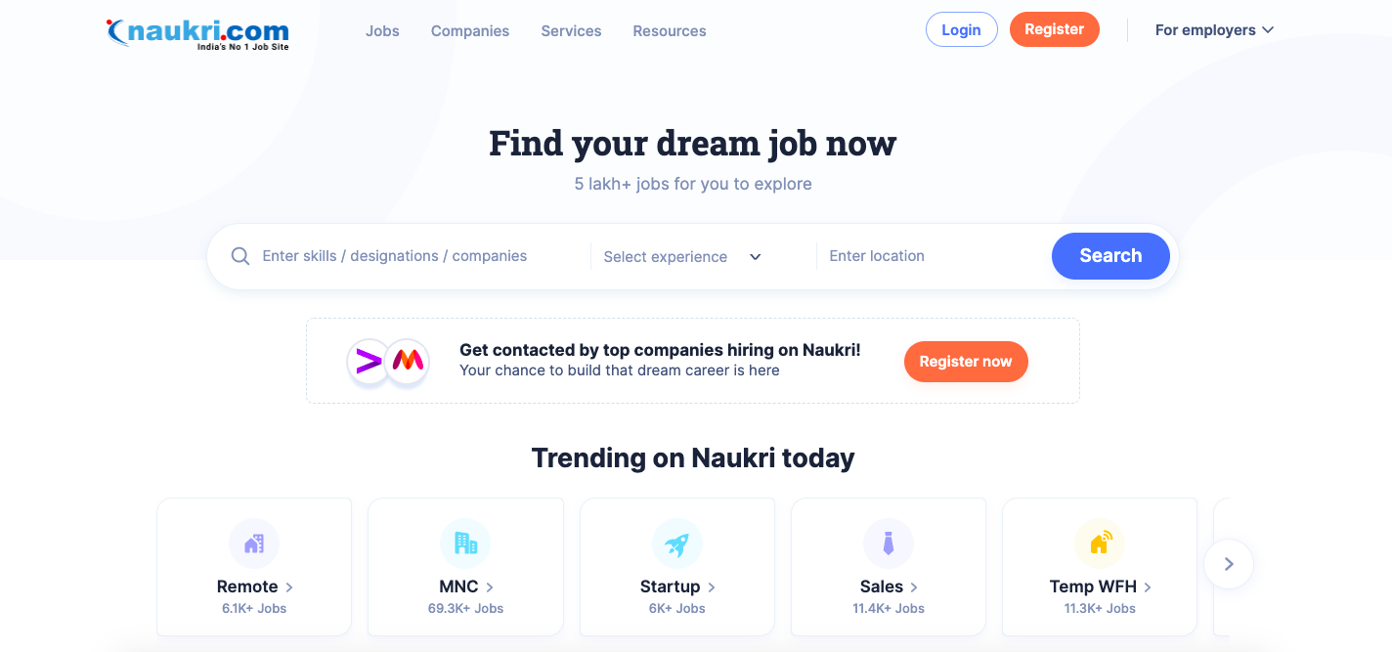
Analysis: Naukri

Slide 11

Overview
Naukri.com was launched by Sanjeev Bikhchandani in the year 1997.
Naukri is part of Infoedge conglomerate which owns other companies like shiksha,Jeevansathi,99acres etc
Naukri is the market leader in the job tech domain. It serves as a meeting ground for the job seeker and the employer looking to hire right talent.
Features
Free for job applicants and earns most of it’s revenue from recruiters.
First mover advantage in job tech domain , started in the year 1997.
Can Apply to multiple jobs with a single click, saves time for job seeker.
Large userbase of recruiter and job seekers already present in the database of Naukri.
Get job recommendations based on the candidate career preference.
Track the job application status.
Compatible across all devices of web, Android, IOS application.
Job suggestion based on location, skills and other user preferences.
Paid services provided to candidate to improve the candidature of the user.
When I go on an online shopping spree - Jannah

Slide 12
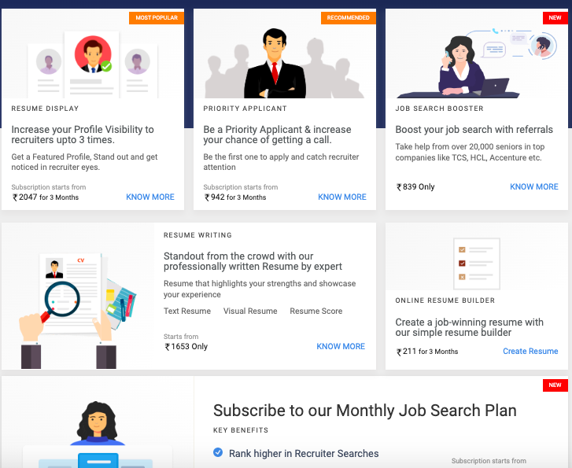
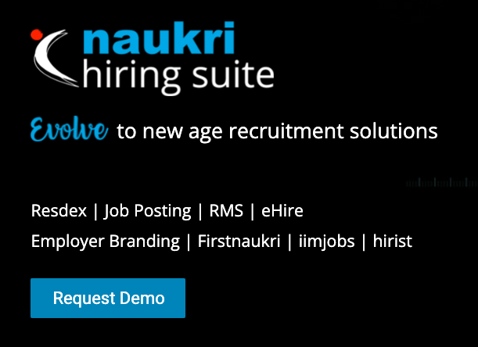
BUSINESS MODEL
Business to Business (B2B)
Business to Consumer (B2C)
Products
Naukri sells a number of products directly to customer. These products are supposed to improve the profile and increase the visibility of the employee.
Some of these products are:
Resume Display: Increase profile visibility
Priority Applicant: Increase chance of call.
Resume writing: Help in resume building.
Jobs for you: For becoming early applicant.
Products
90% of Naukri revenue comes from this business model. It sells a number of product to help recruiters hire the talent available on the platform.
Some of these products are:
Resdex: Access to 6 cr+ resume database to hire right talent.
Job posting: Helps in job posting on the platform.
RMS: To automate the hiring process of applicants.
Firstnaukri, iimjobs: To hire talent from college campus.

Slide 13
MARKETING MODEL
Marketing strategy used by Naukri
Transactional Marketing
Transactional marketing is used by Naukri to sell the solutions to the new emerging company recruiters where hiring process is not streamlined or is in initial phase. They have big sales team to promote their solutions to the company.
Word-of-Mouth Marketing
Word-of-Mouth marketing has played a very important in Naukri’s com growth. It was one of the pioneers of job tech domain in India which started a culture of job finding on internet.
Viral Marketing
Since Naukri is free for job seekers, it is the most effective marketing technique for Naukri. When a user gets a job from Naukri he tells it to other users creating a ripple effect driving users to the platform.
Social Media Marketing
Social media marketing done on platforms like YouTube, Instagram and Twitter improves Naukri’s brand presence and entice new customers on these media platforms to give Naukri a chance for job search.
Content Marketing
Naukri also has a blog section on it’s website which publishes content on career advice, interview advice, job search, Covid 19 resources and other HR resources which helps new user discover the product offerings of Naukri through the blog content.
Email Marketing
This strategy is also used by Naukri sending users their latest product offerings, product catalogue along with job recommendations and top hiring companies. This drives a lot of traffic and increases daily active users of the site.

Slide 14

Marketing Techniques
Organic Traffic
Search Engine Marketing
26.7% of total traffic is coming from Search engine marketing and SEO contributes 96.16% of total searches while the rest of the traffic to its website comes from a paid form of search engine marketing.
The majority of visitors to the Naukri website come from organic sources, making up roughly 51.23 percent of all visitors.
Social Media Marketing
Email Marketing
About 1.25 percent of all website traffic comes from social media marketing, with Facebook accounting for about 70 percent of it and the remaining 30 percent coming from Twitter, LinkedIn, YouTube, etc.
Naukri sends regular updates to the user and in the case of it contributes about 5% of the total traffic to its website.

Slide 15
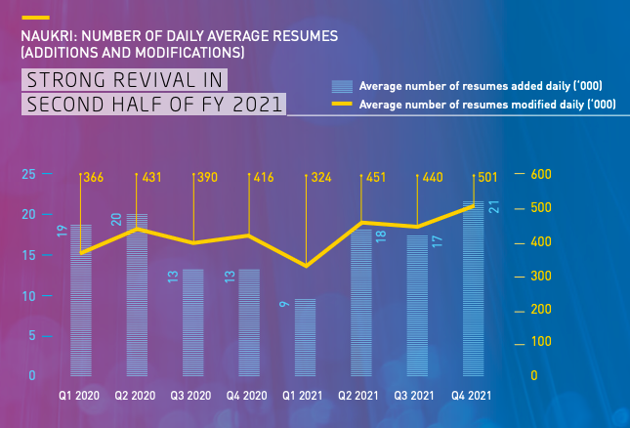
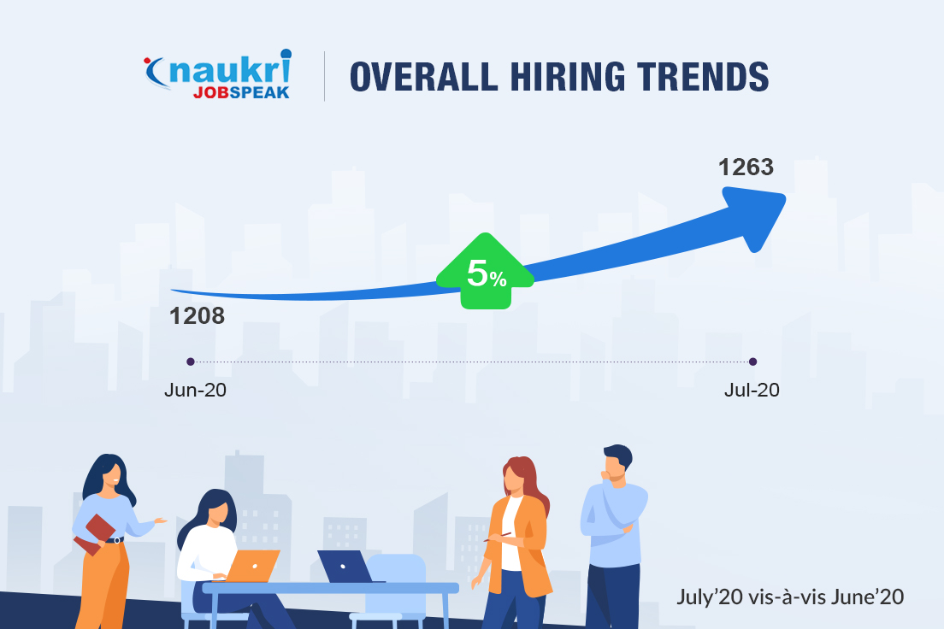
Growth strategy of Naukri
Growth of Naukri is directly related to the growth of companies that hires from it’s platform. As per Naukri JobSpeak Report, hiring activity recorded a marginal recovery of 5% in July 2020 as compared to June 2020 that brought some delight to the jobseeker community.
Info Edge (Naukri) has greatly improved its physical sales and customer infrastructure over the past number of years.
The large sales force supports all the brands of Infoedge with physical last mile connect. It increases new user to discover platform and boosts user growth.
Apart from the sales force, the Company is investing in product development, brand building and analytics to support all the brands.
Promotional positioning on internet, print, radio and television.
Analytics is now being extensively used to understand customer behaviour on the net across all brands to provide insights for better strategy development.
The recruitment solution provided by Infoedge is earning them high returns. The recruitment solutions had a strong Q4, FY2021 with a 22.05% YoY growth in billings.
Hiring demand picked up in the IT and IT enabled services sector, even as some traditional sectors continue to be under stress.

Slide 16
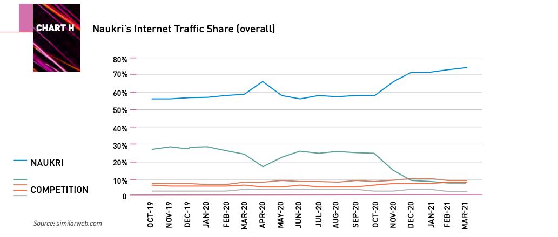
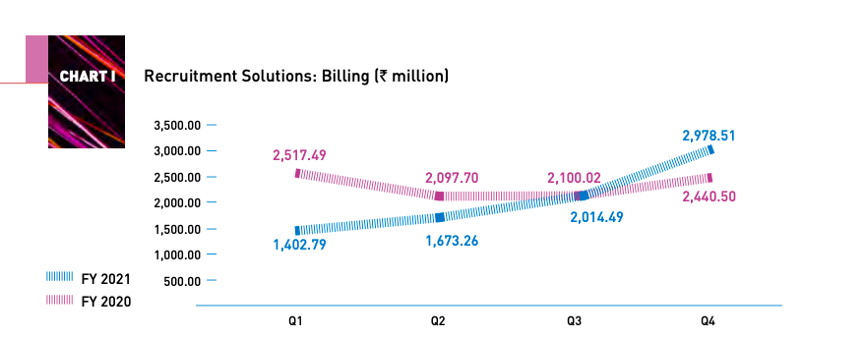
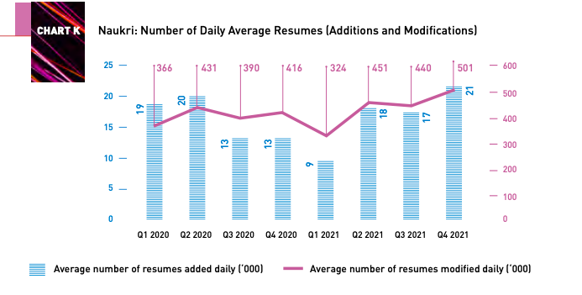
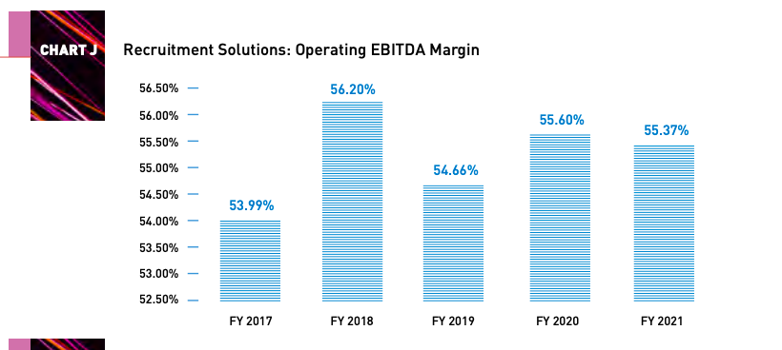
Growth Metrics of Naukri
Naukri.com is the Infoedge flagship business and the core brand that has gained clear market leadership, today, it is the primary source of revenues and profits for the Company.

Slide 17
OPPORTUNITIES
REMOTE JOBS
PROCTORED ASSESMENT
LEARNING PLATFORM
FEATURED
After the pandemic a lot of candidates are looking for remote jobs. Our platform could promote as the platform where remote hiring is done in India and other countries.
The platform could provide platform for proctored exams. It will help employers to quickly check the skill efficacy of the candidate.
The platform could provide videos and expert webinar to help candidates improve their candidature
Give the user to customize his profile page free of cost so that his profile be highlighted to top recruiters.

Slide 18


References for Analysis
Similarweb.com for network traffic details.
InfoEdge Annual report 2020-2021 for the growth metrics.
Semrush.com for analytics regarding traffic present on competitors.
Naukri.com for features and images.
Crunchbase.com for company information.
Google and Wikipedia

Slide 19

THANK YOU!
Have a great day ahead.

