Slide 1
Cyber Insecurity in the Wild
Chris Cumming

Slide 2




Who am I? (i.e. Shameless Self Promotion)
Software Consultant https://saturdaymp.com chris.cumming@satudaymp.com Host of: http://weeklydevchat.com/ https://www.legacycode.rocks/
Slacks Chris C on Dev Edmonton Legacy Code Rocks YegSec
Notes:
I’m a software consultant and do my work under the name of Saturday Morning Productions. I help clients ship secure high quality code faster. I’m also the creator and host of the Weekly Dev Chat which is a virtual chat every mostly about software development.
Also host Legacy Code Rocks (stole idea for WDC).
Contact me via email, Slacks, or LinkedIn. This is my picture on the Slacks.

Slide 3
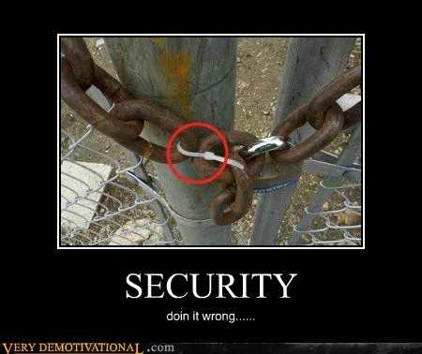
Cyber Insecurity I’ve Witnessed (and possibly done)
APIs with no security
Reversible passwords
Credentials/secrets in source code
Publicly accessible databases
Environments not isolated
No rate limiting
Password on sticky note
Credentials in shared Excel file
Basic auth over HTTP
What have you seen?
Notes:
Some examples of insecurities I’ve personally witnessed or, maybe, created. Get some ideas from others.
The purpose of this talk is tell some stories that, hopefully, others find interesting.
The other purpose is to get you thinking about security not just in the code but the entire stack/process. From developer writing code, to Dev-Ops, to UAT, to release.
Apply to Python, Nodejs, Rails, etc.

Slide 4
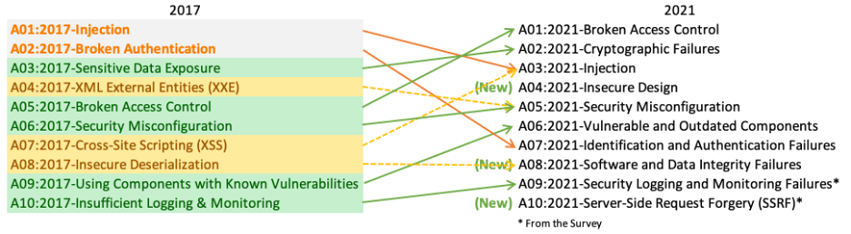
My Examples vs. OWASP
OWASP top 10: https://owasp.org/www-project-top-ten/
See OWASP Cheat Sheets: https://cheatsheetseries.owasp.org/

Slide 5
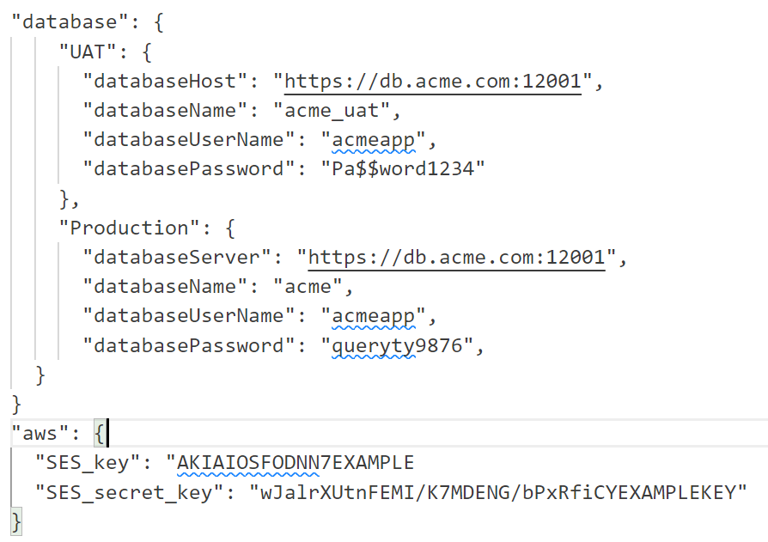
Hard Code Secrets in Source Code
Notes:
Other problems:
Environments not separated.
If mobile app the credentials will be on the users phone.
12 Factor App (part 3):
https://12factor.net/
GitHub Secret Scanning: https://docs.github.com/en/code-security/secret-scanning/introduction/about-secret-scanning

Slide 6
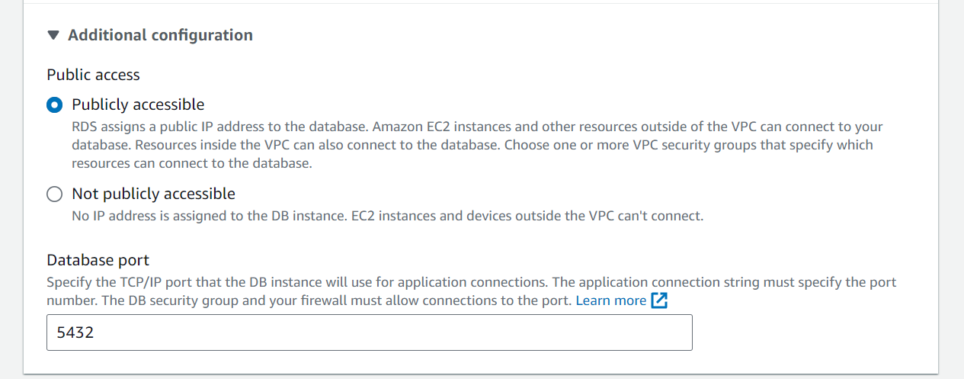
Database Publicly Accessible
Notes:
Usually no reason to have DB publicly accessible.’
Hide DB behind firewall and only allow certain IPs.

Slide 7
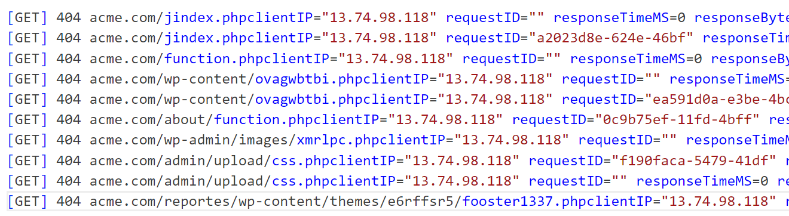
No Rate Limiting
Notes:
Use a 3rd party provider such as CloudFlare.
Setup rate limiting manually:
https://github.com/saturdaymp-examples/rate-limiting-with-nginx-fail2ban

Slide 8
Learn More
Contact chris.cumming@satudaymp.com Chris C on Slack: Dev Edmonton Legacy Code Rocks YegSec
Slides: https://github.com/saturdaymp-examples/cyber-insecurity-in-the-wild
OWASP: https://owasp.org/ https://www.meetup.com/meetup-group-opbybwve/ YegSec: https://www.yegsec.ca/ Security Now Podcast: https://twit.tv/shows/security-now Rate Limiting with nginx & Fail2Ban: https://github.com/saturdaymp-examples/rate-limiting-with-nginx-fail2ban SaturdayMP Videos: https://www.youtube.com/@saturdaymp

