Slide 1
Foundation Models
Paolo Rota
paolo.rota@unitn.it
Marco Bronzini
marco.bronzini-1@unitn.it
University of Trento
November 12, 2025

Slide 2
Overview
Lab 1
Metrics for Natural Language Generation (NLG)
Real-world use cases (MT, QA with RAG)
Lab 2
Lab 3
Lab 4
Extract latent features from LLM embeddings by training a classification model
Generate video captions using:
CLIP-inspired models (Contrastive Captioners)
Vision-Language Models (VLMs)
Agents using LangChain
Friday, October 10
Wednesday,
October 15
Friday, November 7
Wednesday, November 12

Slide 3
Agents
An agent is a language model with superpowers💪🏻
It can be defined as a system that:
Maps inputs from the environment to actions
using some internal policy or decision-making mechanism.
Key Characteristics
Autonomy: It controls its own actions without direct human intervention;
Perception: It senses its environment through data inputs (e.g., history) or sensors.
Action: It influences the environment through output mechanisms;
Goal-oriented behaviours: It acts to achieve defined objectives;
Adaptivity: Many can learn from experience or adapt to changes in their environment.

Slide 4
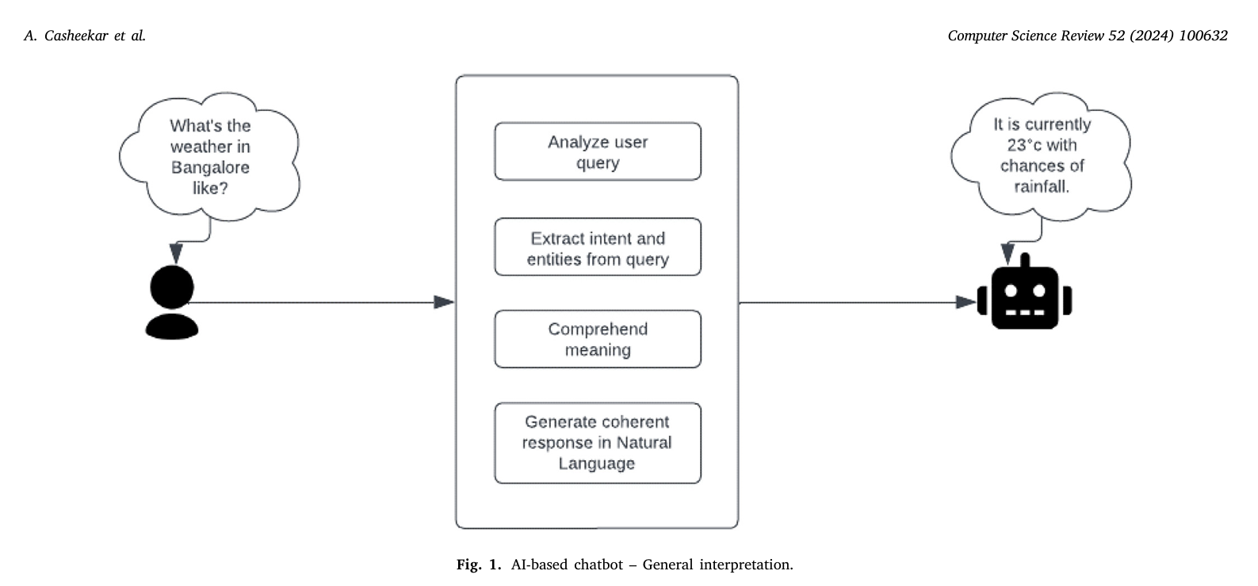
Conversational Agents (i.e., Chat Bot)
A conversational agent is an agent designed to interact with humans through natural language:
Simulate conversation
Understand user’s requests
Generate appropriate responses to achieve specific goals
A contemporary review on chatbots, AI-powered virtual conversational agents, ChatGPT: Applications, open challenges and future research directions

Slide 5
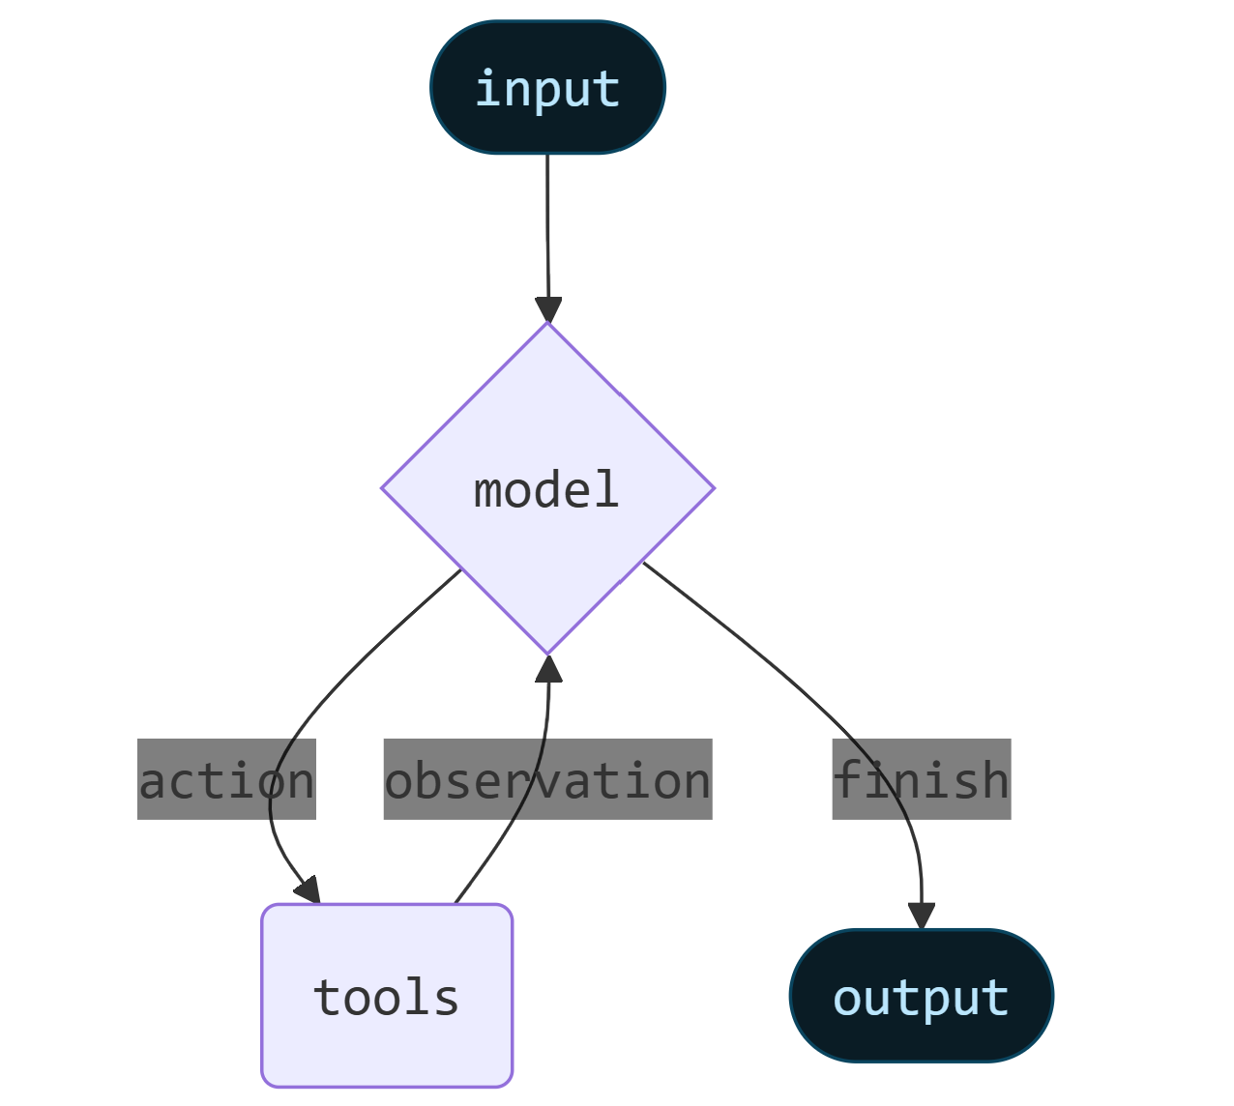
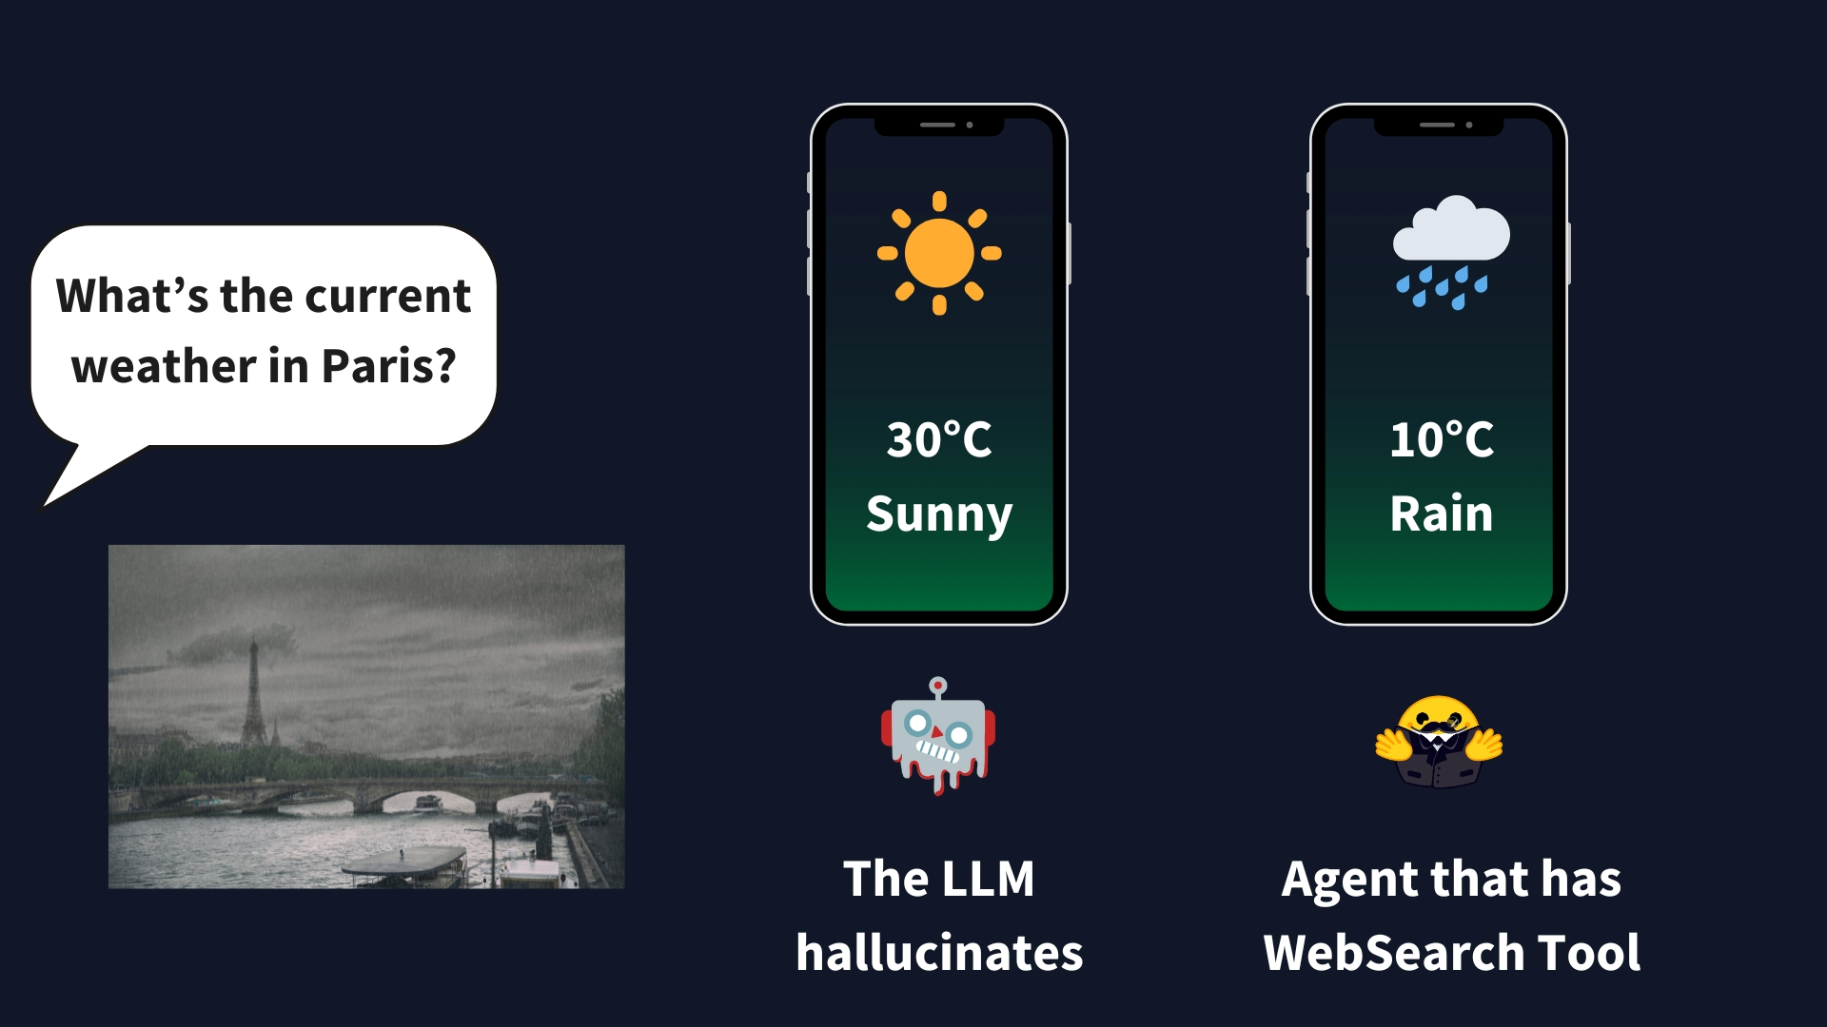
Tools
Tools refer to external capabilities or resources that:
  an agent can invoke to perform tasks beyond its internal reasoning ability.
It is typically a specialized function or external system that:
  an agent uses whenever it decided the tool’s capabilities are needed to reach its goal.
docs.langchain.com/oss/python/langchain/agents
huggingface.co/learn/agents-course/en/unit1/to

Slide 6
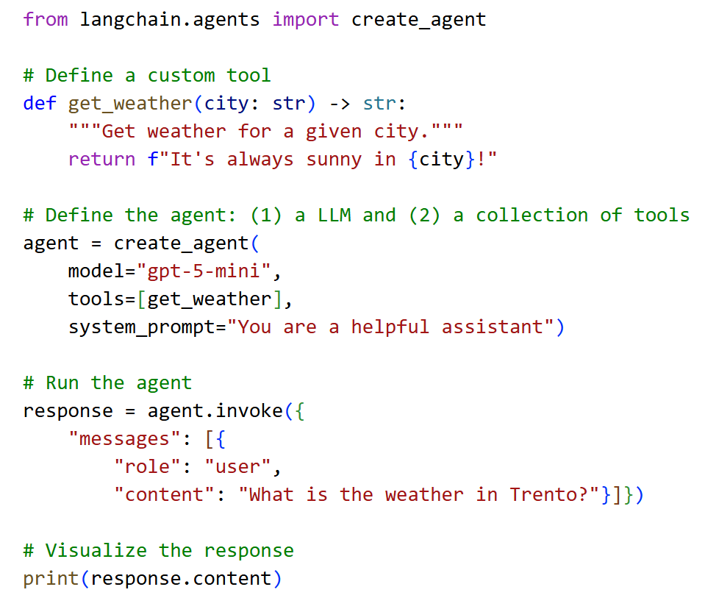
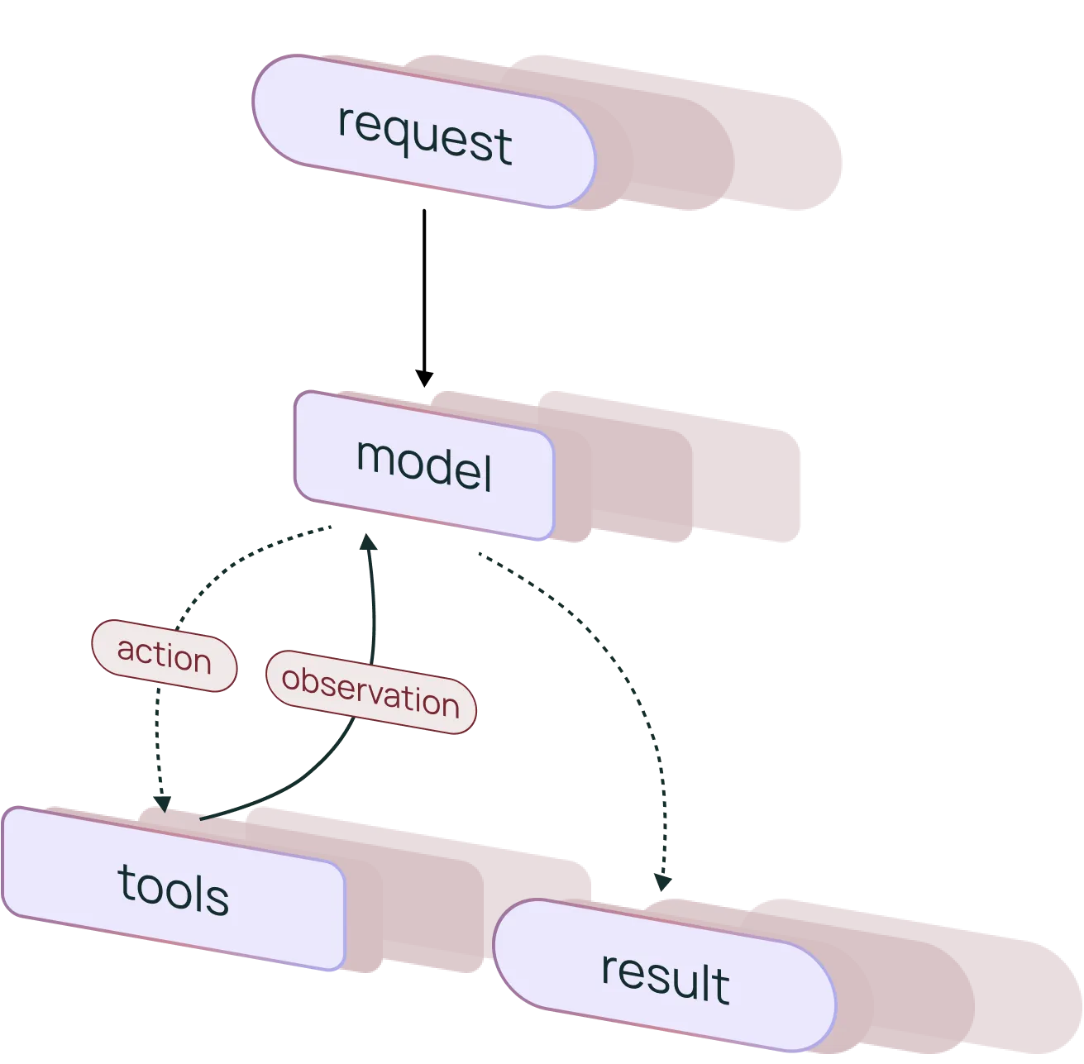



LangChain 🦜️🔗
It’s an open-source library enabling building agents and applications powered by LLMs.
It provides a pre-built agent architecture and model integrations to help you get started quickly and seamlessly incorporate LLMs into your agents and applications
Define a TOOL
Create a tool-calling AGENT
Run the agent

Slide 7

Practical Tutorial
Please, open the following notebook:
https://colab.research.google.com/github/saturnMars/FM_2025/blob/main/Lab4_agents.ipynb

Slide 8

QUIZ
MENTI (6672 8392)
https://www.menti.com/alna8gf2nrfw

